Slide 1

Unit 4: Global Warming
Lesson 1.1: Vocab & Listening
Pages: 36 & 37

Slide 2
Lesson Outline
Warm-up
Vocabulary
Listening
Consolidation
Wrap-up

Slide 3

By the end of this lesson, students will be able to…
- learn vocabulary words related to global warming.
- practice listening and understanding general and specific information.
- practice functional English (asking for repetition).

Slide 4

New words
Fossil fuel
Global warming
Hectares
Tonne
Emission
Approximately
Carbon dioxide

Slide 5

WARM UP

Slide 6
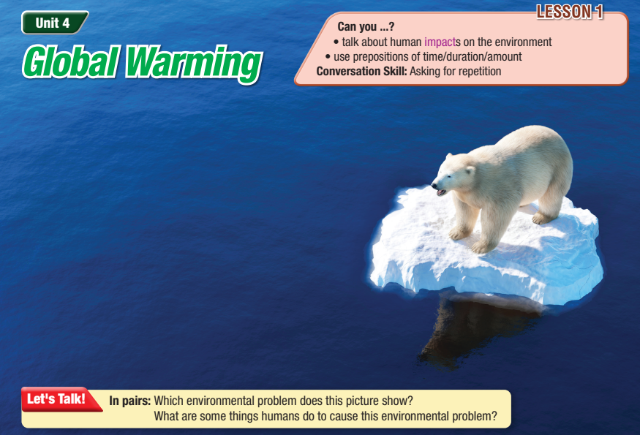

Slide 7

Work in pairs
1. Which environmental problem does this picture show?
2. What are some things humans do to cause this environmental problem?

Slide 8

Vocabulary

Slide 9
a. Match the underlined words to the definitions.
Fossil fuels are one of the main ways we get electricity. Global warming has caused the Earth to get hotter. The forest is getting hotter by fifty thousand hectares a day. Billions of tonnes of plastic are released into the ocean every year. | A unit of weight – one of them is the same as one thousand kilograms. Types of energy like gas, oil, and coal. An area which is the same as ten thousand square meters. The increase in Earth’s temperature because of more green house gases in the air.

Slide 10
a. Match the underlined words to the definitions.
5. The air quality in the city is really bad because of the emissions from traffic and factories. 6. Approximately 2,400 trees are cut down every minute. 7. Carbon dioxide in the atmosphere has reached a dangerously high level. | e. Gas (also known as CO2) which comes from humans, animals, and burning trees and coal. f. Gas or smoke which goes into the air and damages the environment. g. Near or close to a number or amount.

Slide 11

Listen and repeat. Click on each word to hear the sound.
fossil fuel (n) /ˈfɑːsəl ˌfjʊəl/ năng lượng hóa thạch
global warming (n) /ˌɡloʊbəl ˈwɔːrmɪŋ/ sự nóng lên toàn cầu
hectare (n) /ˈhekter/ héc ta (ha)
tonne (n) /tʌn/ tấn
emission (n) /ɪˈmɪʃn/ khí thải
approximately (adv) /əˈprɑːksəmətli/ xấp xỉ
carbon dioxide (n) /ˌkɑːrbən daɪˈɑːksaɪd/ cacbon đioxit (CO2)
Notes:
GV click vào từng cụm nghe âm thanh

Slide 12
Practice saying these words with a partner.
fossil fuel (n) /ˈfɑːsəl ˌfjʊəl/ năng lượng hóa thạch
global warming (n) /ˌɡloʊbəl ˈwɔːrmɪŋ/ sự nóng lên toàn cầu
hectare (n) /ˈhekter/ héc ta (ha)
tonne (n) /tʌn/ tấn
emission (n) /ɪˈmɪʃn/ khí thải
approximately (adv) /əˈprɑːksəmətli/ xấp xỉ
carbon dioxide (n) /ˌkɑːrbən daɪˈɑːksaɪd/ cacbon đioxit (CO2)

Slide 13


Work in pairs
b. Use the new words to talk about environmental problems in your country.

Slide 14

Listening

Slide 15
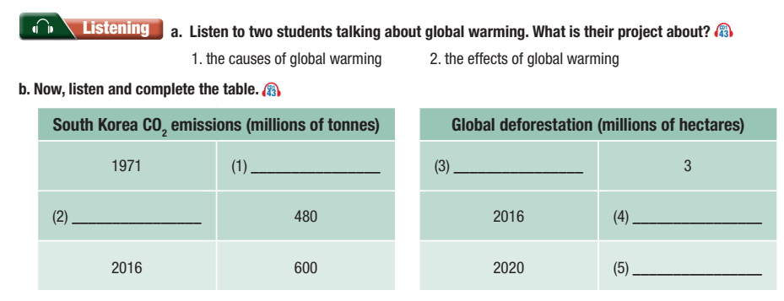
Pre - Listening
Read the instruction quickly. Underline the key words.
What are we going to do?

Slide 16
While- Listening
Transcript
60
2002
2000
6
4

Slide 17
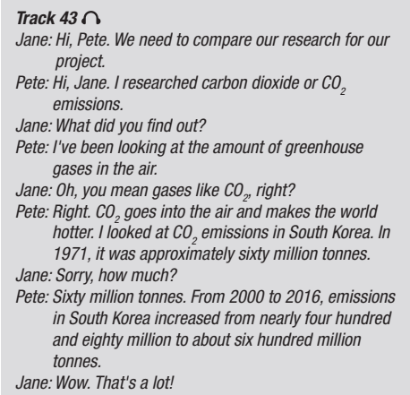
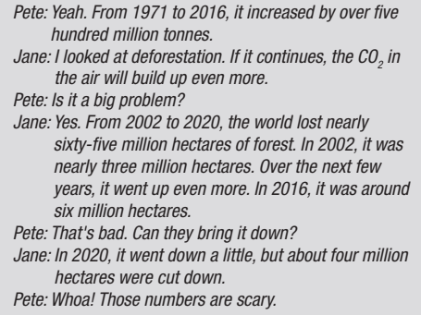
While- Listening

Slide 18
Jane: Hi, Pete. We need to compare our research for our project.
Pete: Hi, Jane. I researched carbon dioxide or CO2 emissions.
Jane: What did you find out?
Pete: I've been looking at the amount of greenhouse gases in the air.
Jane: Oh, you mean gases like CO2, right?
Pete: Right. CO2 goes into the air and makes the world hotter. I looked at CO2 emissions in South Korea. In 1971, it was approximately sixty million tonnes.
Jane: Sorry, how much?
Pete: Sixty million tonnes. From 2000 to 2016, emissions in South Korea increased from nearly four hundred
and eighty million to about six hundred million tonnes.
Jane: Wow. That's a lot!
Pete: Yeah. From 1971 to 2016, it increased by over five hundred million tonnes.
Jane: I looked at deforestation. If it continues, the CO2 in the air will build up even more.
Pete: Is it a big problem?
Jane: Yes. From 2002 to 2020, the world lost nearly sixty-five million hectares of forest. In 2002, it was nearly three million hectares. Over the next few years, it went up even more. In 2016, it was around six million hectares.
Pete: That's bad. Can they bring it down?
Jane: In 2020, it went down a little, but about four million hectares were cut down.
Pete: Whoa! Those numbers are scary.
Listening scripts

Slide 19
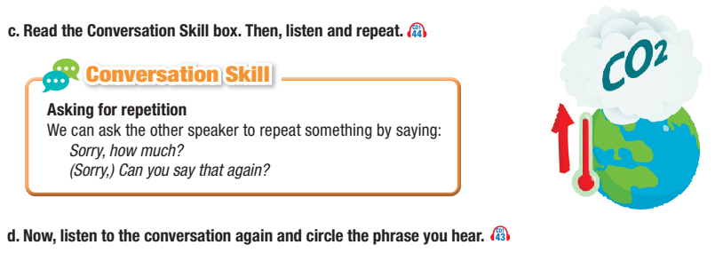
While- listening

Slide 20
Post-listening
e. In pairs: Do you think Pete an Jane were surprised by what they found out? Why (not)?

Slide 21

CONSOLIDATION

Slide 22
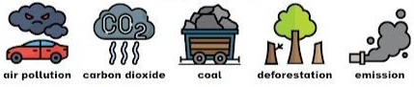
Talk about the causes of global warming in your country/ hometown.
E.g. In my country, people drive too many cars and cause air pollution. This is one of the causes of global warming.

Slide 23

WRAP-UP

Slide 24
Today’s lesson
Vocabularies
fossil fuel
global warming
hectares
tonne
emission
approximately
carbon dioxide

Slide 25
Today’s lesson
Listening:
Understanding instructions.
Listening for the main idea and specific information.
Speaking:
- Talking about the causes of global warming.

Slide 26
Homework
Learn by hearts vocabularies and make sentences using them.
Do the exercises on pages 20 & 21 WB.
Prepare the next lesson (Grammar pages 37 & 38 SB)
Play the consolidation games on www.eduhome.com.vn

Slide 27

Lesson 3
Stay positive and have a nice day!

