Slide 1

Unit 3: SOCIAL ISSUES
Lesson 3.2 Writing and Speaking
Page: 33

Slide 2
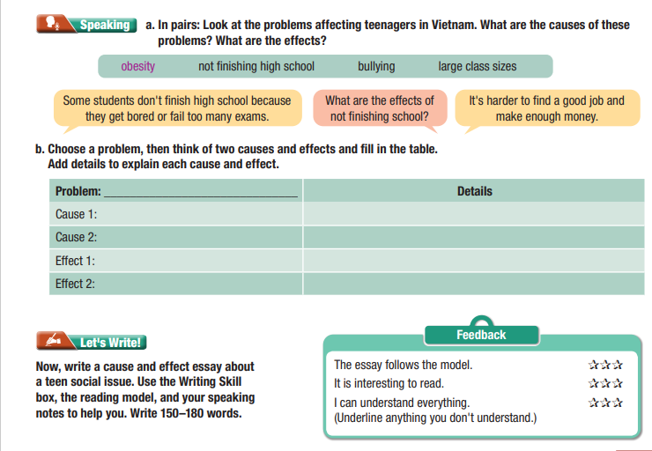
Lesson Outline
Warm-up
Writing
Speaking
Consolidation
Wrap-up

Slide 3

By the end of this lesson, students will be able to…
Writing
- write a cause and effect essay about
a teen social issue.

Slide 4

WARM UP

Slide 5
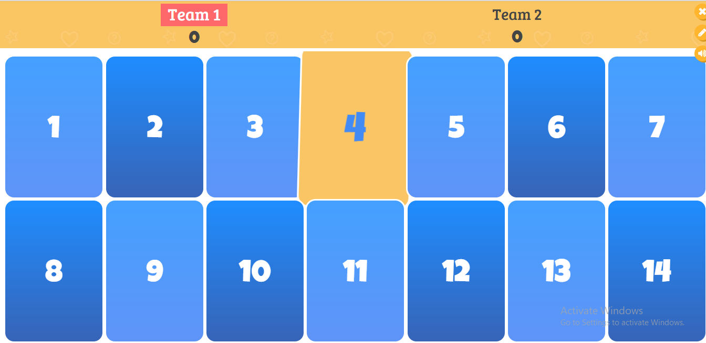
Click to play bamboozle game:
Topic: in order to/ so that

Slide 6



Work in pairs.
Talk about the best place for children to play

Slide 7

Pre-Writing
a. Read about writing cause and effect essays. Then, read John's essay again and underline the two causes and two effects.
Writing cause and effect essays
To write an effective cause and effect essay, you should:
1. Introduce the problem and explain the purpose of the essay.
One problem affecting teenagers is stress. This essay will look at the causes and effects of this problem.
2. Give causes for the problem. For each cause, add supporting evidence (reasons, opinions, examples).*
The first cause of stress is exams. Students have to take lots of exams and are worried about failing them.

Slide 8
Pre-Writing
a. Read about writing cause and effect essays. Then, read John's essay again and underline the two causes and two effects.
Writing cause and effect essays
To write an effective cause and effect essay, you should:
3. State the effects of the problem. For each effect, add supporting evidence.*
The first effect of stress is it affects your sleep. Students cannot sleep because they cannot stop thinking about their schoolwork.
4. Give a conclusion. Restate the problem and the causes and effects that you described.
In conclusion, stress is a problem for teens. It is caused by exams that result in sleeping problems.
*see "Giving supporting evidence in body paragraphs" on page 23

Slide 9
Read John's essay again and underline the two causes and two effects.
One problem affecting teenagers in the USA is social media addiction. This essay will look at the causes and effects of this problem.
The first cause of social media addiction is the social media apps. The apps are designed to make people keep using them by knowing exactly what they like to read, watch, and look at and showing you it when you turn on the app. This means you will always see new interesting content. The second cause of social media addiction is the need to create an attractive "online life." For some teens, it is more important to be cool and popular online than offline. They spend hours every day trying to create the perfect "online life."

Slide 10
Read John's essay again and underline the two causes and two effects.
The first effect of social media addiction is it causes low self-esteem. This means you do not feel confident in yourself. Seeing photos of others having fun makes you feel sad because you do not have the same experiences. The second effect of social media addiction is it damages your "offline life." Relationships with friends and family get damaged because teens are distracted by social media.
In conclusion, social media addiction is a problem for teens in the USA. It is
caused by apps and the importance of a cool "online life," and results in low
self-esteem and problems in your "offline life."

Slide 11
b. Match the causes to the effects.
Some students get bullied because they dress or act differently from others.
Class sizes are large because the city's population grew quickly in the last ten years.
Teenagers who don't get enough exercise can become overweight.
Some teens leave school because they have to work to earn money for their families.
a. They can suffer from health problems and struggle to breathe when climbing stairs.
b. It can be difficult for teachers to manage and control so many students.
c. They will find it hard to get a good job in the future without any qualifications.
d. They might drop out of school because they are afraid of getting hurt

Slide 12

Speaking

Slide 13
Pre-writing
a. In pairs: Look at the problems affecting teenagers in Vietnam. What are the causes of these problems? What are the effects?
Obesity not finishing high school bullying large class sizes
Some students don't finish high school because they get bored or fail too many exams.
What are the effects of
not finishing school?
It's harder to find a good job and make enough money.

Slide 14
b. Choose a problem, then think of two causes and effects and fill in the table. Add details to explain each cause and effect.
Problem: ________________________ | Details
Cause 1:
Cause 2
Cause 3:
Cause 4:

Slide 15



Slide 16
While-writing
Now, write a cause and effect essay about a teen social issue. Use the Writing Skill box, the reading model, and your speaking notes to help you. Write 150–180 words.

Slide 17
Sample answer:
One problem affecting teenagers in Vietnam is obesity. This essay will look at the causes and effects of this problem.
The first cause of obesity is their diet. Teenagers eat too much fast food. Fast food has lots of fat and sugar which can make you gain weight. The second cause of obesity is that teenagers do not exercise enough. Most teenagers spend their free time playing video games and using social media. This can also increase weight.
The first effect of obesity is it affects physical health. Obesity causes serious health problems. It can affect your heart and make it difficult to breathe. The second effect of obesity is it affects mental health. Teenagers often worry about their bodies, and other students can make fun of them. This can make them feel sad and lonely.
In conclusion, obesity is a problem for teens in Vietnam. It is caused by diet and not enough exercise and results in physical and mental health problems.

Slide 18

Post-writing
Exchange your work and check.
The essay follows the model.   
It is interesting to read.   
I can understand everything   
(Underline anything you don’t understand)

Slide 19

WRAP-UP

Slide 20
Lesson 3
Today’s lesson
Writing
- write a cause and effect essay about a teen social issue.

Slide 21


Slide 22

Prepare the next lesson – Vocabulary and Listening on pages 34 & 35 in SB.
Play the consolidation games in Tiếng Anh 11 i-Learn Smart World DHA App on www.eduhome.com.vn

Slide 23
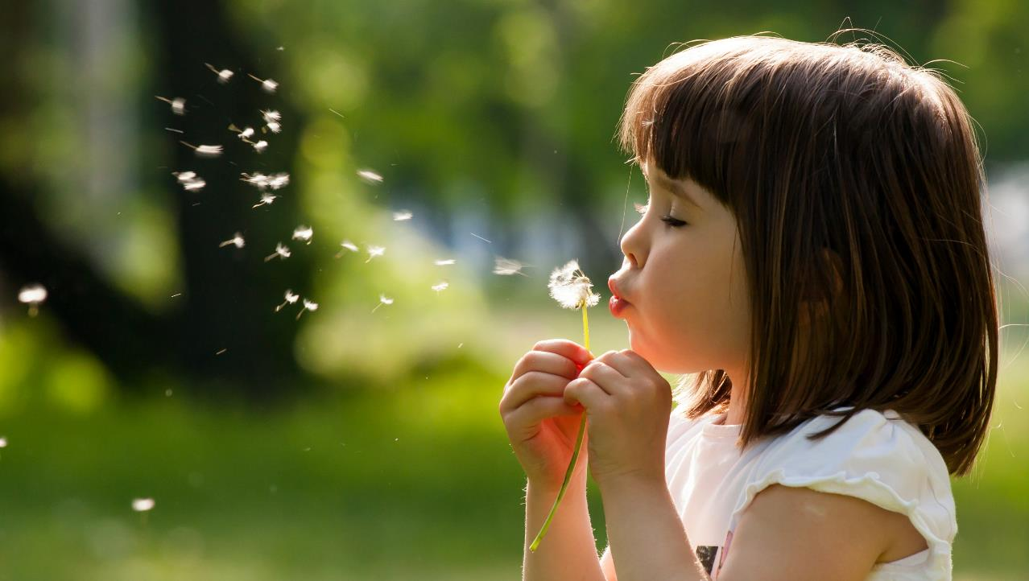
Have a nice day!

