Slide 1

Unit 3: SOCIAL ISSUES
Lesson 2.3: Pronunciation and Speaking
Pages: 30 & 31

Slide 2
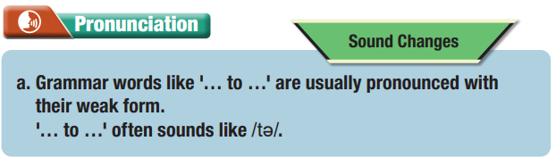
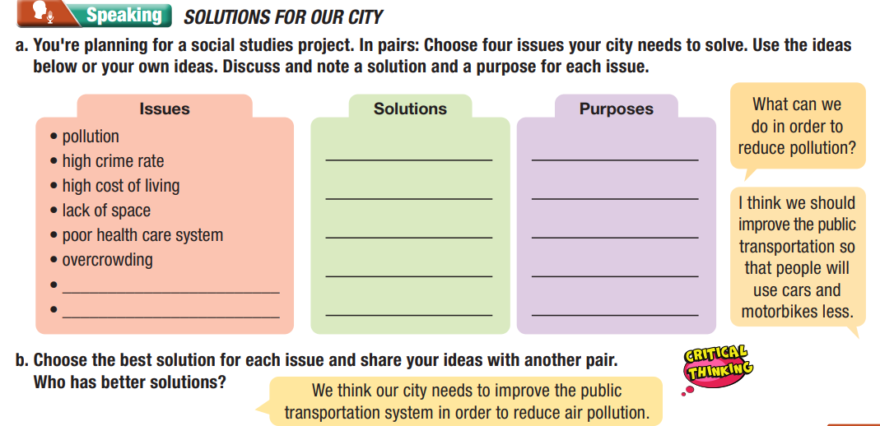
Lesson Outline
Warm-up
Pronunciation
Speaking
Consolidation
Wrap-up

Slide 3

By the end of this lesson, students will be able to…
Pronunciation:
- Grammar words like '… to …' are usually pronounced with their weak form.
'… to …' often sounds like /tə/.
Speaking:
- talk about issues a city need to solve.
- improve speaking skill.

Slide 4

WARM UP

Slide 5

Work in pairs.
Choose the word whose main stress is placed
differently from the others.
A. permission B. influence C. privacy D. skyscraper
A. suitable B. repetitive C. efficient D. impressive
3. A. benefit B. prohibit C. emphasize D. summarize
/pərˈmɪʃn/
/ˈɪnfluəns/
/ ˈpraɪvəsi/
/ˈskaɪˌskreɪpə/
/ˈsuːtəbl/
/rɪˈpetətɪv/
/ɪˈfɪʃnt/
/ɪmˈpresɪv/
/ˈbenəfɪt/
/prəˈhɪbɪt/
/ˈemfəsaɪz/
/ˈsʌməraɪz/

Slide 6
Work in pairs.
Choose the word whose underlined part is
pronounced differently from that of the other words.
A. rocket B. column C. program D. option
2. A. tax B. dam C. law D. have
3. A. curfew B. fitness C. founder D. charter
/ˈrɑːkɪt/
/ˈkɑːləm/
/ˈproʊɡræm/
/ˈɑːpʃn/
/tæks/
/dæm/
/lɑː/
/hæv/
/ˈkɜːfjuː/
/ˈfɪt.nəs/
/ˈfaʊndə/
/ˈtʃærtə/

Slide 7



Slide 8


a. Grammar words like '… to …' are usually pronounced with their weak form.
'… to …' often sounds like /tə/.

Slide 9


b. Notice the sound changes of the underlined words.
We should ban plastic in order to keep rivers clean
The city banned cars in order to reduce traffic.

Slide 10
c. Listen and cross out the sentence that doesn't use a weak
form.
We should have more security cameras in order to prevent crime.
My town banned karaoke parties in order to reduce noise pollution.

Slide 11
d. Read the sentences with the correct sound changes
to a partner.

Slide 12

Practice

Slide 13

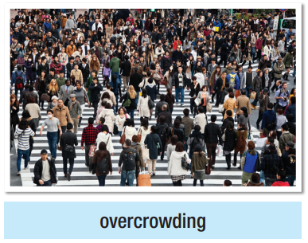
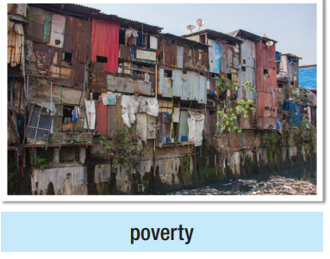

Take turns to ask and answer about problems of living in cities.
What can we do in order to solve overcrowding?
We should create jobs in the country so
that people won't move to cities.

Slide 14
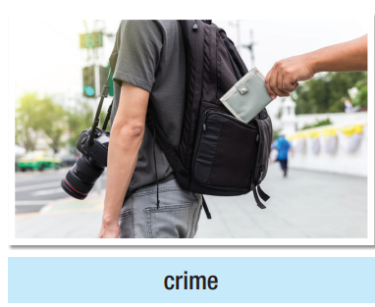

Take turns to ask and answer about problems of living in cities.
What can we do in order to solve overcrowding?
We should create jobs in the country so
that people won't move to cities.

Slide 15
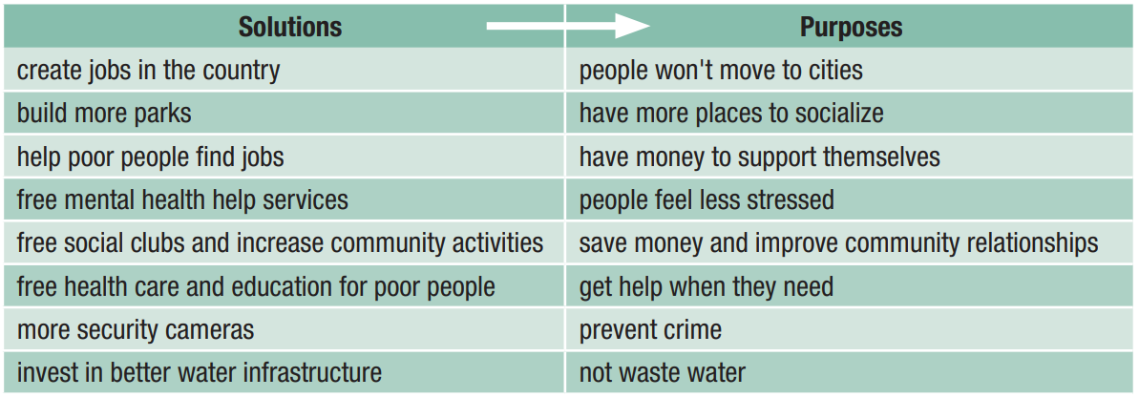
Take turns to ask and answer about problems of living in cities.
What can we do in order to solve overcrowding?
We should create jobs in the country so
that people won't move to cities.

Slide 16

Speaking

Slide 17

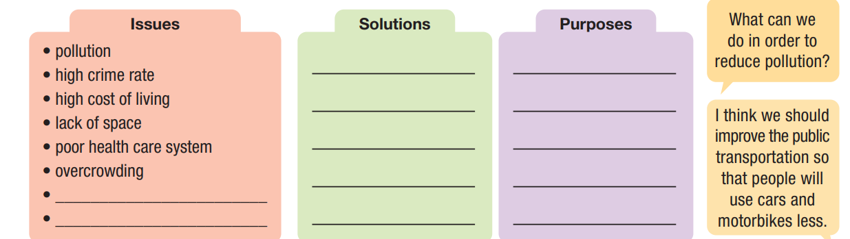
SOLUTIONS FOR OUR CITY
a. You're planning for a social studies project. In pairs: Choose four issues your city needs to solve. Use the ideas below or your own ideas. Discuss and note a solution and a purpose for each issue.
Speaking

Slide 18

SOLUTIONS FOR OUR CITY
b. Choose the best solution for each issue and share your ideas with another pair.
Who has better solutions?
We think our city needs to improve the public transportation system in order to reduce air pollution.
Speaking

Slide 19

CONSOLIDATION

Slide 20
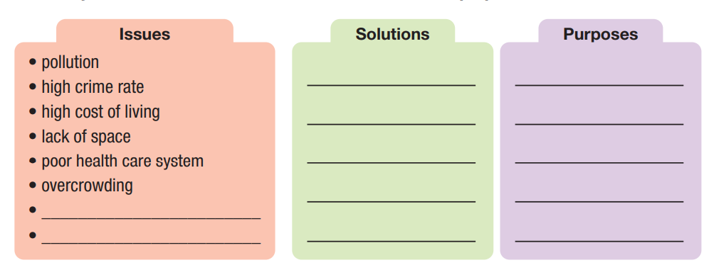
Now, write a paragraph (80-100 words) using the notes that you have taken from your discussion with your partner.
The enormous growth in public transportation system over the last decade in Hanoi has led to radical changes to the way that people travel. Although serious problems have arisen as a result of this, there are solutions.
One of the first problems of…
It is important that action is taken to combat these problems…
To conclude,…

Slide 21

WRAP-UP

Slide 22
Today’s lesson
Pronunciation:
- practice grammar words like '… to …' are usually pronounced with their weak form. '… to …' often sounds like /tə/.
Speaking:
ask and answer about problems of living in cities.
improve speaking skill.

Slide 23


Slide 24

Practice grammar words like '… to …' are usually pronounced with their weak form. '… to …' often sounds like /tə/.
Prepare the next lesson - Listening & Reading on page 32 in SB.
Review all vocabularies and grammar point in the unit.
Play the consolidation games in Tiếng Anh 11 i-Learn Smart World DHA App on www.eduhome.com.vn

Slide 25

Have a nice day!

