Slide 1
Unit 3: SOCIAL ISSUES
Lesson 2.2: Grammar
Page: 29 & 30

Slide 2
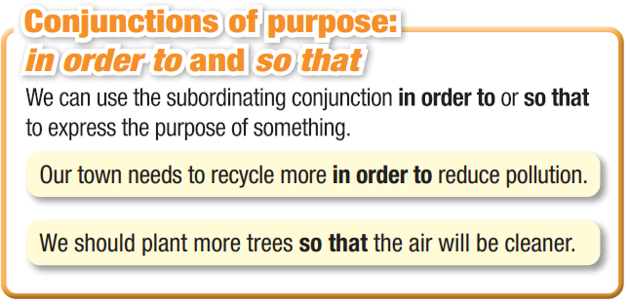
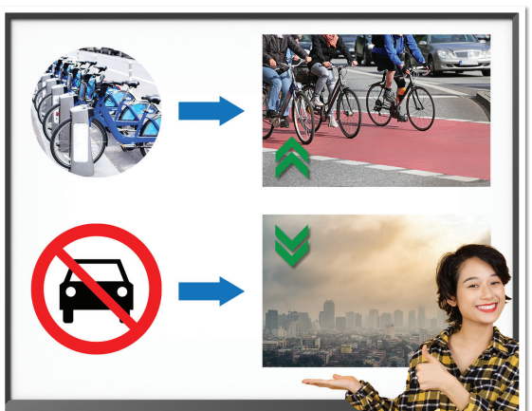
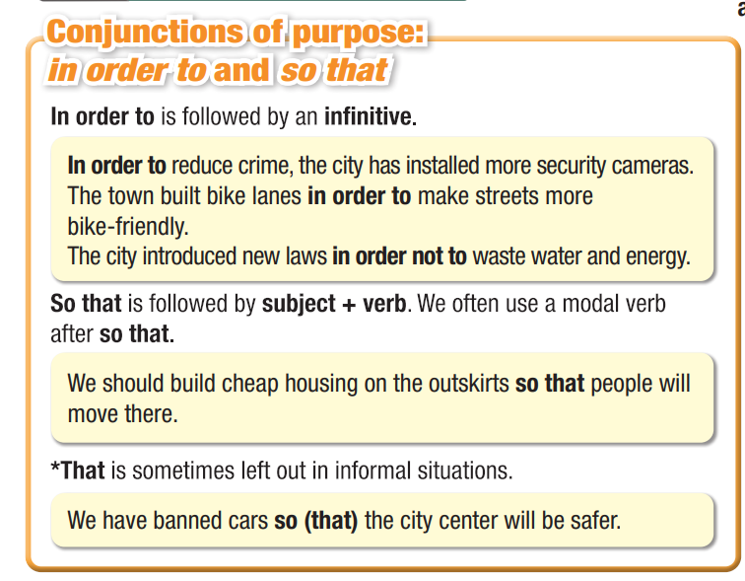
Lesson Outline
Warm-up
Grammar
Consolidation
Wrap-up

Slide 3
By the end of this lesson, students will be able to…
- practice and use conjunctions of purpose: in order to and so that correctly.

Slide 4
WARM UP

Slide 5
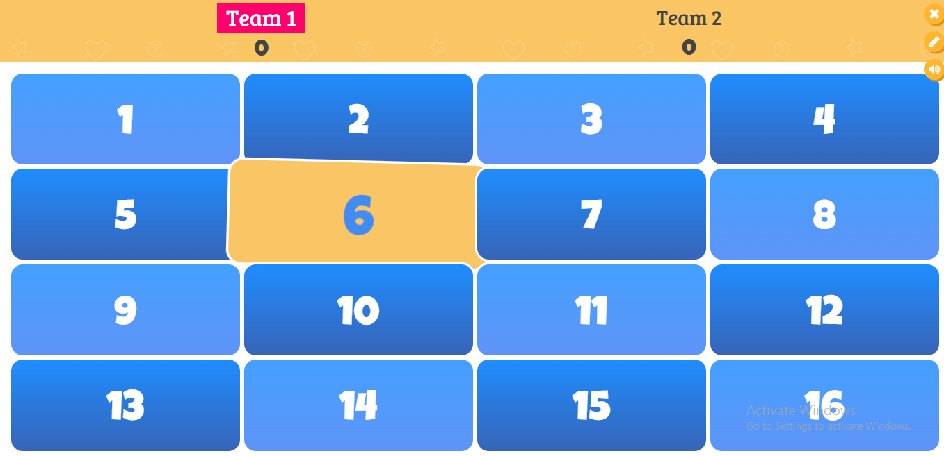
Click to play bamboozle game:
Topic: Past Simple and Present Perfect

Slide 7
Presentation

Slide 8
a. Look at the picture. What do you think the girl is saying?
The city should provide free ___________________ people can cycle more. It should also ban ___________________ reduce air pollution.

Slide 9
b. Now, listen and check your ideas.
The city should provide free ___________________ people can cycle more It should also ban ___________________ reduce air pollution.
bikes so that
cars in order to

Slide 10
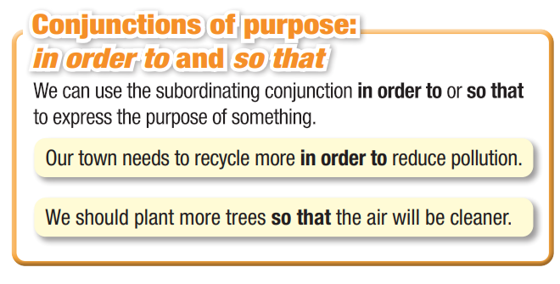

Slide 11
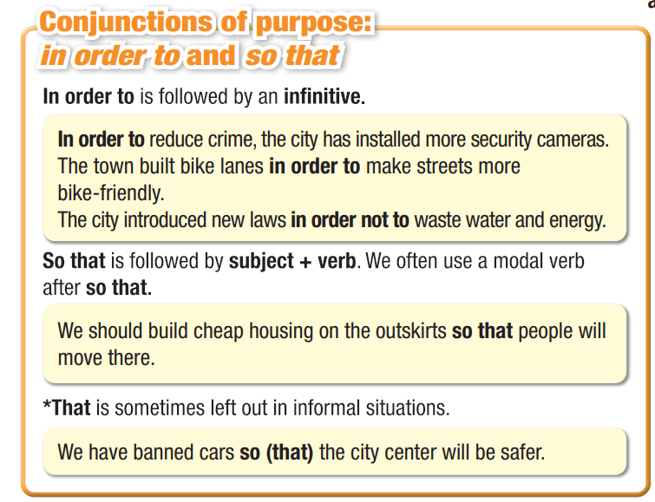
NOTE: In order to is common
in writing than speaking.
Notes:
Please, click on each phrase to hear the sound

Slide 12
Practice

Slide 13
a. Choose the correct conjunctions.
1. People should spend more time in nature so that/in order to improve their mental health.
2. We should install more security cameras so that/in order to people feel safer.
3. Schools need to teach students how to cook healthy meals so that/
in order to young generations will be healthier.

Slide 14
a. Choose the correct conjunctions.
4. House prices shouldn't increase so that/in order not to increase the cost
of living.
5. So that/In order to improve security, the city has installed more lights on streets and in parks.
6. What can we do so that/in order to reduce pollution?
7. Cities should make walking and biking easier so that/in order to people will use cars and motorbikes less.

Slide 15
b. Circle the sentences which best combine the two short sentences above.
1. People often travel to cities. They want to get access to better health care.
a. People want to get access to better health care so that they can travel to cities.
b. People travel to cities in order to get access to better health care.
c. People want to get access to better health care in order to travel to cities.
d. In order to travel to cities, people get access to better health.

Slide 16
2. Our city has banned single-use plastic. The city doesn't want to harm the environment.
a. Our city has banned single-use plastic in order to protect the environment.
b. In order to ban single-use plastics, the city will harm the environment.
c. Our city has banned single-use plastics so that they can harm the environment.
d. In order to harm the environment, our city has not banned single-use plastics.

Slide 17
3. Cities should provide free health care. Poor people should have access to better health care.
a. Cities shouldn't provide free health care so that poor people have access to better health care.
b. Cities should provide free health care so that poor people don't have access to better health care.
c. Poor people should have access to better health care so that cities can provide it for free.
d. In order to give poor people access to better health care, cities should provide it for free.

Slide 18
Extra Practice
WB, page 17
a. Circle the correct words.
We should build a metro so that/in order to reduce pollution.
We must protect our forests so that/in order to people can enjoy nature.
Our city needs good schools so that/in order to give children a better education.
So that/In order to improve security, we need more police on the streets.
We should improve our health care system so that/in order to people can live longer.

Slide 19
b. Unscramble the sentences.
1. we need/reduce/crime rate/people/can feel safe ____________________________________________________
2. people/often/move/other countries/enjoy/low/cost of living _____________________________________________________________
3. I/spent/week/nature/improve/my/mental health ____________________________________________________
4. people/move/the city/they/can get better jobs ________________________________________________
5. people/travel/the countryside/enjoy/lack of pollution. ___________________________________________________________
We need to reduce the crime rate so that people can feel safe.
People often move to other countries in order to enjoy a low cost of living.
I spent a week in nature in order to improve my mental heath.
People move to the city so that they can get better jobs.
Peopl travel to the countryside in order to enjoy the lack of pollution.

Slide 20
Production

Slide 21
c. In pairs: Why would a city do these things? Why not? What problems would they want to solve?
I think a city would ban karaoke parties
in order to reduce noise pollution.
ban karaoke parties
build more parks, playgrounds, and zoos
make streets safe for walking
Production
ban single-use plastic
have free public transportation
invest in better schools

Slide 22
CONSOLIDATION

Slide 23
CONSOLIDATION
Write five sentences about problems and solutions using conjunctions of purpose: in order to and so that .

Slide 24
WRAP-UP

Slide 25
Today’s lesson
Grammar: use conjunctions of purpose: in order to and so that.

Slide 27
Do the exercises in WB on page 17.
Prepare the next lesson – Pronunciation & Speaking SB (pages 30 & 31) .
Play the consolidation games in Tiếng Anh 11 i-Learn Smart World DHA on www.eduhome.com.vn

Slide 28
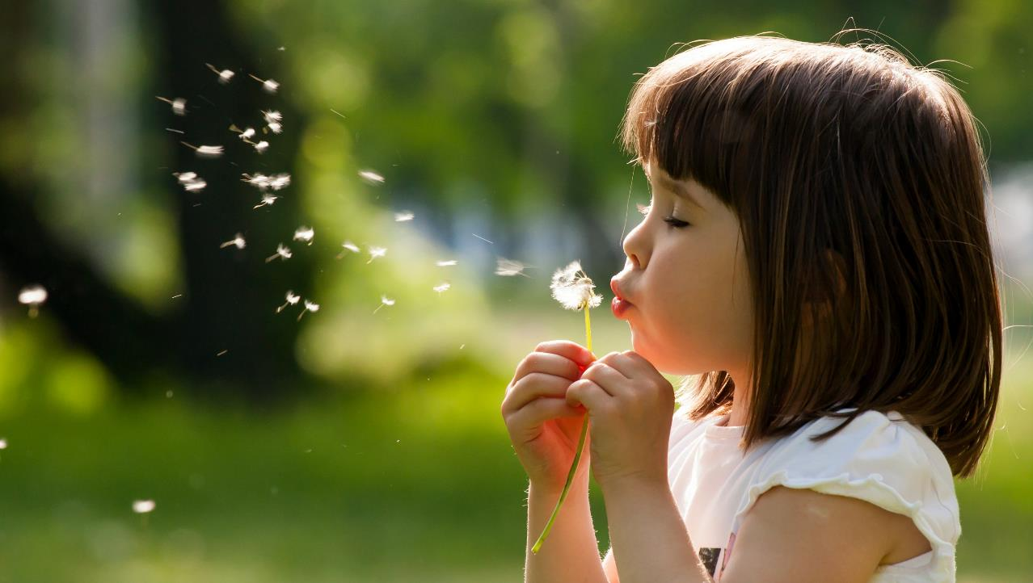
Have a nice day!

