Slide 1
Unit 3: SOCIAL ISSUES
Lesson 2.1: Vocabulary & Reading
Pages: 28 & 29

Slide 2
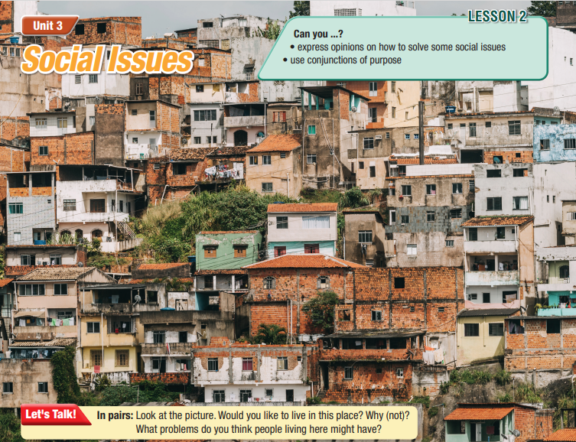
Lesson Outline
Warm-up
Vocabulary
Reading
Consolidation
Wrap-up

Slide 3
By the end of this lesson, students will be able to…
- learn and use vocabulary words related to social issues: health care, crime, security, lack, cost of living, mental health.
- practice reading for main ideas and details.

Slide 4
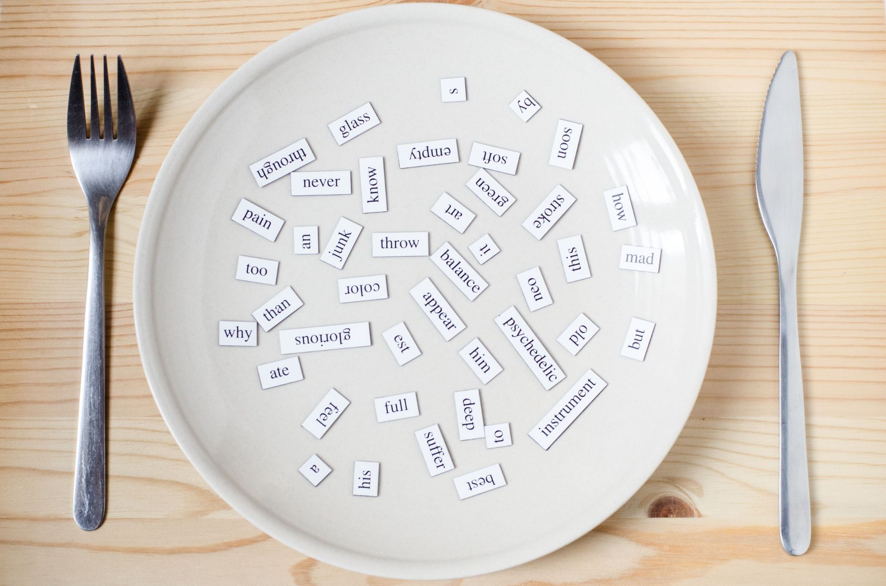
New words:
health care
crime
security
lack
cost of living
mental health

Slide 5
WARM UP

Slide 6
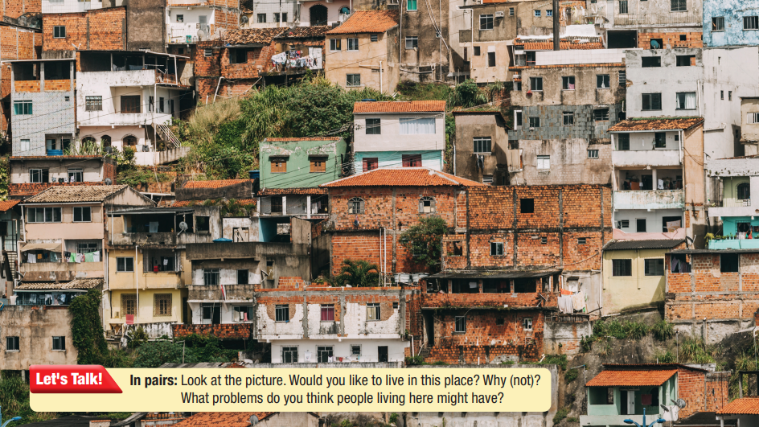

Slide 7
Work in pairs
In pairs: Look at the picture. Would you like to live in this place? Why (not)?
What problems do you think people living here might have?

Slide 9
a. Find the words from the passage that match the definitions . Listen and repeat.
Living in the city has many benefits such as better education and health care. There are usually more and better schools and hospitals in the city than in the country. However, living in the city has its problems, too. Crime rate is often higher, so people don't feel safe. Many people have to invest in a home security system to protect themselves. There is often a lack of green spaces because there aren't enough parks. The cost of living is also higher. For the same amount of money, you can buy less in cities. People are busier and more stressed, and this might affect their physical and mental health.

Slide 10
a. Find the words from the passage that match the definitions. Listen and repeat.
1. ___________: the service that looks after people's health
2. ___________: activities that involve breaking the law
3. ___________: the protection that makes people and places safe
4. ___________: a shortage of something that is needed
5. ___________: the amount of money somebody needs to pay for food, clothing, and a place to live
6. ___________: the health of somebody's mind
health care
crime
security
lack
cost of living
mental health

Slide 11
Listen and repeat. Click on each phrase to hear the sound.
Practice saying these words with a partner.
health care (adj) / 'helθ ker / dịch vụ chăm sóc sức khoẻ
crime (n) /kraɪm/ sự phạm tội
security (n) /səˈkjʊrəti/ an ninh
lack (n) /læk/ sự thiếu hụt
cost of living (n) / ˌkɑːst əv ˈlɪvɪŋ / chi phí sinh hoạt
mental health (n) /ˌmentl ˈhelθ/ sức khoẻ tâm thần
Notes:
GV click vào từng cụm nghe âm thanh

Slide 12
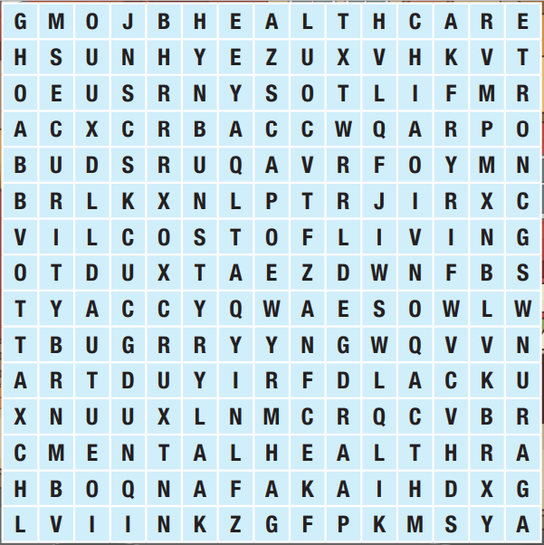
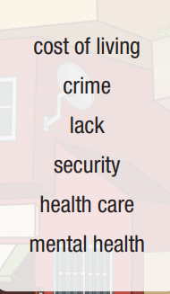
Extra Practice
WB, page 16
a. Find the words in the word search.

Slide 13
Extra Practice
WB, page 16
b. Fill in the blanks with the words from Task a
lack
1. There is a __________ of healthy food options at our school.
2. We need to improve our __________. Lots of things have been stolen recently.
3. The __________ is very high in my city, so you need a lot of money.
4. The city's __________ rate is rising, so people are very worried about their safety.
5. __________ in cities is often better so people from the country travel there to visit doctors.
6. If a person's thinking or behavior suddenly changes, it might be because of a ___________ issue.
security
cost of living
crime
Health care
mental health

Slide 14
b. In pairs: Use the words in Task a to talk about problems in your town. Which is the biggest problem?

Slide 15
Reading

Slide 16
Underline the key words/phrases.
Pre-Reading
a. Read the article about problems of living in cities. What does the article mainly discuss?
a need for better solutions
a surprising solutions around the world

Slide 17
Living in cities has many benefits as well as challenges. Many cities are looking for creative solutions in order to solve their problems.
_____ of green spaces
Cities often don't have enough green spaces. This can have a bad effect on our physical and mental health. Some cities have looked upward in order to find room for trees. In 2015, Hamburg – Germany developed the Green Roof Strategy so that they would have green spaces on the rooftops of buildings. The city would give people up to a hundred thousand euros if they built green roofs. Their goal was to have gardens on at least 70% of suitable roofs.

Slide 18
Pollution
During the 2008 Summer Olympics, Beijing – China banned cars on different days depending on the license plate numbers.
The result was a clear blue sky for the first time in ages. The city still continues this ban but only one day a week.
In Freiburg – Germany, the neighborhood of Vauban makes it very difficult to own a car so that people will walk, bike, or use the public transportation instead. Cars can only be parked in a garage on the edge of the neighborhood. In return for life without cars, people can buy cheap houses and enjoy free bus and train rides.

Slide 19
Crime
You'll be surprised to know that green spaces can help reduce crime rates. In 2011, Youngstown – Ohio allowed people to turn its empty spaces into green spaces. Then, they did a study and found out that crime decreased where the empty spaces were cared for. Community gardens helped reduce the crime rate in Youngstown the most.

Slide 20
b. Read and circle the answer that best fits the numbered gap.
1. a. crime b. security c. lack
Now, read and fill in the blanks.
2. A city in Germany gave people money so that they would build _________.
3. A green space that is taken care of can help reduce___________________.
4. In Beijing, cars are ____________________ for one day a week.
5. A neighborhood in a city in Germany makes owning cars ______________.

Slide 21
While-Reading
Skim the notice. Answer the question
“What does the article mainly discuss?
→2. surprising solutions around the world

Slide 22
b. Read and circle the answer that best fits the numbered gap.
What kind of word is needed
Scan the notice and circle.
1. a. crime b. security c. lack
Now, read and fill in the blanks.
2. A city in Germany gave people money so that they would build ________.
3. A green space that is taken care of can help reduce_________________.
4. In Beijing, cars are ____________________ for one day a week.
5. A neighborhood in a city in Germany makes owning cars ______________.
a noun
a noun
verb_ed
adj

Slide 23
b. Read and circle the answer that best fits the numbered gap.
1. a. crime b. security c. lack
Now, read and fill in the blanks.
2. A city in Germany gave people money so that they would build __________.
3. A green space that is taken care of can help reduce___________________.
4. In Beijing, cars are ____________________ for one day a week.
5. A neighborhood in a city in Germany makes owning cars ______________.
green roofs
crime (rates)
banned
(very) difficult

Slide 24
Extra Practice
WB, page 16
Pre-Reading
Underline the key words/phrases.
a. Read about three cities. What type of text is this?
1. a newspaper article 2. a blog 3. an email

Slide 25
Last week, I wrote about my three worst cities in the world so that you guys would know where NOT to visit. This week, I'll tell you about my three best cities.
Cost of living: Quito, Ecuador
This South American city is well known for its low cost of living. Lots of people visit Quito in order to enjoy Ecuadorian food. The street food in Quito is famous because it's delicious, and it's really cheap, too! I've tried street food in many countries, but the cheapest and best street food was in Quito.

Slide 26
Security: Tokyo, Japan
Tokyo has a very low crime rate. I studied in Tokyo for a year when I was a university student, and I always felt very safe and welcome. One evening after class, I caught a train back to my apartment. I was so tired that I left my laptop on a seat in the station! I went back the next day in order to talk to the station staff, and my laptop was still on the seat! I thought I was very lucky. However, my Japanese friends told me that this is normal in Tokyo!

Slide 27
Nature: Helsinki, Finland
If you want to visit a city with fresh air and clean water, try Helsinki. In Helsinki, you are never more than ten minutes away from nature. Nature is great for our mental health. The government protects and takes care of the parks and forests so that the local people can enjoy nature any time.
So, there you have it. These are my three best cities. What do you think? Do you have a favorite city of your own?
Leave a comment below!

Slide 28
While-Reading
Skim the notice and choose the best title.
→ 2. a blog

Slide 29
b. Now, read and answer.
Scan the notice and circle
1. According to the writer, why do lots of people visit Quito? _________________________________________
2. Why is Quito's street food famous? _________________________________________
3. Why was the writer in Tokyo for a year? _________________________________________
4. Where did the writer find their laptop? _________________________________________
5. Why does the Helsinki government protect the parks and forests? _________________________________________
In order to enjoy Ecuadorian food.
It’s delicious and cheap.
To study/ for university.
On the (same) seat
So that the local people can enjoy nature.

Slide 30
Post-Reading
Work in pairs.
Does your city have any of the problems in the article?
Could it use the solutions discussed in the article? Why (not)?

Slide 31
Consolidation

Slide 32
CONSOLIDATION
Review key vocabulary words from the lesson with correct pronunciation.

Slide 33
WRAP-UP

Slide 34
Lesson 3
Today’s lesson
New words:
health care
crime
security
lack
cost of living
mental heath

Slide 35
Lesson 3
Today’s lesson
Reading:
- Reading for main ideas and details specific
Speaking:
- talking about giving solutions for problems living in a city

Slide 36
Unit 3 Lesson 2.1
Learn by heart vocabularies and make sentences using them.
Prepare the next lesson - Grammar on pages 29 & 30 in SB.
Play the consolidation games in Tiếng Anh 11 i-Learn Smart World DHA App on www.eduhome.com.vn

Slide 37
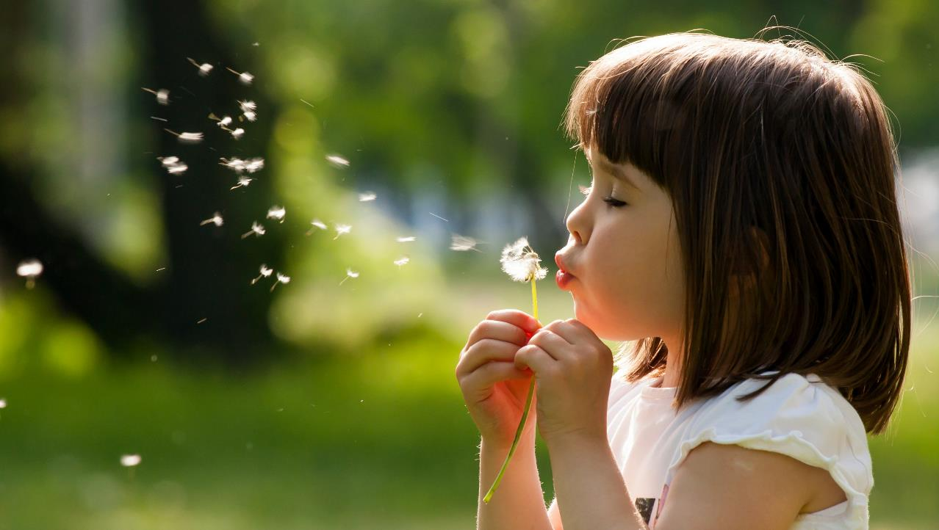
Have a nice day!

