Slide 1
Unit 3: SOCIAL ISSUES
Lesson 1.3. Pronunciation and Speaking
Pages: 26 & 27

Slide 2
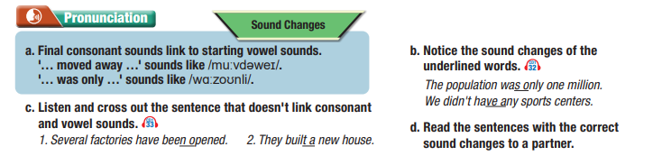
Lesson Outline
Warm-up
Pronunciation
Speaking
Consolidation
Wrap-up

Slide 3
By the end of this lesson, students will be able to…
Pronunciation:
- practice final consonant sounds link to starting vowel sounds.
Speaking:
- talk about solutions for our city.
- improve speaking skill.

Slide 4
WARM UP

Slide 5
Work in pairs.
Choose the word whose main stress is placed
differently from the others.
A. study B. respect C. restate D. invest
2. A. afford B. remove C. focus D. ignore
3. A. study B. lifestyle C. protein D. degree
/ˈstʌdi/
/rɪˈspekt/
/riːˈsteɪt/
/ɪnˈvest/
/əˈfɔːrd/
/rɪˈmuːv/
/ˈfoʊkəs/
/ɪgˈnɔːr/
/ˈstʌdi/
/ˈlaɪfstaɪl/
/ˈproʊtiːn/
/dɪˈɡriː/

Slide 6
Work in pairs.
Choose the word whose underlined part is
pronounced differently from that of the other words.
A. fitness B. outfit C. unit D. sunshine
2. A. adventure B. emperor C. congestion D.semester
3. A. install B. abroad C. human D. remark
/ˈfɪtnəs/
/ˈaʊtfɪt/
/ˈjuːnɪt/
/ˈsʌnʃaɪn/
/ ədˈventʃə/
/ˈempəə/
/kənˈʤesʧn/
/səˈmestə/
/ɪnˈstɑːl/
/əˈbrɑːd/
/ˈhjuːmən/
/rɪˈmɑːk/

Slide 8
a. Final consonant sounds link to starting vowel sounds.
'… moved away …' sounds like /muːvdəweɪ/.
'… was only …' sounds like /wɑːzoʊnli/

Slide 9
b. Notice the sound changes of the
underlined words.
The population was only one million.
We didn't have any sports centers.

Slide 10
c. Listen and cross out the sentence that doesn't link consonant and vowel sounds.
Several factories have been opened.
They built a new house.

Slide 11
d. Read the sentences with the correct sound changes
to a partner.

Slide 12
Practice

Slide 13
Practice the conversation. Swap roles and repeat.
Lisa: How long have you lived in this city, Mark?
Mark: My family moved here when I was six.
Lisa: Has the town changed much since then?
Mark: Well, the population has increased a lot. It takes longer to get to work now.
Lisa: Oh, can you tell me more about that?
Mark: When we moved here, the population was only twenty thousand.
Now, there are one million people.

Slide 14
Practice the conversation. Swap roles and repeat.
Lisa: Wow! What else has changed?
Mark: A new shopping center was built a few years ago.
Lisa: Can you give me some examples?
Mark: Sure, there are stores, restaurants, a cinema, and a bowling alley.
Lisa: That's great!

Slide 15
Practice the conversation. Swap roles and repeat.
Lisa: How long have you lived in this city, Mark?
Mark: My family moved here when I was six.
Lisa: Has the town changed much since then?
Mark: Well, the population has increased a lot.
It takes longer to get to work now.
Lisa: Oh, can you tell me more about that?
Mark: When we moved here,
the population was only twenty thousand.
Now, there are one million people.
Lisa: Wow! What else has changed?
Mark: A new shopping center was built a few years ago.
Lisa: Can you give me some examples?
Mark: Sure, there are stores, restaurants, a cinema,
and a bowling alley.
Lisa: That's great!
nine
three
infrastructure/improve
city/become/modern
easier/get around/now
More/people/want/live/now
roads/old/small
small/rural/town
Now/new/roads/
busy/highways
Now/big/city/many/
skyscrapers
Lots/new/businesses/ open/last/year
Government/improve/emergency services/2020
actories/offices/stores
30/new/ambulance drivers
easy/find/job/now
50/new/police officers

Slide 16
Speaking

Slide 17
INTERVIEW: MY TOWN HAS CHANGED
a. You're doing a news report about small town developments. In pairs: Student A, you're a news reporter. Read your role card and interview Student B.
Speaking

Slide 18
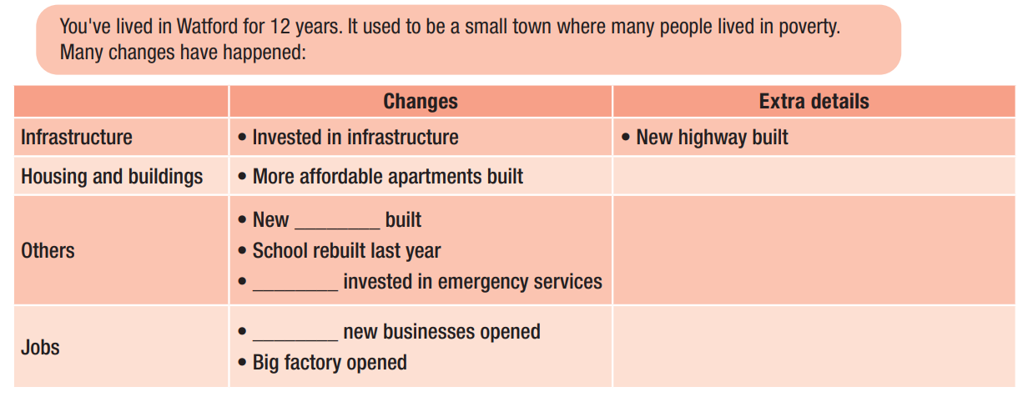
INTERVIEW: MY TOWN HAS CHANGED
Student B, you live in Watford. Read your role card, complete the information below with your own ideas, and add some extra details. Answer Student A's questions.
Speaking
b. Swap roles and repeat.

Slide 19
INTERVIEW: MY TOWN HAS CHANGED
c. Which changes do you think are positive? Which are negative?
What changes would you like to see in your town.
Positive | Negative

Slide 20
CONSOLIDATION

Slide 21
CONSOLIDATION
Now, write a report using the notes that you have taken from your interview and what you have reported to a new partner.
I had an interview with Lisa Hackett, who lives in Watford for 12 years. Watford used to be a small town where many people lived in poverty.
Many changes have happened.

Slide 22
WRAP-UP

Slide 23
Lesson 3
Today’s lesson
Pronunciation:
- practice final consonant sounds link to starting vowel sounds.
Speaking:
- talk about solutions for our city.
- improve speaking skill.

Slide 25
practice final consonant sounds link to starting vowel sounds.
Prepare the next lesson - Listening & Reading on pages 28 & 29 in SB.
Review all vocabularies and grammar point in the unit.
Play the consolidation games in Tiếng Anh 11 i-Learn Smart World DHA App on www.eduhome.com.vn

Slide 26
Have a nice day!

