Slide 1

Unit 3: SOCIAL ISSUES
Lesson 1.2: Grammar
Pages: 25 & 26

Slide 2
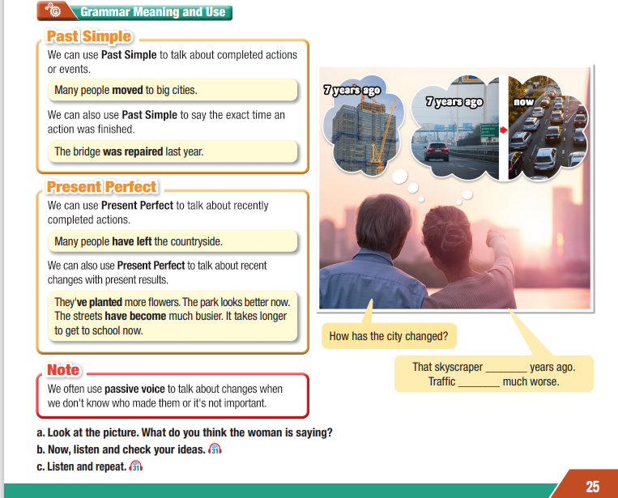
Lesson Outline
Warm-up
Grammar
Consolidation
Wrap-up

Slide 3

By the end of this lesson, students will be able to…
- practice and use Past Simple and Present Perfect correctly.

Slide 4

WARM UP

Slide 5
Describe new words
Use the definition of the new words to describe.
New words:
rural
skyscraper
outskirts
highway
invest
emergency services

Slide 6



Slide 7

Presentation

Slide 8

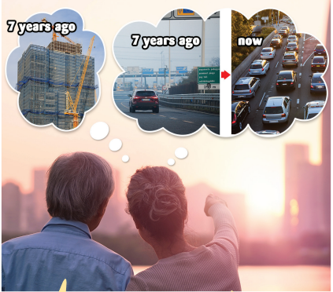
a. Look at the picture. What do you think the woman is saying?
How has the city changed?
That skyscraper ______years ago.
Traffic ______ much worse.

Slide 9

b. Now, listen and check your ideas.
How has the city changed?
That skyscraper ________ years ago.
Traffic __________ much worse.
was built 7
has become

Slide 10

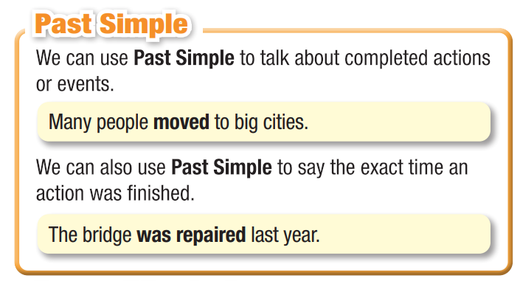
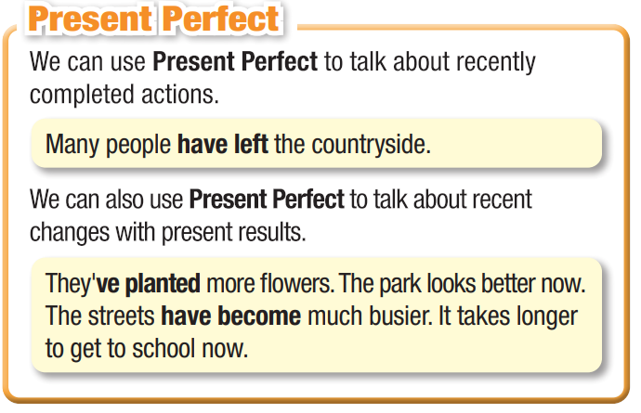
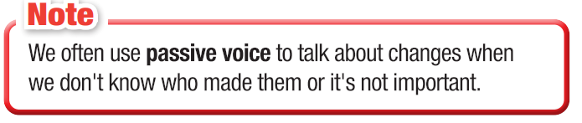

Slide 11

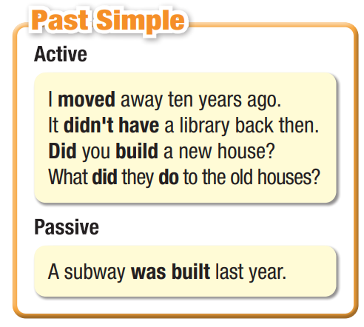
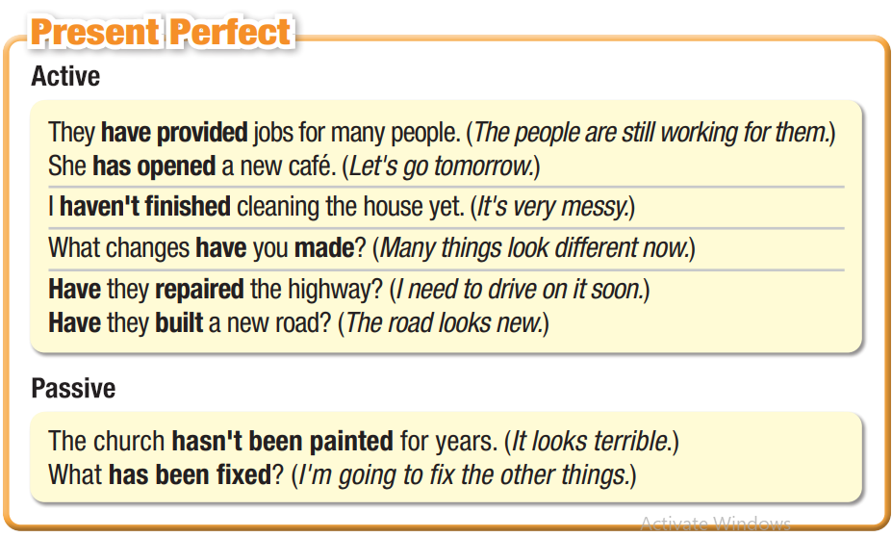

Slide 12

Practice

Slide 13
a. Fill in the blanks with the correct form of the verbs.
1. Several factories _______________ (open) recently. (Present Perfect Passive)
2. We _______________ (not have) any movie theaters or sports centers when I was a kid. (Past Simple)
3. The government _______________ (start) their plan to develop the rural towns in the mountains ten years ago. (Past Simple)
4. _____________________ (the new stadium/build) in 2012? (Past Simple Passive)
5. They ____________________ (not finish) building the new supermarket. (Present Perfect)
6. How much money ______________________ (the town/invest) in emergency services? (Present Perfect)
have been opened
didn’t have
started
Was the new stadium built
haven’t finished
has the town invested

Slide 14
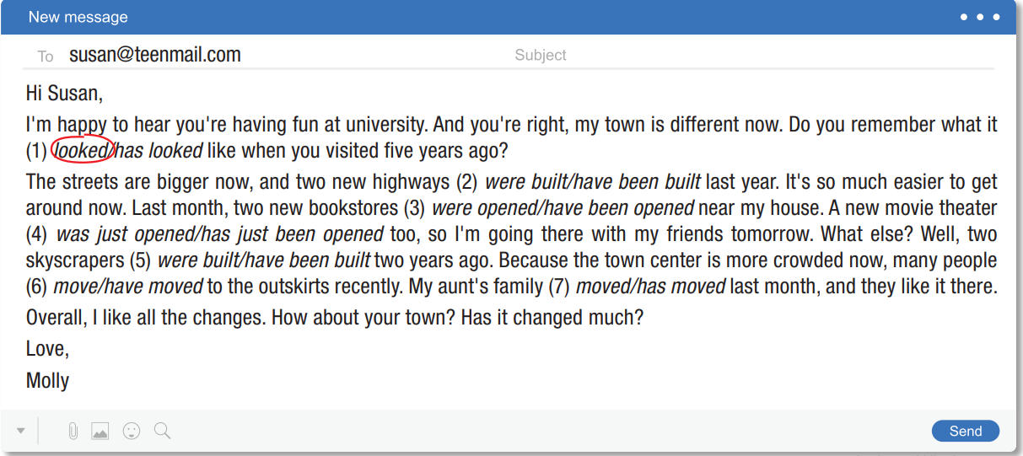
b. Read the email and choose the correct answers.

Slide 15
Extra Practice
WB, page 15
a. Fill in the blanks with words or phrases from the box.
1. The government ________ the hospital last month. It was only open for a year.
2. Look! The shop ________________ !It looks great!
3. A new shopping center ____________ last year.
4. The road ________________ recently. Driving to work is much better now.
5. A lot of money ______________ into the project.
6. Yesterday, the government ____________ work on the new bus station.
7. What _____________ to the school? It looks so different!
started
have they done
closed
have been improved
was opened
has been invested
has been repainted
closed
has been repainted
was opened
has been improved
has been invested
started
have they done

Slide 16
Extra Practice
WB, page 15
b. Unscramble the sentences.
1. village./I/a/grew/in/up/rural _____________________________________________
2. been/Have/the/roads/repaired? _____________________________________________
3.What/did/they/to/the/shopping/do/center? _____________________________________________
4. in/our/invested/of/companies/Lots/have/town. _____________________________________________
5. outskirts/Many/moved/people/the/have/recently./to. _____________________________________________
6. hasn't/old/for/been/years./painted/The/hospital
______________________________________________
I grew up in a rural village.
Have the roads been repaird?
What did they do to the shopping center?
Lots of companies have invested in our town.
Many people have moved to the outskirts recently.
The old hospital hasn’t been painted for years.

Slide 17

Production

Slide 18

c. In pairs: Has your neighborhood had similar changes to Molly's town? Do you know when the changes happened? What is the biggest change?
Last year, a new bridge was built near my house.
Production

Slide 19

CONSOLIDATION

Slide 20
CONSOLIDATION
Write five sentences about the changes in your town using the past simple and present perfect.

Slide 21

WRAP-UP

Slide 22
Today’s lesson
Grammar: Past Simple and Present Perfect.

Slide 23


Slide 24

Make 10 sentences, using past simple and past perfect.
Do the exercises in WB on page 15.
Prepare the next lesson – Pronunciation & Speaking SB (pages 26 & 27) .
Play the consolidation games in Tiếng Anh 11 i-Learn Smart World DHA on www.eduhome.com.vn

Slide 25
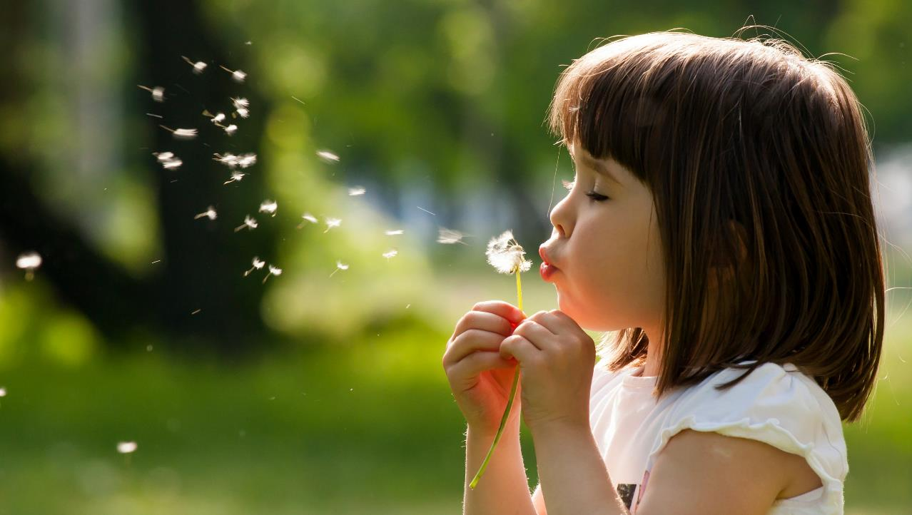
Have a nice day!

