Slide 1

Unit 3: SOCIAL ISSUES
Lesson 1.1: Vocab. and Listening
Pages: 24 & 25

Slide 2
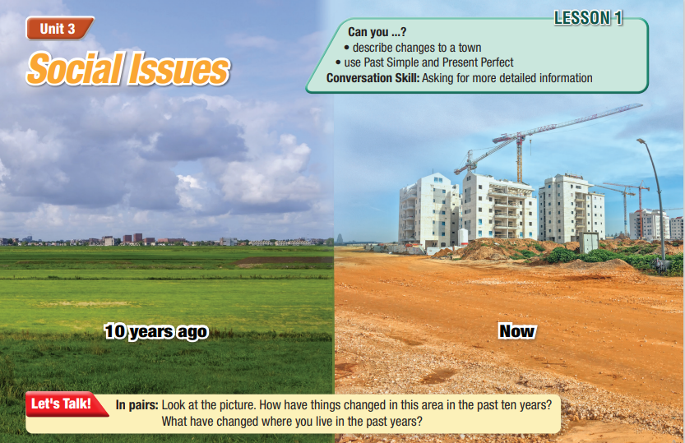
Lesson Outline
Warm-up
Vocabulary
Listening
Consolidation
Wrap-up

Slide 3

By the end of this lesson, students will be able to…
- Describe changes to a town.
- Practice listening and understanding general and specific information about infrastructure.

Slide 4

New words:
rural
skyscraper
outskirts
highway
invest
emergency services

Slide 5

WARM UP

Slide 6
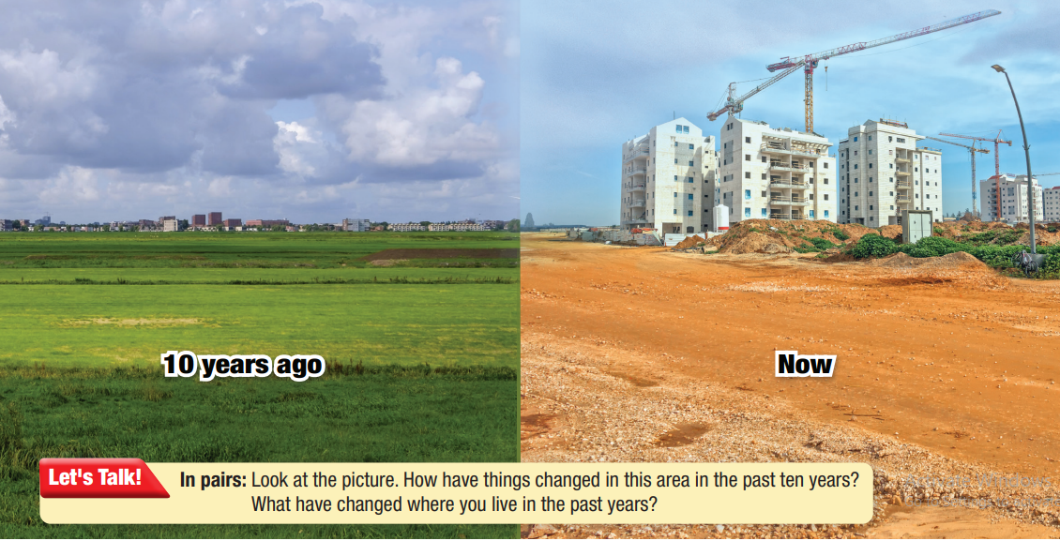

Slide 7

Work in pairs
1. What type of infrastructure is in the picture?
2. How have things changed in this area in the past ten years?
3. What has changed where you live in the past years?

Slide 8



Slide 9

a. Match the underlined words with the definitions. Listen and repeat..
a. A very tall building.
1. I used to live in a rural area. There were farms all around our house, and the nearest shopping mall was 30kilometers away.
b. away from large towns and cities.
2. A new skyscraper has been built. At 438
meters, it's the tallest building in the country.
3. We live on the outskirts of the city. It takes
us nearly an hour to get to the city center.
c. the parts of a town or city that are furthest from the center
4. The city needs a new highway. People need
a faster way to get to the next town.
d. public organizations that help with emergencies
5. The government needs to invest more
money in public transportation. That way,
people will use buses and the subway more.
e. spend money on something to make it better or get something in return
f. a large street, often connecting large towns and cities
6. The city needs better emergency services.
Crime is very high, and there aren't nearly
enough ambulances or firefighters.
Notes:
In the audio, the 1st word is world not rural, please check the audio

Slide 10
Listen and repeat. Click on each phrase to hear the sound.
rural (adj) /ˈrʊrl/ thuộc nông thôn
skyscraper (n) /ˈskaɪˌskreɪpə/ tòa nhà chọc trời
outskirts (n) /ˈaʊtskɜːts/ vùng ngoại ô
highway (n) /ˈhaɪweɪ/ đường cao tốc
invest (v phr) /ɪnˈvest/ đầu tư
emergency services (n) /ɪˌmɜːrdʒənsi ˈsɜːrvɪsɪz/ dịch vụ khẩn cấp
Notes:
Âm rural trong file này đọc là world

Slide 11
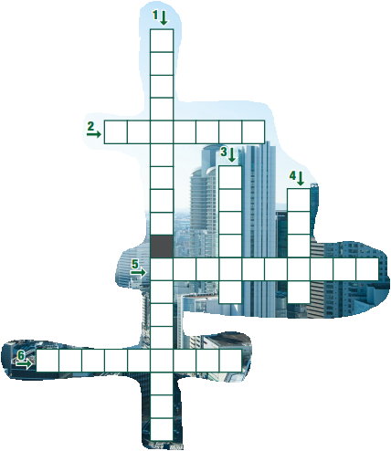
Extra Practice
WB, page 14
a. Read the clues. Complete the crossword.
Emergency services
Highway
Invest
Rural
Skyscraper
Outskirts
ACROSS
2. a large street, often connecting large towns and cities
5. a very tall building
6. the parts of a town or city that are furthest from the center
DOWN
1. public organizations that help with emergencies
3. spend money on something to make it better or get
something in return
4. away from large towns or cities
Notes:
GV click vào từng cụm nghe âm thanh

Slide 12

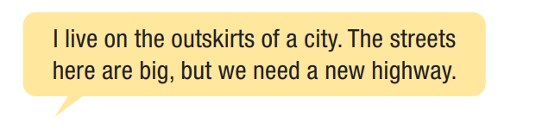
Work in pairs
b. What behavior is not accepted in your family?
When do you have to ask for permission from your parents?

Slide 13

Listening

Slide 14
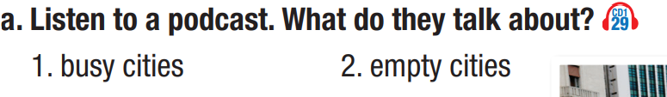
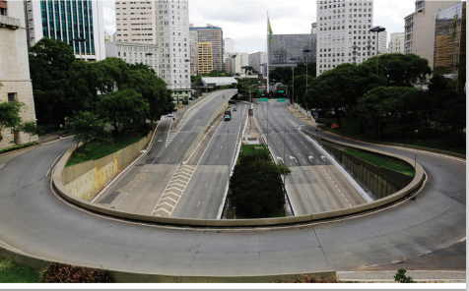
Pre - listening
Read the instruction quickly. Underline the key words. What are we going to do?
Listen and choose the correct answer.

Slide 15
While-Listening
What kind of word is needed?
1. Number of ghost cities visited: _________________
2. Location: often built _________________ of bigger cities
3. Reason they're built: as part of a city's _________________
4. Dantu: built in 2005; around _________________ people started
to move there.
5. People have started to _________________ other ghost cities
numbers
a place
why
a year
a verb

Slide 16
While-Listening
b. Now, listen and fill in the blanks.
7
1. Number of ghost cities visited: _________________
2. Location: often built _________________ of bigger cities
3. Reason they're built: as part of a city's _________________
4. Dantu: built in 2005; around _________________ people started
to move there.
5. People have started to _________________ other ghost cities
on the outskirts
development plan
2013
move into

Slide 17
Audio Scripts
Jessica: Hello, everyone. Please welcome William Davis.
He's a travel blogger, and today he's going to tell us about his trip to China.
William: Thanks, Jessica. Hello, everyone. I'm William.
Today I want to talk to you guys about something that's very unique: the "ghost cities" of China. During my trip, I visited seven of these cities.
Jessica: Do you mean cities that were once busy but are now empty?
William: No, they're new cities, often on the outskirts of bigger cities. They have everything: the infrastructure, apartments, skyscrapers, stores, highways to and from them. The only thing they don't have is people.
Jessica: Interesting. Can you tell me more about why they were built?

Slide 18
Audio Scripts
William: They're part of a city's development plan. The government builds a new city where they want people to move.
Jessica: Really? Could you give me an example?
William: Yes. Dantu. It was built in 2005 and for eight years, it was mostly empty.
Jessica: Did people actually move there?
William: Yes. Around 2013, people started to move there. Shops were opened and offices filled with people. The population has grown slowly and it's now very busy!
Jessica: That's fascinating.
William: Yes. And it isn't the only one. People have started to move into other ghost cities over the past few years.
Jessica: And how do …

Slide 19
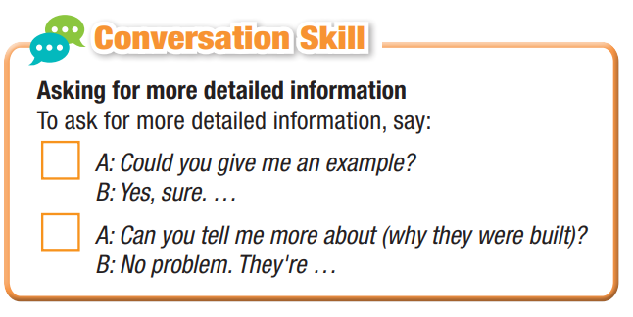
While-Listening
c. Read the Conversation Skill box. Then, listen and repeat.

Slide 20
While-Listening
d. Now, listen to the podcast again and number the
phrases in the order you hear them.
2
1

Slide 21
Extra Practice
WB, page 14
Listen to Jenny talking to her uncle. What do they discuss?
1. the future of their town 2. the history of their town

Slide 22
Extra Practice
WB, page 14
b. Now, listen and circle
1. How many years has her uncle lived on his street?
a. 56 b. 15 c. 50
2. Why were there no jobs in the town in the past?
a. It was a rural town. b. The town was smaller then. c. Businesses didn't want to invest.
3. Where was her uncle's first job?
a. at a school b. at a factory c. at a shopping center
4. Why was the school knocked down?
a. to build another school b. to build a shopping center c. to build a skyscraper

Slide 23

e. In pairs: What do you think of ghost cities? Are they a good way to develop an area? Why (not)?
Post-Listening

Slide 24

Consolidation

Slide 25
CONSOLIDATION
Review key vocabulary words from the lesson with correct pronunciation.

Slide 26

WRAP-UP

Slide 27
Today’s lesson
New words:
rural
skyscraper
outskirts
highway
invest
emergency services

Slide 28
Today’s lesson
Listening:
- Practice listening and understanding general and specific information about infrastructure.
Speaking:
Describe changes to a town.

Slide 29

Make sentences about infrastructure.
Prepare the next lesson - Grammar on pages 25 & 26 in SB.
Play the consolidation games in Tiếng Anh 11 i-Learn Smart World DHA App on www.eduhome.com.vn

Slide 30

Have a nice day!

