Slide 1

Unit 2: Generation Gap
Lesson 3.2: Speaking & Writing Page: 23

Slide 2
Lesson Outline
Warm-up
Speaking
Writing
Consolidation
Wrap-up

Slide 3

By the end of this lesson, students will be able to…
- practice giving supporting evidence in body paragraphs.
- write an essay to show what generations can show each other.
- talk about what generations can show each other.

Slide 4

WARM UP

Slide 5
Put the sentences below in the correct order to make a complete paragraph.
a. My neighbor could teach me how to fish using a spear, which I think would be a really cool thing to learn.
b. I think I would really enjoy learning how to do it, as well as learning a lot of other useful skills from people with more life experience than me.
c. Older generations could teach me lots of skills, such as teaching me interesting and useful outdoor and survival skills.
2
3
1

Slide 6
a. I have already learned lots from people of the older generations.
b. One thing my grandfather taught me was how to start a fire.
c. Many different people have taught me new skills that have helped me in life.
d. I have learned lots of other skills from other family members and friends, too.
e. It's easy and it's really useful when I go camping.
1
3
2
5
4

Slide 7
a. I could help them use technology like computers and tablets better because I know lots about these kinds of technology that my elders may not know.
b. I could also tell them about musical instruments, new fashion, and much more.
c. I think I could show them things that they would benefit from.
d. I also believe that there are things that I could help the older generations with.
2
4
3
1

Slide 8

Pre-writing

Slide 9
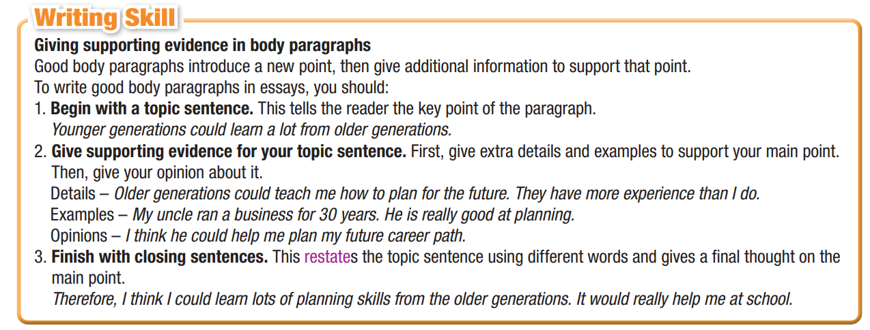
Task a
Read about giving supporting evidence in body paragraphs.

Slide 10
Answer the questions below.
a) How many parts are there in a paragraph?
Three parts: topic sentence, supporting evidence, closing sentence.
b) What’s the function of each part?
Topic sentence: Tells the reader the key point of the paragraph
Supporting evidence: First, give extra details and examples to support your main point. Then, give your opinion about it.
Closing sentence: Restates the topic sentence using different words and gives a final thought on the main point.

Slide 11
Read the essay again and underline the extra supporting details and circle the examples in each body sentence.
Older generations could teach me lots of skills, such as teaching me interesting and useful outdoor and survival skills. My neighbor could teach me how to fish using a spear, which I think would be a really cool thing to learn. I think I would really enjoy learning how to do it, as well as learning a lot of other useful skills from people with more life experience than me.

Slide 12
I have already learned lots from people of the older generations. Many different people have taught me new skills that have helped me in life. One thing my grandfather taught me was how to start a fire. It's easy and it's really useful when I go camping. I have learned lots of other skills from other family members and friends, too.

Slide 13
I also believe that there are things that I could help the older generations with. I could help them use technology like computers and tablets better because I know lots about these kinds of technology that my elders may not know. I think I could show them things that they would benefit from. I could also tell them about musical instruments, new fashion, and much more

Slide 14
Task b
Read the sentences and write D for details, E for examples, and O for opinions.
1. I think I would really enjoy learning to change a tire. ______
2. My father taught me how to play chess. ______
3. I could learn how to put up a tent. ______
4. I can show the older generations how to use social media. ______
5. I showed my grandmother how to put on make-up. ______
O
E
D
D
E

Slide 15

Speaking

Slide 16
Task a
In pairs: You're discussing what different generations can learn from each other. First, talk about some things you have learned or could learn from older people. Then, talk about some things you have shown or could show older people.
My uncle taught me how to swim. It was really fun.
My dad's friend used to be a police officer. He could teach me about the law.
I think I could show my grandparents how to use social media.

Slide 17
Task b
Choose and note 2–3 things you have or could learn from the older generations, and at least one thing you could or have helped them with. Give examples or extra opinions for each idea.
 | Details | Examples and Opinions
What you have learned/could learn from the older generations
What you have shown/could show the older generations
They could show me how to plan effectively.
My uncle ran a business for many years, so he knows how to plan well. I would find it really useful.
My grandpa has taught me a lot.
He showed me how to fix a flat tire on a motorbike. I think it is a really useful skill.
I know a lot about social media.
I could show them how to set up their own accounts. I think they would like to communicate more.

Slide 18
While-writing

Slide 19
Write an essay about what skills and knowledge different generations have or could share with each other. Use the Writing Skill box, the reading model, and your speaking notes to help you. Write 150–180 words.

Slide 20
Fill in the gaps with the correct words.
Older and younger generations can teach each other a lot. We both know things that the other doesn’t.
I could …………. lots from the older generations. They could show me how to plan effectively. My uncle ……… a business for many years, so he knows how to plan well. I would find it really …………… I think there’s much more they could teach me as well.
I have learned from the older generation already. My grandpa has taught me a lot. He showed me how to …….. a flat tire on a motorbike. I think it is a really useful …….. that will help me in the future. I have learned lots of other skills, too.
I could also ………… the older generation. I know a lot about social media. I could show them how to set up their own …………..... I think they would like to …………………………more. There’s much more I could teach them, too.
I should spend more time with the older generations. We all have a lot to learn.
learn
ran
useful
fix
skill
teach
accounts
communicate

Slide 21
Post-writing

Slide 22
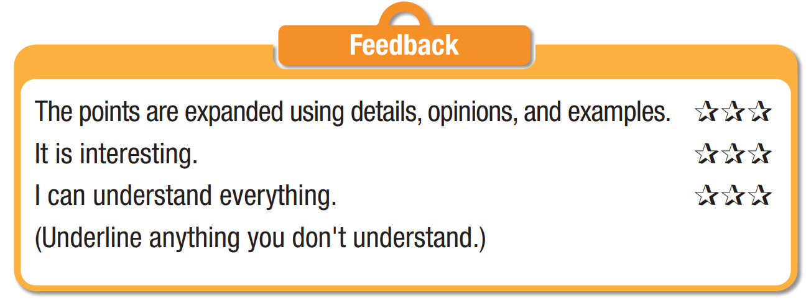
Peer check
Exchange your writing with your partner for checking the following points:

Slide 23

CONSOLIDATION

Slide 24
Pair work: tell your partner things that the elder and younger generation can teach each other that you have mentioned in the essay.
The elders can teach young people how to plan effectively and useful skills such as fixing a flat tire.
Young people can teach older people about social media such as setting up an account on Facebook to communicate more.

Slide 25

WRAP-UP

Slide 26
Today’s lesson
Writing:
Write an essay about what skills and knowledge different generations have or could share with each other.
Speaking:
Talking about how old people and younger generation can help each other.

Slide 27
Homework
Do the exercises on page 13 WB.
Prepare the next lesson (page 24 SB)
Play the consolidation games on www.eduhome.com.vn

Slide 28

Lesson 3
Stay positive and have a nice day!

