Slide 1

Unit 2: Generation Gap
Lesson 1.1: Listening & Reading
Page: 22

Slide 2
Lesson Outline
Warm-up
Listening
Reading
Consolidation
Wrap-up

Slide 3

By the end of this lesson, students will be able to…
- practice listening and reading for gist and specific information.

Slide 4

WARM UP

Slide 5
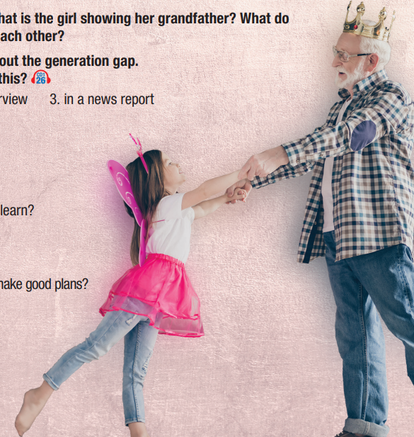
Work in pairs
Look at the pictures and answer the questions:
1. What is the girl showing her grandfather?
2. What do you think they can learn from each other?

Slide 6

Pre -Listening

Slide 7
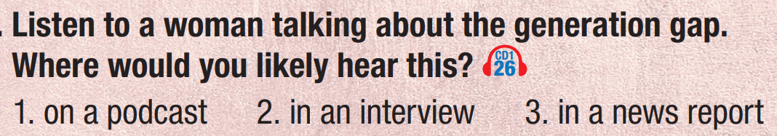

Task a
Read the instruction and guess where you would likely hear this.
Listen and check.

Slide 8
Task b
Read the questions and underline the key words.
What did she previously speak about?
What is the first thing she says young generations can learn?
What reason does she give for why younger people can't make good plans?
What is the final thing she says younger people can learn from older generations?

Slide 9

While-listening

Slide 10
Listen and circle the correct answers.
1. What did she previously speak about?
a. events of the past
b. how styles have changed
c. what generations can learn from each other
2. What is the first thing she says young generations can learn?
a. dealing with adversity
b. how to start a business
c. how to be happy

Slide 11
3. What reason does she give for why younger people can't make good plans?
a. They haven't done it enough.
b. They haven't lived long enough.
c. They don't see the benefit of it.
4. What is the final thing she says younger people can learn from older generations?
a. how to find husbands and wives
b. how to make plans
c. how to have longer relationships

Slide 12
Listen and fill in each gap with one word.
Alice: Welcome back to Teen Talk. We are going to continue our topic about the generation gap. We have already spoken about how …………have changed. Now, we are going to talk about what younger generations can learn from the older ones. Older generations have a lot of ………experience. Some have lived through some very difficult times, and some have built ……………… from nothing. The first thing we can learn is how to deal with adversity. By "adversity," I mean “………………. times in our lives." Many of us younger people find it difficult to deal with …………… and adversity. I think older generations could teach us how to stay ……………….. during hard times.
styles
life
business
difficult
stress
positive

Slide 13
The next thing is how to ……….. effectively. We may make many plans for the future, but we haven't lived long enough to see how our ……………….. plans work. Older generations have made plans and seen how …………they worked. We should ask them how to plan our own ………….. better. Finally, they can teach us how to have long, happy ……………………. Older generations on average have much longer marriages. They could give us ………… on how to maintain good relationships. That's all for this segment. Come back after the break to learn about what we can share with the older generations.
plan
long-term
well
future
relationships
tips

Slide 14
Post-listening

Slide 15

Work in pairs.
What are some things that younger people can share with older generations?
Young people can share their knowledge about technology with older generations.

Slide 16
Pre-reading

Slide 17
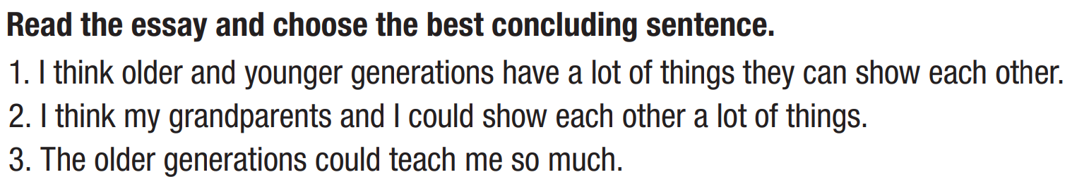
Read the instruction, underline the key words and figure out what you are going to do.
Read the essay and choose the best concluding sentence which restates the main idea of the essay.

Slide 18
Task a
Read the essay and choose the best concluding sentence.
I think older and younger generations have a lot of things they can show each other.
I think my grandparents and I could show each other a lot of things.
The older generations could teach me so much.
Older and younger generations can share a lot with each other.

Slide 19
Vocabulary
spear (n) /spɪr/ cây giáo, cái xiên (để đi săn)
survival (n) /səˈvaɪvl/ sinh tồn
elder (n) /ˈeldər/ người lớn tuổi hơn
benefit (v) /ˈbenəfɪt/ giúp ích, có lợi

Slide 20
Read the questions and underline the key words.
1. Read and circle the answer that best fits the numbered gap.
2. What could the writer's neighbor teach him?
3. What did their grandpa teach him?
4. What devices does the writer think he could help older generations use better?
5. What else does the writer think he could tell the older generations about?

Slide 21
Task b
Read and answer the questions
1. Read and circle the answer that best fits the numbered gap.
a. time b. experience
c. jobs d. school
Older and younger generations can share a lot with each other. I learned very different things in school than older generations did. They also have many years of (1) _____________ doing things that I have never even tried.

Slide 22
Older generations could teach me lots of skills, such as teaching me interesting and useful outdoor and survival skills. My neighbor could teach me how to fish using a spear, which I think would be a really cool thing to learn. I think I would really enjoy learning how to do it, as well as learning a lot of other useful skills from people with more life experience than me.
2. What could the writer's neighbor teach him?
how to fish using a spear

Slide 23
I have already learned lots from people of the older generations. Many different people have taught me new skills that have helped me in life. One thing my grandfather taught me was how to start a fire. It's easy and it's really useful when I go camping. I have learned lots of other skills from other family members and friends, too.
3. What did their grandpa teach him?
how to start a fire

Slide 24
I also believe that there are things that I could help the older generations with. I could help them use technology like computers and tablets better because I know lots about these kinds of technology that my elders may not know. I think I could show them things that they would benefit from. I could also tell them about musical instruments, new fashion, and much more.
4. What devices does the writer think he could help older generations use better?
computers and tablets

Slide 25
5. What else does the writer think he could tell the older generations about?
I also believe that there are things that I could help the older generations with. I could help them use technology like computers and tablets better because I know lots about these kinds of technology that my elders may not know. I think I could show them things that they would benefit from. I could also tell them about musical instruments, new fashion, and much more.
musical instruments and
new fashion

Slide 26
Task c
Listen and read.
Older and younger generations can share a lot with each other. I learned very different things in school than older generations did. They also have many years of (1)___________ doing things that I have never even tried.
Older generations could teach me lots of skills, such as teaching me interesting and useful outdoor and survival skills. My neighbor could teach me how to fish using a spear, which I think would be a really cool thing to learn. I think I would really enjoy learning how to do it, as well as learning a lot of other useful skills from people with more life experience than me.
I have already learned lots from people of the older generations. Many different people have taught me new skills that have helped me in life. One thing my grandfather taught me was how to start a fire. It's easy and it's really useful when I go camping. I have learned lots of other skills from other family members and friends, too. I also believe that there are things that I could help the older generations with. I could help them use technology like computers and tablets better because I know lots about these kinds of technology that my elders may not know. I think I could show them things that they would benefit from. I could also tell them about musical instruments, new fashion, and much more. I
________________________________________________________________________________. I should spend more time with the older generations and see how we can improve each other's lives.
experience
I think older and younger generations have a lot of things they can show each other.

Slide 27
Post-reading

Slide 28
In pairs: Do you agree with all the points in the essay? Why (not)? What else could they show each other?
Young people can show older generation how to use social media such as Facebook, Twitter, ...

Slide 29

CONSOLIDATION

Slide 30
Write a summary about things that young generation and the elders can help each other.
For example:
Old people can help their children or grandchildren with survival skills. For example, they can teach them how to catch fish using a spear or how to start a fire. On the other hand, young generation can help the elders with technology. For instance, they can show them how to use computers and tablets. They can also tell them about musical instruments and new fashion.

Slide 31

WRAP-UP

Slide 32
Today’s lesson
Listening:
Listening for main idea and specific information
Reading:
Reading for main idea and specific information.

Slide 33
Homework
Do the exercises on page 12 WB.
Prepare the next lesson (page 23 SB)
Play the consolidation games on www.eduhome.com.vn

Slide 34

Lesson 3
Stay positive and have a nice day!

