Slide 1

Unit 2: Generation Gap
Lesson 2.1: Vocabulary & Reading
Pages: 18 & 19

Slide 2
Lesson Outline
Warm-up
Vocabulary
Reading
Consolidation
Wrap-up

Slide 3
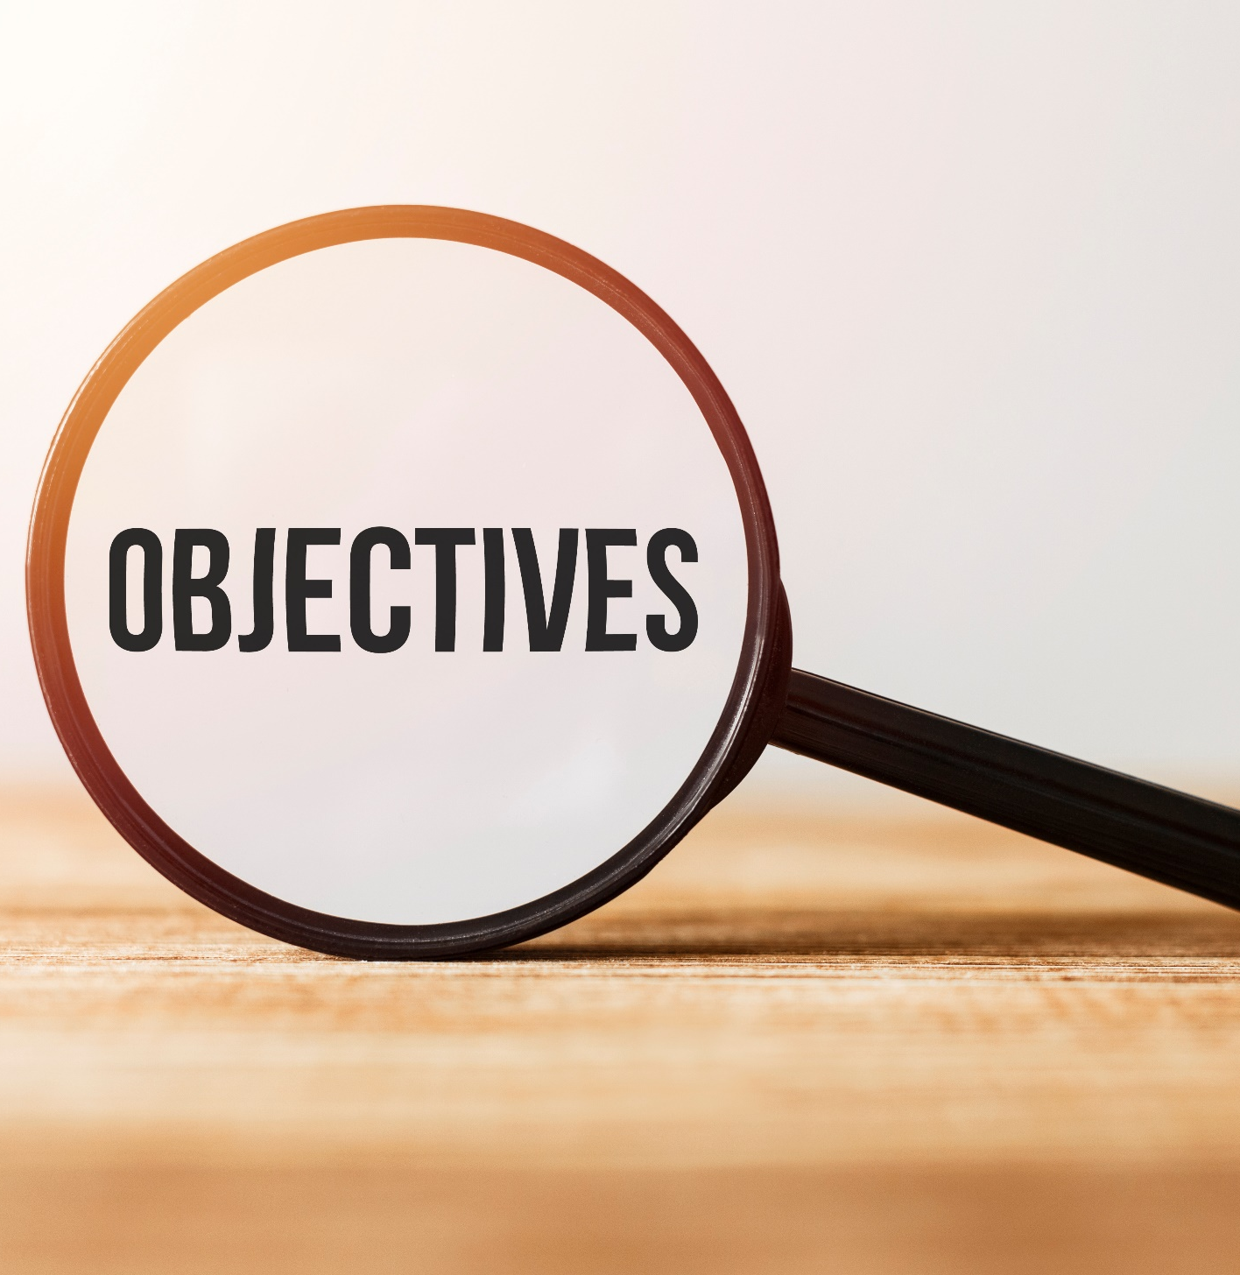
By the end of this lesson, students will be able to…
- practice and learn vocab. related to generations.
- practice reading for specific information.

Slide 4

New words
Influence
Behavior
Respect
Ignore
Curfew
Permission
Privacy

Slide 5

WARM UP

Slide 6

Work in pairs
Look at the picture and answer the questions:
1. What's the problem in the picture?
2. What are some other reasons for arguments between parents and teenagers?

Slide 7

Vocabulary

Slide 8
Match the words with the correct definitions.
1. Influence
2. Behavior
3. Respect
4. Ignore
5. Curfew
6. Permission
7. Privacy
a. how someone acts
b. pay no attention to something
c. the effect that somebody or something has on the way someone thinks or acts
d. the state of being alone and not watched by other people
e. act in a way that shows you are aware of someone's rights, wishes, etc.
f. a time when children must be home in the evening
g. the right to do something that is given to you by someone else

Slide 9

Listen and repeat. Click on each phrase to hear the sound.
influence (n) /ˈɪnfluəns/ sự ảnh hưởng
behavior (n) /bɪˈheɪvjə/ hành vi
respect (v) /rɪˈspekt/ tôn trọng
ignore (v) /ɪgˈnɔːr// làm ngơ, bỏ qua
curfew (n) /ˈkɜːfjuː/ giờ giới nghiêm
permission (n) /pərˈmɪʃn/ sự cho phép
privacy (n) /ˈpraɪvəsi/ sự riêng tư

Slide 10
Task a
Read the words and definitions, then fill in the blanks.
Influence, behavior, respect, ignore, curfew, permission, privacy
1. When working in teams, you should ________ other people's opinions and not make decisions on your own.
2. I need to get my mom's ____________ when I want to go out with my friends.
3. Sarah has a 9:30 p.m. ________. She has to be home before that.
respect
permission
curfew

Slide 11
Influence, behavior, respect, ignore, curfew, permission, privacy
4. As children get older, they want to have more ________ and stop sharing everything with their parents.
5. Tom's ___________ has become quite strange. He doesn't talk much and always stays in his room.
6. Why did you ________ my messages? I sent you so many, and you
never replied!
7. Movies can be a bad _________ on children. Parents should know what their children are watching.
privacy
behavior
ignore
influence

Slide 12
Task a
In pairs: What behavior is not accepted in your family?
When do you have to ask for permission from your parents?
I can't ignore my parents' messages.
I can’t go out without asking for permission.

Slide 13

Pre-reading

Slide 14
Work in pairs: List the problems you usually have with your parents.
Playing games
Doing housework
Studying
Choosing friends
Spending money

Slide 15
Task a
Guess the answer to the following question.
Which of the following is NOT mentioned as a problem between Donna and her daughter?
how her daughter spends money
her daughter's musical taste
her daughter's grades

Slide 16

While-reading

Slide 17
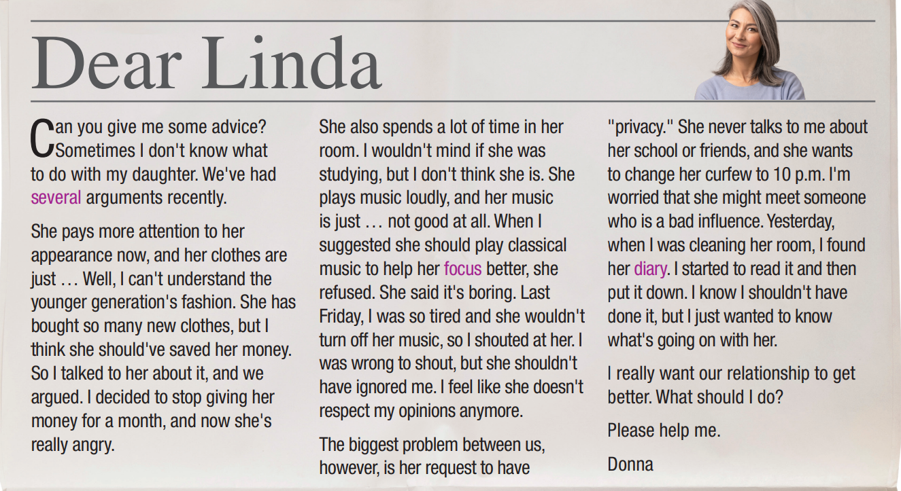
c. her daughter's grades
Read and check.

Slide 18
Task b
Read and underline the key words.
1. Donna thinks her daughter spent too much money on clothes.
2. Donna's daughter likes to listen to classical music.
3. Donna often argues with her daughter about her friends.
4. Donna didn't give her daughter permission to go home late.
5. Donna regrets reading her daughter's diary.

Slide 19
Read and write True, False, or Doesn't say.
1. Donna thinks her daughter spent too much money on clothes.
T
She pays more attention to her appearance now, and her clothes are just … Well, I can't understand the younger generation's fashion. She has bought so many new clothes, but I think she should've saved her money. So I talked to her about it, and we argued. I decided to stop giving her money for a month, and now she's really angry.

Slide 20
2. Donna's daughter likes to listen to classical music.
F
She also spends a lot of time in her room. I wouldn't mind if she was studying, but I don't think she is. She plays music loudly, and her music is just … not good at all. When I suggested she should play classical music to help her focus better, she refused. She said it's boring. Last Friday, I was so tired and she wouldn't turn off her music, so I shouted at her. I was wrong to shout, but she shouldn't have ignored me. I feel like she doesn't respect my opinions anymore.

Slide 21
3. Donna often argues with her daughter about her friends.
4. Donna didn't give her daughter permission to go home late.
5. Donna regrets reading her daughter's diary.
DS
DS
T
The biggest problem between us, however, is her request to have "privacy." She never talks to me about her school or friends, and she wants to change her curfew to 10 p.m. I'm worried that she might meet someone who is a bad influence. Yesterday, when I was cleaning her room, I found her diary. I started to read it and then put it down. I know I shouldn't have done it, but I just wanted to know what's going on with her.

Slide 22
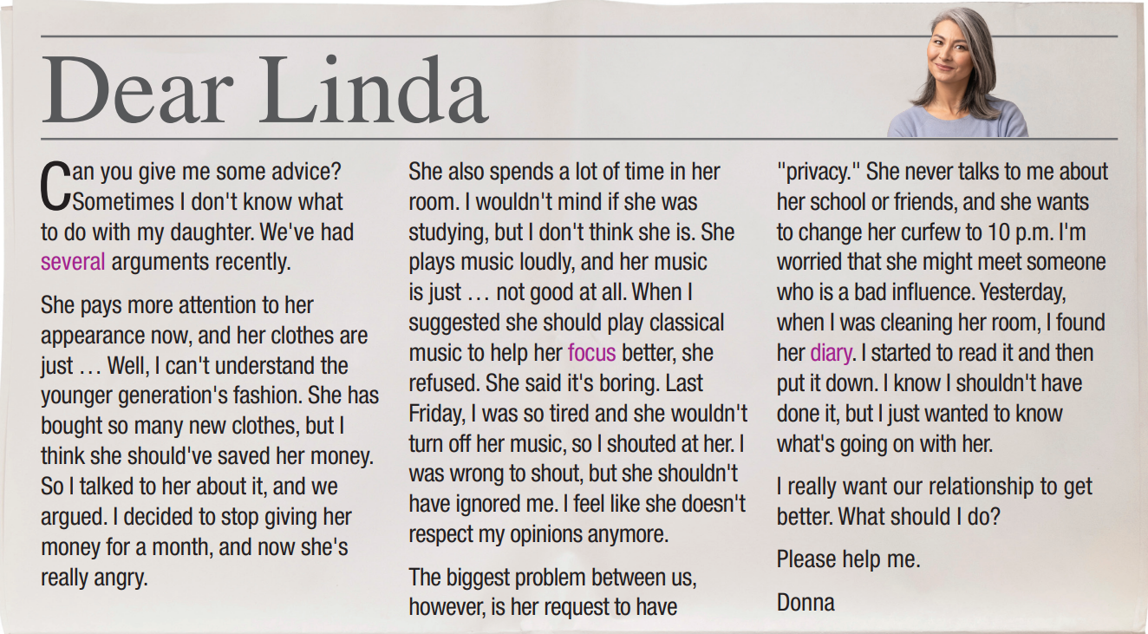
Task c
Listen and read.

Slide 23

Post-reading

Slide 24
Task d
In pairs: What do you think Donna should do? Why?
I think Donna should spend more time with her daughter and talk with her like a friend so that she can know her hobbies as well as problems and give useful advice.

Slide 25

CONSOLIDATION

Slide 26
Write four sentences about problems you usually have with your parents, using the new words in the lesson
For example:
My parents usually complain about my behaviors. I rarely ask for permission when I want to go out.
I feel uncomfortable when my parents don’t respect my privacy. They always go into my room without knocking the door.

Slide 27

WRAP-UP

Slide 28
Today’s lesson
Vocabularies
Influence
Behavior
Respect
Ignore
Curfew
Permission
Privacy

Slide 29
Today’s lesson
Reading:
- Understanding instructions
Skimming and scanning for general and specific information
Speaking:
- Talking about generation gap

Slide 30
Homework
Learn by hearts vocabularies and make sentences using them.
Do the exercises on page 10 WB.
Prepare the next lesson (pages 19 & 20 SB)
Play the consolidation games on www.eduhome.com.vn

Slide 31

Lesson 3
Stay positive and have a nice day!

