Slide 1

Unit 2: Generation Gap
Lesson 1.3: Pronunciation & Speaking
Pages: 16 & 17

Slide 2
Lesson Outline
Warm-up
Pronunciation
Speaking
Consolidation
Wrap-up

Slide 3

By the end of this lesson, students will be able to…
- practice intonation.
- talk about differences in fashion preferences between generations.

Slide 4

WARM UP

Slide 5
Choose the word whose underlined part is pronounced differently form that of the others.
A. gap B. man C. bag D. hall
/ɡæp/ /mæn/ /bæɡ/ /hɑːl/
2. A. outfit B. music C. picture D. highland
/ˈaʊtfɪt/ /ˈmjuːzɪk/ /ˈpɪktʃər/ /ˈhaɪlənd/
3. A. clothes B. cloth C. pole D. hole
/kloʊðz/ /klɑːθ/ /poʊl/ /hoʊl/

Slide 6
Choose the words whose main stress is placed differently from the others.
A. design B. fashion C. leather D. headscarf
/dɪˈzaɪn/ /ˈfæʃən/ /ˈleðər/ /ˈhedskɑːrf/
2. A. popular B. powerful C. practical D. exciting
/ˈpɑːpjələ/ /ˈpaʊəfəl/ /ˈpræktɪkəl/ /ɪkˈsaɪtɪŋ/
3. A. miniskirt B. invention C. animal D. holiday
/ˈmɪniskɜːt/ /ɪnˈvenʃən/ /ˈænɪməl/ /ˈhɑːlədeɪ/

Slide 7

Presentation

Slide 8

Listen to the questions and notice the intonation.
Mom looked very stylish, didn't she?
It isn't very expensive, is it?
Is it falling or rising intonation?
It’s falling intonation.

Slide 9
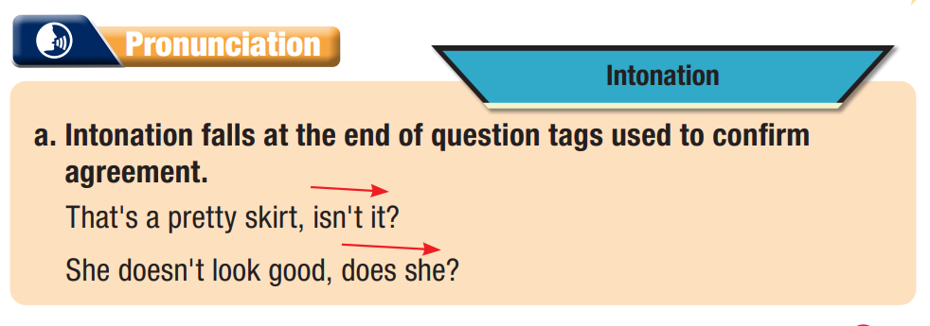
Task a

Slide 10
Task b
Listen and repeat.
Mom looked very stylish, didn't she?
It isn't very expensive, is it?

Slide 11
Task c
Listen and cross out the sentence with the wrong intonation.
That trend wasn't very practical, was it?
This dress is a bit short, isn't it?
Task d
Read the sentences with the correct intonation to a partner

Slide 12

Practice

Slide 13
Task a
Practice the conversation. Swap roles and repeat.
Alex: Take a look at these photos, Emily.
Emily: Oh, are they Mom and Dad's old photos?
Alex: Yes. Look! Dad used to have long hair.
Emily: He looked good with long hair, didn't he?
Alex: Yeah, he did.
Emily: Mom didn't look too bad though, did she?
Alex: No, she didn't.
Emily: She looked great in her tight leather pants and boots.
Alex: But leather isn't stylish anymore, is it?
Emily: No, it isn't.

Slide 14
Make two more conversations using the ideas on the right.
Alex: Take a look at these photos, Emily.
Emily: Oh, are they Grandpa and Grandma’s old pictures?
Alex: Yes. Look! Grandpa used to look like hip hop star.
Emily: He looked cool and handsome, didn’t he?
Alex: Yeah, he did.
Emily: Grandma looked stylish, did she?
Alex: Yes, she did.
Emily: She looked great in colorful clothes and black boots.
Alex: Black boots are still stylish today, aren’t they?
Emily: Yes, they are

Slide 15
Alex: Take a look at these photos, Emily.
Emily: Oh, are they Aunt Kate and Uncle Tom’s old pictures?
Alex: Yes. Look! Uncle Tom used to have red hair.
Emily: He looked silly, didn’t he?
Alex: Yeah, he did.
Emily: Aunt Kate was fashionable, wasn’t she?
Alex: Yes, she was.
Emily: She looked great in black dress and cute shoes.
Alex: Black dresses are still fashionable now, aren’t they?
Emily: No, they aren’t. They went out of fashion years ago.

Slide 16

Speaking

Slide 17
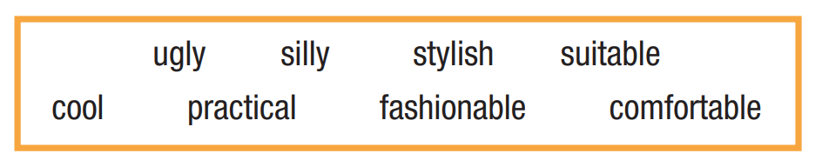
DESCRIBING OLD PHOTOS
In pairs: Make comments you think your partner will agree with about the clothes and hairstyles. Compare the trends in the past with ones that are popular now. Then, choose what you like most and least.

Slide 18
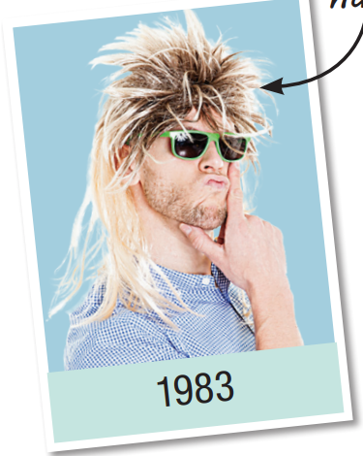
That hairstyle looked ugly, didn’t it?
Yes, it did. We have better hairstyles now, don't we?

Slide 19
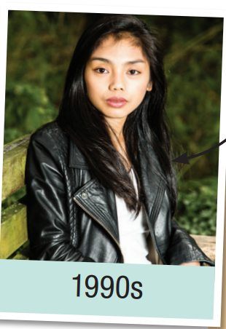
That jacket looked cool, didn’t it?
Yes, it did. We have more suitable jackets now, don't we?

Slide 20
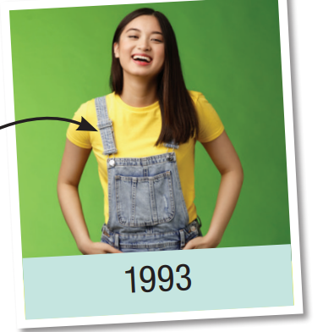
Those clothes looked comfortable, didn’t they?
Yes, they did. We have more stylish clothes now, don't we?

Slide 21
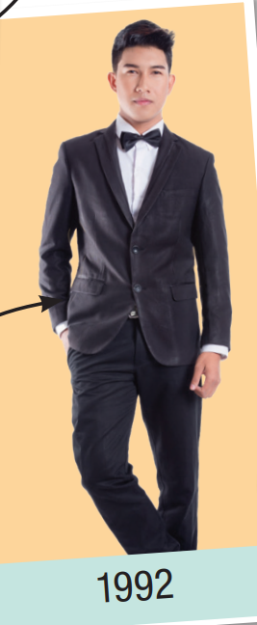
Those clothes looked fashionable, didn’t they?
Yes, they did. We have more practical clothes now, don't we?

Slide 22
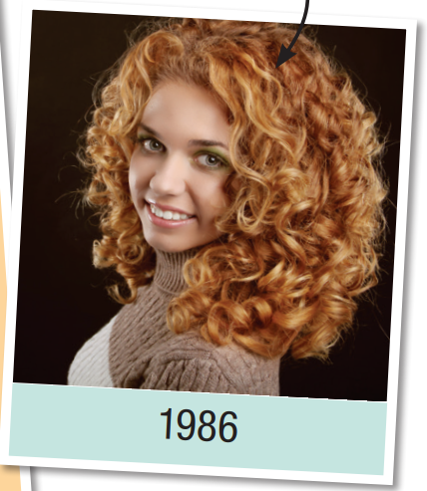
That hairstyle looked fashionable, didn’t it?
Yes, it did. We have more complicated hairstyles now, don't we?

Slide 23
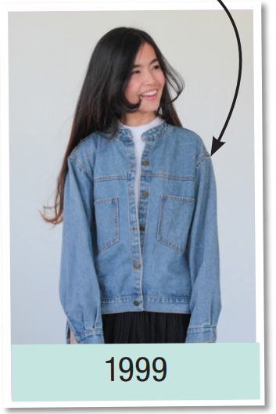
That jacket looked silly, didn’t it?
Yes, it did. We have more fashionable jackets now, don't we?

Slide 24
Production

Slide 25
Work in pairs
Which hairstyles and clothes do you like the most? Why?
I like the hairstyle in 1986 most because it looked cool.

Slide 26

CONSOLIDATION

Slide 27
Write four sentences about the fashion trends you like/don’t like and state the reasons.
For example:
I like wearing hoodies because they are practical and fashionable.
I don’t like wearing curly hair because it looks hot.

Slide 28

WRAP-UP

Slide 29
Today’s lesson
Pronunciation:
- Intonation of tag questions.
Speaking:
- Comparing fashion in the past and present.

Slide 30
Homework
Practice talking about fashion, using tag questions.
Prepare the next lesson (pages 18 & 19 SB).
Play the consolidation games on www.eduhome.com.vn

Slide 31

Lesson 3
Stay positive and have a nice day!

