Slide 1
Unit 2: Generation Gap
Lesson 1.2: Grammar
Pages: 15 & 16

Slide 2
Lesson Outline
Warm-up
Grammar
Consolidation
Wrap-up

Slide 3
By the end of this lesson, students will be able to…
- practice and use tag questions correctly.

Slide 4
WARM UP

Slide 5
Unscramble the words.
1. tysshli ______________
2. rnted ______________
3. ylisl ______________
4. ctirlaacp ______________
5. uilsbaet ______________
6. eralthe ______________
stylish
trend
silly
practical
suitable
leather

Slide 6
Presentation

Slide 7
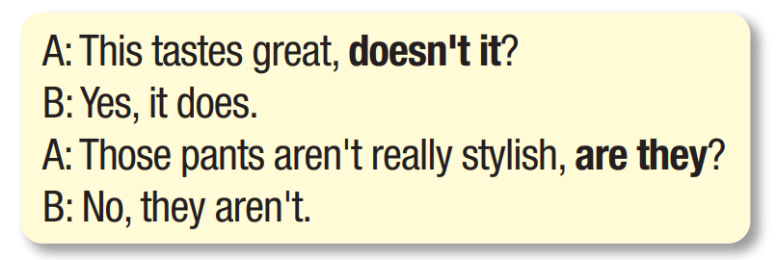
Look at the questions and underline the main verbs.
Complete the rules:
Positive statement →
Negative statement →
Negative tag
Positive tag

Slide 8
Look at the words in bold and complete the rules:
Statement | Tag
To be / auxiliary / model verb
No to be / auxiliary / model verb
To be / auxiliary / model verb
do / does / did

Slide 9
How to respond tag questions.
A: She looks good, doesn't she?
Agree:
Disagree:
A: He isn't very stylish, is he?
Agree:
Disagree:
B: Yes, she does.
B: No, she doesn’t.
B: No, he isn't. .
B: Yes, he is.

Slide 10
How to use tag questions.
We can use tag questions to:
make comments we think others will agree with.
confirm information we believe to be true.
Intonation of tag questions
We use falling intonation on tag questions when:
we think others will agree with.
We want to confirm information we believe to be true.

Slide 11
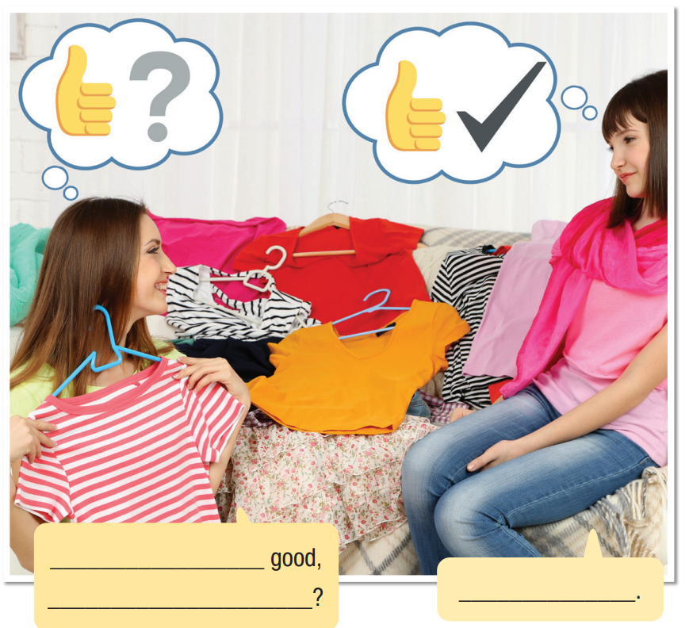
Task a
Look at the picture. What do you think the girls are saying?
Task b
Listen and check your ideas.
Task c
Listen and repeat.
This looks
doesn’t it
Yes, it does

Slide 12
Practice

Slide 13
Task a
Fill in the blanks with the correct tag questions and responses.
1. A: The 1970s had the best music, didn't it?
B: No, __________. 80s music was much better.
2. A: Men's fashion in the 1970s wasn't very good, __________?
B: __________, it wasn't. It was very boring.
3. A: Teens like to follow the latest trends, __________?
B: Yes, __________. They always want the latest fashions.
It didn’t
was it
No
don’t they
they do

Slide 14
4. A: We didn't have the best hairstyles back then, __________?
B: No, __________. Hairstyles looked silly in those days.
5. A: He likes wearing practical clothes, __________?
B: Yes, __________.
6. A: Alice is really interested in fashion, __________?
B: Yes, __________. She always buys new clothes.
did we
we didn’t
doesn’t he
he does
isn’t she
she is

Slide 15
Task b
Complete the questions using the prompts, then answer the questions.
1. A: Their clothes were silly, weren't they? (past – be/silly)
B: ( ) _______________________________
2. A: She _______________, ___________? (now – look/stylish)
B: ( ) _______________________________
3. A: Those jeans _______________, ___________? (now – be/too short)
B: ( ) _______________________________
No, they weren't.
looks stylish
doesn’t she
Yes, she does.
are too short
aren’t they
Yes, they are.

Slide 16
4. A: She ____________ with short hair, _________? (past – look/good)
B: ( ) _______________________________
5. A: Those leather boots ____________, ___________? (now – not be/stylish)
B: ( ) _______________________________
6. A: Those jeans ___________ for girls, __________? (now – be/suitable)
B: ( ) _______________________________
looked good
didn’t she
Yes, she did.
aren’t stylish
are they
No, they aren’t
are suitable
aren’t they
No, they aren’t.

Slide 17
Further practice
Exercise a, WB p. 9
Circle the correct words.
1. That skirt is very stylish, isn't it/didn't it ?
2. Your mother doesn't like pop music, does she/do they ?
3. That dress doesn't/isn't suitable for school, is it?
4. You like to argue with your parents, do you/don't you ?

Slide 18
Further practice
Exercise b, WB p. 9
Write tag questions using the prompts.
1. those boots/not suitable/school (now) ______________________________________________________
2. your sister/very fashionable (now) ______________________________________________________
3. your parents/very strict (now) ______________________________________________________
4. that outfit/look/silly (past) ______________________________________________________
5. she/look/stylish (past)
______________________________________________________
Those boots aren't suitable for school, are they?
Your sister is very fashionable, isn't she?
Your parents are very strict, aren't they?
That outfit looked silly, didn't it?
She looked stylish, didn't she?

Slide 19
Production

Slide 20
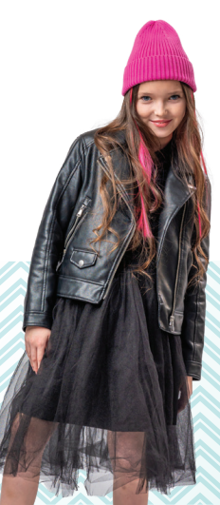
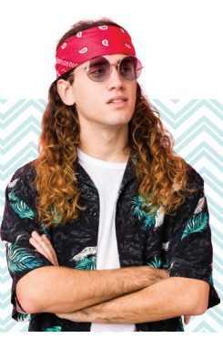
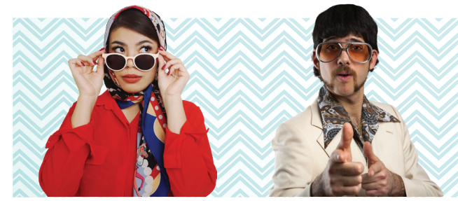
In pairs: Make comments on the pictures on page 14 and see if
your friend can guess which picture you're commenting on.
The woman's outfit is very stylish, isn't it?

Slide 21
CONSOLIDATION

Slide 22
Write four tag questions (two in the past and two in the present) about your classroom, your friends, your teachers and your lessons.
For example:
Our classroom is big, isn’t it?
Mai isn’t very sociable, is she?
Our last English teacher was fashionable, wasn’t she?
The Math test yesterday wasn’t difficult, was it?

Slide 23
WRAP-UP

Slide 24
Today’s lesson
Grammar
Tag questions
Speaking
Making comments on fashion

Slide 25
Homework
Learn by hearts vocabularies and make sentences using them.
Do the exercises on page 9 WB.
Prepare the next lesson (pages 16 & 17 SB)
Play the consolidation games on www.eduhome.com.vn

Slide 26
Lesson 3
Stay positive and have a nice day!

