Slide 1
Unit 2: Generation Gap
Lesson 1.1: Vocab. & Listening
Pages: 14 & 15

Slide 2
Lesson Outline
Warm-up
Vocabulary
Listening
Consolidation
Wrap-up

Slide 3
By the end of this lesson, students will be able to…
- learn vocabulary related to fashion trends.
- practice listening for gist and specific information.
- learn and practice functional English (Introducing topics).

Slide 4
New words
Trend
Leather
Stylish
Silly
Practical
Suitable

Slide 5
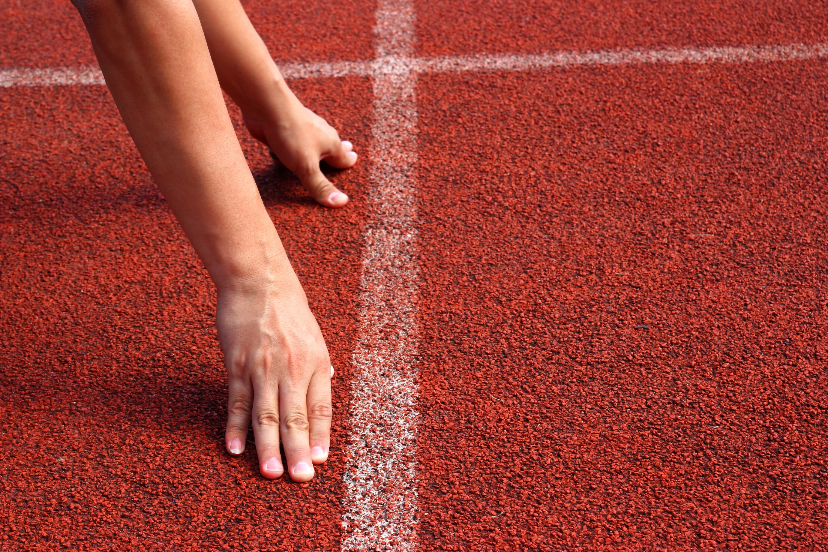
WARM UP

Slide 6
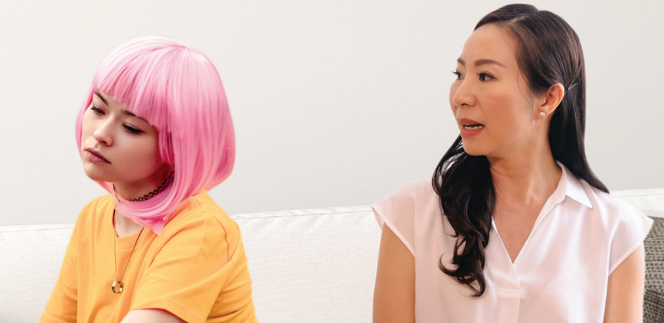
Work in pairs
Look at the pictures and answer the questions:
1. Why does the mom look upset with her daughter?
2. What kinds of things do you and your parents sometimes disagree about?

Slide 7
Vocabulary

Slide 9
Match the words with the correct deninitions.
a. afraid that people will laugh at you
b. a new development in clothing
c. acceptable
d. animal skin used to make shoes, bags, clothes, …
e. having a special quality that makes a person or thing seem different and attractive
f. useful
1. Trend
2. Leather
3. Stylish
4. Silly
5. Practical
6. Suitable

Slide 10
Listen and repeat. Click on each phrase to hear the sound.
trend (n) /trend/ xu hướng
leather (n) /ˈleðər/ đồ da, da thuộc
stylish (a) /ˈstaɪlɪʃ/ có phong cách, hợp thời trang
silly (a) /ˈsɪli/ lố bịch
practical (a) /ˈpræktɪkl/ thiết thực
suitable (a) /ˈsuːtəbl/ phù hợp

Slide 11
Task a
Add more words to the list.
cotton, jeans, wool
fashionable, beautiful, attractive
terrible
comfortable, uncomfortable

Slide 12
Complete sentences 1–6 with the bold words.
trend, leather, stylish, silly, practical, suitable
1. My shoes are very comfortable and __________. People always ask me where I got them.
2. Headscarves are a new __________ this year. You'll see many girls and women wearing scarves.
3. These clothes look so __________. I don't know who would buy them. People will laugh at them.
stylish
trend
silly

Slide 13
trend, leather, stylish, silly, practical, suitable
4. Many women's shoe designs aren't __________. Your feet will hurt if you wear them all day.
5. On Tết holiday, you should wear a shirt that is __________ for visiting your relative's house.
6. I don't wear __________ because I don't think animals should be hurt to make clothes.
practical
suitable
leather

Slide 14
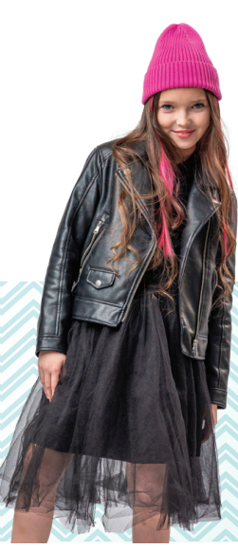
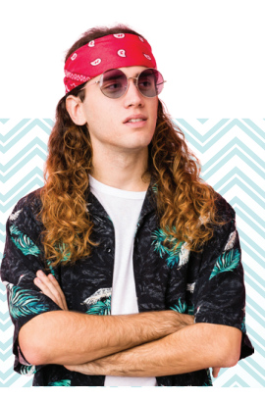
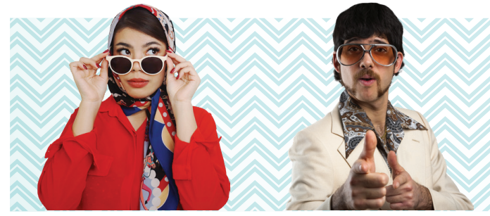
Work in pairs
Task b
Use the words in Task a to describe the pictures. Which styles do you like? Why?

Slide 15
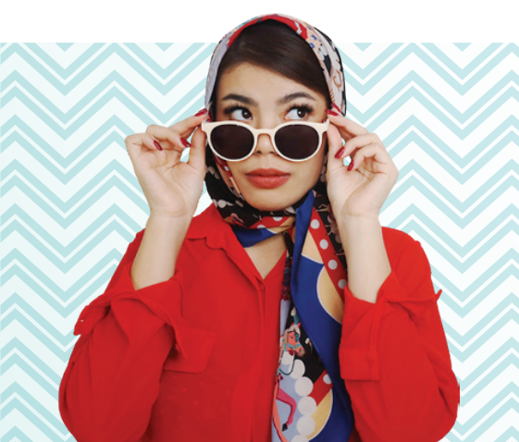
I think the girl wearing sunglasses looks stylish.

Slide 16
Pre-reading

Slide 17
Task a
Read the instruction and underline the key words. What are you going to do?
Listen to a podcast about fashion in the past and choose the main focus of the talk.

Slide 18
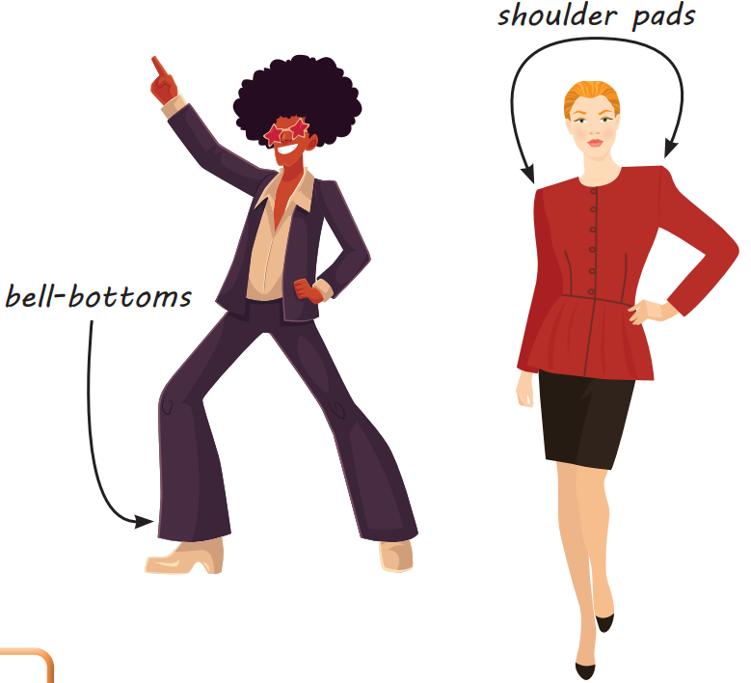
Look at the picture and guess the main focus of the talk.
popular fashion trends
silly fashion trends

Slide 19
Listen to a podcast about fashion in the past. What is the main focus of the talk?
popular fashion trends
silly fashion trends

Slide 20
Task b
Read the sentences and guess the missing information.
1. The miniskirt was invented in the ___________.
2. The speakers both think that the ___________ was one of the greatest inventions in the fashion world.
3. Bell-bottoms could have legs opening up to ___________ centimeters.
4. A trend in the ___________ was "power dressing." Women wore shoulder pads to look powerful.
5. Rachel agrees that _______________________ sounds really cool.
time
clothes
number
time
something

Slide 21
Read the sentences and underline the key words.
1. The miniskirt was invented in the ___________.
2. The speakers both think that the ___________ was one of the greatest inventions in the fashion world.
3. Bell-bottoms could have legs opening up to ________ centimeters.
4. A trend in the ___________ was "power dressing." Women wore shoulder pads to look powerful.
5. Rachel agrees that _______________________ sounds really cool.

Slide 22
While-listening

Slide 23
Listen and fill in the blanks.
1. The miniskirt was invented in the ___________.
2. The speakers both think that the ___________ was one of the greatest inventions in the fashion world.
3. Bell-bottoms could have legs opening up to ________ centimeters.
4. A trend in the ___________ was "power dressing." Women wore shoulder pads to look powerful.
5. Rachel agrees that _______________________ sounds really cool.
1960s
miniskirt
66
1980s
power dressing

Slide 24
Listen and fill in the blanks.
Chris: Rachel, look at this!
Rachel: Chris! What are you wearing? Are you going to a 70s party?
Chris: Haha, no, I'm not. It's because today we're talking about ……………………….in the past.
Rachel and Chris: Welcome to Fashion Dive Podcast.
Rachel: This is Rachel.
Chris: And I'm Chris.
Rachel: You know, younger generations often ………………………..older generations' fashion.
Chris: Yes. But fashion trends often………………………. A lot of what they wear is actually old trends.
Rachel: Right. Like the miniskirt.
Chris: Yes. It was invented in the 1960s. A British …………………………….experimented with shorter skirts, and it became a huge ………………. It was one of the greatest inventions in the fashion world, wasn't it?
Rachel: Yep!
fashion trends
make fun of
come back
fashion designer
trend

Slide 25
stylish
Chris: Now, take a look at these photos. They're so …………………, aren't they?
Rachel: Erm ... yes.
Chris: A big trend in the 1970s was …………………... And I'm wearing those, in case you haven't noticed. They had large leg openings from the knees down. The
openings could be as ………………….. as sixty-six centimeters.
Rachel: In the 1980s, women entered the workforce in large number and they wanted to look …………………………. This was known as "power dressing," and shoulder pads were a big part of it.
Chris: Many trends in the 80s were silly but not this one. Power dressing sounds really ……………………, doesn't it?
Rachel: Yes, it does.
Chris: Fashion in the 1990s ...
bell-bottoms
wide
powerful
cool

Slide 26
Read the Conversation Skill box.
Then, listen and repeat.
Task c

Slide 27
Task d
Now, listen to the podcast again and circle the phrase you hear.

Slide 28
Post-listening

Slide 29
Work in pairs.
What do you think of the trends discussed in the podcast?
I think they are cool. For example, the power dressing. It makes women look powerful.

Slide 30
CONSOLIDATION

Slide 31
Write five sentences about fashion trends of teenagers nowadays, using the new words in the lesson.
For example:
Nowadays, teenagers like wearing fashionable clothes to show their identity. For example, they prefer hip-hop style outfits to show their favorite kind of music. However, they also like wearing practical clothes which make them feel comfortable while doing outdoor activities. Most school boys and girls wear T-shirts and jeans when they play sports or hang out with their friends. In short, teenagers have good sense of fashion.

Slide 32
WRAP-UP

Slide 33
Today’s lesson
Vocabularies
Trend
Leather
Stylish
Silly
Practical
Suitable

Slide 34
Today’s lesson
Listening:
- Understanding instructions
Listening for main ideas and specific information
Speaking:
Talking about fashion trends in the past
Introducing a topic

Slide 35
Homework
Learn by heart vocabulary and make sentences using them.
Do the exercises on page 8 WB.
Prepare the next lesson (pages 15 & 16 SB)
Play the consolidation games on www.eduhome.com.vn

Slide 36
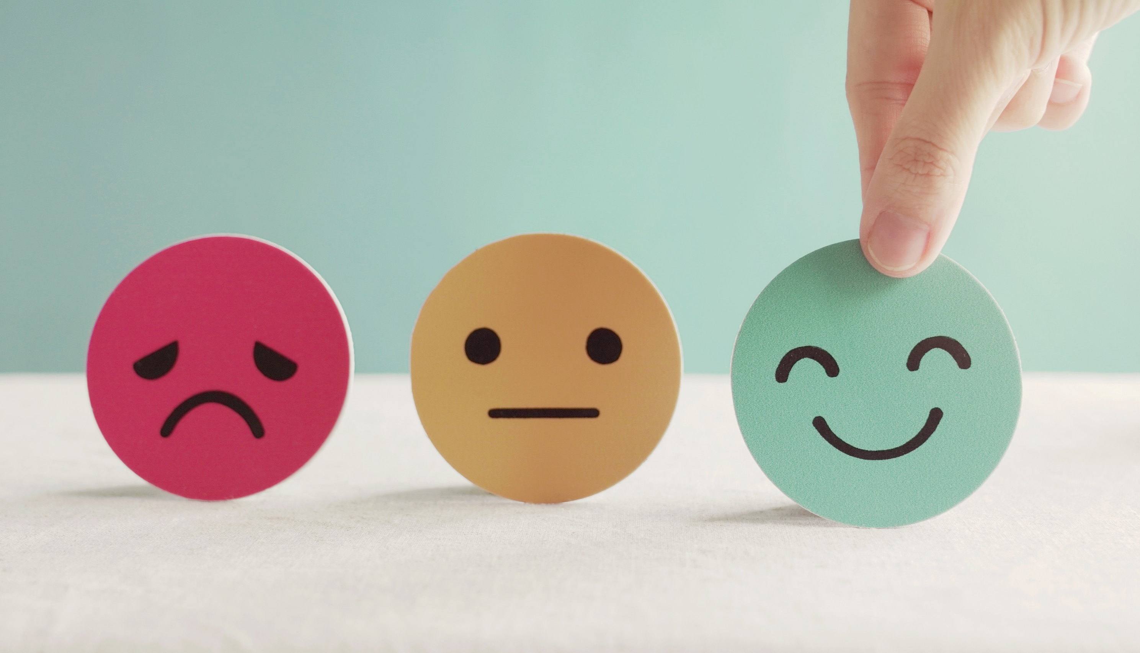
Lesson 3
Stay positive and have a nice day!

