Slide 1

Unit 1: Health and Healthy Lifestyle
Lesson 3.2: Speaking & Writing
Page: 13

Slide 2
Lesson Outline
Warm-up
Speaking
Writing
Consolidation
Wrap-up

Slide 3

By the end of this lesson, students will be able to…
- talk about ways to improve health and life expectancy.
- write an article about ways to live longer and healthier.
- writing short articles in the form of a list.

Slide 4

WARM UP

Slide 5

Work in pairs
Fill in the blank with words from the box.
expectancy exercise sleep risk stressed
1. Eating healthily can increase your life __________.
2. You need to get enough ________ if you want clear skin.
3. _________ daily if you want to lose weight.
4. Try to relax if you feel ________ out.
5. If you eat too much meat, you will be at _________ of heart diseases.
expectancy
sleep
Exercise
stressed
risk

Slide 6

Speaking

Slide 7




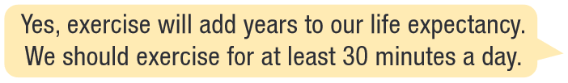
Work in pairs

Slide 8
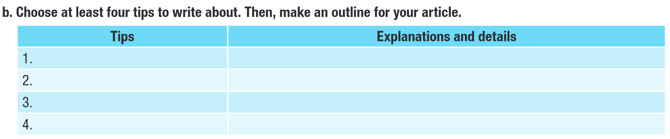
Example:
exercise regularly
increases life expectancy; 30 minutes a day

Slide 9

Writing

Slide 10
Pre – Writing
Read the instruction quickly. Underline the key words.
What are we going to do?
Read the Writing Skill box.
Read the listicle on page 12.
Answer the question.

Slide 11
Pre – Writing
Read the instruction quickly. Underline the key words.
What are we going to do?
Unscramble the sentences.
Write either I or C or B for each sentence.

Slide 12
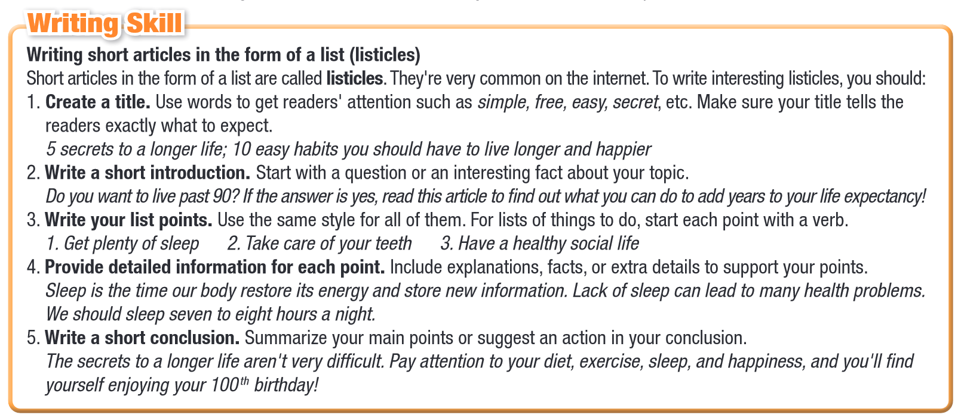

Slide 13
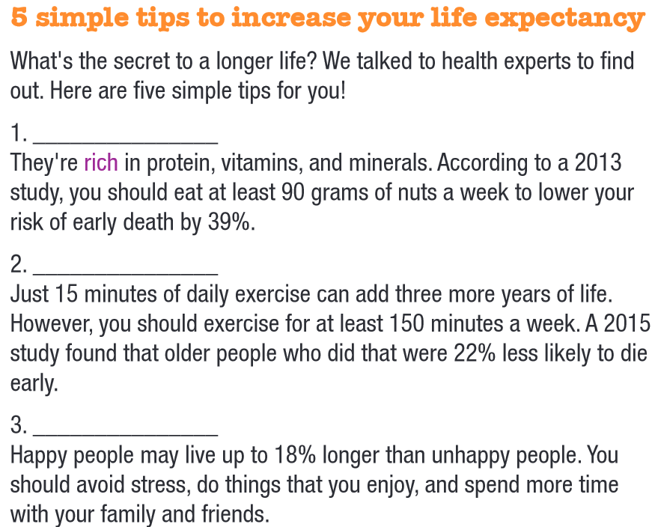
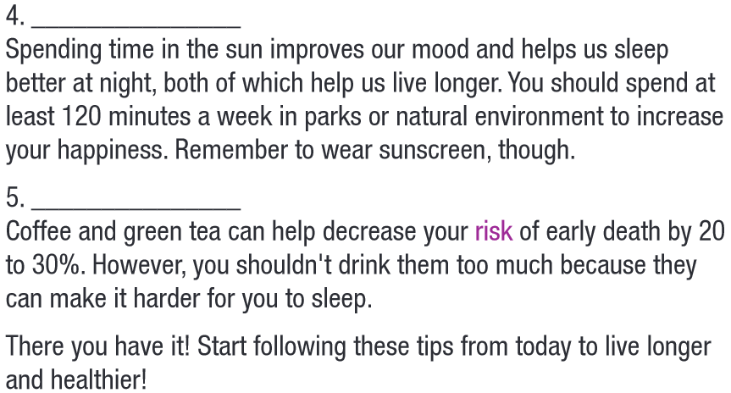
Add nuts to your diet
Go outside
Stay active
Drink coffee or tea
Smile!

Slide 14
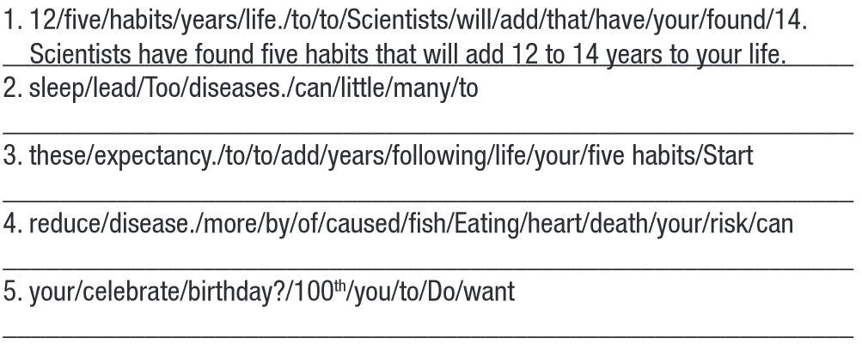

Too little sleep can lead to many diseases.
B
Start following these five habits to add years to your life expectancy.
C
Eating more fish can reduce your risk of death caused by heart disease.
B
Do you want to celebrate your 100th birthday?
I

Slide 15
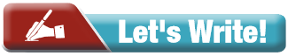
Write a short article in the form of a list about what people should do to live longer and healthier for your school’s newsletter. Write about at least four tips.
Use the Writing Skill box, the reading model, and your speaking notes to help you.
Write 150 – 180 words.
Your article should:
follow the model and have an explanation for each point.
be easy to understand.
be interesting.

Slide 16
EXAMPLE
4 SECRETS TO LIVE HEALTHIER
Do you want to live a long and happy life? Here are four simple tips to help you live longer and healthier:
Exercise regularly: Exercise is important for losing weight and reducing the risk of heart diseases. Try to exercise for at least 30 minutes a day, such as walking, running, or swimming.
Eat a healthy diet: Eating a balanced and nutritious diet can help you maintain a healthy weight and improve overall health. Make sure to include plenty of fruits, vegetables, whole grains, protein, and healthy fats in your diet.
Get enough sleep: Getting enough sleep can help improve memory, mood, and concentration, as well as reduce the risk of many diseases. Try to get 8 hours of sleep a day.
Manage stress: Stress can have negative effects on both physical and mental health. Learning ways to reduce stress, such as meditation or yoga, can help improve overall health.
Start following these simple tips today to become healthier!
TITLE
INTRODUCTION
LIST
DETAILED INFORMATION
CONCLUSION

Slide 17

CONSOLIDATION

Slide 18
Write a few sentences about habits you have that aren’t good for you and explain why it is bad.
You may use:
I have a habit of … It is bad for me because …
Example: I have a habit of playing too much video games. It is bad for me because it hurts my eyes when I look at the computer screen for too long.

Slide 19

WRAP-UP

Slide 20
Today’s lesson
Speaking:
- Talking about ways to improve life expectancy.
Writing:
- Writing a short article in the form of a list.
- Writing an article about ways to live longer and healthier.

Slide 21
Homework
Practice talking about ways to improve life expectancy.
Do the exercises in WB: Lesson 3 – Writing (page 7).
Prepare: Unit 2 – Lesson 1 – Vocabulary & Reading (Pages 14 & 15 SB).
Play the consolidation games on www.eduhome.com.vn

Slide 22

Lesson 3
Stay positive and have a nice day!

