Slide 1

Unit 1: Health and Healthy Lifestyle
Lesson 2.2: Grammar
Pages: 9 & 10

Slide 2
Lesson Outline
Warm-up
Grammar
Consolidation
Wrap-up

Slide 3

By the end of this lesson, students will be able to…
- talk about healthy lifestyles.
- practice using quantifiers.

Slide 4

WARM UP

Slide 5
JUMBLED WORDS
Rearrange the letters to make meaningful words
1. eifntss
2. stesdres
3. soailc iefl
4. baelcand eitd
5. mgeana
1. fitness
2. stressed
3. social life
4. balanced diet
5. manage
ANSWER

Slide 6

Presentation

Slide 7

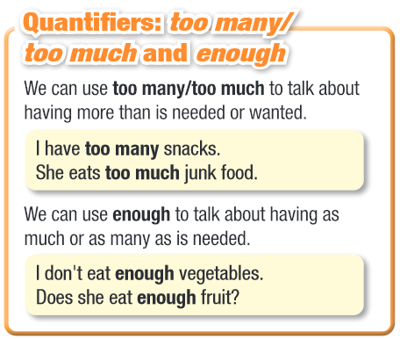

Slide 8
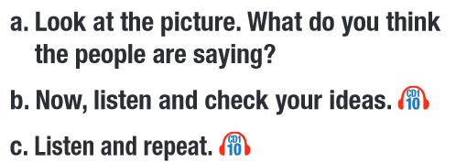
Read the instruction. What are you going to do?
- Guess what the people are saying.
- Listen and check the answers.
- Listen and repeat.

Slide 9
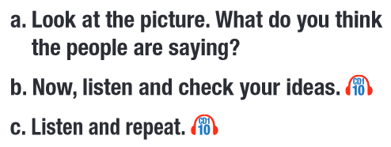
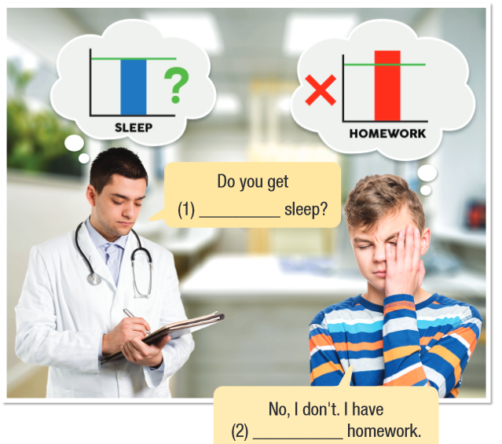

Do you get _______ sleep?
No, I don’t. I have _________ homework.
Do you get enough sleep?
No, I don’t. I have too much homework.

Slide 10
Practice

Slide 11

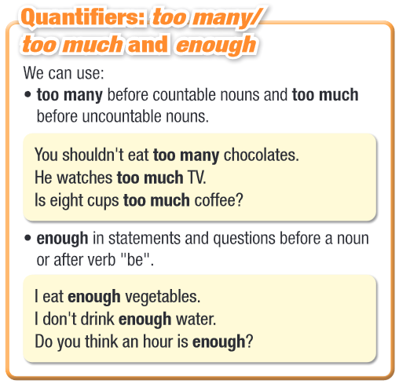

Slide 12
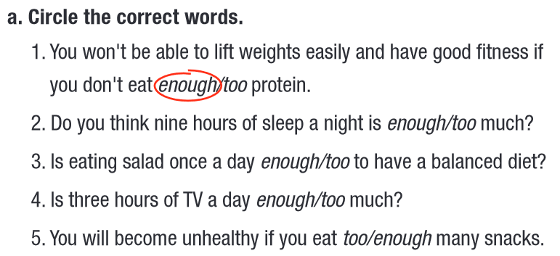

Slide 13
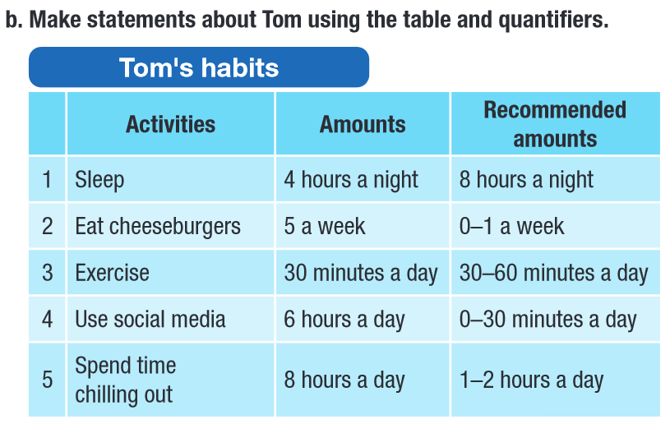
Example: 1. Tom doesn’t get enough sleep.

Slide 14
1. Tom doesn’t get enough sleep.
2. Tom eats too many cheeseburgers.
3. Tom gets enough exercise.
4. Tom uses too much social media.
5. Tom spends too much time chilling out.

Slide 15
b. Unscramble the sentences.
2. much/eats/fast/food./too/She
___________________________________
3. time/you/enough/to/out?/Do/have/chill
___________________________________
4. shouldn’t/much/drink/soda./too/You
___________________________________
5. sure/you/enough/vegetables./Make/eat
___________________________________
Extra Practice,
WB page 5
b. Unscramble the sentences.
2. much/eats/fast/food./too/She
She eats too much fast food.
3. time/you/enough/to/out?/Do/have/chill
Do you have enough time to chill out?
4. shouldn’t/much/drink/soda./too/You
You shouldn’t drink too much soda.
5. sure/you/enough/vegetables./Make/eat
Make sure you eat enough vegetables.

Slide 16
Production

Slide 17
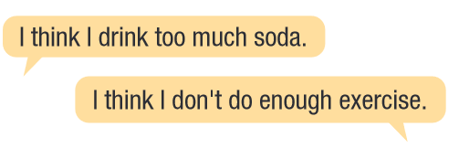

Work in pairs
c. What things do you think you do too much? What don’t you think you do enough?

Slide 18

CONSOLIDATION

Slide 19
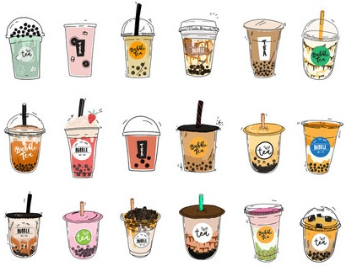
Make a few sentences about what food you should eat more or less of.

Slide 20

WRAP-UP

Slide 21
Today’s lesson
Grammar:
- Using quantifiers.
Speaking:
- Talking about healthy lifestyles.

Slide 22
Homework
Practice making sentences using quantifiers.
Do the exercises: Grammar (page 5 WB).
Prepare the next lesson: Pronunciation (pages 10 & 11 SB).
Play the consolidation games on www.eduhome.com.vn

Slide 23
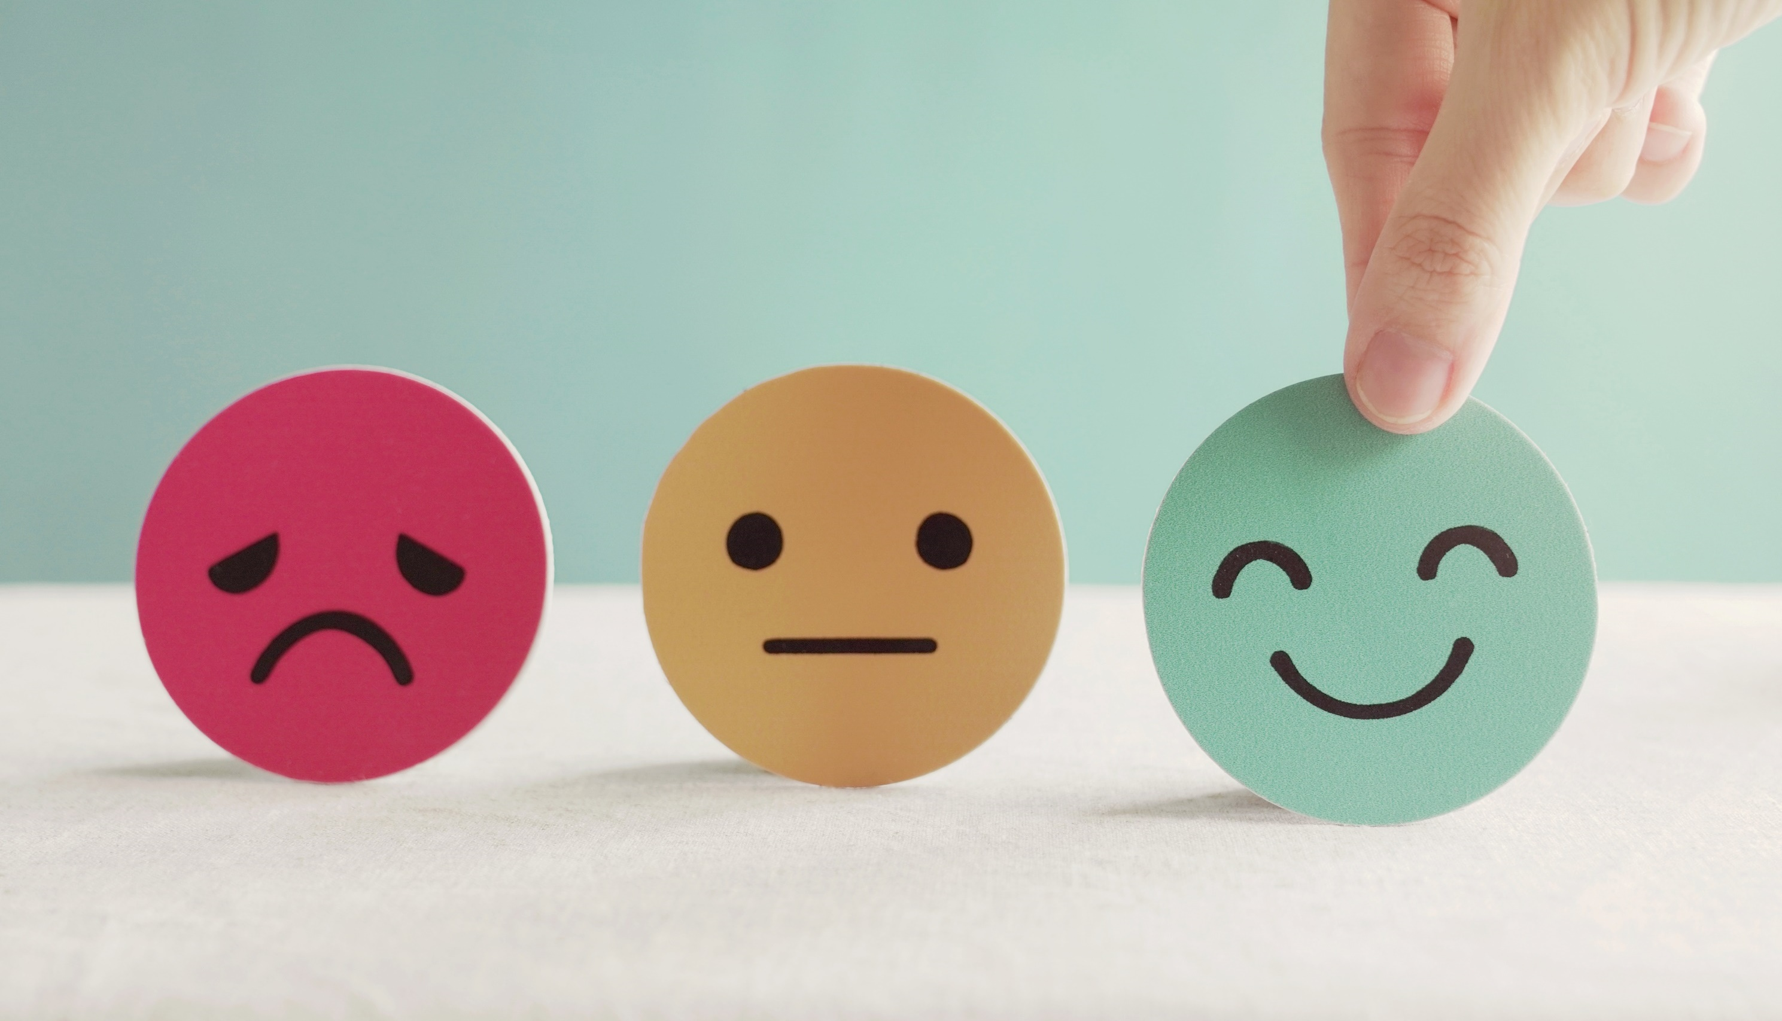
Lesson 3
Stay positive and have a nice day!

