Slide 1

Unit 1: Health and Healthy Lifestyle
Lesson 2.1: Vocab & Listening
Pages: 8 & 9

Slide 2
Lesson Outline
Warm-up
Vocabulary
Listening
Consolidation
Wrap-up

Slide 3

By the end of this lesson, students will be able to…
- learn and use vocabulary related to healthy lifestyle.
- practice listening for main idea and specific information.
- learn and practice functional English (giving opinions).

Slide 4

New words
fitness
manage
stressed
chill out
social life
lift weights
balanced diet

Slide 5

WARM UP

Slide 6


Slide 7

Work in pairs
1 Which of these things are healthy?
2 Which do you do?
3 What other things you can do to have a healthy life?

Slide 8



Slide 9
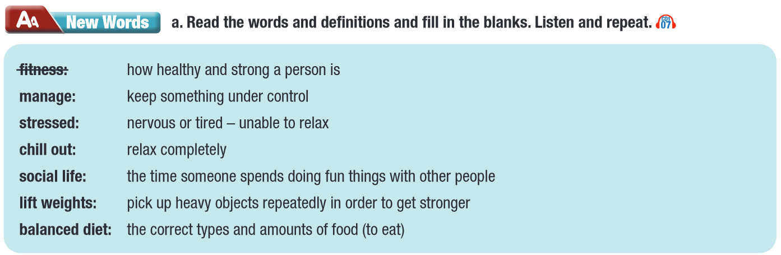


Slide 10
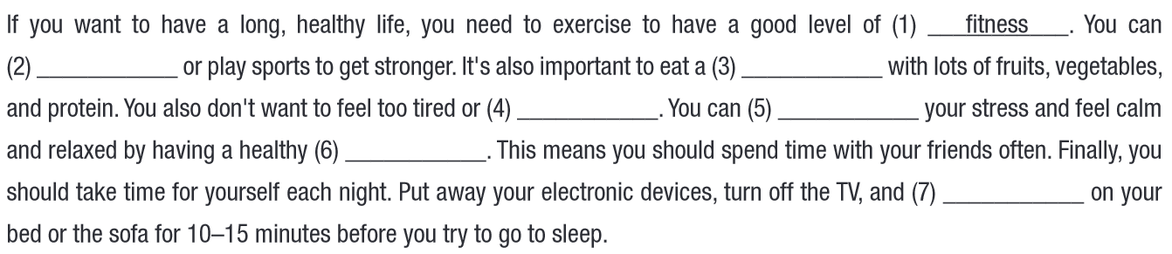
fitness manage stressed chill out
social life lift weights balanced diet
Show answer
balanced diet
lift weights
stressed
manage
social life
chill out

Slide 11
Listen and repeat. Click on each phrase to hear the sound.
fitness (n) /ˈfɪtnəs/ thể trạng
manage (v) /ˈmænɪdʒ/ quản lí
stressed (adj) /strɛst/ căng thẳng
social life (n) /ˈsoʊʃl ˌlaɪf/ đời sống xã hội
lift weights (v phr) /lɪft weɪts/ nâng tạ, tập tạ
balanced diet (n) /ˌbælənst ˈdaɪət/ chế độ ăn uống cân bằng
chill out (v) /ʧɪl aʊt/ thư giãn một cách thoải mái
Notes:
GV click vào từng cụm nghe âm thanh

Slide 12
Practice saying these words with a partner.
fitness (n) /ˈfɪtnəs/ thể trạng
manage (v) /ˈ mænɪdʒ / quản lí
stressed (adj) / strɛst / căng thẳng
social life (n) /ˈsoʊʃl ˌlaɪf/ đời sống xã hội
lift weights (v phr) /lɪft weɪts/ nâng tạ, tập tạ
balanced diet (n) /ˌbælənst ˈdaɪət/ chế độ ăn uống cân bằng
chill out (v) /ʧɪl aʊt/ thư giãn một cách thoải mái
Notes:
GV click vào từng cụm nghe âm thanh

Slide 13

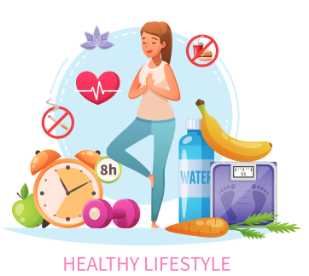


Slide 14

Listening

Slide 15
Pre – Listening
Read the instruction quickly. Underline the key words.
What are we going to do?
Listen and find out what kind of show is it.

Slide 16
While – Listening
Now listen and circle the correct answer.
Show answer
Show script
Host: Welcome to another episode of Health Nuts. Today, I’m joined by Dr. Dorothy Allen. She’s here to discuss her new book, Forever Young.

Slide 17

Pre – Listening
Read the instruction quickly. Underline the key words.
What are we going to do?
Listen and answer the questions.

Slide 18
Pre – Listening
Read the questions. Highlight the key words.
1. What does Dorothy Allen say is the main thing we need to do to be healthy?
2. What does the host not let her child do on Saturdays and Sundays?
3. What type of sleep improves our ability to control our feelings and avoid getting stressed?
4. What does Dorothy Allen say people shouldn’t eat?
5. How many days a week should you spend relaxing?
1. What does Dorothy Allen say is the main thing we need to do to be healthy?
2. What does the host not let her child do on Saturdays and Sundays?
3. What type of sleep improves our ability to control our feelings and avoid getting stressed?
4. What does Dorothy Allen say people shouldn’t eat?
5. How many days a week should you spend relaxing?

Slide 19
While – Listening
Listen and answer the questions.
1. What does Dorothy Allen say is the main thing we need to do to be healthy?
2. What does the host not let her child do on Saturdays and Sundays?
3. What type of sleep improves our ability to control our feelings and avoid getting stressed?
4. What does Dorothy Allen say people shouldn’t eat?
5. How many days a week should you spend relaxing?

Slide 20
While – Listening
Listen again and check your answers.
Show answers
Show script
1. What does Dorothy Allen say is the main thing we need to do to be healthy?
→ get enough sleep
Host: Let’s get to it. My listeners want to know what they can do to have a healthier life.
Dr. Allen: I think the most important thing is to get enough sleep.

Slide 21
While – Listening
Listen again and check your answers.
Show answers
Show script
2. What does the host not let her child do on Saturdays and Sundays?
→ get too much sleep
Host: How much sleep do you think people need?
Dr. Allen: In my opinion, you need to give yourself seven to nine hours in bed each night, and research supports that.
Host: My teenage son always wants to sleep in on the weekends and I try not to let him get too much sleep. Do teens need more sleep?

Slide 22
While – Listening
Listen again and check your answers.
Show answers
Show script
3. What type of sleep improves our ability to control our feelings and avoid getting stressed?
→ early morning sleep
Dr. Allen: It’s especially important for teenagers because their brains and bodies are developing. Early morning sleep helps us repair our minds, which helps us manage our feelings and avoid getting too stressed.

Slide 23
While – Listening
Listen again and check your answers.
Show answers
Show script
4. What does Dorothy Allen say people shouldn’t eat?
→ too much added sugar
Host: Wow. How about fitness?
Dr. Allen: It’s a mix of diet and exercise. You need to make sure you eat enough meat and vegetables to have a balanced diet and avoid eating too much added sugar.

Slide 24
While – Listening
Listen again and check your answers.
Show answers
Show script
5. How many days a week should you spend relaxing?
→ two
Host: And exercise?
Dr. Allen: I believe you need to decide if you want to focus on lifting weights or improve your heart health. Spend three days a week on the one you want to focus on, and two days on the other. Then give yourself two days to chill out and keep a healthy social life.

Slide 25
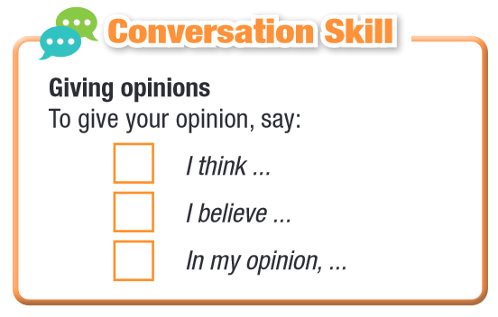
While – Listening

Slide 26

While – Listening
Show answers
1
3
2

Slide 27

Post - Listening
Work in pairs
Do you exercise often?
Yes, I do. I often lift weights to stay fit.
What about you?

Slide 28
Host: Welcome to another episode of Health Nuts. Today, I'm joined by Dr. Dorothy Allen. She's here to discuss her new book, Forever Young.
Dr. Allen: Thanks for having me.
Host: Let's get to it. My listeners want to know what they can do to have a healthier life.
Dr. Allen: I think the most important thing is to get enough sleep.
Host: How much sleep do you think people need?
Dr. Allen: In my opinion, you need to give yourself seven to nine hours in bed each night, and research supports that.
Host: My teenage son always wants to sleep in on the weekends and I try not to let him get too much sleep. Do teens need more sleep?
Dr. Allen: It's especially important for teenagers because their brains and bodies are developing. Early morning sleep helps us repair our minds, which helps us manage our feelings and avoid getting too stressed.
Host: Wow. How about fitness?
Dr. Allen: It's a mix of diet and exercise. You need to make sure you eat enough meat and vegetables to have a balanced diet and avoid eating too much added sugar.
Host: And exercise?
Dr. Allen: I believe you need to decide if you want to focus on lifting weights or improving your heart health. Spend three days a week on the one you want to focus on, and two days on the other. Then give yourself two days to chill out and keep a healthy social life.
Host: Can you tell our listeners more ...

Slide 29

CONSOLIDATION

Slide 30
Write a few sentences about habits you should or should not have and explain why.
You may start with:
I think… or
I believe… or
In my opinion,…

Slide 31

WRAP-UP

Slide 32
Today’s lesson
Vocabularies
fitness
manage
stressed
chill out
social life
lift weights
balanced diet

Slide 33
Today’s lesson
Listening:
- Listening for main idea and specific information.
Speaking:
- Talking about healthy habits.

Slide 34
Homework
Learn by hearts vocabularies and make sentences using them.
Do the Vocab. + Listening exercises on page 4 WB.
Prepare the next lesson (Grammar - pages 9 & 10 SB)
Play the consolidation games on www.eduhome.com.vn

Slide 35

Lesson 3
Stay positive and have a nice day!

