Slide 1

Unit 1: Health and Healthy Lifestyle
Lesson 1.3: Pronunciation & Speaking
Pages: 6 & 7

Slide 2
Lesson Outline
Warm-up
Pronunciation
Speaking
Consolidation
Wrap-up

Slide 3

By the end of this lesson, students will be able to…
- talk about healthy diets.
- pronounce the sound /ks/ correctly.

Slide 4

WARM UP

Slide 5

Work in pairs
Choose the word whose underlined part is pronounced differently from that of the other words.
A. flood B. food C. tool D. pool
2. A. diet B. knit C. hide D. diary
3. A. chicken B. church C. machine D. chance
/flʌd/
/fud/
/tul/
/pul/
/ˈdaɪət/
/nɪt/
/haɪd/
/ˈdaɪri/
/ˈʧɪkɪn/
/ʧɜːrʧ/
/məˈʃiːn/
/ʧæns/

Slide 6
Work in pairs
Choose the word whose main stress is placed
differently from the others.
A. protein B. provide C. product D. promise
2. A. healthy B. unhealthy C. costly D. dairy
3. A. processed B. protein C. avoid D. limit
/ˈproʊtiːn/
/prəˈvaɪd/
/ˈprɑːdʌkt/
/ˈprɑːmɪs/
/ˈhɛlθi/
/ʌnˈhɛlθi/
/ˈkɑːstli/
/ˈdɛri/
/ˈprəsɛst/
/ˈproʊtiːn/
/əˈvɔɪd/
/ˈlɪmɪt/

Slide 7



Slide 8
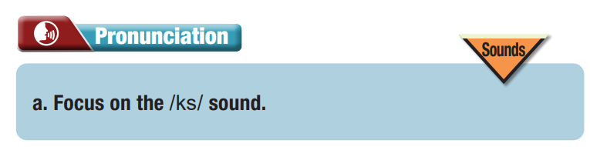
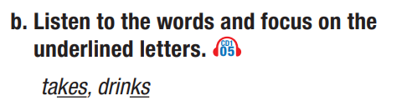


Slide 9
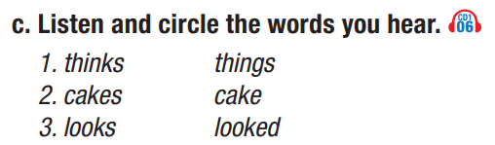


Slide 10

Speaking

Slide 11


Read the instruction. What are you going to do?
Ask about and describe food using verbs in the box.

Slide 12
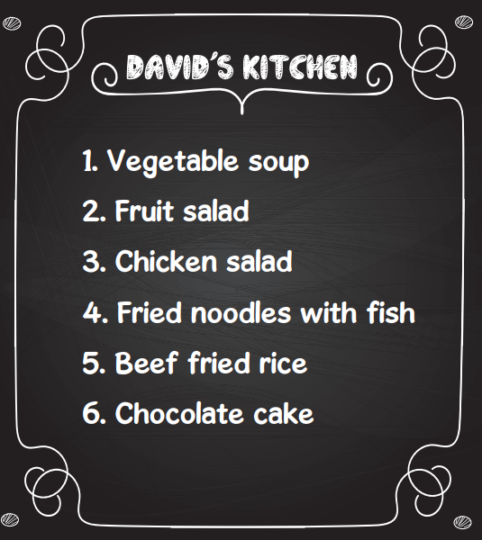
Sample conversation
Which dish do you think tastes good?
I think beef fried rice tastes good.
Is beef fried rice healthy?
I think beef is healthy. But, we should limit how much fried rice we eat.

Slide 13
Sample answers
I would eat vegetable soup for lunch because it’s good for your health.
I think chocolate cake should be eaten in small amounts because it has a lot of sugar.

Slide 14
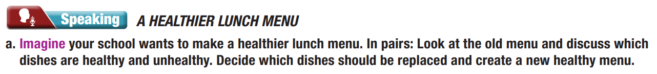
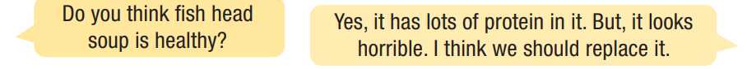
Read the instruction. What are you going to do?
- Discuss which dishes are healthy and unhealthy.
- Decide which dishes should be replaced.
- Create a healthy menu.

Slide 15
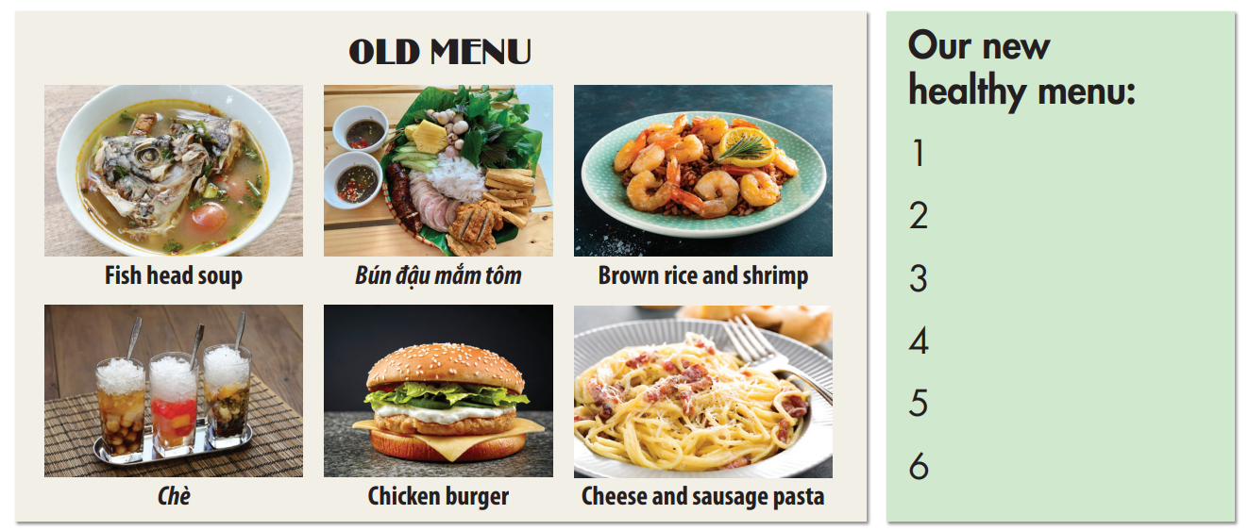

Slide 16
Work in groups
In our group, we didn’t replace the fish head soup because it looks nutritious.
Our group replaced chè because it has a lot of sugar, which is not good for your health.

Slide 17

CONSOLIDATION

Slide 18
Write a few sentences about your favorite food and say whether it is healthy or unhealthy.
You may begin with:
My favorite food is…..

Slide 19

WRAP-UP

Slide 20
Today’s lesson
Speaking:
- Talking about healthy diets.
- Pronouncing the sound /ks/ correctly.

Slide 21
Homework
Make sentences using words with the /ks/ sound and practice saying them.
Do the exercises on page 3 - WB.
Prepare the next lesson (Vocab & Listening - pages 8 & 9 SB)
Play the consolidation games on www.eduhome.com.vn

Slide 22

Lesson 3
Stay positive and have a nice day!

