Slide 1

Unit 1: Health and Healthy Lifestyle
Lesson 1.2: Grammar
Pages: 5 & 6

Slide 2
Lesson Outline
Warm-up
Grammar
Consolidation
Wrap-up

Slide 3
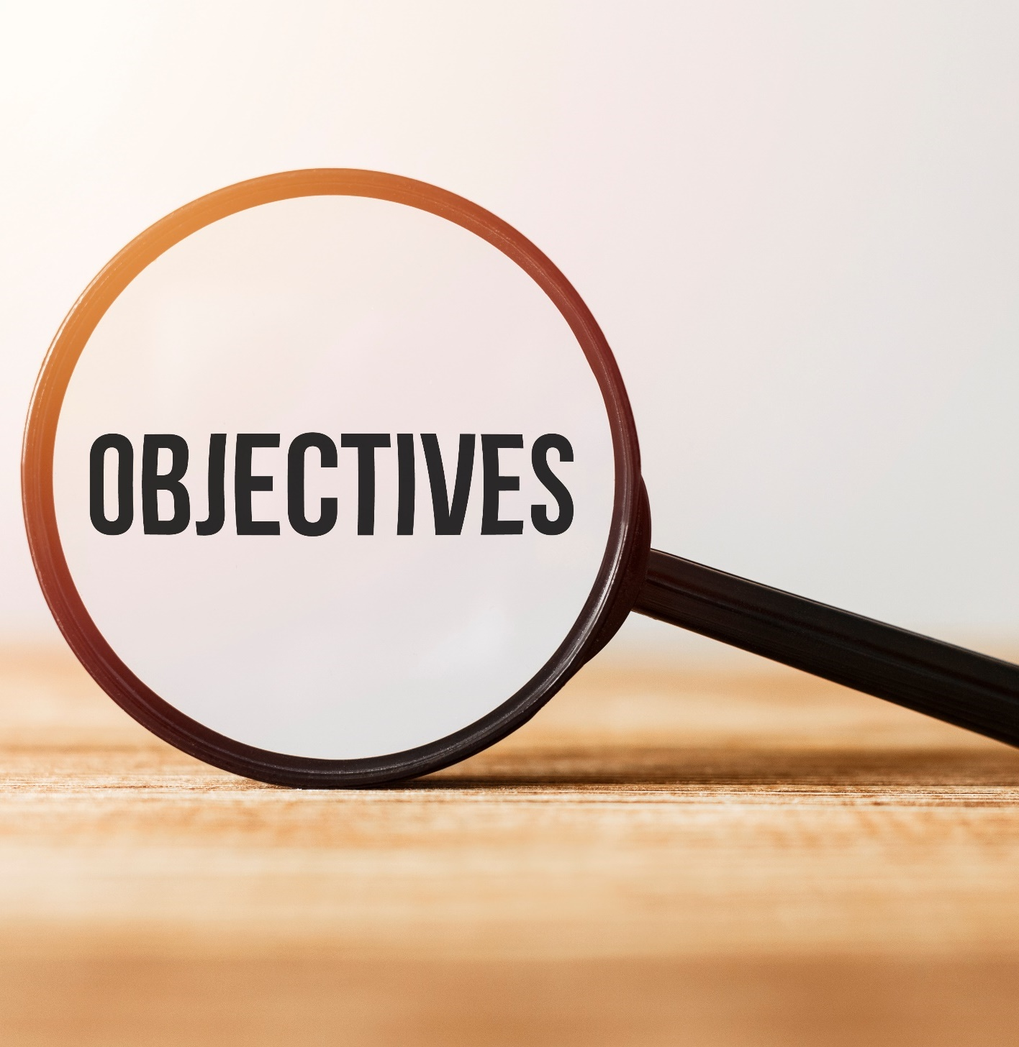
By the end of this lesson, students will be able to…
- talk about favorite food.
- practice using Linking verbs.

Slide 4

WARM UP

Slide 5
JUMBLED WORDS
Rearrange the letters to make meaningful words.
1. roipnte
2. irdya
3. ioadv
4. imtil
5. orpcsdees
1. protein
2. dairy
3. avoid
4. limit
5. processed
ANSWER

Slide 6

Presentation

Slide 7

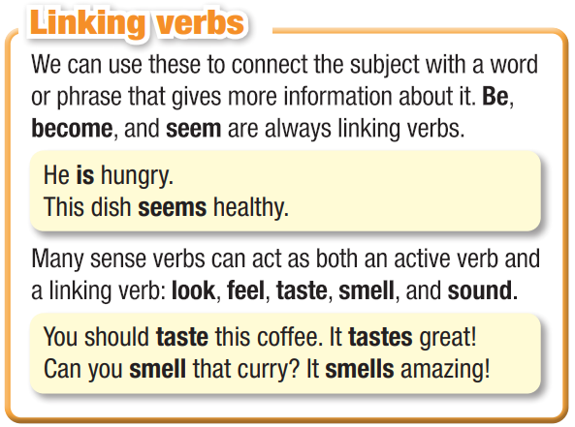

Slide 8
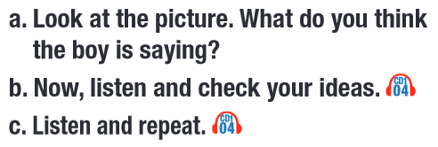
Read the instruction. What are you going to do?
- Guess what the people are saying.
- Listen and check the answers.
- Listen and repeat.

Slide 9
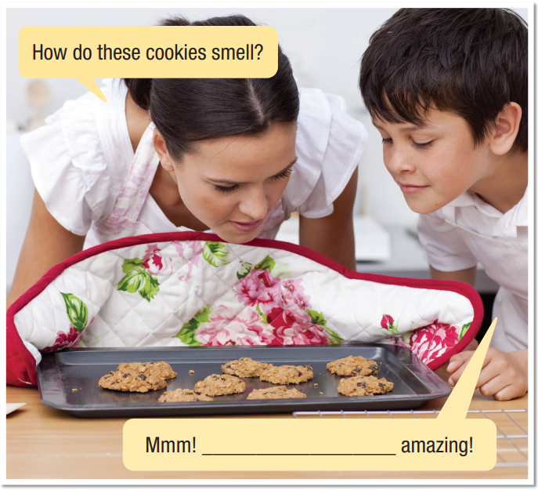

How do these cookies smell?
Mmm! _____________ amazing!
How do these cookies smell?
Mmm! They smell amazing!

Slide 10
Practice

Slide 11

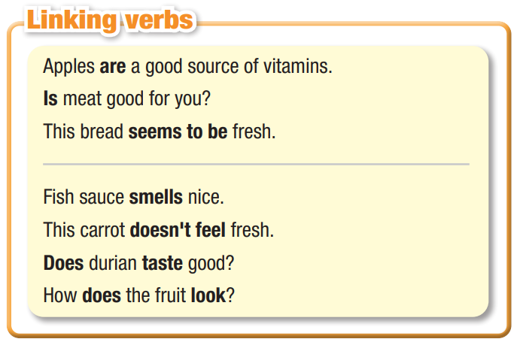

Slide 12
b. Circle the linking verbs.
Do you like the smell of durian? I think it smells pretty good.
I’m looking at the new menu on their website. It looks really healthy.
Wow! This tastes great. You should taste it.
That bread smells great! Can you smell it?
Let’s look for a place to eat. Oh, this looks delicious!

Slide 13
Unscramble the sentences.
1. healthy/rice/carbohydrate./Brown/is/a
___________________________________
2. meats/good/of/aren’t/a/source/Processed/protein.
___________________________________
3. healthy./really/This/looks/menu
___________________________________
Unscramble the sentences.
1. healthy/rice/carbohydrate./Brown/is/a
Brown rice is a healthy carbohydrate.
2. meats/good/of/aren’t/a/source/Processed/protein.
Processed meats aren’t a good source of protein.
3. healthy./really/This/looks/menu
This menu looks really healthy.

Slide 14
4. yogurt/source/Is/good/a/of/dairy?
___________________________________
5. food/the/look?/does/How
___________________________________
6. fried/you/good?/Do/think/smells/food
___________________________________
7. tastes/the/best?/dish/Which
___________________________________
4. yogurt/source/Is/good/a/of/dairy?
Is yogurt a good source of dairy?
5. food/the/look?/does/How
How does the food look?
6. fried/you/good?/Do/think/smells/food
Do you think fried food smells good?
7. tastes/the/best?/dish/Which
Which dish tastes the best?

Slide 15
Extra Practice,
WB page 3
b. Write sentences using the prompts.
1. whole grains/be/healthy/than/processed grains
___________________________________
2. you/feel/OK/today?
___________________________________
3. eat/a lot of sugar/not seem/good idea
___________________________________
b. Write sentences using the prompts.
1. whole grains/be/healthy/than/processed grains
Whole grains are healthier than processed grains.
2. you/feel/OK/today?
Do you feel OK today?
3. eat/a lot of sugar/not seem/good idea
Eating a lot of sugar doesn’t seem like a good idea.

Slide 16
Production

Slide 17

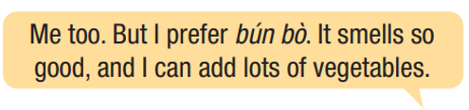

Work in pairs
c. Say what your favorite food is and say why you like it.

Slide 18

CONSOLIDATION

Slide 19
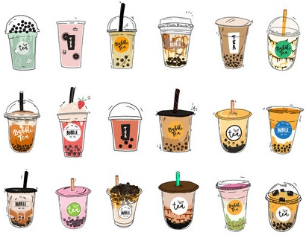
Talk about foods you like to eat that aren’t good for your health. Use Linking verbs in your talk.

Slide 20

WRAP-UP

Slide 21
Today’s lesson
Grammar:
- Using Linking verb.
Speaking:
- Talking about favorite food.

Slide 22
Homework
Make sentences using Linking verbs.
Do the exercises on pages 2 & 3 WB.
Prepare the next lesson (Pronunciation and Speaking -pages 6 & 7 SB)
Play the consolidation games on www.eduhome.com.vn

Slide 23

Lesson 3
Stay positive and have a nice day!

