Slide 1

Unit 1: Health and Healthy Lifestyle
Lesson 1.1: Vocab & Reading
Pages: 4 & 5

Slide 2
Lesson Outline
Warm-up
Vocabulary
Reading
Consolidation
Wrap-up

Slide 3

By the end of this lesson, students will be able to…
- talk about healthy diets.
- practice reading for main ideas and details.

Slide 4

New words
avoid
limit
protein
dairy
processed
carbohydrates

Slide 5

WARM UP

Slide 6
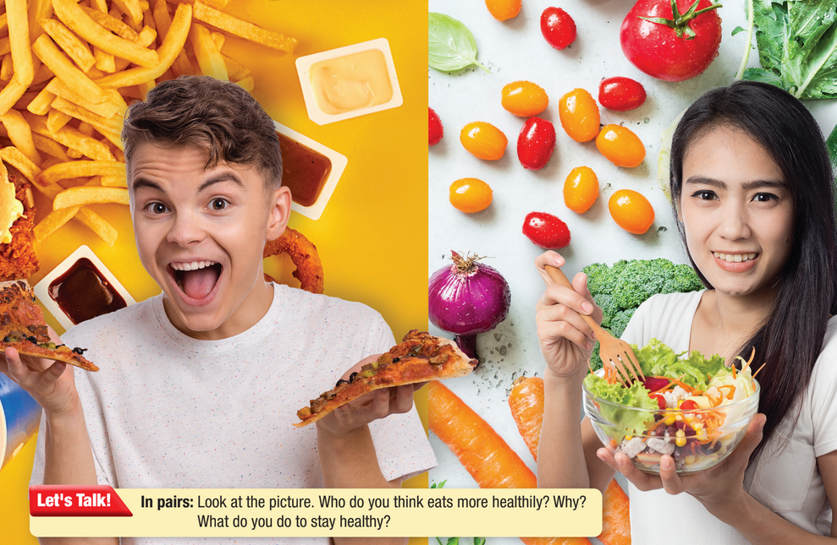

Slide 7

Work in pairs
1 What types of food are in the picture?
2 Who do you think eats more healthily? Why?
3 What do you do to stay healthy?

Slide 8



Slide 9
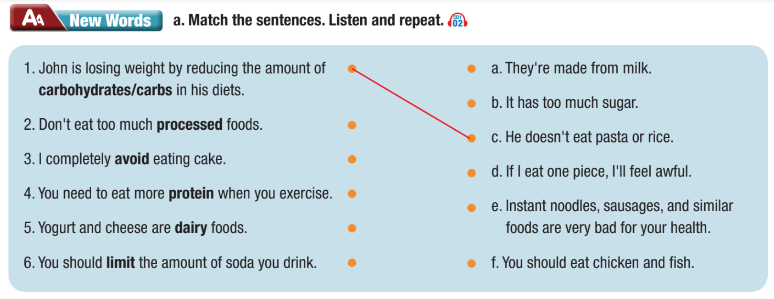

Slide 11

Listen and repeat. Click on each phrase to hear the sound.
avoid (v) /əˈvɔɪd/ tránh
limit (v) /ˈlɪmɪt/ hạn chế, giới hạn
protein (n) /ˈproʊtiːn/ chất đạm
dairy (adj) /ˈderi/ làm từ sữa
processed (adj) /ˈprɑːsest/ đã qua chế biến
carbohydrates (n) /ˌkɑːrboʊˈhaɪdreɪt/ chất đường bột
Notes:
GV click vào từng cụm nghe âm thanh

Slide 12
Practice saying these words with a partner.
avoid (v) /əˈvɔɪd/ tránh
limit (v) /ˈlɪmɪt/ hạn chế, giới hạn
protein (n) /ˈproʊtiːn/ chất đạm
dairy (adj) /ˈderi/ làm từ sữa
processed (adj) /ˈprɑːsest/ đã qua chế biến
carbohydrates (n) /ˌkɑːrboʊˈhaɪdreɪt/ chất đường bột
Notes:
GV click vào từng cụm nghe âm thanh

Slide 13
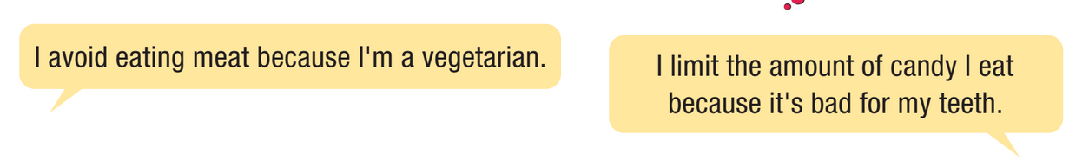

Work in pairs
b. Talk about which foods you limit or avoid eating. Why?

Slide 14

Reading

Slide 15
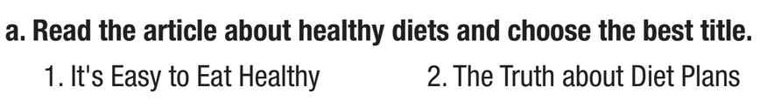
Pre - reading
Read the instruction quickly. Underline the key words.
What are we going to do?
Read and choose the best title.

Slide 16
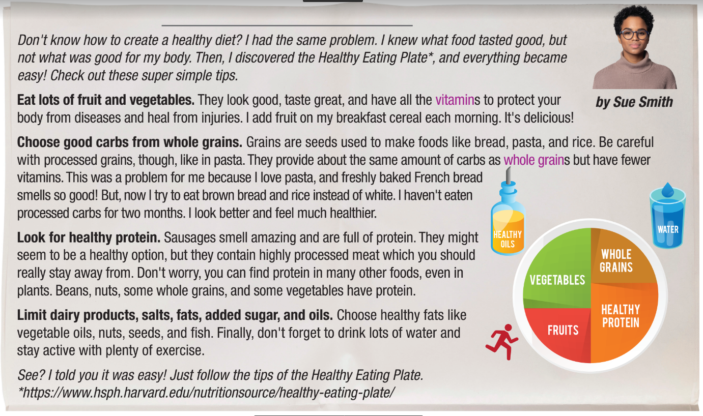
While - reading
Skim the text. Underline the key words. Choose the best title.
It’s Easy to Eat Healthy

Slide 17
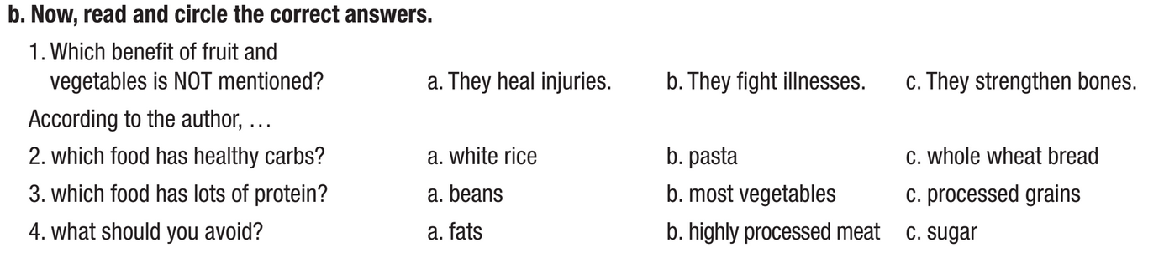
Pre - reading
Read the instruction quickly. Underline the key words.
What are we going to do?
Read and circle the correct answers.

Slide 18
Pre - reading
Read the questions. Highlight the key words.
1. Which benefit of fruit and vegetables is NOT mentioned?
They heal injuries. b. They fight illnesses. c. They strengthen bones.
2. Which food has healthy carbs?
white rice b. pasta c. whole wheat bread
3. Which food has lots of protein?
beans b. most vegetables c. processed grains
4. What should you avoid?
a. fats b. highly processed meat c. sugar

Slide 19
Pre - reading
Read the questions. Highlight the key words.
1. Which benefit of fruit and vegetables is NOT mentioned?
They heal injuries. b. They fight illnesses. c. They strengthen bones.
2. Which food has healthy carbs?
white rice b. pasta c. whole wheat bread
3. Which food has lots of protein?
beans b. most vegetables c. processed grains
4. What should you avoid?
a. fats b. highly processed meat c. sugar

Slide 20
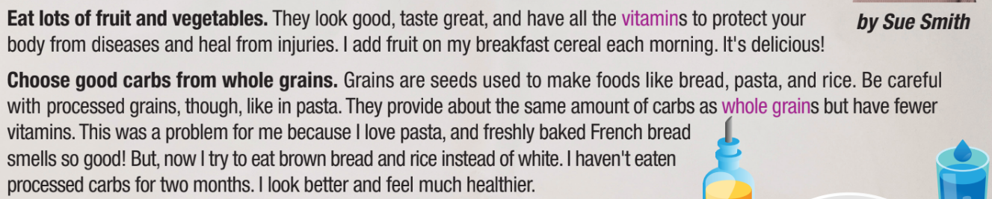
While - reading
Scan the text. Circle the answer.
1. Which benefit of fruit and vegetables is NOT mentioned?
They heal injuries. b. They fight illnesses. c. They strengthen bones.

Slide 21
While - reading
Scan the text. Circle the answer.
2. Which food has healthy carbs?
white rice b. pasta c. whole wheat bread

Slide 22
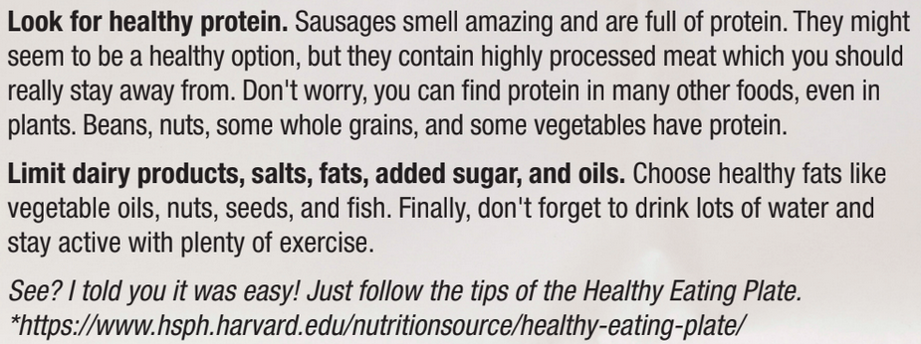
While - reading
Scan the text. Circle the answer.
3. Which food has lots of protein?
beans b. most vegetables c. processed grains

Slide 23
While - reading
Scan the text. Circle the answer.
4. What should you avoid?
a. fats b. highly processed meat c. sugar

Slide 24

Post - reading
Work in pairs
How does your diet compare to the Healthy Eating Plate? What foods do you need to eat more or less?
I need to drink less soda.
I need to eat more vegetables.

Slide 25

CONSOLIDATION

Slide 26
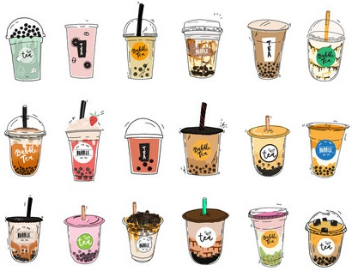
What foods do young people like to eat that are not good for your health?

Slide 27

WRAP-UP

Slide 28
Today’s lesson
Vocabularies
avoid
limit
protein
dairy
processed
carbohydrates

Slide 29
Today’s lesson
Reading:
- Understanding instructions.
Skimming and scanning for general and specific information.
Speaking:
- Talking about healthy diets.

Slide 30
Homework
Learn by hearts vocabularies and make sentences using them.
Do the exercises on pages 2 & 3 WB.
Prepare the next lesson (Grammar pages 6 & 7 SB)
Play the consolidation games on www.eduhome.com.vn

Slide 31

Lesson 3
Stay positive and have a nice day!

