Slide 1
Unit 6
Lesson 2.2: Grammar
Pages: 63 & 64

Slide 2
Lesson Outline
Warm-up
Grammar
Consolidation
Wrap-up

Slide 3
By the end of this lesson,
students will be able to:
practice and use Should correctly.

Slide 4
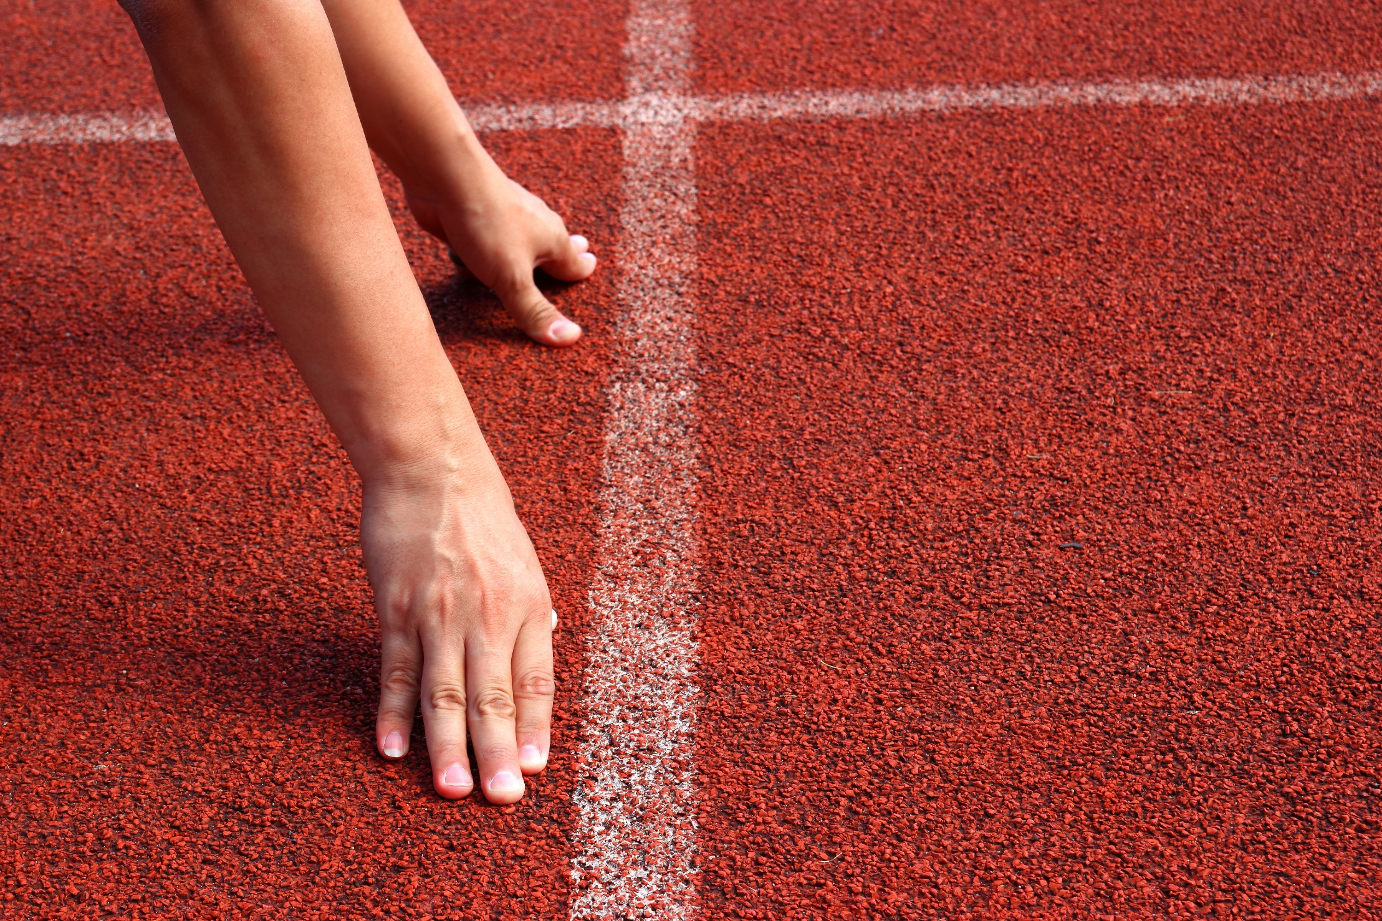

Slide 5
STOP THE BUS!
 | Health | Countries | Generation gap | Global warming | World Heritages
P | protein | Poland | privacy | pandemic | preserve
S
…
…
…

Slide 6
Presentation

Slide 8
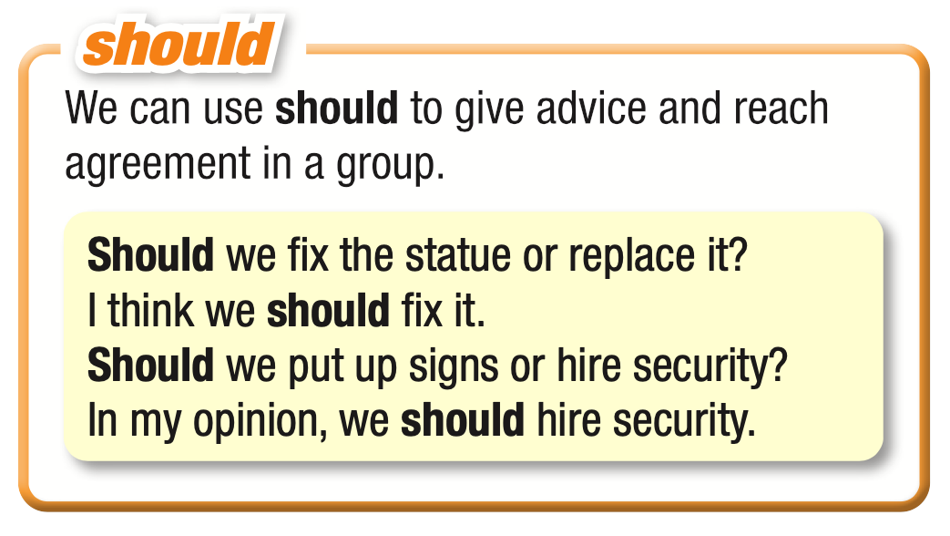

Slide 9
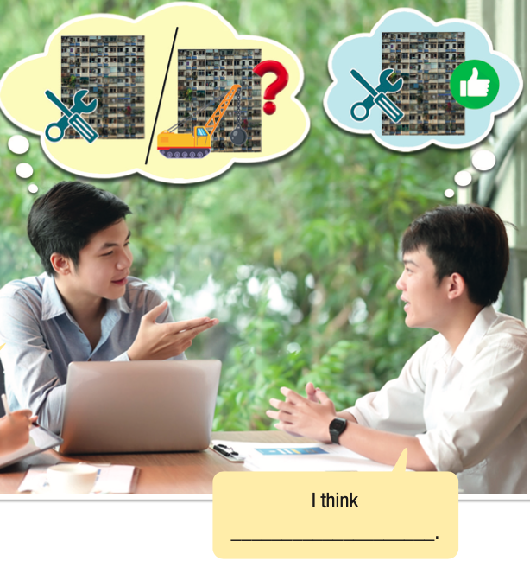
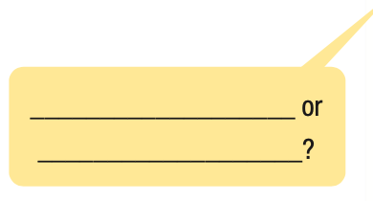
Look at the picture. What do you think the men are saying?
Now, listen and check your ideas.
Listen again and repeat.
Should we repair the old apartments or knock them down?
I think we should repair them.

Slide 11
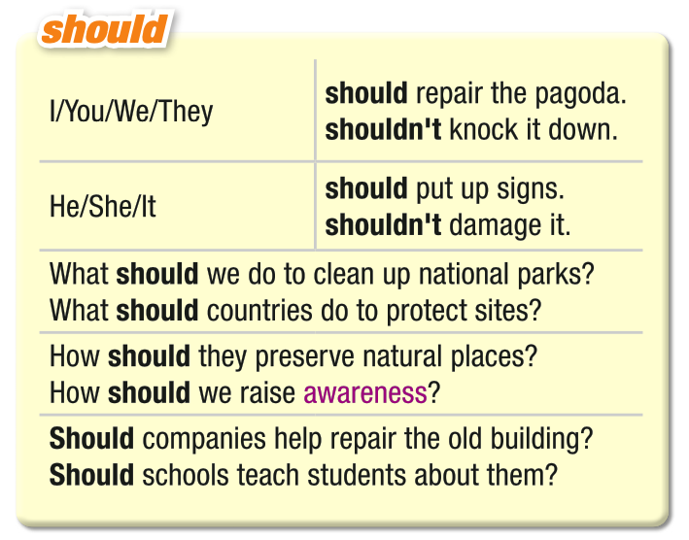

Slide 13
Practice

Slide 14
Task a
Unscramble the sentences.
1. should/people/do/to/promote/tourism?/What What should people do to promote tourism?
2.the/national/of/visitors/parks./limit/we/think/to/number/I/ should
3. to/teach/should/Universities/preserve/how/old/buildings.
4. should/prevent/heritage/How/from/sites?/we/people/
damaging
5. containers./should/sites/have/trash/lots/Heritage/of

Slide 15
Task a
Unscramble the sentences.
2.the/national/of/visitors/parks./limit/we/think/to/number/I/ should
3. to/teach/should/Universities/preserve/how/old/buildings.
I think we should limit the number of visitors to national parks.
Universities should teach how to preserve old buildings.

Slide 16
Task a
Unscramble the sentences.
4. should/prevent/heritage/How/from/sites?/we/people/
damaging
5. containers./should/sites/have/trash/lots/Heritage/of
How should we prevent people from damaging heritage sites?
Heritage sites should have lots of trash containers.

Slide 17
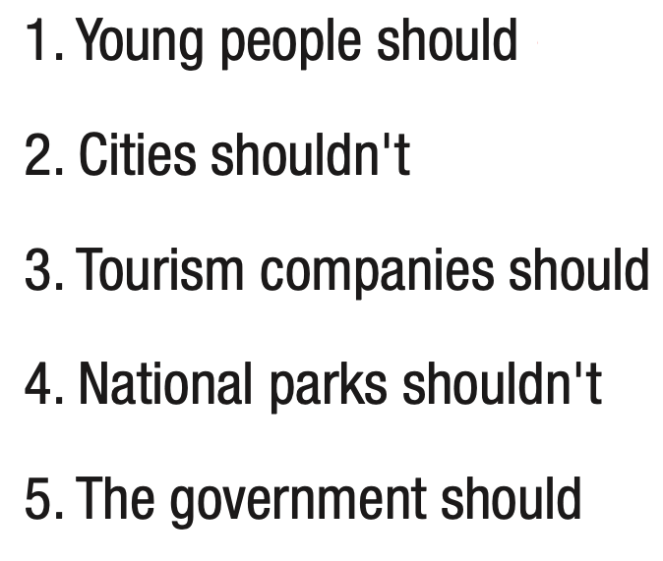
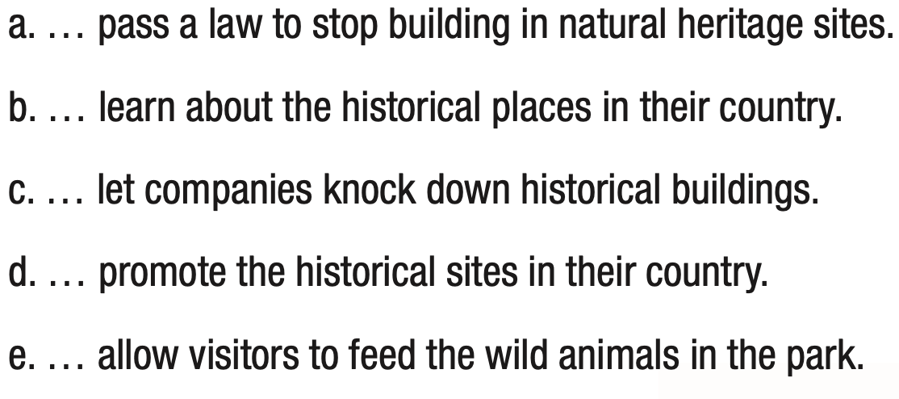
Match the beginning and end of the sentences. Then, read the sentences to your partner.
Task b
1b 2c 3d 4e 5a

Slide 18
Extra practice
WB page 35
a. Unscramble the sentences.
Tourists/damage/shouldn't/environment./the
protect/to/parks?/do/our/we/national/What/should
should/How/old/we/buildings?/our/preserve
that/building./should/They/historical/repair
heritage?/Should/schools/our country's/about/teach/children

Slide 19
Extra practice
WB page 35
a. Unscramble the sentences.
Tourists/damage/shouldn't/environment./the
protect/to/parks?/do/our/we/national/What/should
should/How/old/we/buildings?/our/preserve
Tourists shouldn't damage the environment.
What should we do to protect our national parks?
How should we preserve our old buildings?

Slide 20
Extra practice
WB page 35
a. Unscramble the sentences.
4. that/building./should/They/historical/repair
5. heritage?/Should/schools/our country's/about/teach/children
They should repair that historical building.
Should schools teach children about our country's heritage?

Slide 21
Extra practice
WB page 35
b. Write sentences with should or shouldn't using the prompts.
How/we/protect/natural places?
You/not/drop/trash/when/you/visit/heritage site.
They/spend/more money/historical buildings.
Tourists/respect/historical places.
People/learn/their heritage.

Slide 22
Extra practice
WB page 35
b. Write sentences with should or shouldn't using the prompts.
How/we/protect/natural places?
You/not/drop/trash/when/you/visit/heritage site.
3. They/spend/more money/historical buildings.
How should we protect natural places?
You shouldn't drop trash when you visit a heritage site.
They should spend more money on historical buildings.

Slide 23
Extra practice
WB page 35
b. Write sentences with should or shouldn't using the prompts.
4. Tourists/respect/historical places.
5. People/learn/their heritage.
Tourists should respect historical places.
People should learn about their heritage.

Slide 24
Production

Slide 25
Work in pairs.
What are some natural or historical places in your area that are getting older, damaged, or dirty? Which ones do you think should be preserved?

Slide 26
Consolidation

Slide 27
Write 5 sentences about what we should do to protect the environment.
Example:
I think the government should pass a law to prevent people from throwing garbage on the street.

Slide 28
WRAP-UP

Slide 29
Today’s lesson
practice and use Should correctly

Slide 31
- Learn by hearts the grammar points and make sentences using them.
- Do the exercises in workbook on page 35.
- Prepare the next lesson: Lesson 2.3 – Pronun. & Speaking (pages 64 & 65 SB).
- Play the consolidation games in Tiếng Anh 11 i-Learn Smart World DHA App on www.eduhome.com.vn

Slide 32
Lesson 3
Stay positive and have a nice day!

