Slide 1
Unit 6: World Heritages
Lesson 1.3: Pronun. & Speaking
Pages: 60 & 61

Slide 2
Lesson Outline
Warm-up
Pronunciation
Speaking
Consolidation
Wrap-up

Slide 3
By the end of this lesson,
students will be able to:
Pronunciation
practice sentence stress
Speaking
talk about features of natural world heritage sites

Slide 5
Work in pairs.
Choose the word whose main stress is placed
differently from the others.
A. clever B. native C. rural D. unique
2. A. awareness B. heritage C. kayaking D. reservoir
3. A. favorite B. difficult C. impressive D. dangerous
/ˈneɪtɪv/
/ˈrʊrəl /
/ju:ˈniːk /
/ˈklevər/
/əˈwernəs /
/ˈherɪtɪdʒ /
/ˈkaɪækɪŋ/
/ˈrezərvwɑːr/
/ˈfeɪvərət/
/ˈdɪfəkəlt/
/ɪmˈpresɪv/
/ˈdeɪndʒərəs/

Slide 6
Work in pairs.
Choose the word whose underlined part is
pronounced differently from that of the other words.
A. danger B. shadow C. balance D. practice
A. landscape B. charter C. statue D. canyon
A. lightning B. limestone C. impact D. license
/ ˈʃædoʊ /
/ˈbæləns/
/ˈpræktɪs/
/ ˈdeɪndʒə/
/ˈlændskeɪp /
/ˈtʃɑːrtər/
/ˈstætʃuː/
/ˈkænjən /
/ ˈlaɪtnɪŋ/
/ ˈlaɪmstoʊn /
/ˈɪmpækt/
/ ˈlaɪsəns /

Slide 8
a. Stress the focus word in cleft sentences.
b. Listen to the sentences and focus on the stressed words.
It's the sunsets that I remember best.
Camping was fun, but it was kayaking that I really enjoyed.

Slide 9
c. Listen and cross out the sentence with the wrong sentence stress.
The waterfall is nice, but it's the mountains that are really pretty.
The jungle is interesting, but it's the karst caves that are so unique.
d. Read the sentences with the correct sentence stress to a partner.

Slide 10
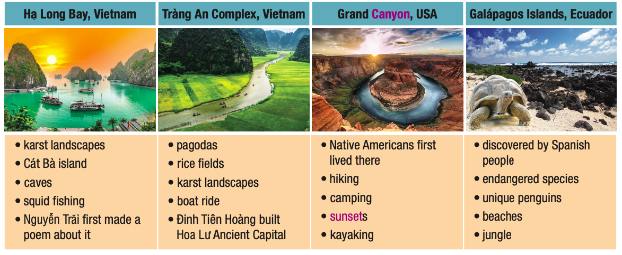
Ask your partner what they think about each of the UNESCO World Heritage Sites.
Pronunciation

Slide 11
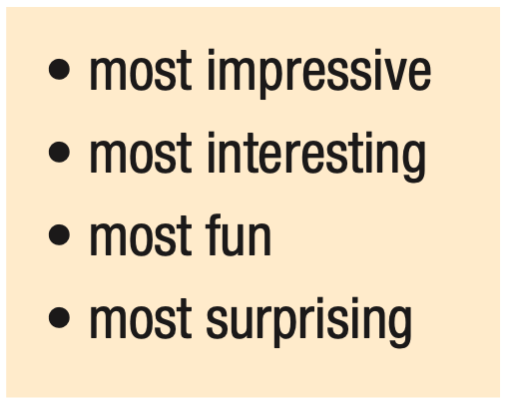
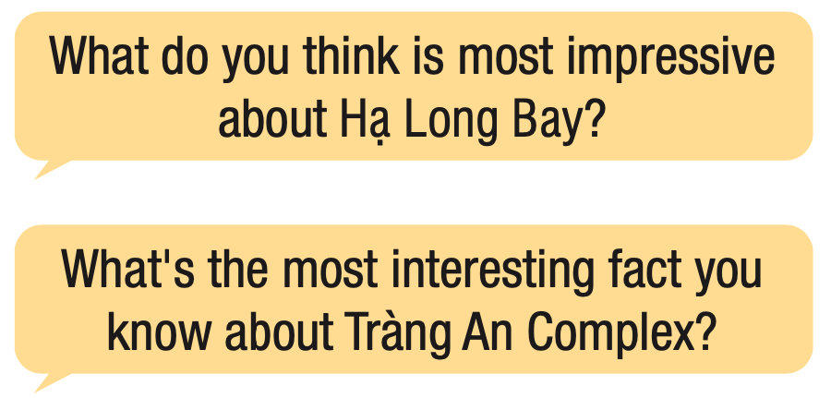
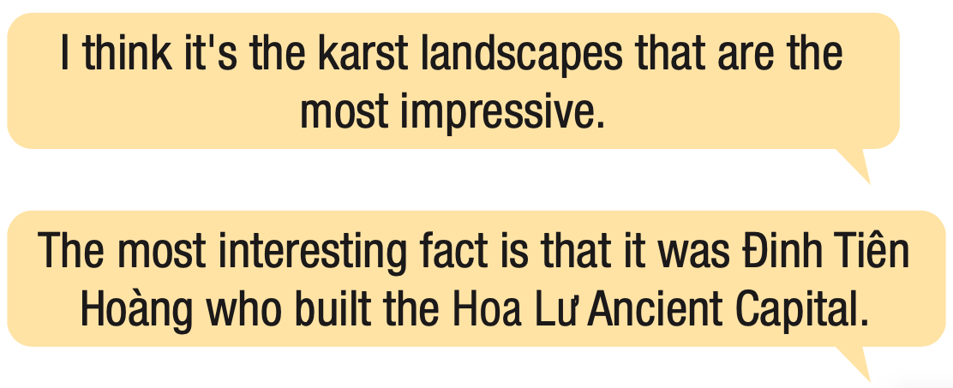

Slide 12
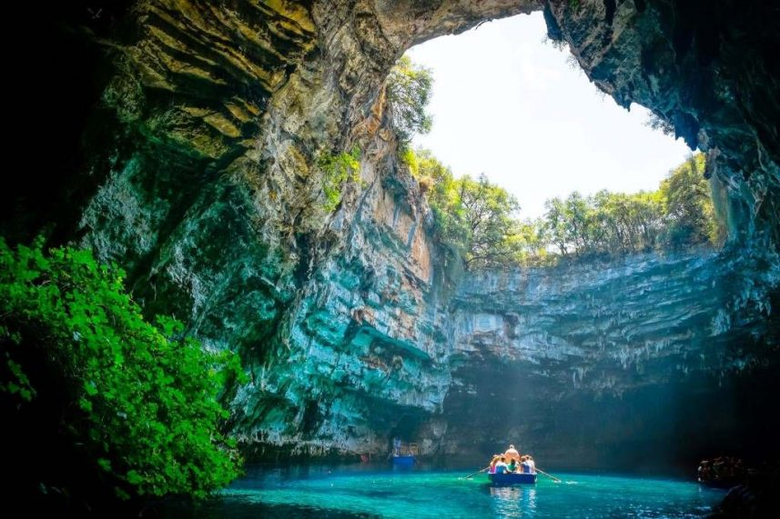
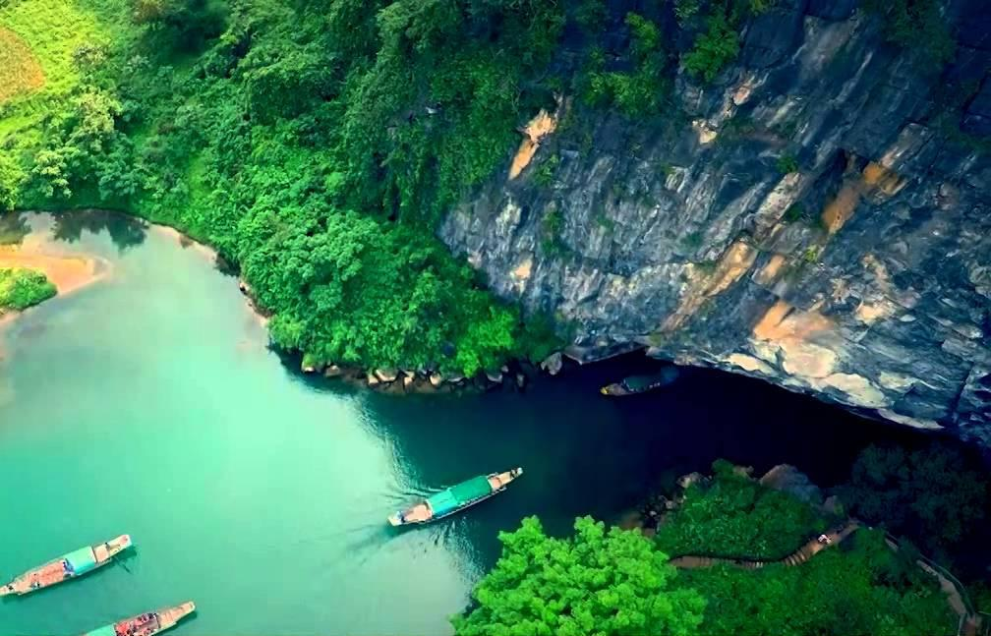
PLANNING A PRESENTATION:
OUR TRIP TO PHONG NHA-KE BÀNG

Slide 13
Task a
In each column, circle the feature you like most.
In pairs: Ask your partner what they like.
If you disagree, give extra attention to what you like. Choose one fact, activity, and detail to talk about in the presentation.

Slide 14
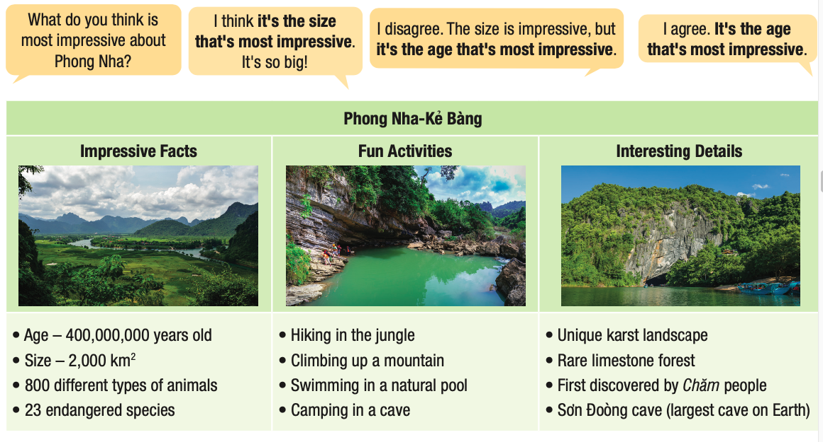

Slide 15
Task b
Join another pair.
Tell them what you like most.
If you disagree, give extra attention to the one you like.

Slide 16
Consolidation

Slide 17
Write 5 sentences about interesting facts about different UNESCO World Heritage Sites.
Example:
The most interesting fact about Ha Long Bay is that it was Nguyen Trai who first made a poem about it.

Slide 18
WRAP-UP

Slide 19
Today’s lesson
Pronunciation
practice sentence stress
Speaking
talk about features of natural world heritage sites

Slide 21
- Practice sentence stress.
- Do the exercises in workbook on page 33.
- Prepare the next lesson: Lesson 2.1 – Vocab. & Listening (pages 62 & 63 SB).
- Play the consolidation games in Tiếng Anh 11 i-Learn Smart World DHA App on www.eduhome.com.vn

Slide 22
Lesson 3
Stay positive and have a nice day!

