Slide 1

Unit 3:
Protecting the Environment
Lesson 1.3
Pronunciation + Practice & Speaking
Pages 26 & 27

Slide 2
Lesson Outline
Warm-up
Pronunciation
Speaking
Consolidation
Wrap-up

Slide 3

By the end of this lesson, students will be able to…
- practice /t/ sound.
- talk about the effects of pollution, using First conditional.

Slide 4

WARM UP

Slide 5
Odd One Out
Choose the word whose underlined part is pronounced differently form that of the others.
A. proud B. about C. around D. would
2. A. problem B. love C. box D. hobby
3. A. market B. depart C. card D. scare
/praʊd/ /əˈbaʊt/ /əˈraʊnd/ /wʊd/
/ˈprɑːbləm/ /lʌv/ /bɑːks/ /ˈhɑːbi/
/ˈmɑːkɪt/ /dɪˈpɑːt/ /kɑːrd/ /sker/

Slide 6
Odd One Out
Choose the words whose main stress is placed differently from the others.
A. animal B. pollution C. restaurant D. tourism
/ˈænɪməl/ /pəˈluːʃən/ / ˈrestərɑːnt / /ˈtʊrɪzəm/
2. A. hotel B. business C. plastic D. dirty
/ hoʊˈtel / /ˈbɪznɪs/ /ˈplæstɪk / /ˈdɜːti/
3. A. visitor B. natural C. generous D. effective
/ˈvɪzɪtər / /ˈnætʃərəl/ /ˈdʒenərəs/ /əˈfektɪv/

Slide 7

Pronunciation

Slide 8
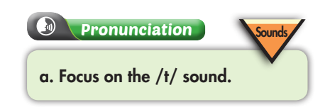
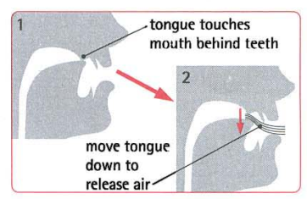
/t/ is the voiceless consonant sound.
To make this sound, we should:
Stop the air with your tongue behind your teeth.
Move your tongue down to release the air. Put the paper in front of your mouth and practice.
https://youtu.be/0T1QYByMxrs
https://youtu.be/mLlotV_0dRI

Slide 9

Task b
Listen to the words and focus on the underlined letters.
affect /əˈfekt/
pollute / pəˈluːt /
protect /prəˈtekt/
Practice saying these words. Pay attention to the /t/ sound.

Slide 10
Task c
Listen and cross out the one with the different sound.
effect environment pollution forest
/əˈfekt/ /ɪnˈvaɪrənmənt/ /pəˈluːʃən/ /ˈfɔːrɪst/
Task d
Read the words to your partner.

Slide 11

Practice:
Speaking

Slide 12

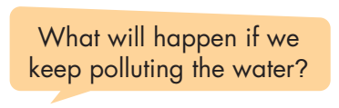
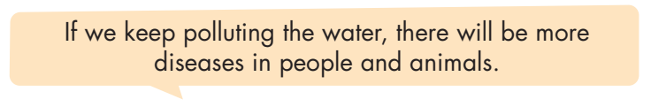
Work in pairs

Slide 13
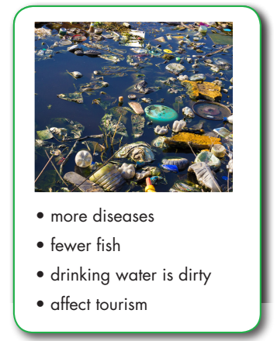
Take turns asking and answering about the different effects of pollution.

Slide 14
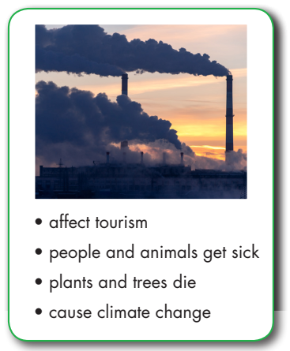
Take turns asking and answering about the different effects of pollution.
What will happen if we keep polluting the air?
If we keep polluting the air, there will affect tourism.

Slide 15
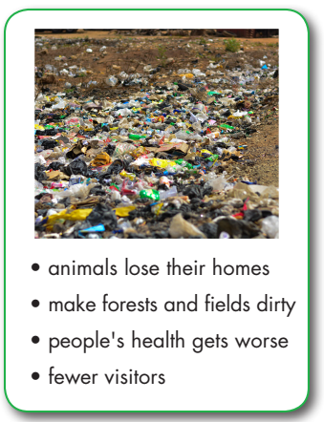
Take turns asking and answering about the different effects of pollution.
What will happen if we keep polluting the land?
If we keep polluting the land, it will make forests and fields dirty.
What will happen if ………………………….?
If …………, it will ………..
If …………, ...will ………..

Slide 16

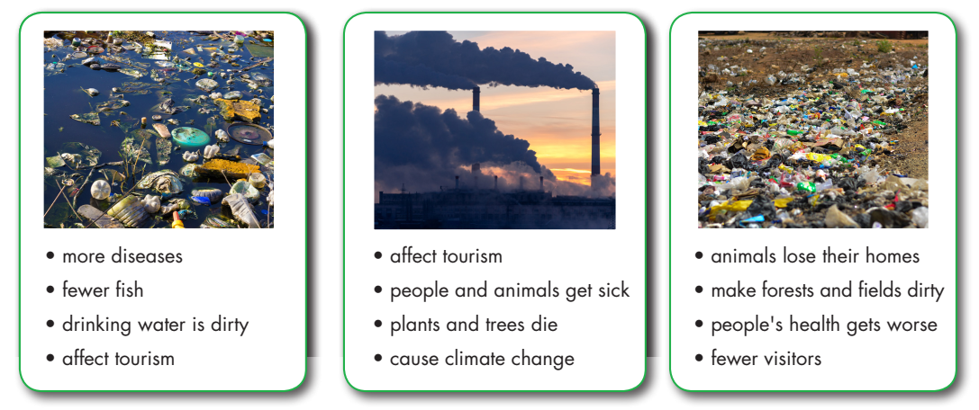
Practice with your own ideas.

Slide 17

Production:
Speaking

Slide 18


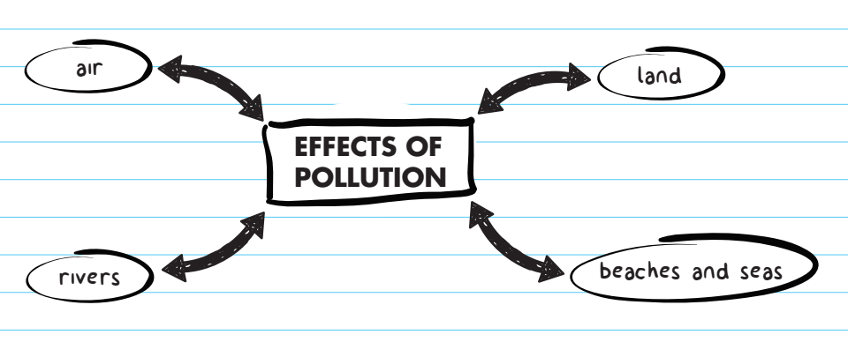

In pairs: Discuss the four kinds of pollution and think of possible effects of each.

Slide 19
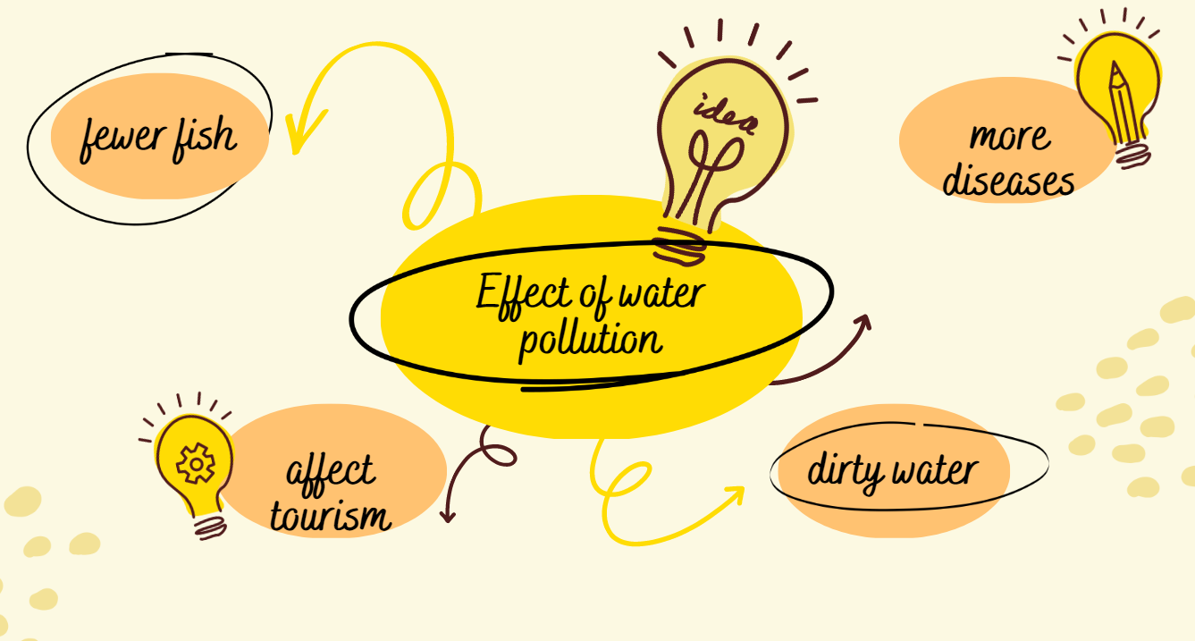

Slide 20
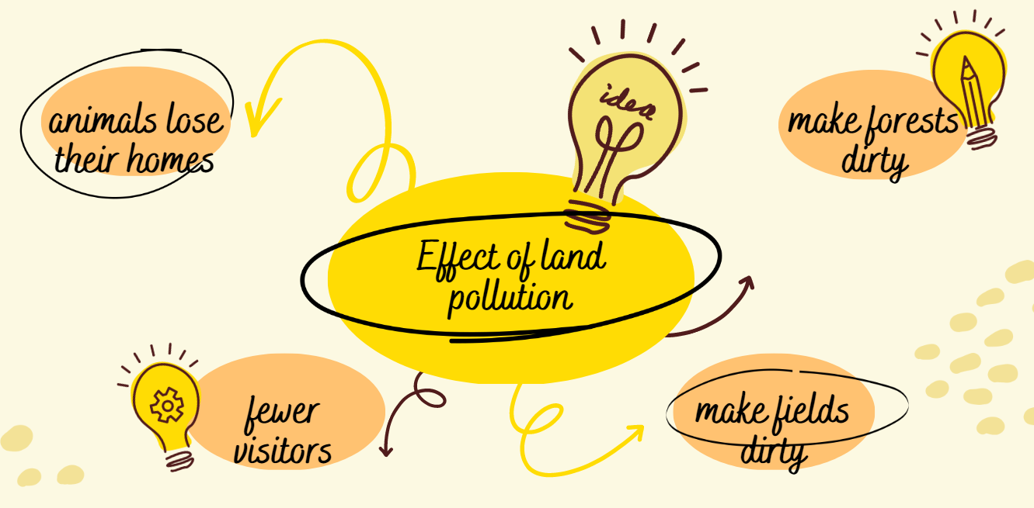

Slide 21
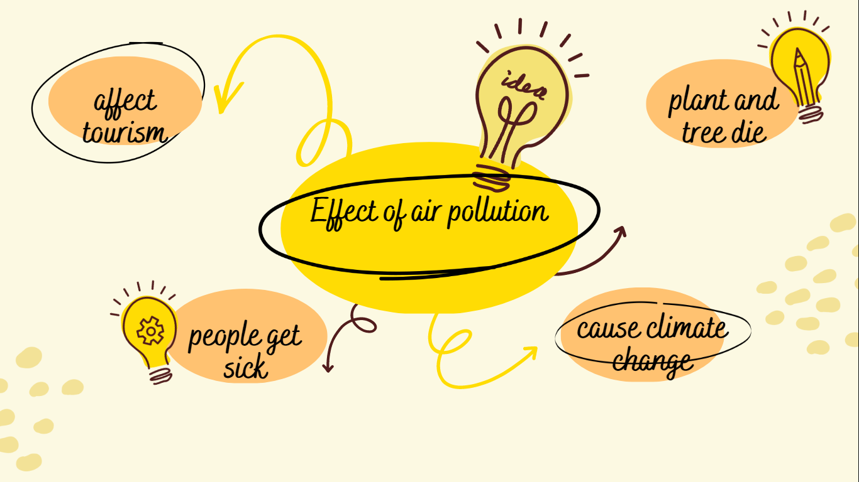

Slide 22
Decide which kind of pollution will cause the most problems to people and wildlife. Explain your decision to another pair.
Task b
Examples:
We think water pollution will cause the most problems to people and wildlife because there will be fewer fish.
We think water pollution will cause the most problems to people and wildlife because there will affect tourism.

Slide 23

CONSOLIDATION

Slide 24
In pairs
Practice discussing kinds of pollution with other pairs.

Slide 25
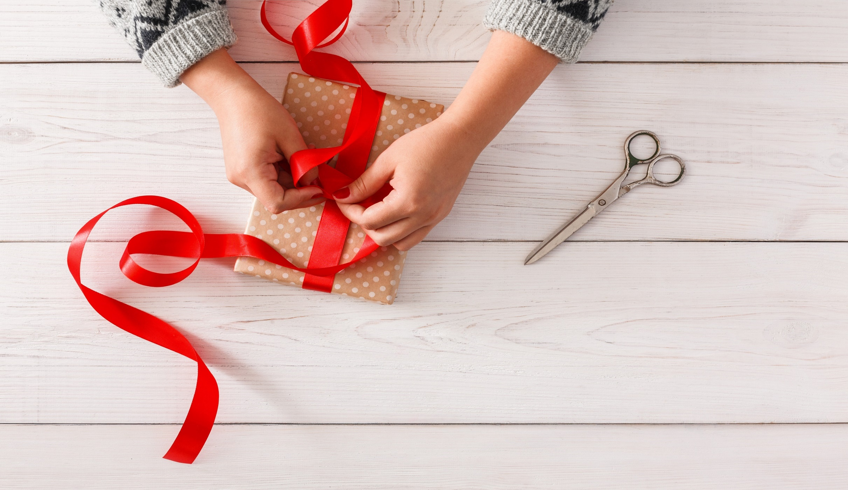
WRAP-UP

Slide 26
Today’s lesson
Pronunciation
Pronouncing the /t/ sound.
Speaking
Talking about the different effects of pollution.

Slide 27
Homework
Practice saying the /t/ sound.
Prepare the next lesson (pages 28 & 29 SB)
Play the consolidation games on www.eduhome.com.vn

Slide 28

Lesson 3
Stay positive and have a nice day!

