Slide 1

Unit 3:
Protecting the Environment
Lesson 1.2: Grammar
-- Pages 25 & 26 --

Slide 2
Lesson Outline
Warm-up
Grammar
Consolidation
Wrap-up

Slide 3

By the end of this lesson, students will be able to…
- practice and use the First Conditional with if or unless correctly.

Slide 4

WARM UP

Slide 5
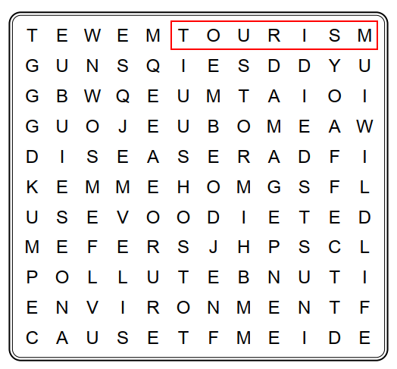
Wordsearch
How many words can you see?

Slide 6

Wordsearch
Can you find ten words?

Slide 7

Presentation

Slide 8
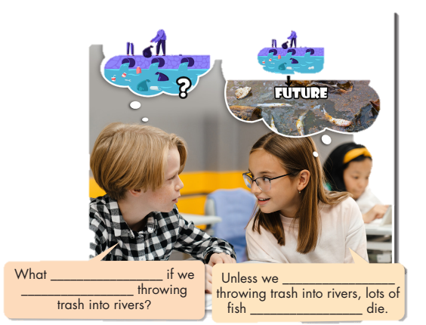
Look at the picture and fill in the blanks.
What are they talking about?
will happen
stop
keep
will die

Slide 9

Listen again and repeat
will happen
stop
keep
will die

Slide 10

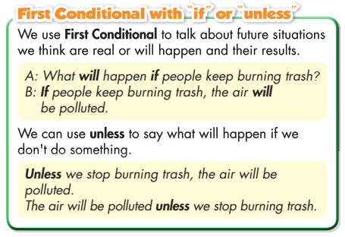
Read the box and answer the question below.
What do we use First Conditional for?

Slide 11

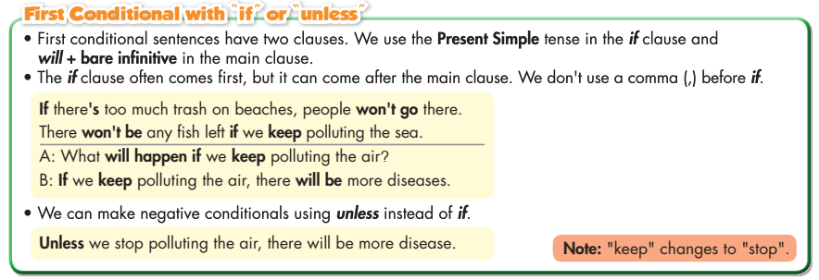
- Read the sentences and underline the bold words.
- Focus on the usage of unless and if.

Slide 12
First Conditional
We use the First Conditional to talk about future situations we think are real or will happen and their result.
If clause | Main clause
Present simple (Hiện tại đơn) (+) S + V1/ s/es + O. (-) S + don’t/doesn’t + V + O. (?) Do/does + S + V + O? * Note: do not = don’t does not = doesn’t | Future simple (Tương lai đơn) (+) S + will + V(infinitive) + O. (-) S + won’t + V + O. (?) Will + S + V + O? * Note: will not = won’t
We can make negative conditionals using unless instead of if.
Can you give more examples using First Conditional?

Slide 13
First Conditional
We use the First Conditional to talk about future situations we think are real or will happen and their result.
If clause | Main clause
Present simple (Hiện tại đơn) (+) S + V1/ s/es + O. (-) S + don’t/doesn’t + V + O. (?) Do/does + S + V + O? * Note: do not = don’t does not = doesn’t | Future simple (Tương lai đơn) (+) S + will + V (infinitive) + O. (-) S + won’t + V(infinitive) + O. (?) Will + S + V + O? * Note: will not = won’t
We can make negative conditionals using unless instead of if.
Can you give more examples using First Conditional?

Slide 14
First Conditional
We use the First Conditional to talk about future situations we think are real or will happen and their result.
If clause | Main clause
Present simple (Hiện tại đơn) (+) S + V1/ s/es + O. (-) S + don’t/doesn’t + V + O. (?) Do/does + S + V + O? * Note: do not = don’t does not = doesn’t | Future simple (Tương lai đơn) (+) S + will + V (infinitive) + O. (-) S + won’t + V(infinitive) + O. (?) Will + S + V (infinitive) + O? * Note: will not = won’t
We can make negative conditionals using unless instead of if.
Can you give more examples using First Conditional?

Slide 15
First Conditional
We use the First Conditional to talk about future situations we think are real or will happen and their result.
If clause | Main clause
Present simple (Hiện tại đơn) (+) S + V1/ s/es + O. (-) S + don’t/doesn’t + V + O. (?) Do/does + S + V + O? * Note: do not = don’t does not = doesn’t | Future simple (Tương lai đơn) (+) S + will + V (infinitive) + O. (-) S + won’t + V(infinitive) + O. (?) Will + S + V (infinitive) + O? * Note: will not = won’t
We can make negative conditionals using unless instead of if.
Can you give more examples using First Conditional?

Slide 16
First Conditional
We use the First Conditional to talk about future situations we think are real or will happen and their result.
If clause | Main clause
Present simple (Hiện tại đơn) (+) S + V1/ s/es + O. (-) S + don’t/doesn’t + V + O. (?) Do/does + S + V + O? * Note: do not = don’t does not = doesn’t | Future simple (Tương lai đơn) (+) S + will + V (infinitive) + O. (-) S + won’t + V(infinitive) + O. (?) Will + S + V (infinitive) + O? * Note: will not = won’t
We can make negative conditionals using unless instead of if.
Can you give more examples using First Conditional?

Slide 17

Practice

Slide 18
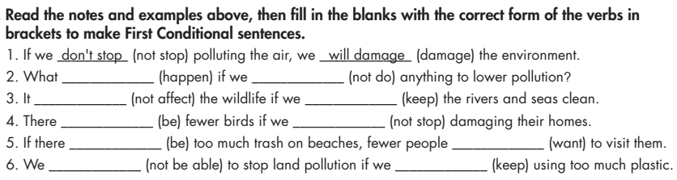
Task a
will happen
don’t do
won’t affect
keep
will be
don’t stop
is
will want
won’t be able
keep

Slide 19
https://www.baamboozle.com/game/168094
https://www.baamboozle.com/game/2583103

Slide 20
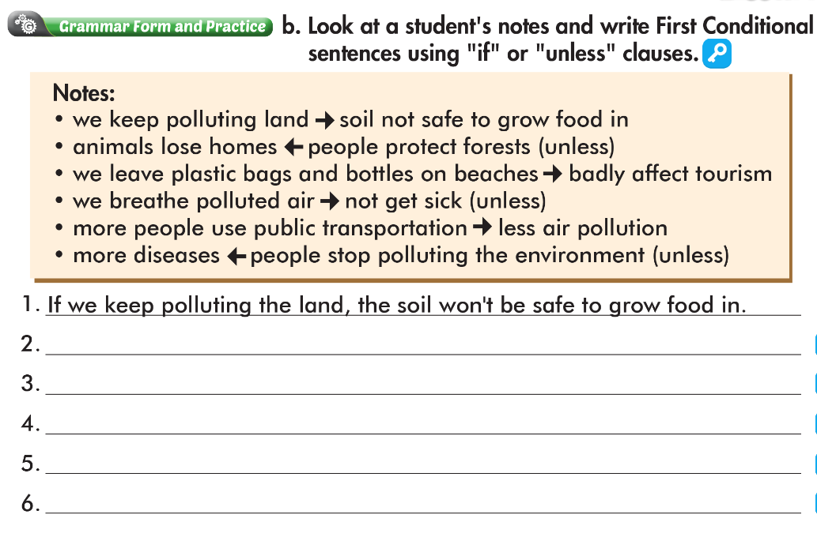
Animals will lose home unless people protect forests.
If we leave plastic bags and bottles on beaches, it’ll badly affect tourism
Unless we breathe polluted air, we won’t get sick.
If more people use public transportation, there will be less air pollution.
There will be more diseases unless people stop polluting the environment.

Slide 21

Production:
Speaking

Slide 22

Work in pairs
Make First Conditional sentences using the prompts and “if” or “unless”.

Slide 23
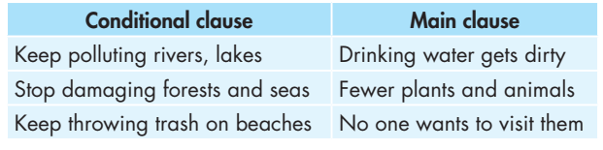
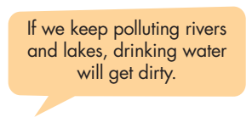

Slide 24

CONSOLIDATION

Slide 25
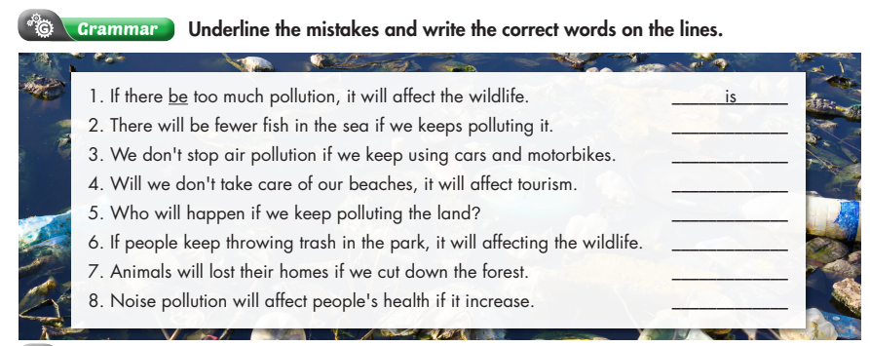
keep
won’t
if
what
affect
trees
increases

Slide 26

WRAP-UP

Slide 27
Today’s lesson
Grammar:
We use First Conditional to talk about future situations we think are real or will happen and their result.
Speaking:
Make First Conditional sentences with the given prompts.

Slide 28
Homework
Make five sentences using First Conditional.
Do the exercises in WB: Grammar (page 15).
Play the consolidation games in Tiếng Anh 8 i-Learn Smart World DHA App on www.eduhome.com.vn
Do the exercises in Tiếng Anh 8 i-Learn Smart World Notebook, page 22.
- Prepare: Lesson 1 – Pronunciation and Speaking (pages 26 & 27 – SB).

Slide 29

Lesson 3
Stay positive and have a nice day!

