Slide 1

Unit 3:
Protecting the Environment
Lesson 1.1 : New words + Reading
--- Pages 24 & 25 ---

Slide 2
Lesson Outline
Warm-up
Vocabulary
Reading
Consolidation
Wrap-up

Slide 3

By the end of this lesson, students will be able to…
- learn and use vocabulary, related to pollution.
- practice reading for gist and specific information about some effects of pollution.

Slide 4

New words
affect
cause
pollute
disease
wildlife
tourism
environment
damage

Slide 5

WARM UP

Slide 6
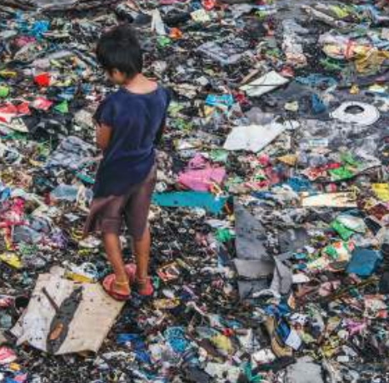
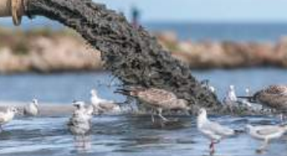
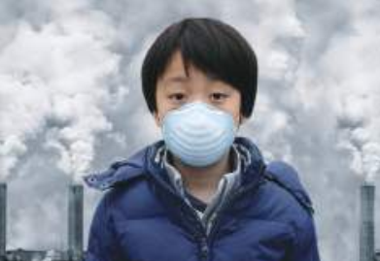
Let’s talk
Work in pairs. Look at the pictures. What kinds of pollution can you see? Is pollution a big problem in your country? Why does pollution happen?
Water pollution
Air pollution
Land pollution

Slide 7

NEW LESSON

Slide 8

Pre-reading
Vocabulary

Slide 9
New words
affect
cause
pollute
disease
wildlife
tourism
environment
damage

Slide 10


Listen and repeat. Practice saying these words with a partner.
Click on the word to hear
affect /əˈfekt/ (v) : tác động, ảnh hưởng.
cause /kɔːz/ (v) : gây ra.
pollute / pəˈluːt / (v) : gây ô nhiễm.
disease / dɪˈziːz / (n) : bệnh.
wildlife / ˈwaɪldlaɪf / (n): đời sống hoang dã.
tourism / ˈtʊrɪzəm / (n) : du lịch.
environment /ɪnˈvaɪrənmənt/ (n): môi trường.
damage /ˈdæmɪdʒ/ (v) : tàn phá, phá hủy.

Slide 11
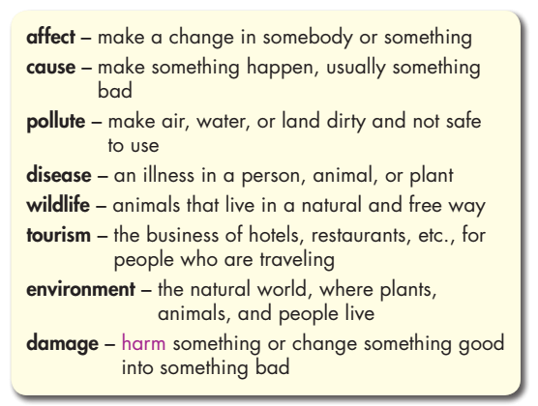
Pre - reading
Read the words and definitions, then fill in the blanks with new words.

Slide 12
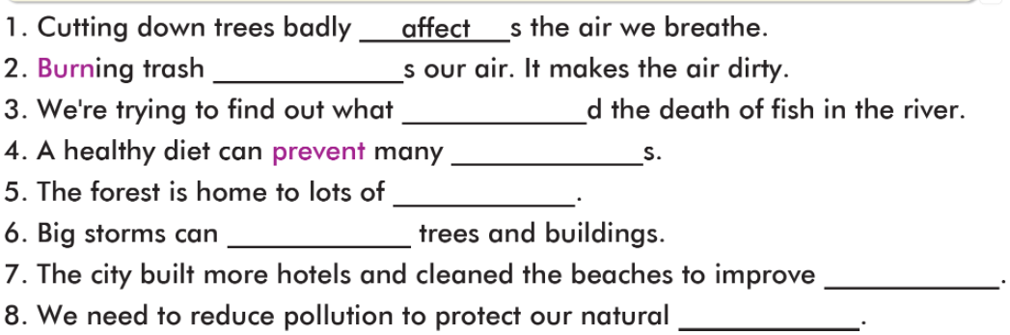
Read the words and definitions, then fill in the blanks with new words.
affect (v)
pollute
cause
cause
pollute
disease
disease
wildlife
wildlife
damage
tourism
tourism
environment
damage
environment

Slide 13





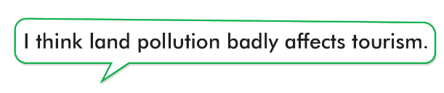
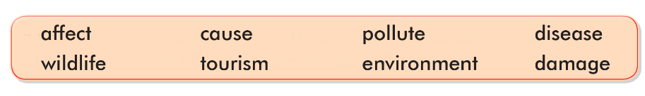
Work in pairs
Which kinds of pollution affect tourism and cause diseases?

Slide 14

While-
reading

Slide 15
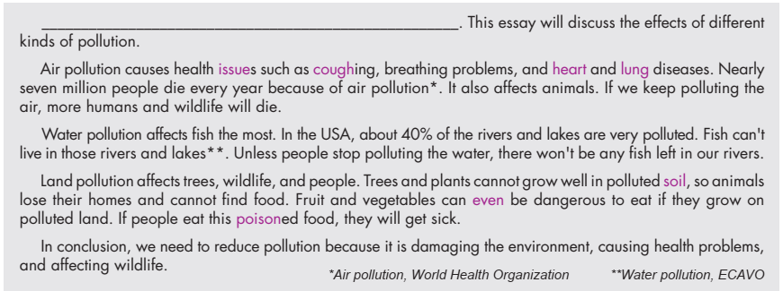
Read the essay about some effects of pollution and choose the best introduction sentence.
1. Air, water, light, and noise are four main types of pollution affecting our world.
2. There are many types of pollution, and each type can affect people, wildlife, and the environment.

Slide 16
1. affect (v) /əˈfekt/ - effect (n) /ɪˈfekt/ : tác động, ảnh hưởng
2. air pollution : sự ô nhiễm không khí
3. water pollution : sự ô nhiễm nước
4. land pollution : sự ô nhiễm đất
5. issue (n) /ˈɪʃuː/ : vấn đề
6. cough (v) /kɔːf/ : ho
7. heart (n) /hɑːrt/ : trái tim
8. lung (n) /lʌŋ/ : phổi
9. disease (n) /dɪˈziːz/ : bệnh
10. soil (n) /sɔɪl/ : đất trồng
11. even (adv) /ˈiːvn/ : thậm chí
12. poison (v) /ˈpɔɪzn/ : đầu độc
13. protect (v) /prəˈtekt/ : bảo vệ

Slide 17
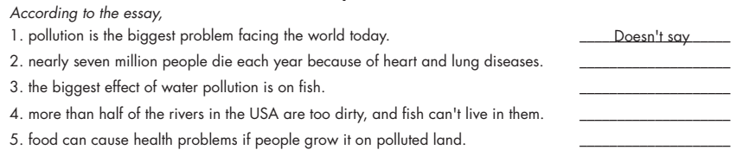
Now, listen, read and write True, False, or Doesn’t say.
False
True
False
True

Slide 18

Post-
reading

Slide 19

Post - reading
Work in pairs
What kinds of pollution are there in your area?
There’s land pollution in my area. People throw trash everywhere.
What are their effects?
It makes street very dirty. It also causes air pollution.

Slide 20

CONSOLIDATION

Slide 21
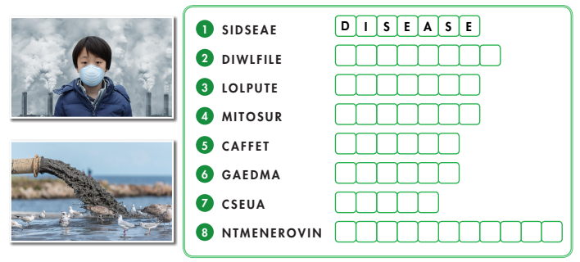
Unscramble words. (WB page 14)
W I L D L I F E
P O L L U T E
T O U R I S M
A F F E C T
D A M A G E
C A U S E
E N V I R O N M E N T

Slide 22

WRAP-UP

Slide 23
Today’s lesson
Vocabularies
affect
cause
pollute
disease
wildlife
tourism
environment
damage

Slide 24
Today’s lesson
* Vocabulary: affect, cause, pollute, disease, wildlife, tourism, environment, damage.
* Reading: Skimming and scanning for general and specific information
* Speaking:
- Talking about kinds of pollution.

Slide 25
Homework
Learn by heart vocabularies and make sentences using them.
Do the exercises on pages 14 & 15 WB.
Do the exercises in TA 8 Notebook (pages 20 & 21)
Prepare the next lesson (pages 25 & 26 - SB)
Play the consolidation games on www.eduhome.com.vn

Slide 26

Lesson 3
Stay positive and have a nice day!

