Slide 2
Unit
2
The generation gap
Unit
FAMILY LIFE
LESSON 3
READING
Different generations

Slide 3
LESSON 3
READING
WARM-UP
Mysterious picture
PRE-READING
Vocabulary
- Task 2. Read the article. Match the highlighted words with their meanings
- Task 3. Read the article again and choose the best title.
- Task 4. Read the article again. Tick (✓) the characteristics of each generation according to the article.
WHILE-READING
POST-READING
Discussion
Wrap-up
Homework
CONSOLIDATION

Slide 4
WARM-UP
MYSTERIOUS PICTURE
- Ss work in groups.
- There are 4 questions which relate to a key picture.
- Guess the word/ phrase in each puzzle and guess the key picture behind after each puzzle is opened.
- The group which gets the correct answer of the key picture is the winner.

Slide 5
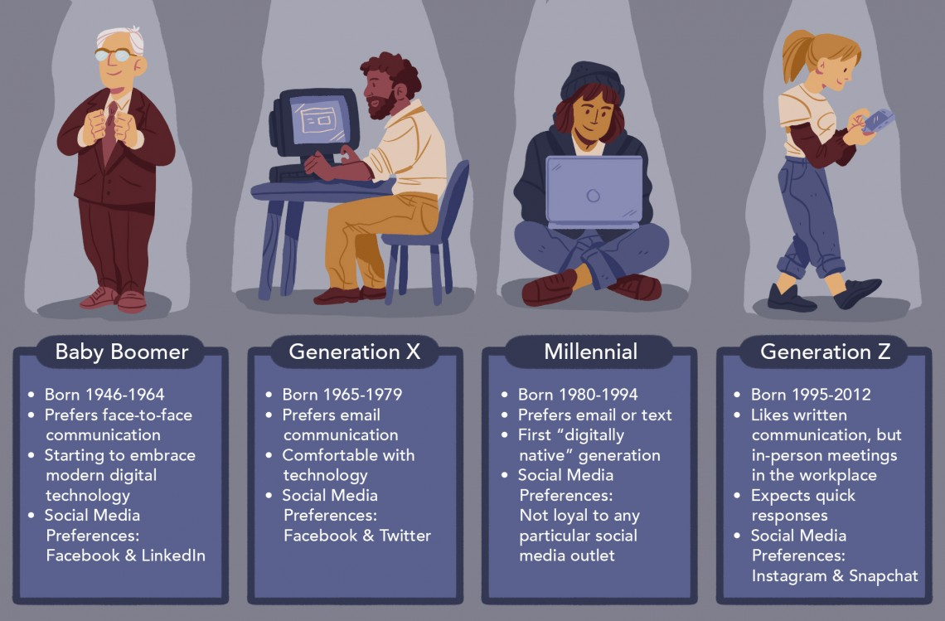
WARM-UP
Answer the question in each puzzle.
1
2
3
4
GENERATIONS

Slide 6
WARM-UP
Question 1
special qualities that belong to a group of people or things
➔ COMMON CHARACTERISTICS
BACK

Slide 7
WARM-UP
Question 2
a disagreement between different generations
➔ GENERATIONAL CONFLICT
BACK

Slide 8
WARM-UP
Question 3
beliefs about what is important in the culture of a particular society
➔ CULTURAL VALUES
BACK

Slide 9
WARM-UP
Question 4
a belief or an opinion that has existed for a long time without changing
➔ TRADITIONAL VIEW
BACK

Slide 10
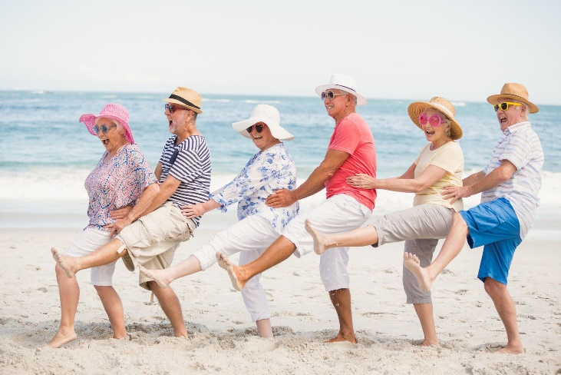
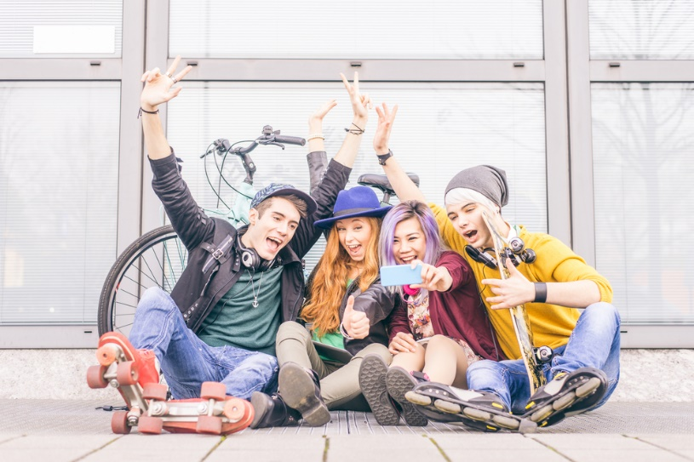
PRE-READING
1
Work in pairs. Look at the photos. Discuss what you know about the generation in each picture (e.g. age, characteristics, interests, life experiences).
Generation X
Generation Y
Generation Z

Slide 11
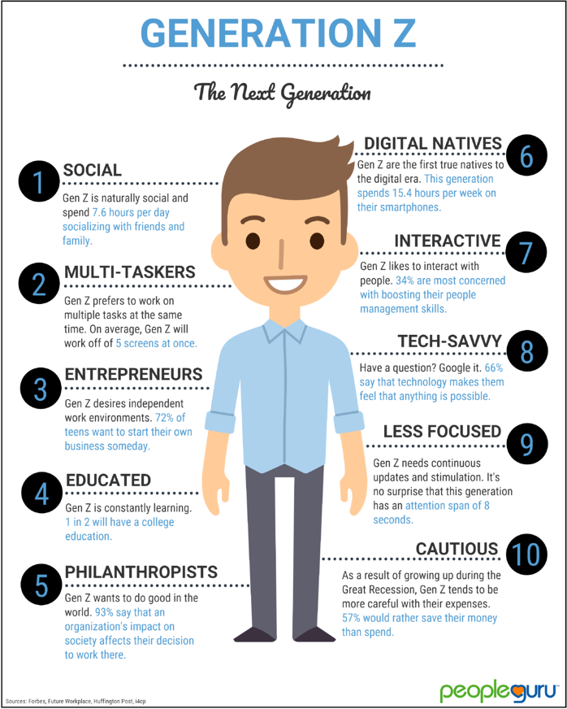
PRE-READING
characteristic (n)
/ˌkærəktəˈrɪstɪk/
a typical feature or quality that something/somebody has

Slide 12
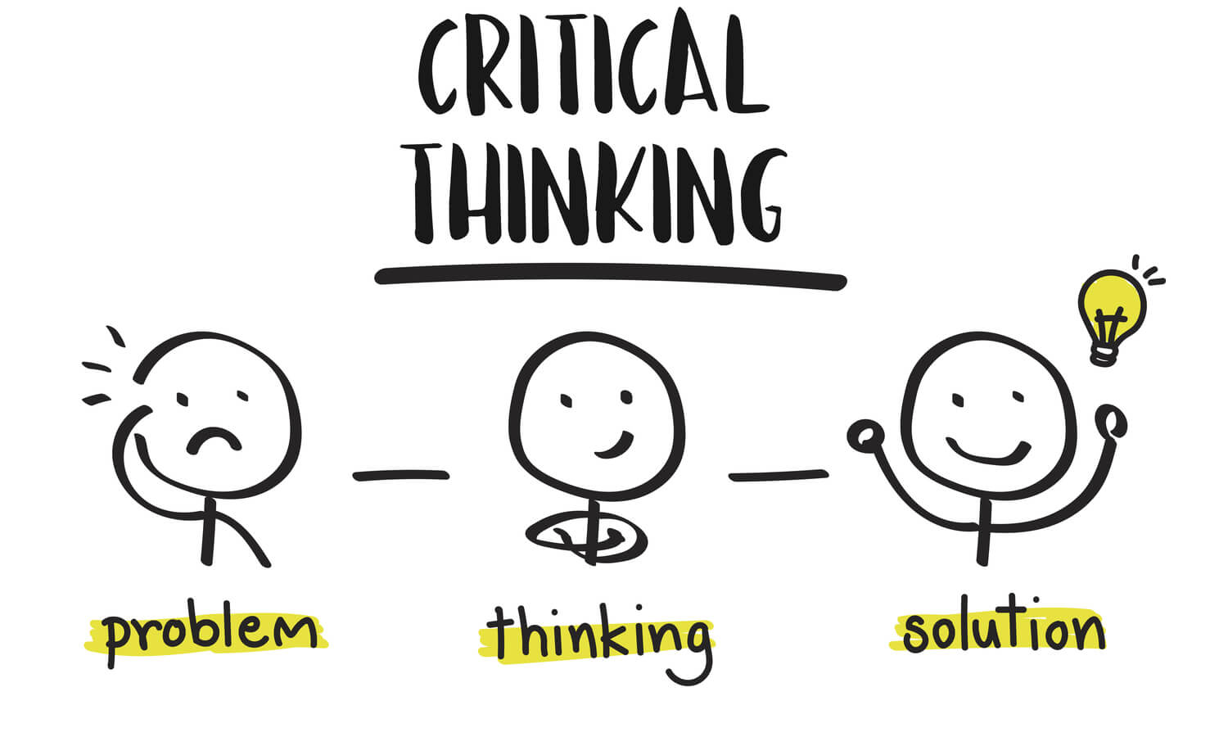
PRE-READING
critical (adj)
/ˈkrɪtɪkl/
making careful judgements

Slide 13
PRE-READING
creative (adj)
/kriˈeɪtɪv/
involving the use of skill and the imagination to produce something new or a work of art

Slide 14
PRE-READING
platform (n)
/ˈplætfɔːm/
the type of computer system or the software that is used

Slide 15
Form | Pronunciation | Meaning | Vietnamese equivalent
1. characteristic (n) | /ˌkærəktəˈrɪstɪk/ | a typical feature or quality that something/somebody has | đặc điểm
2. critical (adj) | /ˈkrɪtɪkl/ | making careful judgements | có tính phản biện
3. creative (adj) | /kriˈeɪtɪv/ | involving the use of skill and the imagination to produce something new or a work of art | sáng tạo
4. platform (n) | /ˈplætfɔːm/ | the type of computer system or the software that is used | nền tảng

Slide 16
2
Read the article. Match the highlighted words with their meanings.
1. experienced
a. to try or test new ideas or methods
2. curious
b. went through
c. to employ
3. digital natives
d. wanting to know about something
4. experiment
e. people born in the era of technology
5. hire

Slide 17
WHILE-READING
3
Read the article again and choose the best title.
A. The study of different generations
B. Generational differences in different societies
C. Characteristics of different generations

Slide 18
4
Read the article again. Tick (✓) the characteristics of each generation according to the article.
 |  | Generation X | Generation Y | Generation Z
1. | They enjoy working in a team with others.
2. | They can use apps and digital devices in creative ways.
3. | Critical thinking is one of their characteristics.
4. | Most of them plan to have their own business.
5. | They are known for their curiosity.
✓
✓
✓
✓
✓

Slide 19
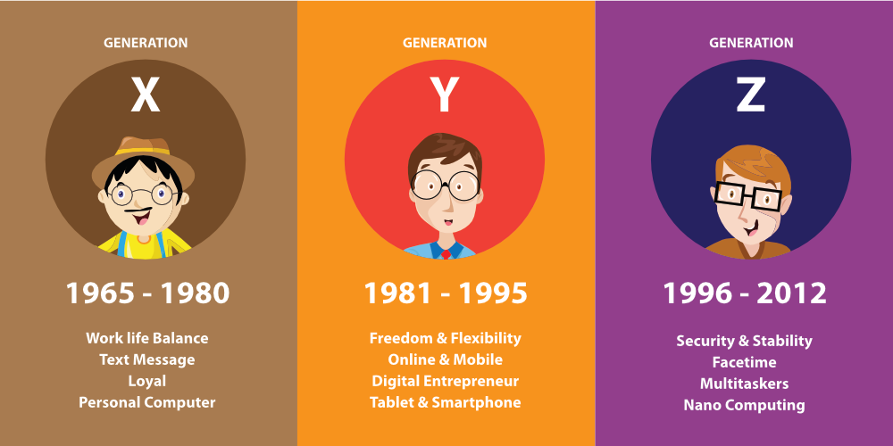
POST-READING
Do you agree with the descriptions of each generation?
5
Discussion

Slide 20
CONSOLIDATION
1
Wrap-up
What have you learnt today?
Some lexical items about different generations
Reading for main ideas and specific information about generations

Slide 21
CONSOLIDATION
2
Homework
Do exercises in the workbook.
Prepare for Lesson 4 - Unit 2.

Slide 22
Website: hoclieu.vn
Fanpage: facebook.com/www.tienganhglobalsuccess.vn

