Slide 2
Unit
1
A long and healthy life
Unit
FAMILY LIFE
LESSON 6
WRITING
A short message

Slide 3
LESSON 6
WRITING
WARM-UP
Kahoot
PRE-WRITING
Task 1. Put the parts in the correct order.
Task 2. Write a sentence to express each message below. Begin with the words given.
Task 3. Write a short message to reply to the one in Task 1.
WHILE-WRITING
POST-WRITING
Peer review
Wrap-up
Homework
CONSOLIDATION

Slide 4
WARM-UP
KAHOOT
- Use your electronic devices to access to the link on Kahoot.it and join the game.
- The whole class complete to answer the questions.
- After the game, Ss with the highest point is the winner.

Slide 5
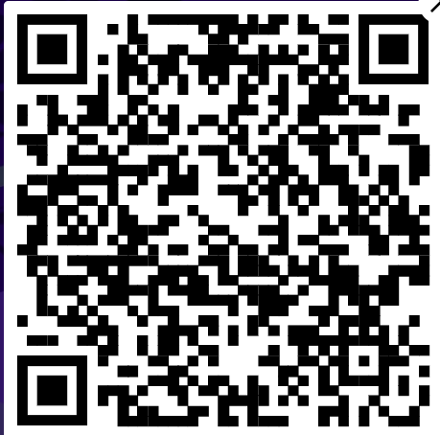
WARM-UP
https://kahoot.it?pin=5964145&refer_method=link

Slide 6
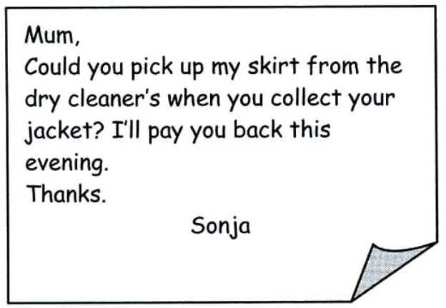
PRE-WRITING
How to write a short message?

Slide 7
PRE-WRITING
1
Below is a short message. Put the parts in the correct order.
Key: B - D - C - A - E - F

Slide 8
Hi Linda,
Thanks for lending me the book about healthy cooking tips. It’s great!
How about coming to my house this Sunday to try some recipes from the book? Don’t forget to bring some fresh fruits from your garden. We’ll need them for some recipes.
See you soon,
Mai
Greeting
Message
Closing

Slide 9
Useful expressions
Greeting | Message | Closing
+ Hi, + Hello, + Dear …, | + Thank you for … + How about … + What about … + Why don’t we … + Shall we … + Remember to … + Don’t forget to … + I would like to invite you to … + Do you want to … | + See you again, + See you soon, + Write back soon, + Bye, + Love,

Slide 10
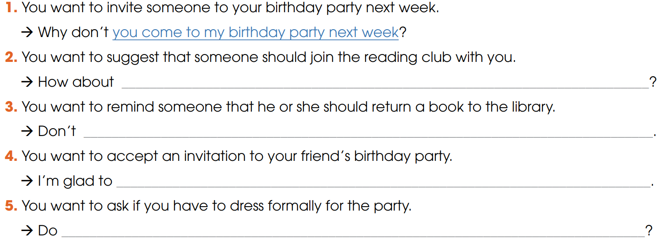
2
Write a sentence to express each message below. Begin with the words given.
joining the reading club with me
forget to return the book to the library
come to your birthday party
I have to dress formally for the party

Slide 11
3
Write a short message to reply to the one in Task 1
Suggested answer
Hi Mai,
Thank you for inviting me to your house this Sunday.
I am so glad to come to try some recipes from the book with you. Shall we meet at 10 a.m? Please tell me if I need to buy something in advance to prepare for the meal.
See you soon,
Linda.

Slide 12
POST-WRITING
4
Exchange your writing with your friend for peer review.
Writing rubric
Organization: …/10
Legibility: …/10
Ideas: …/10
Word choice: …/10
Grammar usage and mechanics: …/10
TOTAL: …/50

Slide 13
CONSOLIDATION
1
Wrap-up
What have you learnt today?
How to write and respond to a short message
Apply structures to express suggestions, invitation or acceptance, etc.

Slide 14
Write a short message to respond your friend’ invitation to his/her birthday party. You accept his/her invitation.
+ thank you for and accept the invitation
+ ask where and when should you come.
+ ask if you need to bring or buy anything else in advance

Slide 15
CONSOLIDATION
2
Homework
Do exercises in the workbook.
Prepare for Lesson 7 - Unit 1.

Slide 16
Website: hoclieu.vn
Fanpage: facebook.com/www.tienganhglobalsuccess.vn

