Slide 2
Unit
1
A long and healthy life
Unit
FAMILY LIFE
COMMUNICATION AND CULTURE / CLIL
LESSON 7

Slide 3
LESSON 7
COMMUNICATION AND CULTURE / CLIL
WARM-UP
Mysterious creature
Task 1: Listen and complete the conversation with the expressions in the box
Task 2: Make similar conversations for these situations.
COMMUNICATION
CLIL
Task 1: Read the text and complete the comparison table below.
Task 2: Discuss in pairs.
EXTRA ACTIVITY
Watch a video about Covid-19 pandemic and discuss.
Wrap-up
Homework
CONSOLIDATION

Slide 4
WARM-UP
MYSTERIOUS CREATURE
- Ss work in groups.
- There are 4 questions which relate to a key picture.
- Guess the word in each puzzle and guess the key picture behind after each puzzle is opened.
- The group which gets the correct answer of the key picture is the winner.

Slide 5
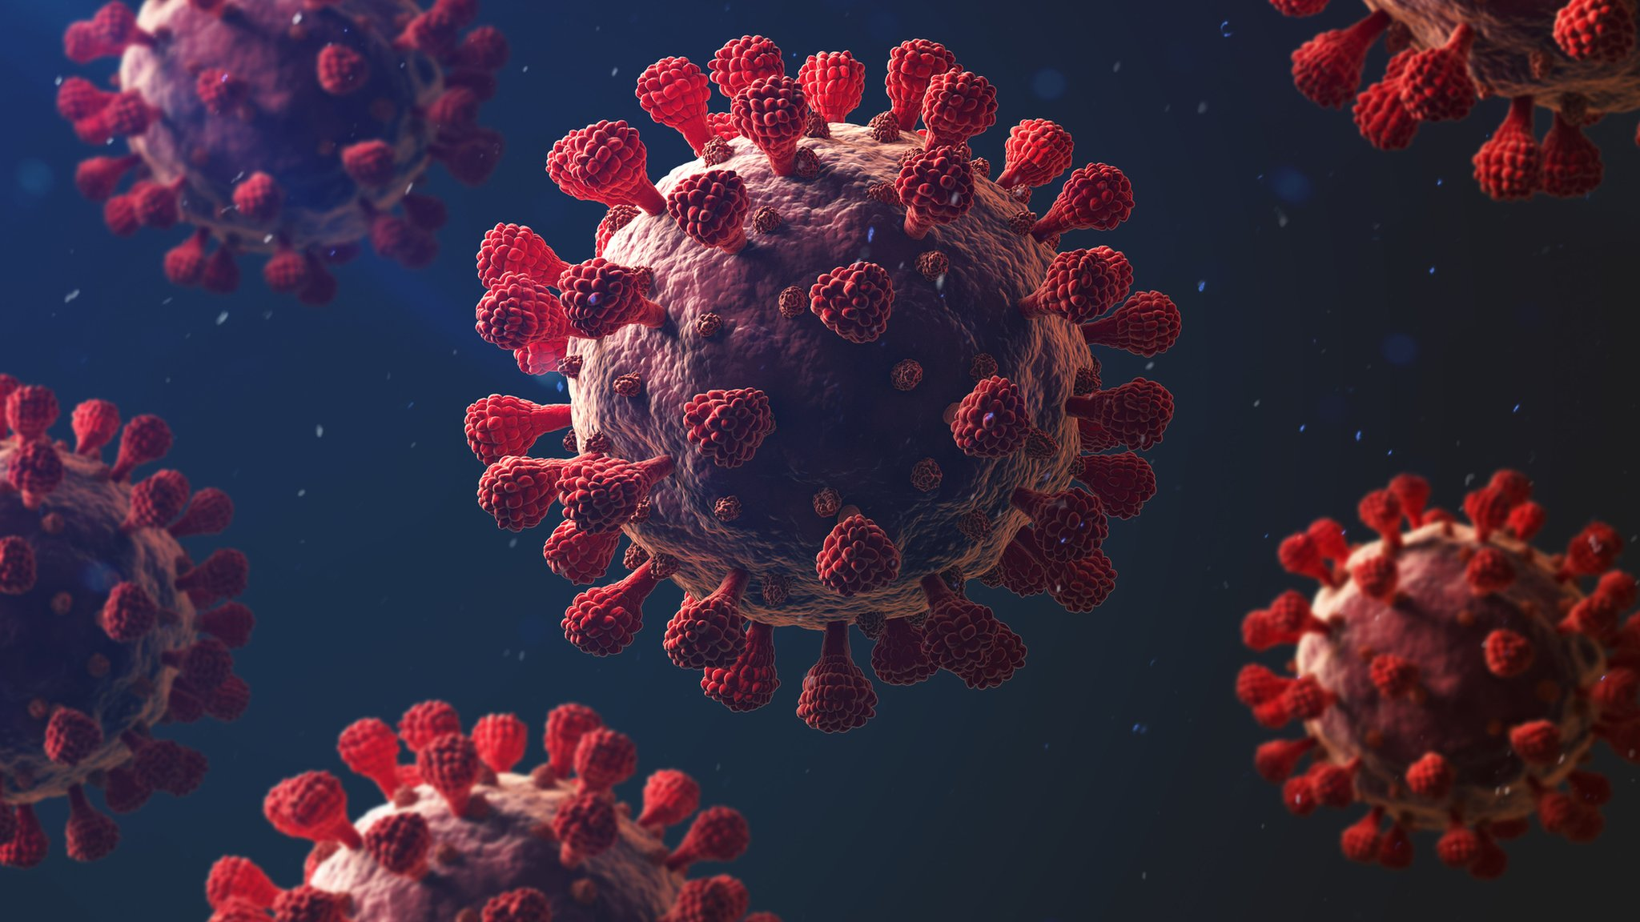
WARM-UP
Answer the question in each puzzle.
1
2
3
4

Slide 6
WARM-UP
Question 1
The kind of education that takes place over the Internet
➔ ONLINE LEARNING
BACK

Slide 7
WARM-UP
Question 2
A substance that is put into the body of a person or animal to protect them from a disease by causing them to produce antibodies.
➔ VACCINE
BACK

Slide 8
WARM-UP
Question 3
A covering for your face or for part of your face
➔ MASK
BACK

Slide 9
WARM-UP
Question 4
A set of measures aiming at stopping the spread of an infectious disease, based on staying away from other people as much as possible.
➔ SOCIAL DISTANCING
BACK

Slide 10
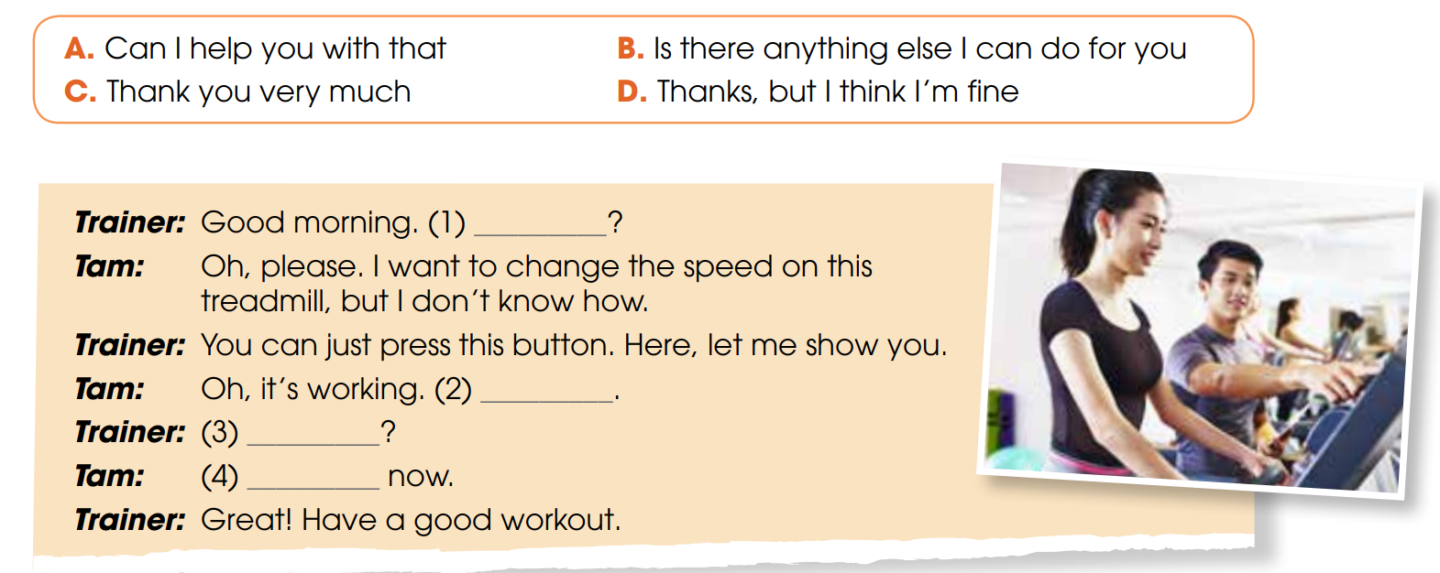
EVERYDAY ENGLISH
1
Listen and complete the conversation with the expressions in the box. Then practise it in pairs.
A
C
B
D

Slide 11
EVERYDAY ENGLISH
Useful expressions
Offering help | Responding to offers
+ Can I give you a hand? + Can I help you with …? + Let me help you with … + What can I do for you? + Is there anything (else) I can do for you? | + That’s very kind/nice of you. + Thanks for your help. + Thanks, but I think I’m fine. + You are so kind. Thanks a lot.

Slide 12
EVERYDAY ENGLISH
2
Work in pairs. Make similar conversations for these situations.
Student B is a supermarket assistant. Student A is a customer. Student A is trying to find some healthy foods for his/her family, and Student B is offering help.
Student A is a PE teacher. Student B is a student. Student B is trying to do an exercise routine and Student A is offering help.

Slide 13
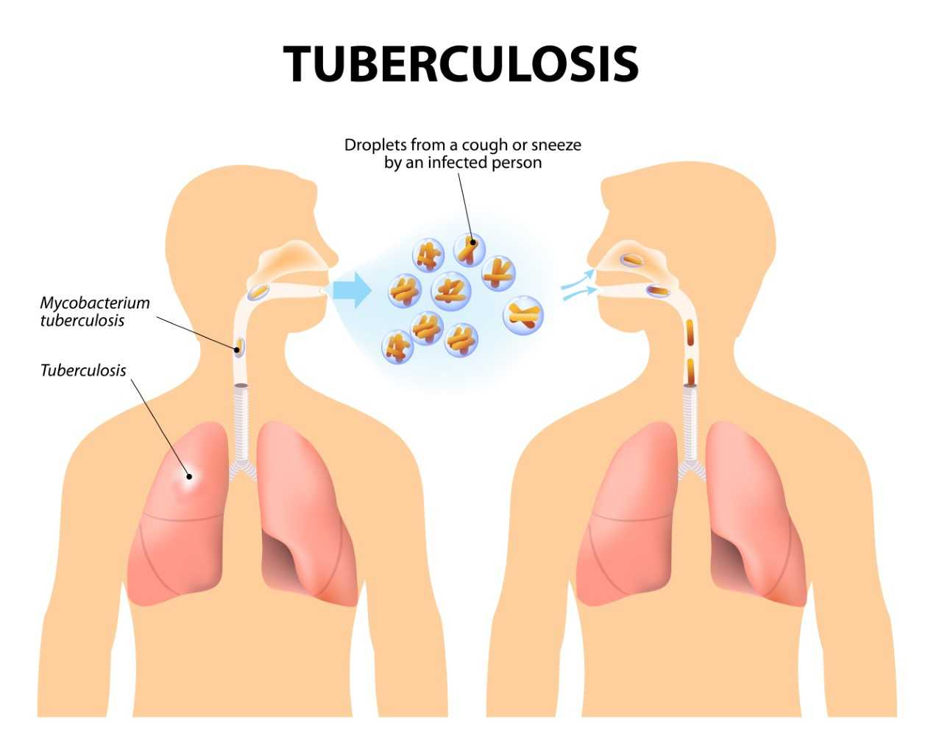
CLIL
tuberculosis (n)
/tjuːˌbɜːkjuˈləʊsɪs/
a serious disease, caused by bacteria, in which swellings appear on the lungs and other parts of the body

Slide 14
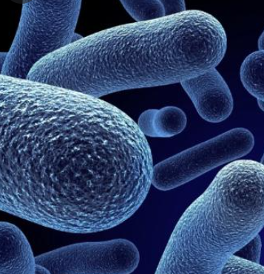
CLIL
organism (n)
/ˈɔːɡənɪzəm/
a living thing, especially one that is extremely small

Slide 15
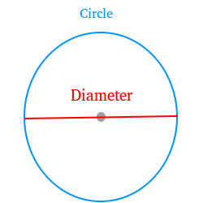
CLIL
diameter (n)
/daɪˈæmɪtə(r)/
a straight line going from one side of a circle or any other round object to the other side, passing through the centre

Slide 16
CLIL
antibiotic (n)
/ˌæntibaɪˈɒtɪk/
a substance, for example penicillin, that can destroy or prevent the growth of bacteria and cure infections

Slide 17
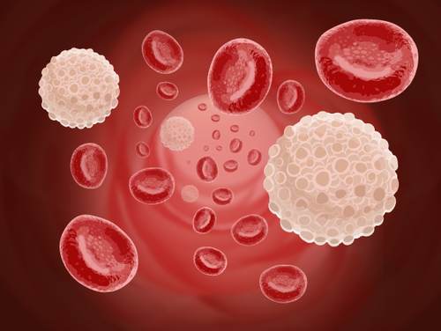
CLIL
cell (n)
/sel/
the smallest unit of living matter that can exist on its own. All plants and animals are made up of cells.

Slide 18
Form | Pronunciation | Meaning | Vietnamese equivalent
1. tuberculosis (n) | /tjuːˌbɜːkjuˈləʊsɪs/ | a serious disease, caused by bacteria, in which swellings appear on the lungs and other parts of the body | bệnh viêm phổi
2. organism (n) | /ˈɔːɡənɪzəm/ | a living thing, especially one that is extremely small | loài sinh vật
3. diameter (n) | /daɪˈæmɪtə(r)/ | a straight line going from one side of a circle or any other round object to the other side, passing through the centre | đường kính
4. antibiotic (n) | /ˌæntibaɪˈɒtɪk/ | a substance, i.e penicillin, that can destroy or prevent the growth of bacteria and cure infections | thuốc kháng sinh
5. cell (n) | /sel/ | The smallest unit of living matter that can exist on its own, all plants and animals are made up of cells | tế bào

Slide 19
1
Read the text and complete the comparison table below.
 | Bacteria | Viruses
Living or not when entering human body?
Which is smaller?
Examples of diseases they can cause
How to treat/prevent diseases caused by them?
Living
Not living
Bigger
Smaller
tuberculosis or food poisoning
Common cold, flu, AIDS and Covid-19
Antibiotics
Vaccines

Slide 20
2
Discuss in pairs. What would you say to these people?

Slide 21
EXTRA ACTIVITY
Do you know any pandemics or diseases caused by viruses and/or bacteria?
Diseases caused by viruses:
AIDS
Common cold
Ebola
Genital herpes
Influenza
Measles
Chickenpox and shingles
Coronavirus disease 2019
Diseases caused by bacteria
Tuberculosis
Pneumonia
Cholera

Slide 22
EXTRA ACTIVITY
Watch a video about Covid-19 and answer the questions.
Guiding questions:
1. How can the coronavirus spread?
2. What are some measures to avoid the spreading of the conoravirus?

Slide 23
Watch a video about Covid-19 and answer the questions
Guiding questions:
How can the coronavirus spread?
2. What are some measures to avoid the spreading of the conoravirus?
➔ Via vectors like objects we have touched through sneezing or coughing.
➔ Wash your hands, use hydro alcoholic gel, avoid touching your face, keep a safe distance, don’t touch your mask, cough or sneeze into your elbow.

Slide 24
CONSOLIDATION
1
Wrap-up
What have you learnt today?
Distinguish bacteria and viruses and how to deal with them
Review expressions for offering help and responding to offers

Slide 25
CONSOLIDATION
2
Homework
Do exercises in the workbook.
Prepare for Lesson 8 - Unit 1.

Slide 26
Website: hoclieu.vn
Fanpage: facebook.com/www.tienganhglobalsuccess.vn

