Slide 1
Welcome to our class

Slide 2
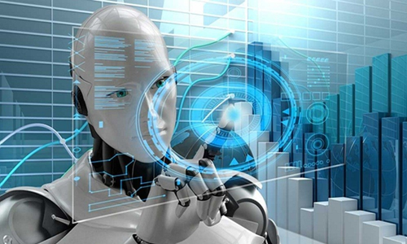
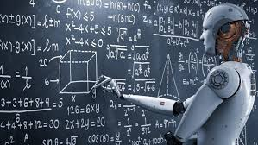
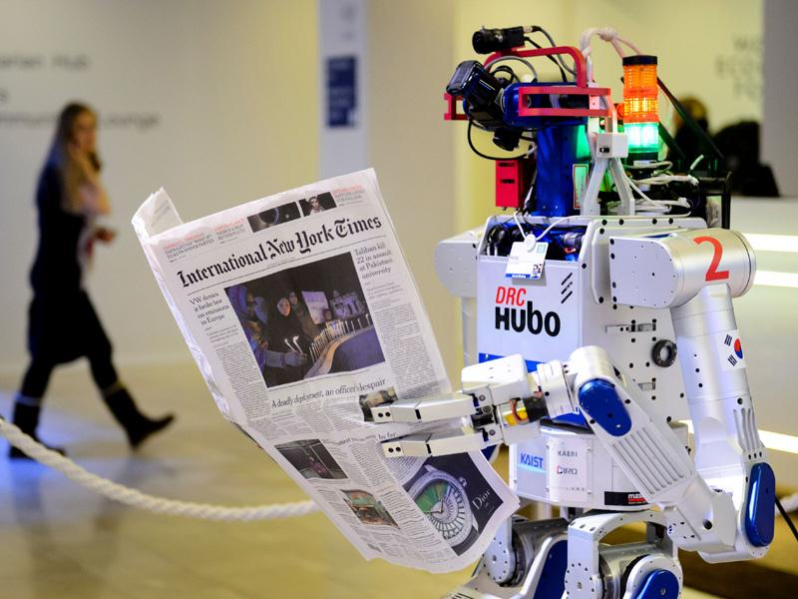
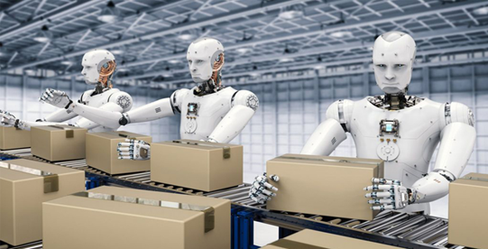
What are advantages and disadvantages of intelligent Robots ?
Intelligent Robots

Slide 3
Unit 7: Artificial intelligence Lesson: WRITING
Advantages and disadvantages of intelligent machines

Slide 4
I. Read the following phrases and discuss Advantages or Disadvantages of intelligent robots.
1. costly to train the operating staff and upgrade the computer programs
2. complete tasks faster and more precisely than humans
3. have fewer errors and defects
4. malfunctions due to computer system crashes
5. hackers taking control of computers and causing damage
6. reduce the workforce and cost of production
Disadvantages
Advantages
Advantages
Disadvantages
Disadvantages
Advantages

Slide 5
II. Read and combine the sentence halves.
1. A.I. robots are widely used in many areas,
2. Obviously, robots bring advantages to many areas;
3. The use of robots can replace the human workforce
4. They can not only complete tasks faster than humans,
5. In hospitals, robots will work as medical doctors performing operations on patients,
6. When attacked by malware or viruses, or disabled by power failure,
7. Robots could be controlled by hackers.
8. In short, robots benefit humans in some ways, especially in stressful and dangerous jobs,
9. The advantages of using intelligent robots outweigh the disadvantages.
a. A.I. robots may lead to the misuse and destruction to the world.
b. and reduce the cost of production.
c. including the car and food industries, and medicine.
d. and helping human doctors to identify damaged organs.
e. Therefore, robotic machines can cause damage to human lives.
f. however, there are also disadvantages when using them.
g. but can also make fewer errors than humans.
h. However, we must consider carefully when using them.
i. and make humans’ lives better.

Slide 6
III. Complete the outline. Then write an essay of 220-260 words to discuss the advantages and disadvantages of using intelligent robots.
INTRODUCTION:
BODY:
-Advantages: ……….
-Disadvantages: ………….
CONCLUSION:

Slide 7
Outline of an essay
INTRODUCTION:
Introduce how the robots use; their advantages and disadvantages
BODY:
-Advantages: +First(ly),/ The first, ………
+ Second (ly),/ the second, …….
……
-Disadvantages: + The first one is that ………
+ Another disadvantage is that …….
…..
CONCLUSION:
Summarize the main point and your opinions

Slide 8
1. A.I. robots are widely used in many areas, including the car and food industries, and medicine.
2. Obviously, robots bring advantages to many areas; however, there are also disadvantages when using them.
3. The use of robots can replace the human workforce and reduce the cost of production.
4. They can not only complete tasks faster than humans, but can also make fewer errors than humans.
5. In hospitals, robots will work as medical doctors performing operations on patients, and helping human doctors to identify damaged organs.
6. When attacked by malware or viruses, or disabled by power failure, A.I. robots may lead to the misuse and destruction to the world.
7. Robots could be controlled by hackers. Therefore, robotic machines can cause damage to human lives.
8. In short, robots benefit humans in some ways, especially in stressful and dangerous jobs, and make humans’ lives better.
9. The advantages of using intelligent robots outweigh the disadvantages. However, we must consider carefully when using them.
Intro
Intro
Body- Ads
Body- Ads
Body- Ads
Body- Disads
Body- Disads
Con
Con

Slide 9
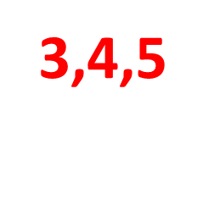
III. Write an essay of 220-260 words to discuss the advantages and disadvantages of using intelligent robots, using the ideas in 2 and 3 and your own ideas.
INTRODUCTION:
1,2
BODY:
-Advantages:
-Disadvantages:
CONCLUSION:
8,9

Slide 10
Sample writing

Slide 11
A.I. robots are widely used in many areas, including the car and food industries, and medicine. Obviously, robots bring advantages to many areas; however, there are also disadvantages when using them.
The advantages of intelligent robots are countless. The first, The use of robots can replace the human workforce and reduce the cost of production. The second, They can not only complete tasks faster than humans, but can also make fewer errors than humans. The last, in hospitals, robots will work as medical doctors performing operations on patients, and helping human doctors to identify damaged organs. Moreover, They also help experts to do research on any serious side effects caused by the interactions of different medications on patients that can lead to complications in treatment.
However, A.I. robots have some drawbacks. The first one is that When attacked by malware or viruses, or disabled by power failure, A.I. robots may lead to the misuse and destruction to the world. Another disadvantage is that the computer operating systems could be taken control of by hackers, causing misuse of robotic devices. This could potentially be dangerous to human lives.
In conclusion, robots benefit humans in some ways, especially in stressful and dangerous jobs, and make humans lives better. Although the advantages of using intelligent robots outweigh the disadvantages, we must consider carefully when using them.

Slide 12
Homework
Complete the essay
Prepare next part: Communication and culture

Slide 13
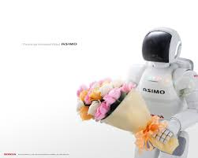
Thank YOU
Goodbye!

Slide 14
VOCABULARY:
- costly = expensive (adj):
- upgrade (v)
- precisely (adv)= exactly
- error = fault (n)
- defect (n):
- workforce (n)
- malware (n) =malicious-logic software
: đắt
: nâng cấp
: đúng, chính xác, cẩn thận
: lỗi, sai sót
: khuyết điểm
: lực lượng lao động
: virut máy tính

