Slide 1
WELCOME TO OUR CLASS!

Slide 2
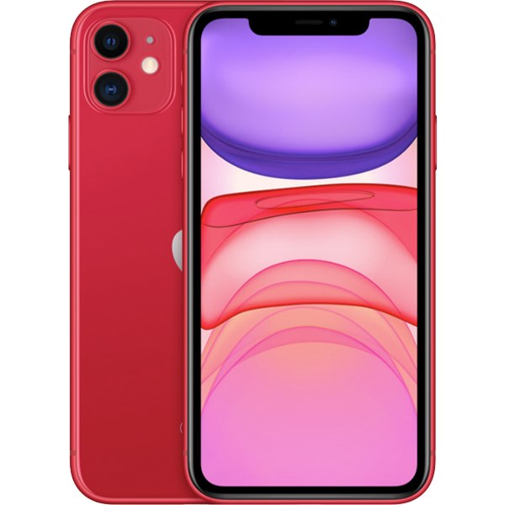
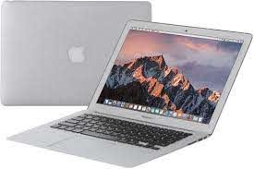
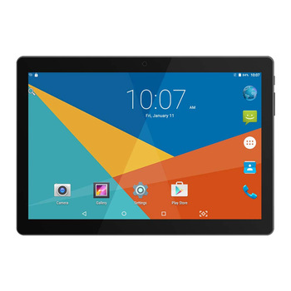
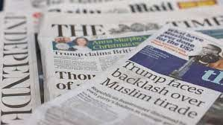
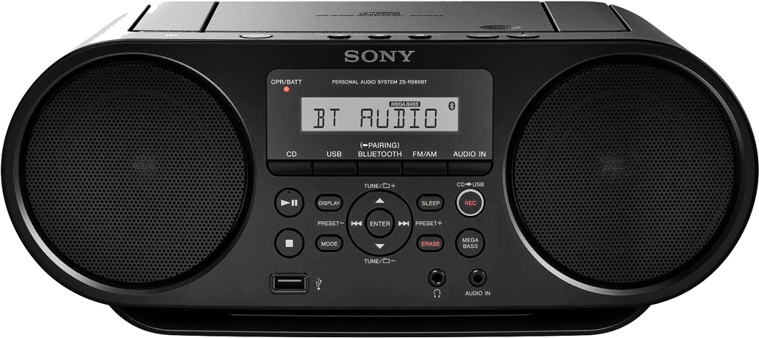
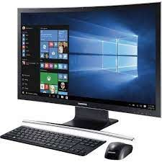
The mass media
mobilephone
Laptop
Tablet
Newspaper
Radio
facebook
TV/ television
Computer

Slide 3
Unit 4 – THE MASS MEDIA
Getting Started

Slide 4
Complete the table with the appropriate words and phrases
smartphones,
newspapers,
chatting,
magazines,
tablet PCs,
sending messages,
radio,
TV,
DVDs,
reading online newspapers,
accessing the Internet,
computers,
social media,
searching for news,
the Internet.
Digital devices | The mass media | Online activities

Slide 5
Listen and read

Slide 6
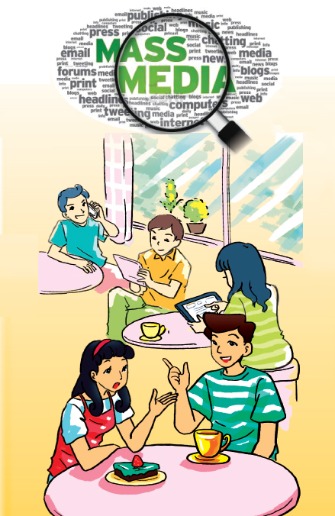

Slide 7
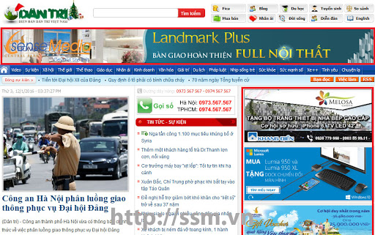
Vocabulary:
- Print newspaper (n):
Báo in
- Online newspaper (n):
Báo điện tử
- Digital device (n):
Thiết bị số
Eg: Smartphones, tablets PCs are digital devices.
- Subscribe (v):
Đăng kí (dài hạn)
Very big / huge
- Enomous (adj):
To lớn, khổng lồ
- Be addicted to st:
Nghiện, say mê
Eg: I think many students are addicted to Facebook.

Slide 8
Match each verb with the correct preposition.
search with
connect for
Nam (1) : Yeah. May be they are chatting, sending messages or searching for news.
Tìm kiếm
Nam (5) : Yes, but once they start using the Internet they can also connect with friends and family members any time.
kết nối với

Slide 9
Answer the questions.
1. What are the people around Nam and Lan doing?
2. Why did Minh’s father subscribe to fewer
print newspapers and magazines?
3. How had Minh’s grandpa accessed the Internet before he was given a tablet PC?
4. What is the reason that older people don’t want to use the Internet according to Lan?
5. What does Nam think of Lan’s use of social media and the Internet?

Slide 10
Game: Secret in the ball
Question

Slide 11
Game: Secret in the ball
1
2
3
5
6
7
8
Choose a ball

Slide 12
Question 1
Why did Minh’s father subscribe to fewer print newspapers and magazines?
2
1
4
3
0
5
Time up
Because everyone in his house can read the news on their digital devices.
Time
Open
Shoot

Slide 13
Question 2
What does Nam think of Lan’s use of social media and the Internet?
2
1
4
3
0
5
Time up
He thinks that she is addicted to social media and relies too much on the Internet.
Time
Open
Shoot

Slide 14
Question 3
What are the people around Nam and Lan doing?
2
1
4
3
0
5
Time up
They are chatting, sending messages or searching for news.
Time
Open
Shoot

Slide 15
A lucky ball
+ 10 points
Open
Shoot

Slide 16
Question 7
What is the reason that older people don’t want to use the Internet according to Lan?
2
1
4
3
0
5
Time up
She thinks that they may not understand the benefits of online information.
Time
Open
Shoot

Slide 17
Question 6
How had Minh’s grandpa accessed the Internet before he was given a tablet PC?
2
1
4
3
0
5
Time up
Time
He had used the computers in the local library to access the Internet.
Open
Shoot

Slide 18
A lucky ball
+ 20 points
Open
Shoot

Slide 19
How do you usually
contact your friends and get information for your school project?

Slide 20
Read the following sentences. Underline the verbs. What tenses are they in?
Past perfect
-> This action happened first
He had already started using the computers in the
local library to access the Internet when Minh’s dad
bought him a tablet PC four months ago.
Past simple
-> This action happened later

Slide 21
Game

Slide 22
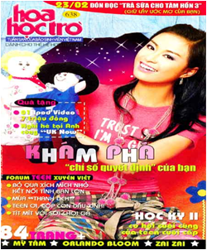
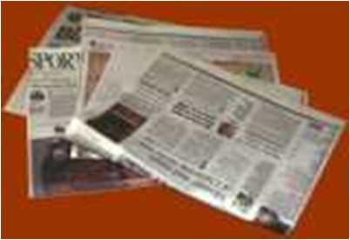
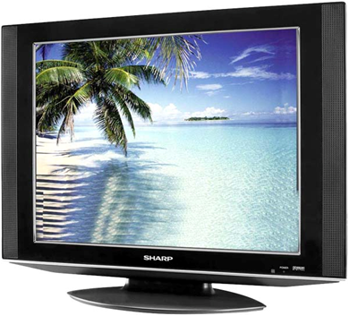
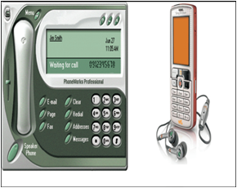
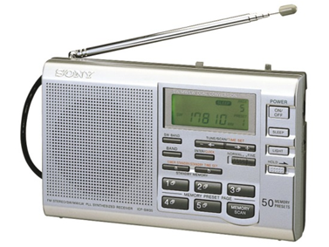
Who is quicker?

Slide 23
1. The ____ involves TV, radio and even electronic forms of communication such as the Internet.
media B. press
C. network D. telecommunication

Slide 24
2. Linda only ____ the film after she ____ the book.
understood – read
understood - had read
C. had understood – read
D. understood - was reading

Slide 25
3. Smartphones, tablets, laptops and computers are all_______.
A. instant messaging
B. digital devices
C. social networking
D. Online activities

Slide 26
4. people around Nam and Lan are chatting, sending messages or _________ news.
searching for
looking up
C. connecting with
D. asking for

Slide 27
5. Nam thinks that Lan is _______ to social media and relies too much on the Internet.
A. addicting
B. addicted
C. addiction
D. addict

Slide 28
Homework
Learn new words.
Make sentences with two phrases: Search for and Connect with.
Review the past simple & past perfect.
Prepare: unit 4- Language.

Slide 29
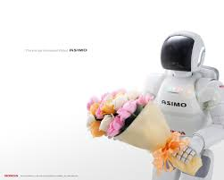
Thank YOU
Goodbye!

