Slide 1
WELCOME TO CLASS 9A2

Slide 2
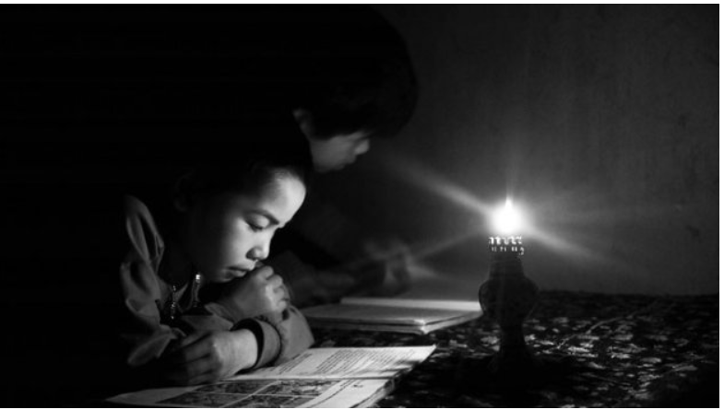
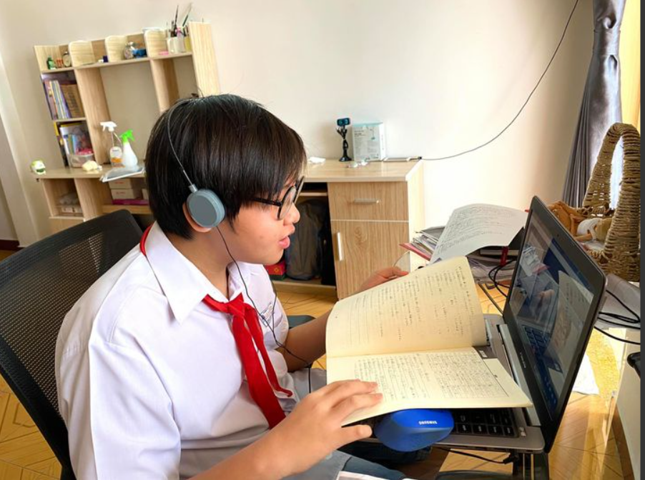
WARM-UP
1
2
PAST LEARNING
PRESENT LEARNING

Slide 3
WARM-UP
Was learning in the past different from learning in the present?
PAST LEARNING
PRESENT LEARNING

Slide 4
UNIT 6:
VIETNAMESE LIFESTYLES: THEN AND NOW
LESSON 5: SKILLS 1

Slide 5
READING
1
Work in groups. Discuss if each of the following phrases describes past or present learning.
– Depending on textbooks
– Using the Internet
– Learning under an oil lamp
– Being independent and active
Phrases:
PAST LEARNING | PRESENT LEARNING
– Depending on textbooks
– Using the Internet
– Learning under an oil lamp
– Being independent and active

Slide 6
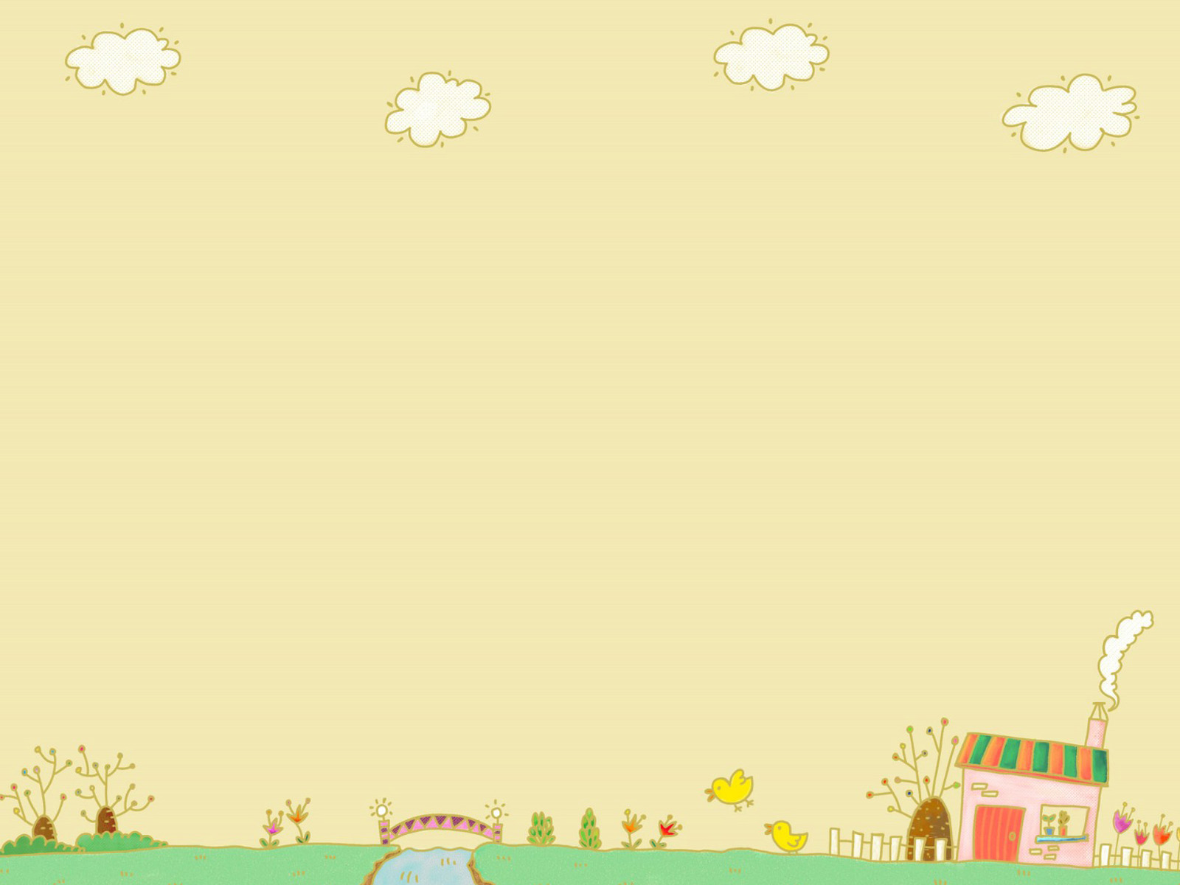
READING
lab (n)
/læb/
phòng thí nghiệm
a room used for scientific work

Slide 7
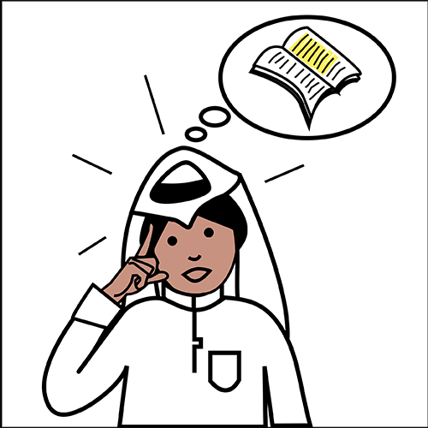
READING
memorise (v)
/'meməraiz/
ghi nhớ
learn something carefully so that you can remember it exactly

Slide 8
READING
independent (a)
/,indi'pendənt/
độc lập
Not influenced or controlled in any way by other people, events, or things.

Slide 9
PRESENTATION
New words | Pronunciation | Meaning
lab (n) | /læb/ | Phòng thí nghiệm
2. memorise (a) | /'meməraiz/ | Ghi nhớ
3. independent (a) | /,indi'pendənt/ | độc lập

Slide 10
READING
LISTEN AND READ THE PASSAGES TO CHOOSE THE CORRECT ANSWER A, B, C OR D
Mr Nam, grandfather, a 70-year-old farmer
I was one of the few children in my village who was still at school at the age of 15. Every day, I got up early and walked to school. Learning then depended mostly on our teachers and textbooks. We had no library or lab. The nearest bookshop was six kilometres away. I learned simply by taking notes during class, memorising them, and doing the homework. Life then was simple. We rarely travelled outside our village, so we didn't know much about the world around us.
Mai, granddaughter, a 15-year-old student
Learning today is very different from my grandfather's time. It is easier and more convenient. Besides learning from teachers and textbooks, we use the Internet. It provides us with various online sources such as documents, clips, and programmes. Google helps us find the answers to almost any questions we have. The Internet also allows us to pursue our own interests. Learning has become more independent. Although most children in my village have fewer private learning facilities than the students in the city, we are still luckier than my grandfather's generation. We have TVs to watch at home and a library and computers at school.

Slide 11
Mr Nam, grandfather, a 70-year-old farmer
I was one of the few children in my village who was still at school at the age of 15. Every dgay, I got up early and walked to school. Learning then depended mostly on our teachers and textbooks. We had no library or lab. The nearest bookshop was six kilometres away. I learned simply by taking notes during class, memorisingthem, and doing the homework. Life then was simple. We rarely travelled outside our village, so we didn’t know much about the world around us.
READING
2
Two people of different generations are talking about their learning styles. Read the passages and choose the correct answer A, B, C, or D.
1. In Mr Nam’s time, ______.
A. teachers played an important role
B. there were no bookshops
C. students did experiments in labs
D. all children stayed on at school until they were 15
2. Few people travelled outside their village, so ______.
A. life in the village was simple
B. his school didn’t have any learning facilities
C. the villagers didn’t know much about the world around
D. none of the villagers knew about city life

Slide 12
Mr Nam, grandfather, a 70-year-old farmer
I was one of the few children in my village who was still at school at the age of 15. Every dgay, I got up early and walked to school. Learning then depended mostly on our teachers and textbooks. We had no library or lab. The nearest bookshop was six kilometres away. I learned simply by taking notes during class, memorisingthem, and doing the homework. Life then was simple. We rarely travelled outside our village, so we didn’t know much about the world around us.
READING
2
Two people of different generations are talking about their learning styles. Read the passages and choose the correct answer A, B, C, or D.
3. Learning now ______.
A. does not require textbooks
B. uses some online programmes
C. depends only on the Internet
D. does not require students to take notes
4. The word “It” refers to ______.
A. learning today
B. my grandfather’s time
C. learning facilities
D. the Internet

Slide 13
Mr Nam, grandfather, a 70-year-old farmer
I was one of the few children in my village who was still at school at the age of 15. Every dgay, I got up early and walked to school. Learning then depended mostly on our teachers and textbooks. We had no library or lab. The nearest bookshop was six kilometres away. I learned simply by taking notes during class, memorisingthem, and doing the homework. Life then was simple. We rarely travelled outside our village, so we didn’t know much about the world around us.
READING
2
Two people of different generations are talking about their learning styles. Read the passages and choose the correct answer A, B, C, or D.
5. The word “we” refers to __________.
A. learning facilities
B. students at my grandfather’s generation
C. students in the city
D. children in the village

Slide 14
READING
3
Fill in each blank with ONE word from the passage.
1. Mr Nam learned mainly from teachers and _________.
2. He learned by ___________ the information he got in class.
3. Nowadays, students can learn from ________ online sources.
4. An example of an online source is __________________________.
5. The Internet helps children _______ their interests.
textbooks
memorising
various
documents / clips / programmes
pursue

Slide 15
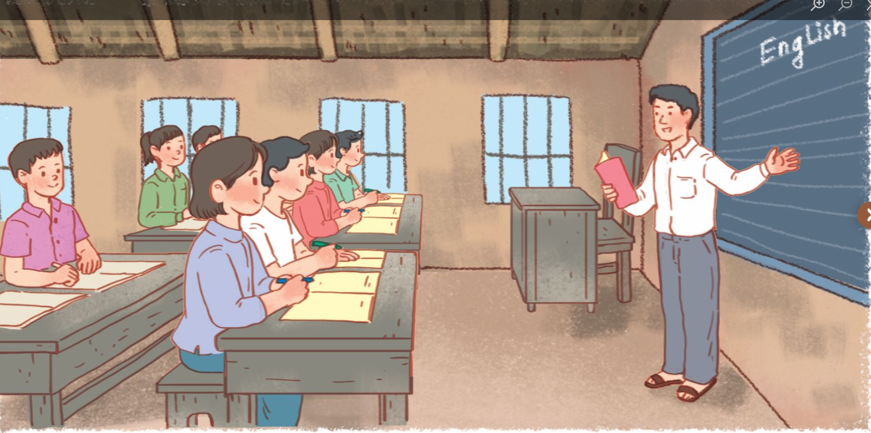
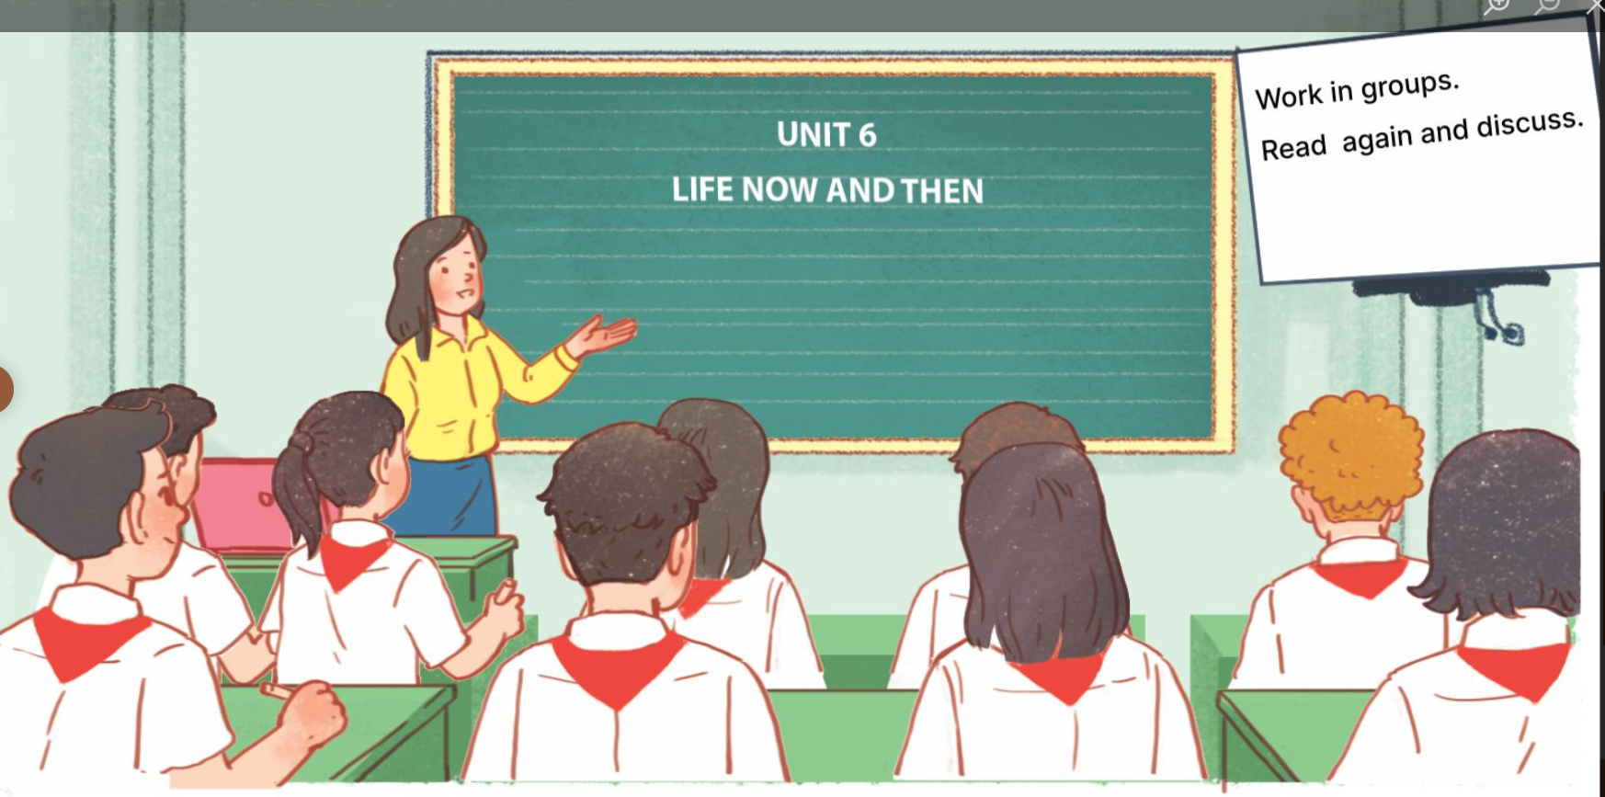
"We’ve just read about the learning styles of two generations. Through this, you can see that each era has its unique approach to education. Now, let’s reflect on yourselves: how has your learning style changed over the past 5 years?

Slide 16
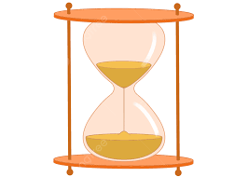
SPEAKING
4
Work in groups. Discuss and make a list of the changes in your learning over the past five years. And present your opinion.
You can mention:
– number of subjects
– teachers
– learning facilities
– learning style (dependent / independent ...)
GROUP 1
GROUP 2
GROUP 3
GROUP 4

Slide 17
SPEAKING
4
Work in groups. Discuss and make a list of the changes in your learning over the past five years.
ASPECTS | 5 YEARS AGO | NOW
Number of subjects | Fewer subjects | More subjects
Teachers | Three or four teachers teach all the subjects | Different teachers for different subjects
Learning facilities | Almost textbook | Use textbooks and Internet…
Learning style | Dependent | Independent

Slide 18
RULES
LOG IN KAHOOT
ANSWER 6 QUESTIONS
WIN THE QUIZ (CORRECT ANSWERS AND FASTER ANSWERS)

Slide 19
ARE YOU READY?

Slide 20
"Every generation has its own way of learning, and we’re lucky to live in a time with so many tools to support us. Let’s make the most of these advantages to grow and achieve our dreams!"

Slide 21
HOMEWORK
- Learn the vocabulary
Do exercises in the workbook.
Prepare the new lesson – Skills 2

Slide 22
THANK YOU!

