Slide 1
Welcome to class 8A2!

Slide 2
WATCH A VIDEO.
CAN YOU GUESS THE TOPIC WE LEARN TODAY?
SCIENCE AND TECHNOLOGY

Slide 3
Unit
11
SCIENCE AND TECHNOLOGY
LESSON 1: GETTING STARTED
Great news for students
1

Slide 4
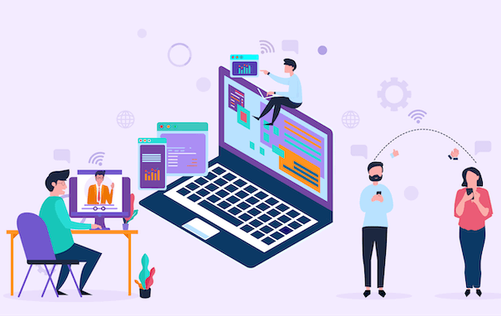
PRESENTATION
technology (n)
/tekˈnɒlədʒi/
công nghệ

Slide 5
PRESENTATION
face to face (adj)
/ˌfeɪs tə ˈfeɪs/
trực tiếp,
mặt đối mặt

Slide 6
PRESENTATION
epidemic (n)
/ˌepɪˈdemɪk/
dịch bệnh

Slide 7
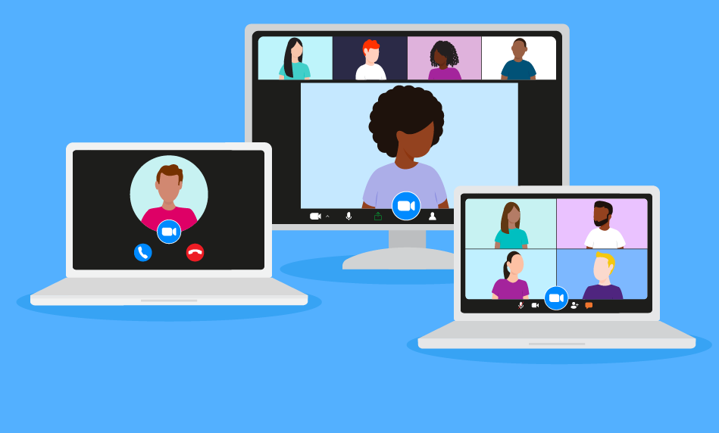
PRESENTATION
breakout room (n)
/ˈbreɪkaʊt rʊm /
phòng học chia nhỏ, chia nhóm

Slide 8
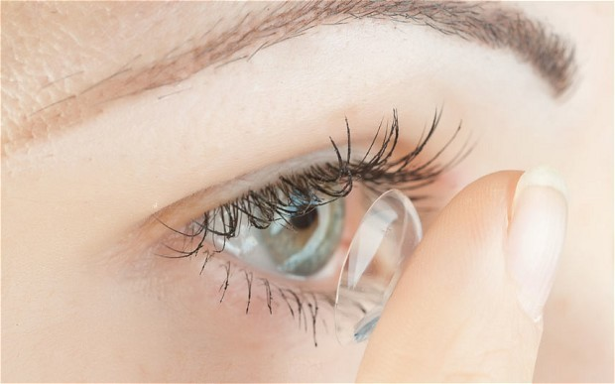
PRESENTATION
contact lens (n)
/ˈkɒntækt lenz/
kính áp tròng

Slide 9
PRESENTATION
invention (n)
/ɪnˈvenʃn/
sự phát minh

Slide 10
PRESENTATION
New words | Pronunciation | Meaning
1. technology (n) | /tekˈnɒlədʒi/ | công nghệ
2. face-to-face | /ˌfeɪs tə ˈfeɪs/ | trực tiếp, mặt đối mặt
3. epidemic (n) | /ˌepɪˈdemɪk/ | đại dịch
4. breakout room (n) | /ˈbreɪkaʊt ruːm/ | phòng học chia nhỏ
5. contact lens (v) | /ˈkɒntækt lenz/ | kính áp tròng
6. invention (n) | /ɪnˈvenʃn/ | sự phát minh

Slide 11
MATCH THE WORDS OR PHRASES WITH THEIR MEANING
PRESENTATION
NEW WORDS | MEANING
1. technology | A. phòng học chia nhỏ
2. face-to-face | B. phát minh
3. epidemic | C. trực tiếp, mặt đối mặt
4. breakout room | D. công nghệ
5. contact lens | E. dịch bệnh
6. invention | F. kính áp tròng

Slide 12
PRACTICE
1
Listen and read.
Minh: Ann, do you like yesterday’s lesson? I really enjoy learning online.
Ann: I prefer having face-to-face classes. I like to interact with my classmates during the lessons.
Minh: I think online classes are convenient during bad weather or epidemics. Also, students can still interact when they are in breakout rooms.
Ann: But the Internet connection doesn’t always work well enough to learn online. And my eyes get tired when I work in front of the computer screen for a long time.
Minh: I know what you mean. But there’s some great news for us. 3D contact lenses will soon be available. With them, our eyes won’t get tired when looking at a computer screen all day long.
Ann: Wow, that’s brilliant!
Minh: Another helpful invention is robot teachers. They will teach us when our human teachers are not available or get ill. My uncle said the robots would be able to mark our work and give us feedback too.
Ann: Fantastic! I can’t wait.

Slide 13
PRACTICE
2
Read the conversation again and tick T (True) or F (False).
Statements | T | F
1. Ann and Minh had a face-to-face class yesterday.
2. Ann likes face-to-face classes because she can interact with her classmates.
3. Minh finds online classes inconvenient.
4. When students use 3D contact lenses, their eyes will not get tired.
5. Robot teachers will be able to mark papers and comment on students’ work.

Slide 14
PRACTICE
1
Listen and read.
Minh: Ann, do you like yesterday’s lesson? I really enjoy learning online.
Ann: I prefer having face-to-face classes. I like to interact with my classmates during the lessons.
Minh: I think online classes are convenient during bad weather or epidemics. Also, students can still interact when they are in breakout rooms.
Ann: But the Internet connection doesn’t always work well enough to learn online. And my eyes get tired when I work in front of the computer screen for a long time.
Minh: I know what you mean. But there’s some great news for us. 3D contact lenses will soon be available. With them, our eyes won’t get tired when looking at a computer screen all day long.
Ann: Wow, that’s brilliant!
Minh: Another helpful invention is robot teachers. They will teach us when our human teachers are not available or get ill. My uncle said the robots would be able to mark our work and give us feedback too.
Ann: Fantastic! I can’t wait.

Slide 15
PRACTICE
3
Label each picture with a phrase from the box.
robot teacher, online class, 3D contact lenses, computer screen, breakout rooms, Internet connection
1.
computer screen
2.
3D contact lenses
3.
online class
4.
robot teacher
5.
breakout rooms
6.
Internet connection

Slide 16
PRACTICE
4
Complete the sentences, using the phrases in 3.
1. I can’t see the documents on the computer very clearly. I need a larger ______________.
2. During our lessons, our teacher puts us into ______________ for group discussions.
3. A ____________ in Korea teaches English to primary students.
4. We had a(n) ____________ yesterday with a teacher in the US.
5. Can I wear ________________ and watch a movie too?
computer screen
breakout rooms
robot teacher
online class
3D contact lenses

Slide 17
PRODUCTION
5
Do you know what things were invented in these years?
1. 1822: Charles Babbage invented it. Students use it to type essays and to learn online.
The first computer

Slide 18
PRODUCTION
5
Do you know what things were invented in these years?
2. 1876: Alexander Graham Bell invented it. We use it to communicate with our friends and families.
The telephone

Slide 19
PRODUCTION
5
Do you know what things were invented in these years?
3. 1928: Sir Alexander Fleming discovered it. It was the world’s first antibiotic.
Penicillin

Slide 20
PRODUCTION
5
Do you know what things were invented in these years?
4. 1989: Tim Berner-Lee invented it. It links information sources so everyone can access them.
The WWW - World Wide Web

Slide 21
PRODUCTION
5
Do you know what things were invented in these years?
5. 2000: Honda developed it. It can run, jump, and work as a bartender.
Robot ASIMO

Slide 22
HOMEWORK
Learn new words
Do exercises in the workbook
Prepare for the next lesson: A closer look 1

