Slide 1


Slide 2
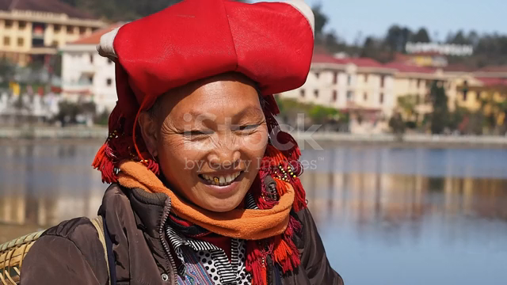

LESSON 5: SKILLS 1
Tiếng Anh
GV: Đặng Thị Hương Hoa
Lớp 8A

Slide 3
WARM-UP
building
Town house
cottage
Villa
Types of house
Houseboat
apartment
Stilt house
flat
Country house

Slide 4
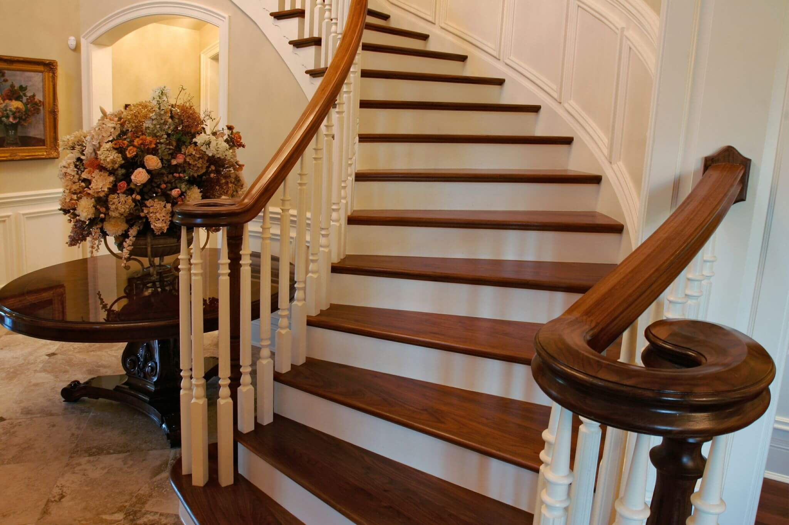

VOCABULARY
staircase (n)
/ˈsteəkeɪs/
cầu thang bộ

Slide 5

VOCABULARY
material (n)
/məˈtɪəriəl/
vật liệu

Slide 6
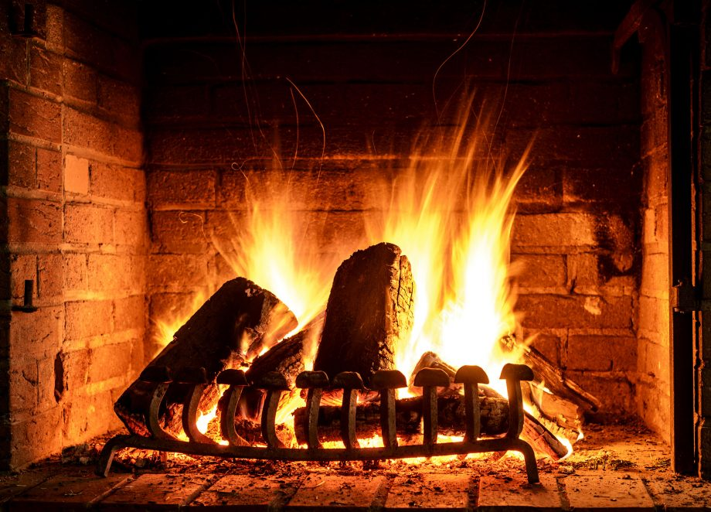
VOCABULARY
open fire (n)
/ˌəʊpən ˈfaɪə/
lò sưởi, bếp lửa

Slide 7

VOCABULARY
owner (n)
/ˈoʊnə/
người sở hữu, chủ

Slide 8
VOCABULARY
New words | Pronunciation | Meaning
1. staircase (n) | /ˈsteəkeɪs/ | cầu thang bộ
2. material (n) | /məˈtɪəriəl/ | vật liệu
3. open fire (n) | /ˌəʊpən ˈfaɪə/ | lò sưởi, bếp lửa
4. owner (n) | /ˈoʊnə/ | người sở hữu, chủ

Slide 9
VOCABULARY
New words |  | Meaning
1. staircase (n)
2. material (n)
3. open fire (n)
4. owner (n)
vật liệu
người sở hữu, chủ
cầu thang bộ
lò sưởi, bếp lửa

Slide 10
READING
1
Write the words and phrase from the box under the correct pictures.
open fire
posts
staircase
1. _______________
2. _______________
3. _______________

Slide 11

READING
2
Read the passage and tick T (True) or F (False)
Statements | True | False
1. Only a few minority groups live in stilt houses.
2. All stilt houses look alike.
3. Family gatherings take place by the open fire in the middle of the house.
4. The Rong house serves as the centre of an Ede village

Slide 12
READING
3
Read the passage again and fill in each blank with one word.
1. A stilt house shows the _________ culture of the owner.
traditional
2. The Tay’s and Nung’s stilt houses overlook a _________.
field
3. The Thai’s stilt houses overlook a _________ or __________.
forest
mountains
4. The largest and tallest house in an Ede village is the _________ house.
Rong

Slide 13


SPEAKING
4
Work in pairs. Discuss and tick ( )the features of a stilt house from the list below. Share your opinions with the class.
A stilt house ____________.
- has a flat cement roof
- stands on big posts
- is made from natural materials
- has a modern toilet
- is a flat in a big block
- is close to nature
- has an open fire

Slide 14
SPEAKING
5
Work in pairs. Ask and answer about the type of home each of you lives in. Take notes of your partner’s answer and report what you find to the class.
1. What type of home do you live in?
2. What materials is it made from?
3. What is the most important part of your home? What do you do there?

Slide 15
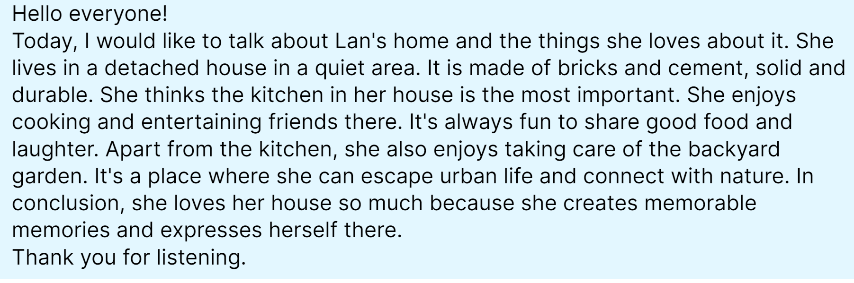
1
Suggested answers:

Slide 16

CONSOLIDATION
1
Wrap-up
In this lesson, you have:
learnt new words related to the topic of stilt house.
read a passage about stilt houses.
described the house you live in.

Slide 17

CONSOLIDATION
2
Homework
Learn by heart all the new words.
Do exercises in the workbook.
Prepare for Lesson 6 – Skills 2.

