Slide 2
Unit
2
The generation gap
Unit
FAMILY LIFE
LESSON 3
READING
Different generations
Giáo viên: Phạm Thị Thúy Hạ
Lớp: 11A2

Slide 3
* WARM-UP
MYSTERIOUS PICTURE
- Ss work in groups.
- There are 4 questions which relate to a key picture.
- Guess the word/ phrase in each puzzle and guess the key picture behind after each puzzle is opened.
- The group which gets the correct answer of the key picture is the winner.

Slide 4
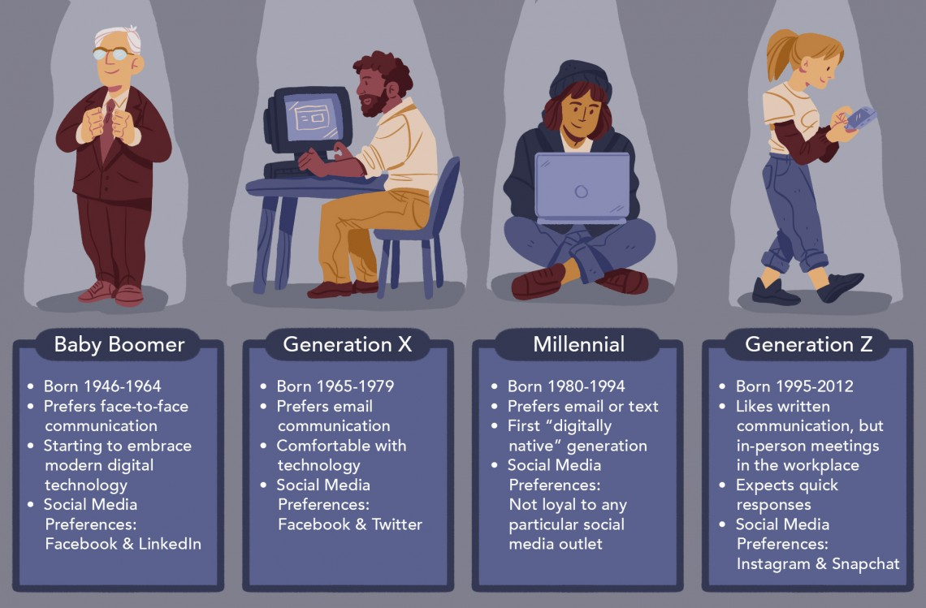
* WARM-UP
Answer the question in each puzzle.
1
2
3
4
GENERATIONS

Slide 5
* WARM-UP
Question 1
special qualities that belong to a group of people or things
➔ COMMON CHARACTERISTICS
BACK

Slide 6
* WARM-UP
Question 2
a disagreement between different generations
➔ GENERATIONAL CONFLICT
BACK

Slide 7
* WARM-UP
Question 3
beliefs about what is important in the culture of a particular society
➔ CULTURAL VALUES
BACK

Slide 8
* WARM-UP
Question 4
a belief or an opinion that has existed for a long time without changing
➔ TRADITIONAL VIEW
BACK

Slide 9
Unit
2
The generation gap
Unit
FAMILY LIFE
LESSON 3
READING
Different generations

Slide 10
LESSON 3
READING
WARM-UP
Mysterious picture
PRE-READING
Vocabulary
- Task 2. Read the article. Match the highlighted words with their meanings
- Task 3. Read the article again and choose the best title.
- Task 4. Read the article again. Tick (✓) the characteristics of each generation according to the article.
WHILE-READING
POST-READING
Discussion
Homework
CONSOLIDATION

Slide 11
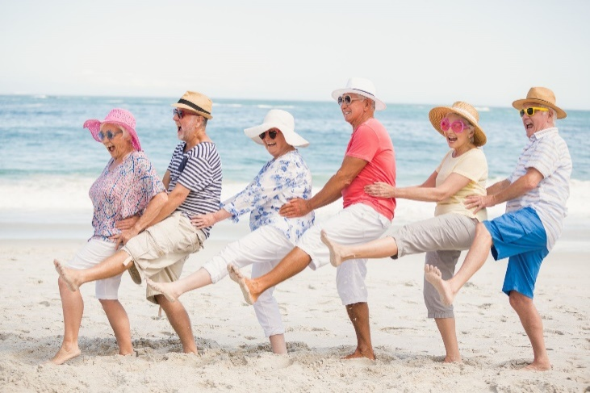
PRE-READING
1
Work in pairs. Look at the photos. Discuss what you know about the generation in each picture (e.g. age, characteristics, interests, life experiences).
Generation X
Generation Y
Generation Z

Slide 12
PRE-READING
Generation X
Generation X includes those born between 1965 and 1981, during the reconstruction of Europe after the war. They are less dependent on smartphones than the next generations.
(Thế hệ X bao gồm những người sinh từ năm 1965 đến 1981, trong thời kỳ tái thiết châu Âu sau chiến tranh. Họ ít phụ thuộc vào smartphone hơn các thế hệ tiếp theo.)

Slide 13
PRE-READING
Generation Y is those born between 1982 and 1994 and technology is part of their everyday lives: all their activities are mediated by a screen. However, the millennial generation is labelled as being lazy, narcissistic and spoilt.
(Thế hệ Y là những người sinh từ năm 1982 đến 1994 và công nghệ là một phần trong cuộc sống hàng ngày của họ: mọi hoạt động của họ đều được điều khiển bởi màn hình. Tuy nhiên, thế hệ Y bị coi là lười biếng, tự ái và hư hỏng.)

Slide 14
PRE-READING
Generation Z were born between1995 and 2010 — they arrived with a tablet and a smartphone under their arms. It is a group of people that is marked by the Internet. Their mastery of technologies may make them neglect their interpersonal relationships to a greater extent, but they are the ones who give more of a voice to social causes on the Internet.
(Thế hệ Z sinh năm 1995 đến 2010 - họ được cung cấp một chiếc máy tính bảng và điện thoại thông minh. Đó là một nhóm người được đánh dấu bởi Internet. Sự thông thạo công nghệ của họ có thể khiến họ bỏ bê các mối quan hệ giữa các cá nhân ở mức độ lớn hơn, nhưng họ là những người đưa ra nhiều tiếng nói hơn cho các hoạt động xã hội trên Internet.)

Slide 15
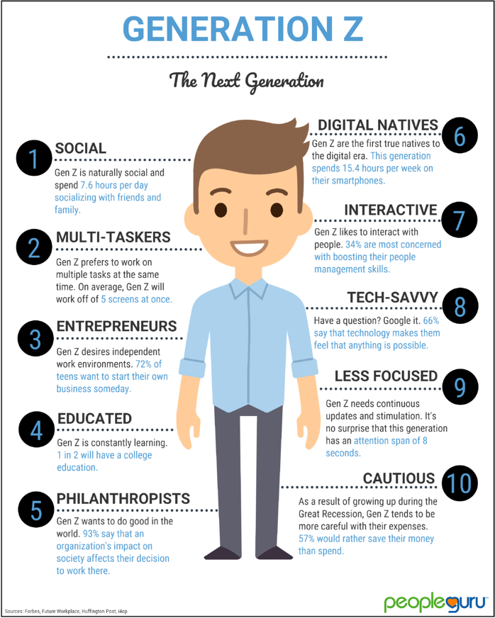
PRE-READING
1. Characteristic (n)
/ˌkærəktəˈrɪstɪk/
a typical feature or quality that something/somebody has

Slide 16
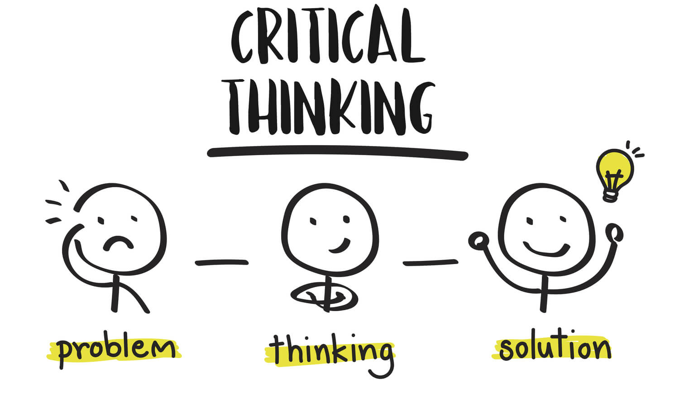
PRE-READING
2. Critical (adj)
/ˈkrɪtɪkl/
making careful judgements

Slide 17
PRE-READING
3. Creative (adj)
/kriˈeɪtɪv/
involving the use of skill and the imagination to produce something new or a work of art

Slide 18
PRE-READING
4. Platform (n)
/ˈplætfɔːm/
the type of computer system or the software that is used

Slide 19
PRE-READING
Form | Pronunciation | Meaning | Vietnamese equivalent
1. Characteristic (n) | /ˌkærəktəˈrɪstɪk/ | a typical feature or quality that something/somebody has | Đặc điểm
2. Critical (adj) | /ˈkrɪtɪkl/ | making careful judgements | Có tính phản biện
3. Creative (adj) | /kriˈeɪtɪv/ | involving the use of skill and the imagination to produce something new or a work of art | Sáng tạo
4. Platform (n) | /ˈplætfɔːm/ | the type of computer system or the software that is used | Nền tảng

Slide 20
WHILE-READING
2
Read the article. Match the highlighted words with their meanings.
1. Experienced (adj)
a. to try or test new ideas or methods
2. Curious (adj)
b. went through
3. digital natives (np)
c. to employ
4. Experiment (v)
d. wanting to know about something
5. Hire (v)
e. people born in the era of technology

Slide 21
WHILE-READING
3
Read the article again and choose the best title.
A. The study of different generations
B. Generational differences in different societies
C. Characteristics of different generations
Over the past two centuries, different generations were born and given different names. Each generation comes with its characteristics, which are largely influenced by the historical, economic, and social conditions of the country they live in. (Paragraph 1)

Slide 22
WHILE-READING
4
Read the article again. Tick (✓) the characteristics of each generation according to the article.
 |  | Generation X | Generation Y | Generation Z
1. | They enjoy working in a team with others.
2. | They can use apps and digital devices in creative ways.
3. | Critical thinking is one of their characteristics.
4. | Most of them plan to have their own business.
5. | They are known for their curiosity.
1. Generation Y: They enjoy working in a team with others.
(Họ thích làm việc trong một nhóm với những người khác.)
Thông tin: They also value teamwork. (Họ coi trọng tinh thần đồng đội.)
✓
2. Generation Z: They can use apps and digital devices in creative ways.
(Họ có thể sử dụng các ứng dụng và thiết bị kĩ thuật một cách sáng tao.)
Thông tin: They are very creative and able to experiment with platforms to suit their needs.
(Họ rất sáng tạo và có thể thử nghiệm các nền tảng phù hợp với nhu cầu của họ.)
✓
3. Generation X: Gen Xers are also known as critical thinkers because they achieved higher levels of education than previous generations. (Gen Xers còn được gọi là những người có tư duy phản biện vì họ đạt trình độ học vấn cao hơn các thế hệ trước.)
✓
4. Generation ZThông tin: so they think it is safer to be your own boss than relying on someone else to hire you.
(vì vậy họ nghĩ rằng tự mình làm chủ sẽ an toàn hơn là nhờ người khác thuê mình.)
✓
Generation Y: They are known for their curiosity. (Họ được biết đến vì sự tò mò.)
Thông tin: They are curious and ready to accept changes. (Họ tò mò và sẵn sàng chấp nhận thay đổi.)
✓

Slide 23
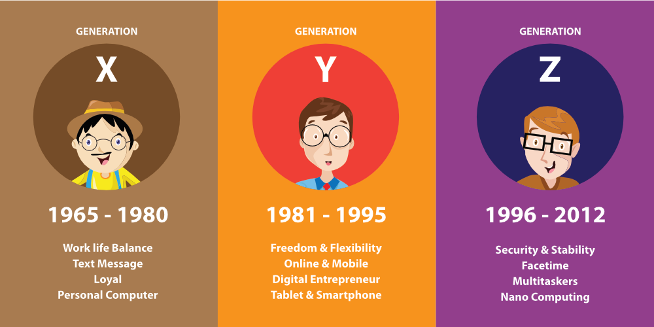
POST-READING
5
Discussion
Do you agree with the descriptions of each generation?

Slide 24
CONSOLIDATION
Homework
Do exercises in the workbook.
Prepare for Lesson 4 - Unit 2.

Slide 25
Website: hoclieu.vn
Fanpage: facebook.com/www.tienganhglobalsuccess.vn

