Slide 1
Unit
8
1
FAMILY LIFE
Unit
NEW WAYS TO LEARN
LESSON 1
GETTING STARTED
New learning activities
Tiếng Anh
GV: Nguyễn Thị Bích Phương
Lớp 10A4

Slide 2
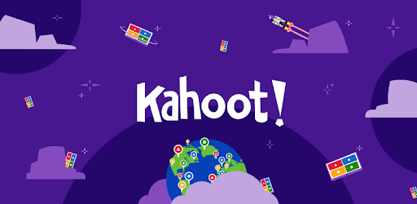
LESSON 1
GETTING STARTED
Unit
GETTING STARTED
*WARM-UP: Game 'Kahoot!'

Slide 3
Pairwork
Groupwork
Debate
???
LEARNING ACTIVITIES
Experiment
Project
Presentation

Slide 4
PRE-LISTENING
Vocabulary
Groupwork | /ˈɡruːp wɜːk/ | Làm việc theo nhóm
Pairwork | /peə(r) wɜːk/ | Làm việc theo đôi
Presentation | /ˌpreznˈteɪʃn/ | Bài thuyết trình
Debate | /dɪˈbeɪt/ | Tranh luận
Project | /ˈprɒdʒekt/ | Dự án
Experiment | /ɪkˈsperɪmənt/ | Thí nghiệm

Slide 5
PRESENTATION
***Vocabulary game: WHO IS FASTER?
- Team A & B: 6 verbs
- 6 phrases on the board
- Each team: go to the board, stick your cards to form a correct phrase.
Example:
A
wear
a mask
B
wear

Slide 6
PRESENTATION
Vocabulary
1. upload a video
2. find/search for information
3. discuss a topic
4. take notes
5. prepare materials
6. do a project
đăng tải video
tìm thông tin
thảo luận về một đề tài
ghi chép
chuẩn bị tài liệu
làm dự án

Slide 7
PRESENTATION
1
Listen and read.
New learning activities (page 86)
Long: Hi, Nick. What are you doing?
Nick: I’m watching the video that my geography teacher uploaded on Eclass.
Long: Really? What is it about?
Nick: It’s about global warming. My teacher asked us to watch the video and find more information about this topic.
Long: So, is watching the video part of your homework?
Nick: Yes, then next week, we’ll work in groups and discuss the topic in class.
Long: Sounds interesting. You can watch the video many times and also search for more information at home.
Nick: You’re right. I’m not good at taking notes in class, you know. So I prefer this way of learning. It gives me a chance to discuss with my classmates, who may have original ideas on the topic.
Long: Does your teacher often ask you to prepare materials at home and discuss in class, Nick?
Nick: Yes, she does. We’re doing a lot of projects that help us understand the lessons better. This way of studying, which gives us more control over our own learning, is quite useful.
Long: You’re lucky. My teachers use very traditional methods of teaching at my schools. I wish I could try these new learning activities.
What are Long and Nick talking about???

Slide 8
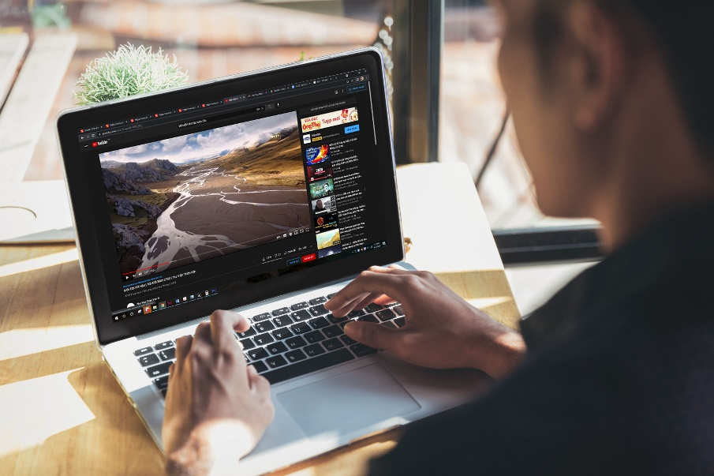
PRACTICE
1
Listen and read.
New learning activities (page 86)
Long: Hi, Nick. What are you doing?
Nick: I’m watching the video that my geography teacher uploaded on Eclass.
Long: Really? What is it about?
Nick: It’s about global warming. My teacher asked us to watch the video and find more information about this topic.
Long: So, is watching the video part of your homework?
Nick: Yes, then next week, we’ll work in groups and discuss the topic in class.
Long: Sounds interesting. You can watch the video many times and also search for more information at home.
Nick: You’re right. I’m not good at taking notes in class, you know. So I prefer this way of learning. It gives me a chance to discuss with my classmates, who may have original ideas on the topic.
Long: Does your teacher often ask you to prepare materials at home and discuss in class, Nick?
Nick: Yes, she does. We’re doing a lot of projects that help us understand the lessons better. This way of studying, which gives us more control over our own learning, is quite useful.
Long: You’re lucky. My teachers use very traditional methods of teaching at my schools. I wish I could try these new learning activities.
They are talking about:
- Nick's geography homework about global warming.
- their ways of learning: watching a video, working in groups, doing projects...

Slide 9
PRACTICE
2
Read the conversation in pairs and tick () T (True) or F (False). (part 2, p.87)
STATEMENT | TRUE | FALSE
1. Nick is preparing for his next geography class.
2. Nick’s note taking skills are quite good.
3. Nick’s class is working on many projects now.

Slide 10
CORRECTION
STATEMENT | TRUE | FALSE
1. Nick is preparing for his next geography class.
✓
Long: Hi, Nick. What are you doing?
Nick: I’m watching the video that my geography teacher uploaded on Eclass.
Long: Really? What is it about?
Nick: It’s about global warming. My teacher asked us to watch the video and find more information about this topic.
Long: So, is watching the video part of your homework?
Nick: Yes, then next week, we’ll work in groups and discuss the topic in class.
Long: Sounds interesting. You can watch the video many times and also search for more information at home.
Nick: You’re right. I’m not good at taking notes in class, you know. So I prefer this way of learning. It gives me a chance to discuss with my classmates, who may have original ideas on the topic.
Long: Does your teacher often ask you to prepare materials at home and discuss in class, Nick?
Nick: Yes, she does. We’re doing a lot of projects that help us understand the lessons better. This way of studying, which gives us more control over our own learning, is quite useful.
Long: You’re lucky. My teachers use very traditional methods of teaching at my schools. I wish I could try these new learning activities.

Slide 11
CORRECTION
STATEMENT | TRUE | FALSE
2. Nick’s note taking skills are quite good.
not good.
✓
Long: Hi, Nick. What are you doing?
Nick: I’m watching the video that my geography teacher uploaded on Eclass.
Long: Really? What is it about?
Nick: It’s about global warming. My teacher asked us to watch the video and find more information about this topic.
Long: So, is watching the video part of your homework?
Nick: Yes, then next week, we’ll work in groups and discuss the topic in class.
Long: Sounds interesting. You can watch the video many times and also search for more information at home.
Nick: You’re right. I’m not good at taking notes in class, you know. So I prefer this way of learning. It gives me a chance to discuss with my classmates, who may have original ideas on the topic.
Long: Does your teacher often ask you to prepare materials at home and discuss in class, Nick?
Nick: Yes, she does. We’re doing a lot of projects that help us understand the lessons better. This way of studying, which gives us more control over our own learning, is quite useful.
Long: You’re lucky. My teachers use very traditional methods of teaching at my schools. I wish I could try these new learning activities.

Slide 12
CORRECTION
STATEMENT | TRUE | FALSE
3. Nick’s class is working on many projects now.
✓
Long: Hi, Nick. What are you doing?
Nick: I’m watching the video that my geography teacher uploaded on Eclass.
Long: Really? What is it about?
Nick: It’s about global warming. My teacher asked us to watch the video and find more information about this topic.
Long: So, is watching the video part of your homework?
Nick: Yes, then next week, we’ll work in groups and discuss the topic in class.
Long: Sounds interesting. You can watch the video many times and also search for more information at home.
Nick: You’re right. I’m not good at taking notes in class, you know. So I prefer this way of learning. It gives me a chance to discuss with my classmates, who may have original ideas on the topic.
Long: Does your teacher often ask you to prepare materials at home and discuss in class, Nick?
Nick: Yes, she does. We’re doing a lot of projects that help us understand the lessons better. This way of studying, which gives us more control over our own learning, is quite useful.
Long: You’re lucky. My teachers use very traditional methods of teaching at my schools. I wish I could try these new learning activities.

Slide 13
PRACTICE
3
Complete the sentences with ONE word only. (part 4, page 87)
1. Nick is watching the video _______ his geography teacher uploaded on Eclass.
2. This way of learning gives him a chance to discuss with his classmates, _______ may have original ideas on the topic.
3. They are doing a lot of projects _______ help them understand the lessons better.
4. That way of studying, _______ gives them more control over their own learning, is quite useful

Slide 14
CORRECTION
that
1. Nick is watching the video ________ his geography teacher uploaded on Eclass.
Long: Hi, Nick. What are you doing?
Nick: I’m watching the video that my geography teacher uploaded on Eclass.
Long: Really? What is it about?
Nick: It’s about global warming. My teacher asked us to watch the video and find more information about this topic.
Long: So, is watching the video part of your homework?
Nick: Yes, then next week, we’ll work in groups and discuss the topic in class.
Long: Sounds interesting. You can watch the video many times and also search for more information at home.
Nick: You’re right. I’m not good at taking notes in class, you know. So I prefer this way of learning. It gives me a chance to discuss with my classmates, who may have original ideas on the topic.
Long: Does your teacher often ask you to prepare materials at home and discuss in class, Nick?
Nick: Yes, she does. We’re doing a lot of projects that help us understand the lessons better. This way of studying, which gives us more control over our own learning, is quite useful.
Long: You’re lucky. My teachers use very traditional methods of teaching at my schools. I wish I could try these new learning activities.

Slide 15
CORRECTION
2. This way of learning gives him a chance to discuss with his classmates, _______ may have original ideas on the topic.
who
Long: Hi, Nick. What are you doing?
Nick: I’m watching the video that my geography teacher uploaded on Eclass.
Long: Really? What is it about?
Nick: It’s about global warming. My teacher asked us to watch the video and find more information about this topic.
Long: So, is watching the video part of your homework?
Nick: Yes, then next week, we’ll work in groups and discuss the topic in class.
Long: Sounds interesting. You can watch the video many times and also search for more information at home.
Nick: You’re right. I’m not good at taking notes in class, you know. So I prefer this way of learning. It gives me a chance to discuss with my classmates, who may have original ideas on the topic.
Long: Does your teacher often ask you to prepare materials at home and discuss in class, Nick?
Nick: Yes, she does. We’re doing a lot of projects that help us understand the lessons better. This way of studying, which gives us more control over our own learning, is quite useful.
Long: You’re lucky. My teachers use very traditional methods of teaching at my schools. I wish I could try these new learning activities.

Slide 16
CORRECTION
that
3. They are doing a lot of projects _____ help them understand the lessons better.
Long: Hi, Nick. What are you doing?
Nick: I’m watching the video that my geography teacher uploaded on Eclass.
Long: Really? What is it about?
Nick: It’s about global warming. My teacher asked us to watch the video and find more information about this topic.
Long: So, is watching the video part of your homework?
Nick: Yes, then next week, we’ll work in groups and discuss the topic in class.
Long: Sounds interesting. You can watch the video many times and also search for more information at home.
Nick: You’re right. I’m not good at taking notes in class, you know. So I prefer this way of learning. It gives me a chance to discuss with my classmates, who may have original ideas on the topic.
Long: Does your teacher often ask you to prepare materials at home and discuss in class, Nick?
Nick: Yes, she does. We’re doing a lot of projects that help us understand the lessons better. This way of studying, which gives us more control over our own learning, is quite useful.
Long: You’re lucky. My teachers use very traditional methods of teaching at my schools. I wish I could try these new learning activities.

Slide 17
CORRECTION
which
4. That way of studying, _______ gives them more control over their own learning, is quite useful.
Long: Hi, Nick. What are you doing?
Nick: I’m watching the video that my geography teacher uploaded on Eclass.
Long: Really? What is it about?
Nick: It’s about global warming. My teacher asked us to watch the video and find more information about this topic.
Long: So, is watching the video part of your homework?
Nick: Yes, then next week, we’ll work in groups and discuss the topic in class.
Long: Sounds interesting. You can watch the video many times and also search for more information at home.
Nick: You’re right. I’m not good at taking notes in class, you know. So I prefer this way of learning. It gives me a chance to discuss with my classmates, who may have original ideas on the topic.
Long: Does your teacher often ask you to prepare materials at home and discuss in class, Nick?
Nick: Yes, she does. We’re doing a lot of projects that help us understand the lessons better. This way of studying, which gives us more control over our own learning, is quite useful.
Long: You’re lucky. My teachers use very traditional methods of teaching at my schools. I wish I could try these new learning activities.

Slide 18
Long: Hi, Nick. What are you doing?
Nick: I’m watching the video that my geography teacher uploaded on Eclass.
Long: Really? What is it about?
Nick: It’s about global warming. My teacher asked us to watch the video and find more information about this topic.
Long: So, is watching the video part of your homework?
Nick: Yes, then next week, we’ll work in groups and discuss the topic in class.
Long: Sounds interesting. You can watch the video many times and also search for more information at home.
Nick: You’re right. I’m not good at taking notes in class, you know. So I prefer this way of learning. It gives me a chance to discuss with my classmates, who may have original ideas on the topic.
Long: Does your teacher often ask you to prepare materials at home and discuss in class, Nick?
Nick: Yes, she does. We’re doing a lot of projects that help us understand the lessons better. This way of studying, which gives us more control over our own learning, is quite useful.
Long: You’re lucky. My teachers use very traditional methods of teaching at my schools. I wish I could try these new learning activities.
RELATIVE PRONOUNS

Slide 19
PRACTICE
CLASS SURVEY: Your experiences with the following learning activities
Pairwork
Groupwork
Debate
???
LEARNING ACTIVITIES
Experiment
Project
Presentation

Slide 20
PRACTICE
- GAME SURVEY: Quizizz
- Answer 5 questions by voting. You can choose more than 1 option.

Slide 21
PRACTICE
SURVEY SUMMARY:
STUDENTS’ VOTES | LEARNING ACTIVITIES
FAVOURITE | Experiment, project
DISLIKE | Presentation, debate
MOST DIFFICULT | debate
WANT TO EXPERIENCE MORE | Experiment, project

Slide 22
PRACTICE
4
Talk about your favorite learning activity, choosing ONE from 6 activities below.
Pairwork
Groupwork
Debate
???
LEARNING ACTIVITIES
Experiment
Project
Presentation

Slide 23
PRACTICE
4
Talk about your favorite learning activity in 2 minutes.
1. What is it called? (debate, presentation, experiment ...)
2. In what subject have you applied this learning activity?
3. What have you learnt from this activity? (teamwork, note-taking, confidence....)

Slide 24
CONSOLIDATION
1
Wrap-up: What have we learnt today?
- Learn language items:
+ Words/phrases related to topic 'New learning activities'
+ Grammar: relative pronouns
- Get to know different learning activities and how they are done in and out of class.

Slide 25
CONSOLIDATION
2
Homework
- Practice the words/phrases in Vocabulary section
- Do the exercises: Unit 8 - Lesson 1, Workbook

