Slide 1
ENGLISH 5
UNIT 12: OUR TET HOLIDAY
LESSON 1 ( 1, 2, 3)
Notes:
MADE BY FACEBOOK :TRAN THI THANH TAM

Slide 2
CONTENTS
1
WARM -UP
2
LOOK, LISTEN AND REPEAT
3
VOCABULARY
4
LISTEN, POINT AND SAY
5
LET’S TALK
6
PLAY GAME
Notes:
MADE BY FACEBOOK :TRAN THI THANH TAM

Slide 3
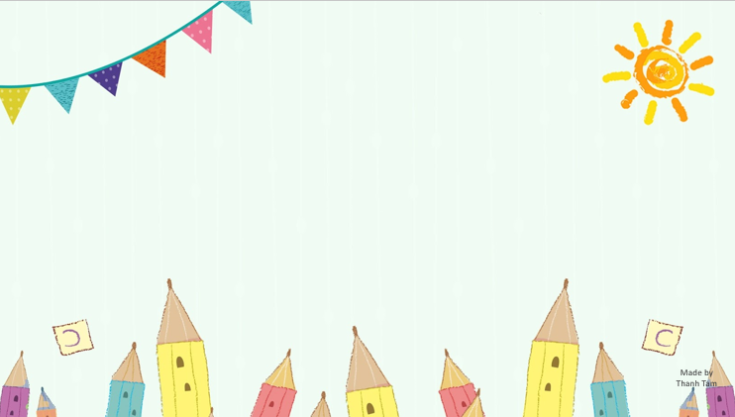
Warm - up
Notes:
MADE BY FACEBOOK :TRAN THI THANH TAM

Slide 4
LET’S PLAY
GUESSING GAME

Slide 5
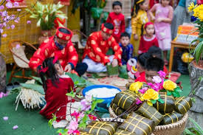
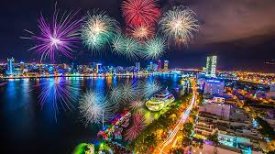
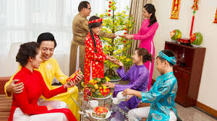
Look at these pictures and guess what festival is it
Notes:
Made by FACEBOOK: TRAN THI THANH TAM

Slide 6
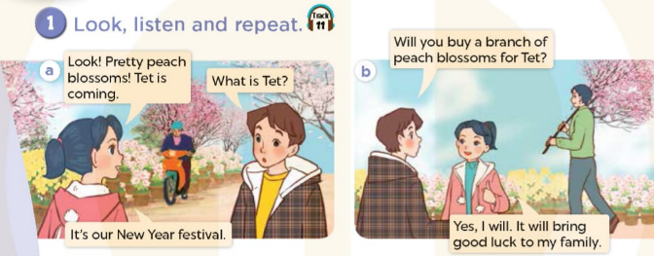
Notes:
MADE BY FACEBOOK :TRAN THI THANH TAM

Slide 7
Notes:
MADE BY FACEBOOK :TRAN THI THANH TAM

Slide 8
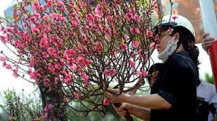
buy a branch of peach blossoms/ baɪ ə brɑːntʃ əvˌpiːtʃ ˈblɒsəm/ : mua 1 cành hoa đào
Notes:
MADE BY FACEBOOK :TRAN THI THANH TAM

Slide 9
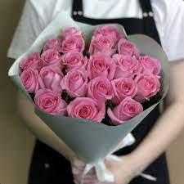
buy roses/ baɪ rəʊziz/: mua hoa hồng
Notes:
MADE BY FACEBOOK :TRAN THI THANH TAM

Slide 10
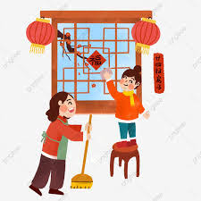
decorate the house / ˈdekəreɪt ðə haʊs/: trang trí nhà
Notes:
MADE BY FACEBOOK :TRAN THI THANH TAM

Slide 11
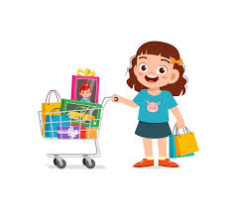
do the shopping/ duː ˈʃɒpɪŋ/
:đi mua sắm
Notes:
MADE BY FACEBOOK :TRAN THI THANH TAM

Slide 12
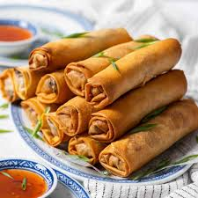
make spring rolls /meɪk ˌsprɪŋ ˈrəʊl/:
làm nem
Notes:
MADE BY FACEBOOK :TRAN THI THANH TAM

Slide 13
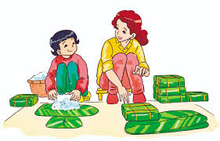
make banh chung/meɪk banh tʃʊŋ/
: làm bánh chưng
Notes:
MADE BY FACEBOOK :TRAN THI THANH TAM

Slide 14
VOCABULARY
Buy a branch of peach blossoms:mua 1 cành hoa đào
Buy roses: mua hoa hồng
Decorate the house:trang trí nhà
Do the shopping: đi mua sắm
Make banh chung: làm bánh chưng
Make spring rolls: làm nem

Slide 15
Let's play
Check vocabulary
Guessing game
Notes:
Made by Facebook: TRAN THI THANH TAM

Slide 16
Guessing
Guessing?
Buy a branch of peach blossoms
Notes:
MADE BY FACEBOOK :TRAN THI THANH TAM

Slide 17
Guessing
Guessing?
Do the shopping
Notes:
MADE BY FACEBOOK :TRAN THI THANH TAM

Slide 18
Guessing
Guessing?
Decorate the house
Notes:
MADE BY FACEBOOK :TRAN THI THANH TAM

Slide 19
Guessing
Guessing?
Buy roses
Notes:
MADE BY FACEBOOK :TRAN THI THANH TAM

Slide 20
Guessing
Guessing?
Make banh chung
Notes:
MADE BY FACEBOOK :TRAN THI THANH TAM

Slide 21
Guessing
Guessing?
Make spring rolls
Notes:
MADE BY FACEBOOK :TRAN THI THANH TAM

Slide 22
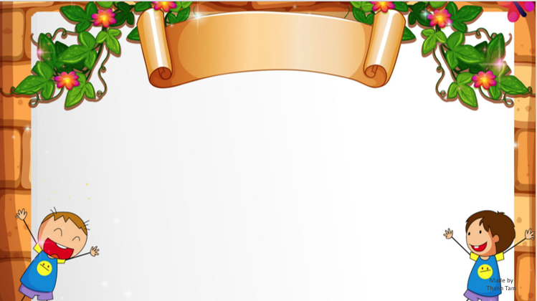
SENTENCE PATTERN
Notes:
MADE BY FACEBOOK :TRAN THI THANH TAM

Slide 23
Hỏi và trả lời xem có phải ai đó có làm một việc gì vào dip tết không
Will you decorate the house for Tet?
( Bạn sẽ trang trí nhà vào dịp tết phải không?)
Yes, I will.
(Vâng, tôi sẽ.)

Slide 24
Hỏi và trả lời xem có phải ai đó có làm một việc gì vào dip tết không
Will you make banh chung for Tet?
( Bạn sẽ làm bánh chưng vào dịp tết phải không?)
No, I won’t. I’ll make spring rolls.
(Không, tôi sẽ làm nem.)

Slide 25
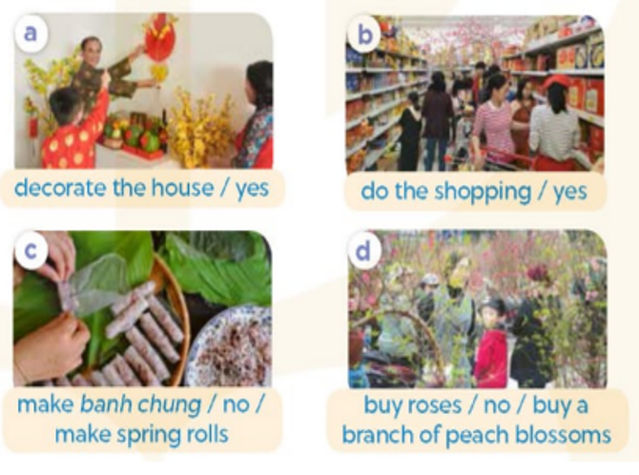
2.Listen, point and say
decorate the house
Will you.................................for Tet ?
make springs rolls.
Yes, I will.
No, I won’t. I’ll..............................
Notes:
MADE BY FACEBOOK :TRAN THI THANH TAM

Slide 26
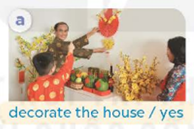
decorate the house
Will you.................................for Tet ?
Yes, I will.
Notes:
MADE BY FACEBOOK :TRAN THI THANH TAM

Slide 27
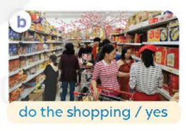
do the shopping
Will you.................................for Tet ?
Yes, I will.
Notes:
MADE BY FACEBOOK :TRAN THI THANH TAM

Slide 28
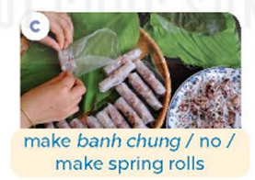
make banh chung
Will you.................................for Tet ?
make springs rolls.
No, I won’t. I’ll..............................
Notes:
MADE BY FACEBOOK :TRAN THI THANH TAM

Slide 29
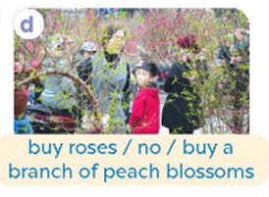
buy roses
Will you..........................for Tet ?
buy a branch of peach blossoms
No, I won’t. I’ll.................................................
Notes:
MADE BY FACEBOOK :TRAN THI THANH TAM

Slide 30
Notes:
MADE BY FACEBOOK :TRAN THI THANH TAM

Slide 31
PLAY GAME
Lucky numbers
Notes:
Step 2: Have groups put the posters on the desk and practice the presentation. Encourage all members in the group to present. Go around the classroom and offer help where necessary.

Slide 32
NEXT
+10
Lose all points

Slide 33
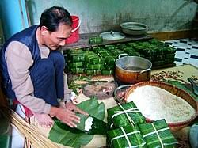
make banh chung
Will you.................................for Tet ?
BACK
Yes, I will.

Slide 34
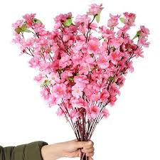
Will you buy roses for Tet ?
BACK
buy a branch of peach blossoms
No, I won’t. I’ll.........................................

Slide 35
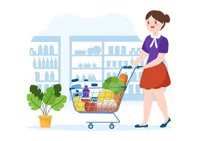
do the shopping
Will you.................................for Tet ?
BACK
Yes, I will.

Slide 36
buy roses
Will you..........................for Tet ?
BACK
Yes, I will.

Slide 37
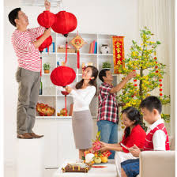
Will you make spring rolls for Tet ?
BACK
decorate the house
No, I won’t. I’ll.........................................

Slide 38
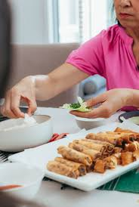
Will you do the shopping for Tet ?
BACK
make spring rolls
No, I won’t. I’ll.........................................

Slide 39
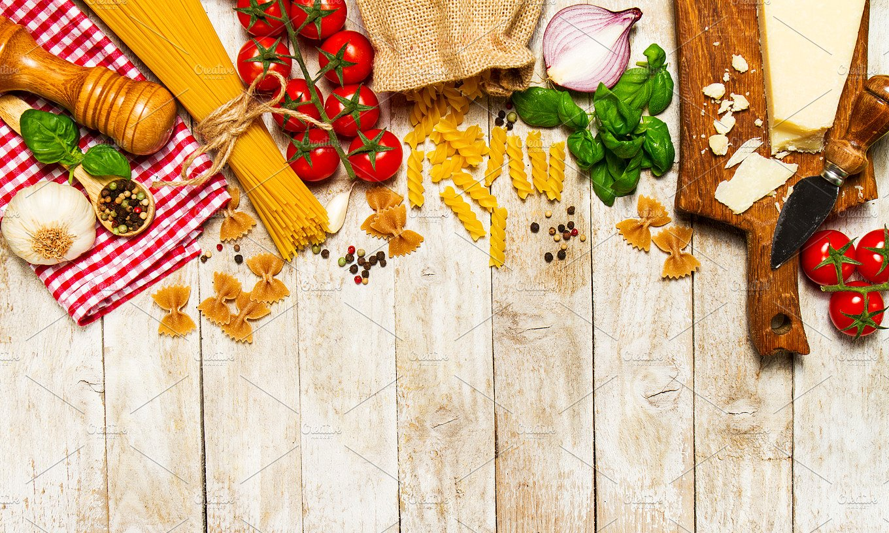
SUMMARY

Slide 40
SUMMARY
1.Vocabulary:
Buy a branch of peach blossoms:mua 1 cành hoa đào
Buy roses: mua hoa hồng
Decorate the house:trang trí nhà
Do the shopping: đi mua sắm
Make banh chung: làm bánh chưng
Make spring rolls: làm nem
2. Sentence pattern:
-Will you decorate the house for Tet?
(Bạn sẽ trang trí nhà cửa vào dịp tết phải không?)
-> Yes, I will. (Vâng, tôi sẽ.)
-> No, I won’t. I’ll make spring rolls. (Không, tôi sẽ làm nem.)

Slide 41
Homework:
- Learn by heart vocabulary and sentence pattern
- Prepare Unit 12- lesson 1 ( 4, 5, 6)

Slide 42
* SING AND DANCE: BYE BYE GOODBYE SONG

Slide 43
Notes:
MADE BY FACEBOOK :TRAN THI THANH TAM

