Slide 1
ENGLISH 4
UNIT 5: THINGS WE CAN DO
LESSON 2 ( 1, 2, 3)
Notes:
MADE BY FACEBOOK :TRAN THI THANH TAM

Slide 2
A. NUMBERS
1
WARM -UP
2
VOCABULARY
3
LOOK, LISTEN AND REPEAT
4
LISTEN, POINT AND SAY
5
LET’S TALK
6
PLAY GAME
Notes:
MADE BY FACEBOOK :TRAN THI THANH TAM

Slide 3
Warm - up
Game: CHINESE WISHPERS
Notes:
MADE BY FACEBOOK :TRAN THI THANH TAM

Slide 4
Chinese Whispers
Group 1
Group 2
Can you ride a bike?
Can you ride a horse?
Notes:
Made by Facebook: TRAN THI THANH TAM

Slide 5
VOCABULARY
Notes:
MADE BY FACEBOOK :TRAN THI THANH TAM

Slide 6
Swim: bơi
Notes:
MADE BY FACEBOOK :TRAN THI THANH TAM

Slide 7
Cook: nấu ăn
Notes:
MADE BY FACEBOOK :TRAN THI THANH TAM

Slide 8
Draw: vẽ
Notes:
MADE BY FACEBOOK :TRAN THI THANH TAM

Slide 9
Roller skate: trượt pa tin
Notes:
MADE BY FACEBOOK :TRAN THI THANH TAM

Slide 10
Play badminton: đánh cầu lông
Notes:
MADE BY FACEBOOK :TRAN THI THANH TAM

Slide 11
Play football:chơi đá bóng
Notes:
MADE BY FACEBOOK :TRAN THI THANH TAM

Slide 12
VOCABULARY
Swim: bơi
Play badminton: đánh cầu lông
Roller skate: trượt pa tin
Cook: nấu ăn
Draw: vẽ
Play football: chơi đá bóng

Slide 13
Let's play
MATCHING

Slide 14
CHECK VOCABULARY:MATCHING
draw
Play football
cook
swim
Play badminton
roller skate

Slide 15
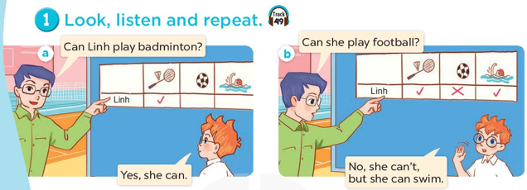
Notes:
MADE BY FACEBOOK :TRAN THI THANH TAM

Slide 16
SENTENCE PATTERN
Notes:
MADE BY FACEBOOK :TRAN THI THANH TAM

Slide 17
Hỏi và trả lời ai đó có thể làm gì?
Can he swim?
( Anh ấy có thể bơi không?)
Yes, he can./ No, he can’t
Notes:
MADE BY FACEBOOK :TRAN THI THANH TAM

Slide 18
Hỏi và trả lời xem ai đó có thể làm gì?
Can he roller skate?
( Anh ấy có thể trượt pa tin không?)
No, he can’t.
Không, anh ấy không thể.)
Notes:
MADE BY FACEBOOK :TRAN THI THANH TAM

Slide 19
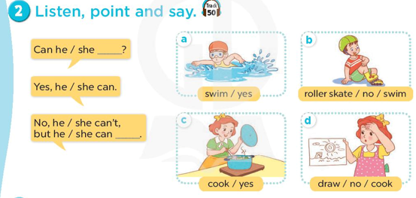
Can he roller skate?
No, he can’t, but he can swim
Notes:
MADE BY FACEBOOK :TRAN THI THANH TAM

Slide 20
Can he swim ?
Yes, he can
………………….
Notes:
MADE BY FACEBOOK :TRAN THI THANH TAM

Slide 21
Can he roller skate ?
No, he can’t, but he can play badminton
…………….………………….
Notes:
MADE BY FACEBOOK :TRAN THI THANH TAM

Slide 22
Can she cook ?
Yes, she can
………………….
Notes:
MADE BY FACEBOOK :TRAN THI THANH TAM

Slide 23
Can she draw?
No, she can’t, but she can cook.
…………….………………….
Notes:
MADE BY FACEBOOK :TRAN THI THANH TAM

Slide 24
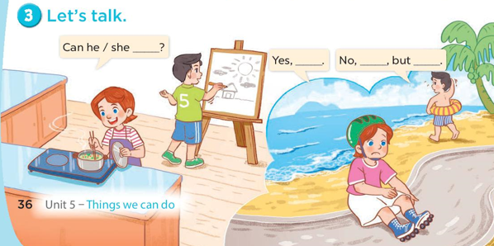
Can he roller skate?
No,he can’t, but he can swim
Yes, he can.
Notes:
MADE BY FACEBOOK :TRAN THI THANH TAM

Slide 25
Let's play
Notes:
MADE BY FACEBOOK :TRAN THI THANH TAM

Slide 26
LET’S PLAY
50
10
20
30
MAGIC WHEEL
10
20
30
40
Spin
PLAY
LUẬT CHƠI
Nhấn nút để quay.
Trả lời đúng câu hỏi sẽ được cộng số điểm tương ứng vị trí mũi tên dừng.
Kết thúc trò chơi đội cao điểm hơn sẽ chiến thắng.
Spin

Slide 27
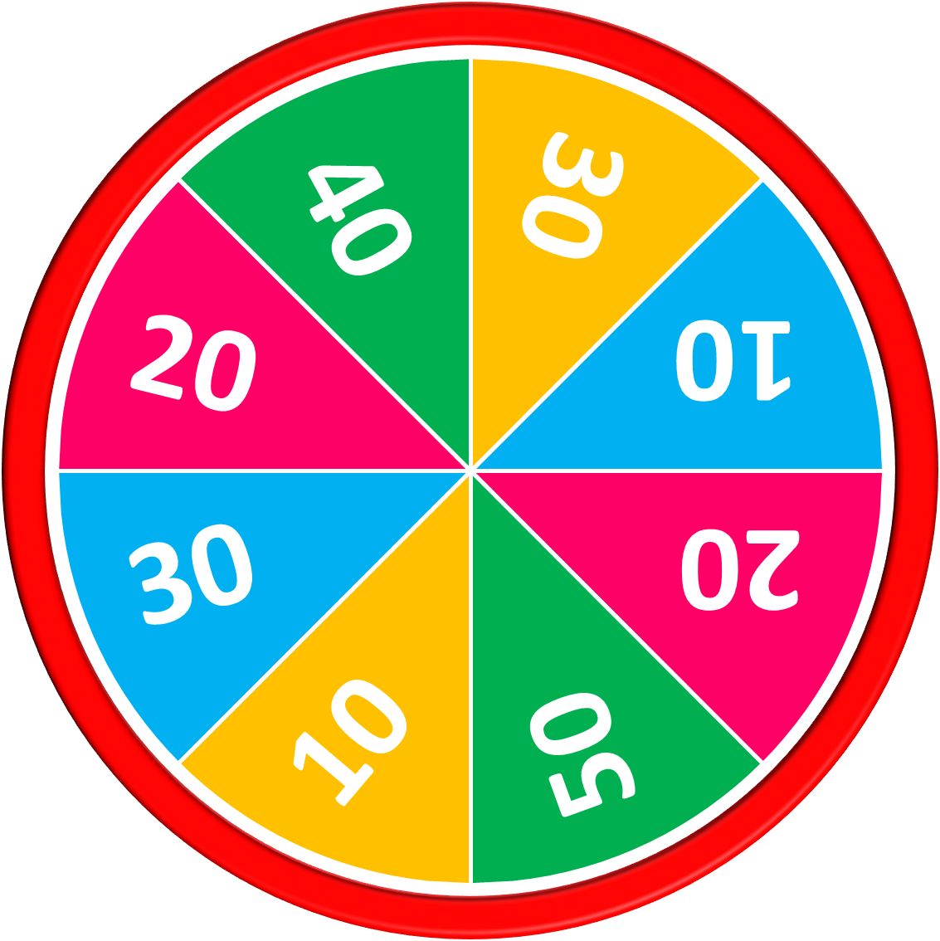
Can she cook?
50
10
20
30
10
20
Answer
30
40
Yes, she can.
Stop
Spin

Slide 28
Can he ride a bike?
50
10
20
30
10
20
Answer
30
40
No, he can’t.
Stop
Spin

Slide 29
Can she draw?
50
10
20
30
10
20
Answer
30
40
Yes, she can.
Stop
Spin

Slide 30
Can he swim?
50
10
20
30
10
20
Answer
30
40
Yes, he can.
Stop
Spin

Slide 31
Can he roller skate?
50
10
20
30
10
20
Answer
30
40
No, he can’t.
Stop
Spin

Slide 32
Can she play football?
50
10
20
30
10
20
Answer
30
40
Yes, she can.
Stop
Spin

Slide 33
50
10
20
30
10
20
30
40
Exit

Slide 34
SUMMARY
Notes:
MADE BY FACEBOOK :TRAN THI THANH TAM

Slide 35
SUMMARY
1.Vocabulary:
Swim: bơi
Play badminton: đánh cầu lông
Roller skate: trượt pa tin
Cook: nấu ăn
Draw: vẽ
Play football: chơi đá bóng
2. Sentence pattern:
-Can he/ she swim?
( Anh ấy/ cô ấy có thể bơi không?)
-> Yes,he/ she can.
-> No, he / she can’t.

Slide 36
Homework:
- Learn sentence pattern by heart
- Prepare Unit 5- Lesson 2 ( 4, 5, 6)
Notes:
MADE BY FACEBOOK :TRAN THI THANH TAM

Slide 37
Notes:
MADE BY FACEBOOK :TRAN THI THANH TAM

Slide 38
GOODBYE,
SEE YOU AGAIN !
Made by Thanh Tam

