Slide 1
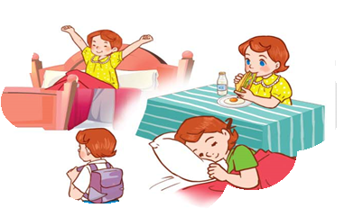
PHUOC SON NO.2 PRIMARY SCHOOL
Teacher: Dang Thi Hoai Nu
Class: 4B2

Slide 2

Warm-up

Slide 3

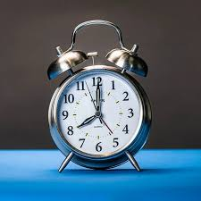

Slide 4
Wednesday, September 24th 2025
Unit
2
Time and daily routines
Period 11: Lesson 1 (Part: 1, 2, 3)

Slide 5



Contents
Look, listen and repeat.
Listen, point and say.
Let’s talk.

Slide 6

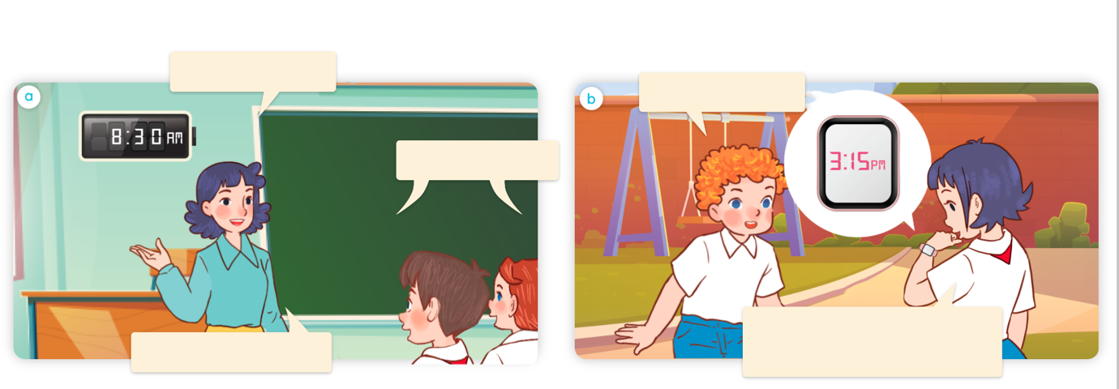
1. Look, listen and repeat.
What time is it?
What time is it?
a
b
It’s eight thirty.
It’s three fifteen. Let’s go into the classroom
Let’s have a break.
Where are they?
Who are they?
What are they doing?
Click on the sentences to hear the sound.

Slide 7
Vocabulary

Slide 8



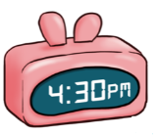
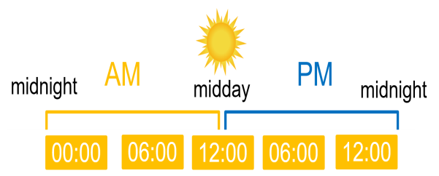
fifteen
/ˌfɪfˈtiːn/
số 15
thirty
/ˈθɜːtɪ/
số 30
forty-five
/fɔːtɪ ˈfaɪv/
số 45
AM
/ˈeɪ em/
giờ sáng
PM
/ˈpɪ em/
giờ chiều/tối
o’clock
/əˈklɒk/
giờ (chẵn)

Slide 9


Look and match.
30
15
45
1
2
3
4
fifteen
thirty
forty-five
o’clock
a
b
c
d

Slide 10
Sentence patterns

Slide 11


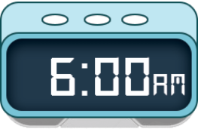
Cách hỏi thời gian.
What time is it?
(Bây giờ là mấy giờ?)
It’s = It is
It’s _______.
(Bây giờ là____.)
Ex:
What time is it?
It’s six o’clock.

Slide 12

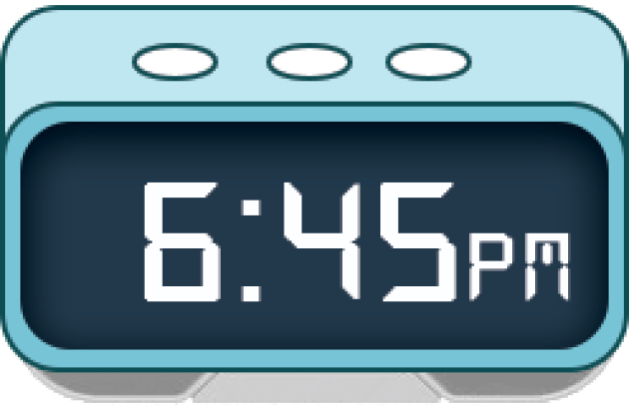


Unit 2 lesson 1
What time is it?
It’s _______.
it’s = it is
six o’clock
six forty- five
six fifteen
six thirty

Slide 13
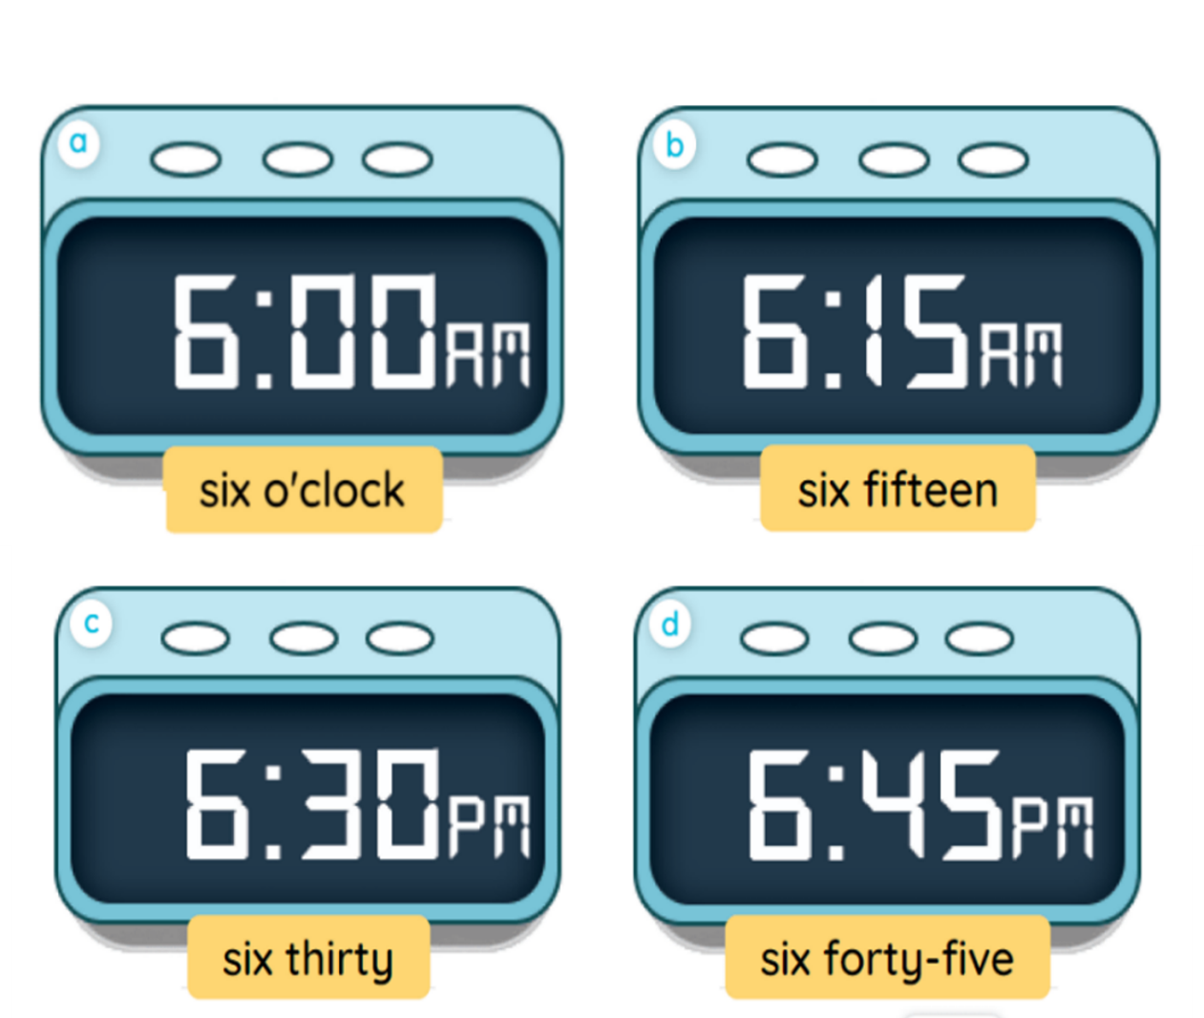
2. Listen, point and say.
a
b
What time is it?
It’s __________.
c
d

Slide 14
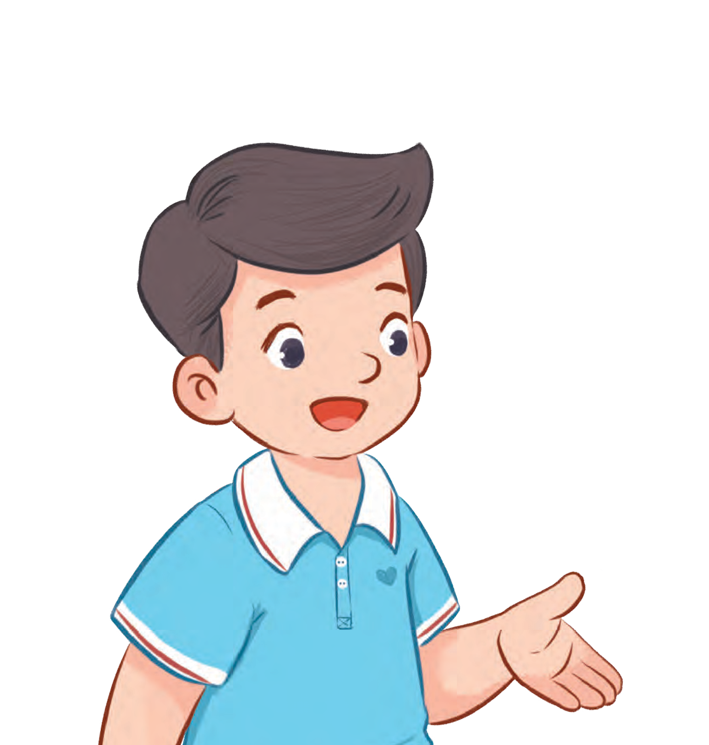

2. Listen, point and say.
a
What time is it?
It’s six o’clock.

Slide 15
2. Listen, point and say.
b
What time is it?
It’s six fifteen.

Slide 16
2. Listen, point and say.
c
What time is it?
It’s six thirty.

Slide 17
2. Listen, point and say.
d
What time is it?
It’s six forty-five.

Slide 18
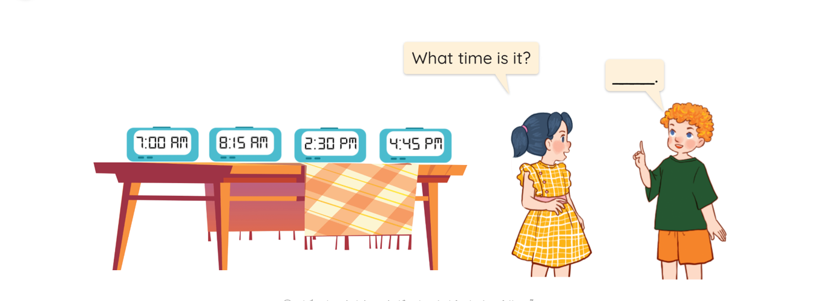
3. Let’s talk.

Slide 19




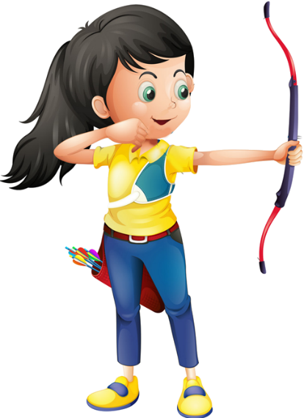




Ms Huyền Phạm
0936.082.789

Slide 20
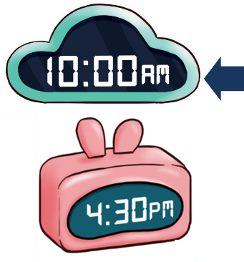

A. o’clock
B. It’s ten o’clock.
Ms Huyền Phạm
0936.082.789

Slide 21
A. It’s six fifteen.
B. It’s seven fifty.
Ms Huyền Phạm
0936.082.789

Slide 22

A. It’s two fifty.
B. It’s one fifteen.
Ms Huyền Phạm
0936.082.789

Slide 23
A. It’s six ten.
B. It’s six o’clock.
Ms Huyền Phạm
0936.082.789

Slide 24

A. It’s three thirteen.
B. It’s three thirty.
Ms Huyền Phạm
0936.082.789

Slide 25
Facebook : Bùi Liễu
Mobile phone: 0968142780
What time __ it?
It’s six thirty.
A. are
B. is
Ms Huyền Phạm
0936.082.789

Slide 26
____ time is it?
It’s six o’clock.
A. What
B. Where
Ms Huyền Phạm
0936.082.789

Slide 27
What ____ is it?
_____ nine o’clock.
A. time – They are
B. time - It’s
Ms Huyền Phạm
0936.082.789

Slide 28
A.
What time is it?
It’s six o’clock.
B.
Ms Huyền Phạm
0936.082.789

Slide 29
What time ___ ___?
A. is it
B. are they
Ms Huyền Phạm
0936.082.789
Notes:
Facebook : Bùi Liễu
Mobile phone: 0968142780

Slide 30

Good job!
Ms Huyền Phạm
0936.082.789

Slide 31
Wrap up

Slide 32
Unit 2 lesson 1
What time is it?
It’s _______.
it’s = it is
Bùi Liễu
0968142780
six o’clock
six forty- five
six fifteen
six thirty

Slide 33
Homework
Learn by heart all the new words and sentence patterns.
Prepare the next lesson: Unit 2 (Lesson 1: 4, 5, 6).

Slide 34

Thank you!

