Slide 1


Phuoc Hung 2 Primary School
WELCOME TO
OUR CLASS 3
Teacher: Nguyễn Thị Thu Mến
Notes:
MADE BY FACEBOOK :TRAN THI THANH TAM

Slide 2

UNIT 14: MY BEDROOM
LESSON 1( 4, 5, 6)

Slide 3

CONTENTS
1
WARM -UP
2
LISTEN AND TICK
3
LOOK, COMPLETE AND READ
4
LET’S PLAY
5
SING A SONG
Notes:
MADE BY FACEBOOK :TRAN THI THANH TAM

Slide 4

Warm - up

Slide 5


Let's play GAME
CHOOSE COCONUTS
Notes:
MADE BY FACEBOOK :TRAN THI THANH TAM

Slide 6




windows
doors
chairs
doors
Choose the right coconut!

Slide 7
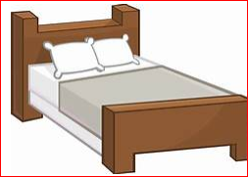
chairs
windows
beds
beds
Choose the right coconut!

Slide 8
bed
table
door
door
Choose the right coconut!

Slide 9

door
window
table
window
Choose the right coconut!

Slide 10

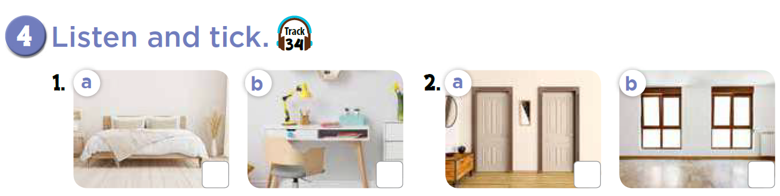



Slide 11
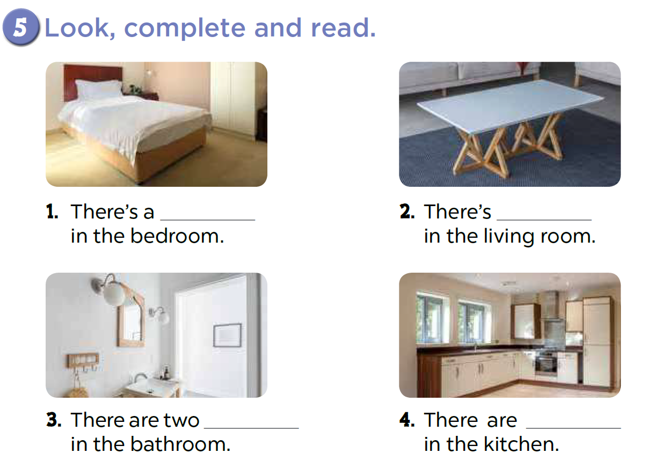
bed
a desk
lamps
two windows

Slide 12
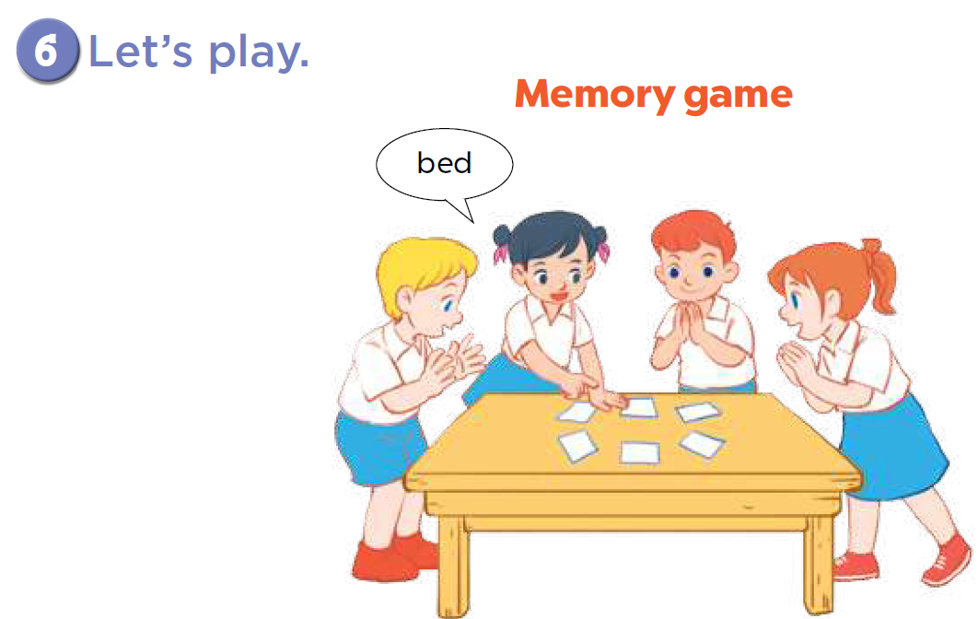

Slide 13

LET ’S PLAY
Chinese Whispers

Slide 14
Chinese Whispers
Group 1
Group 2
There’s a bed in the room.
There’s a table in the room.
Notes:
Made by Facebook: TRAN THI THANH TAM

Slide 15
Chinese Whispers
Group 1
Group 2
There are two windows.
There are six chairs.
Notes:
Made by Facebook: TRAN THI THANH TAM

Slide 16

Homework:
- Practice more at home
- Prepare Unit 14- lesson 2 ( 1, 2, 3)

Slide 17







GOODBYE,
SEE YOU AGAIN !
Made by Thanh Tam

Slide 18




The bye bye song
Bye, bye.
See you tomorrow.
Bye, bye.
See you tomorrow.
Bye, bye.
See you tomorrow.
Bye, bye. Bye, bye.
The bye bye song

