Slide 1
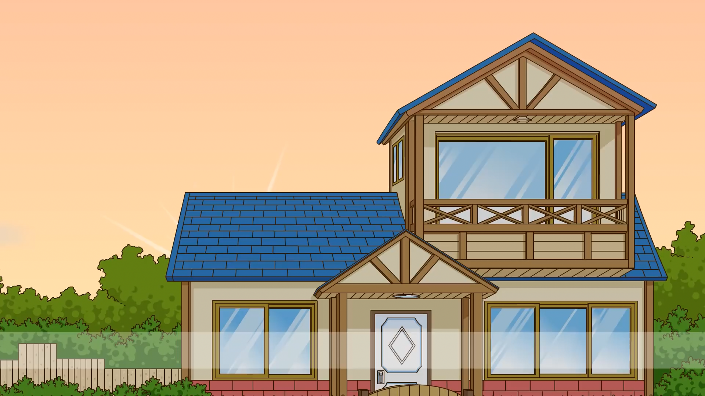

Phuoc Hung 2 Primary School
WELCOME TO
OUR CLASS 3
Teacher: Nguyễn Thị Thu Mến

Slide 2

UNIT 10: BREAKTIME ACTIVITIES
LESSON 1( 1, 2, 3)

Slide 3

CONTENTS
1
WARM -UP
2
VOCABULARY
3
LOOK, LISTEN AND REPEAT
4
LISTEN, POINT AND SAY
5
LET’S TALK
6
PLAY GAME
Notes:
MADE BY FACEBOOK :TRAN THI THANH TAM

Slide 4

Warm - up

Slide 5

Let's play

Slide 6


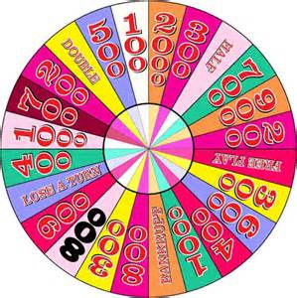
Fotune wheel
Question 1
Choose the best answer
A. green
A.green
B. blue
Spin
C. orange
Answer
Next
Very Good!

Slide 7

Fotune wheel
Question 2
Choose the best answer
A. red
B. orange
B. orange
Spin
C. brown
Answer
Next
Very Good!

Slide 8

Fotune wheel
Question 3
Choose the best answer
A. blue
B. school
Spin
C. black
C. black
Answer
Next
Very Good!

Slide 9

Fotune wheel
Question 4
Choose the best answer
A. white
A. white
B. blue
Spin
C. brown
Answer
Next
Very Good!

Slide 10


Slide 11


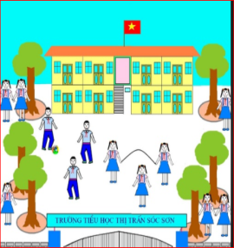
Break time: /breɪk taɪm/
giờ giải lao

Slide 12
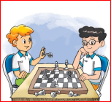
Play chess /pleɪ tʃes /
Chơi đánh cờ

Slide 13

Play volleyball /pleɪˈvɒl.i.bɔːl/
đánh bóng chuyền

Slide 14

Play basketball /pleɪ ˈbɑː.skɪt.bɔːl/
Chơi bóng rổ

Slide 15

Play badminton: /pleɪˈbædˌmɪn·tən/
chơi cầu lông

Slide 16
Let's play

Slide 17
What and where
1
Play chess
Break time
2
3
4
Play volleyball
Play basketball
5
6
old
Play badminton

Slide 18

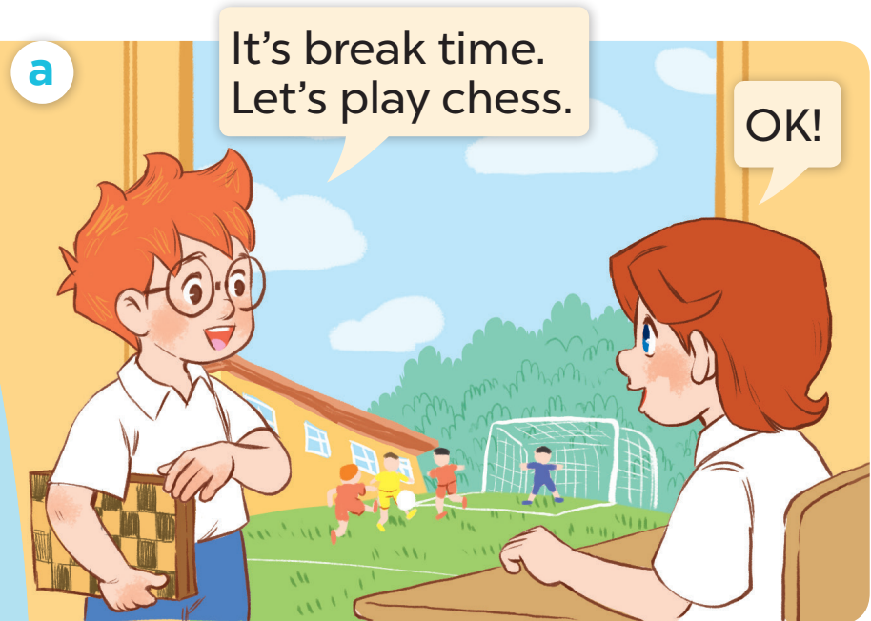
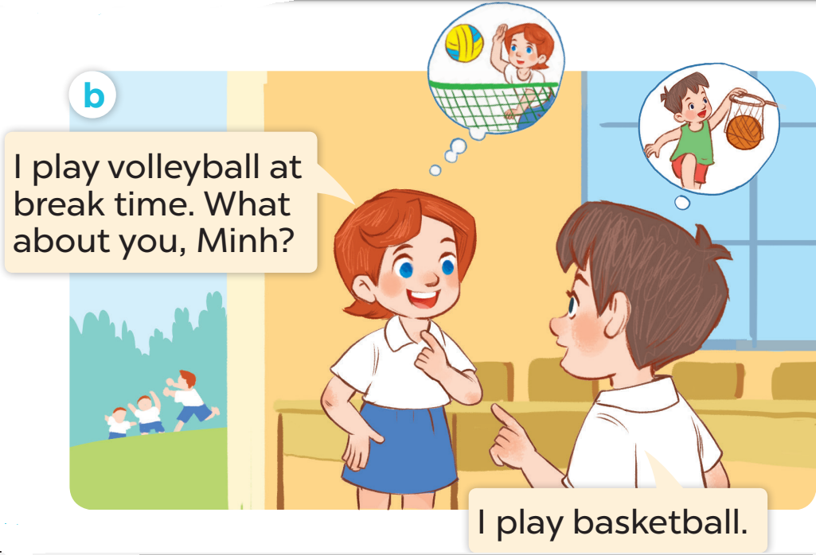
1. LOOK , LISTEN AND REPEAT

Slide 19
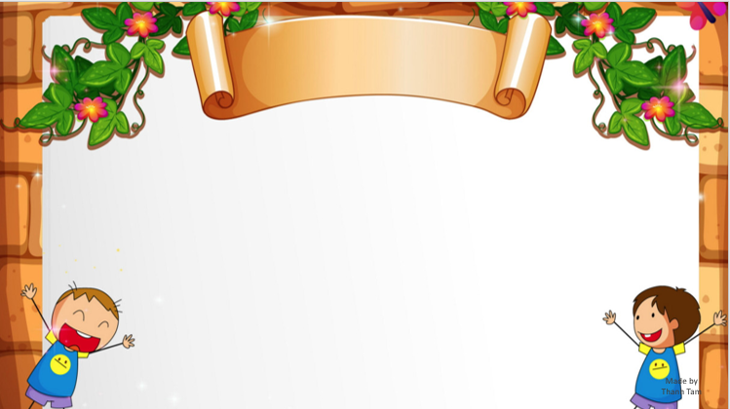
SENTENCE PATTERN

Slide 20

Nói về hoạt động vào thời gian giải lao
I play chess at break time.
(Tôi chơi đánh cờ vào giờ giải lao.)

Slide 21
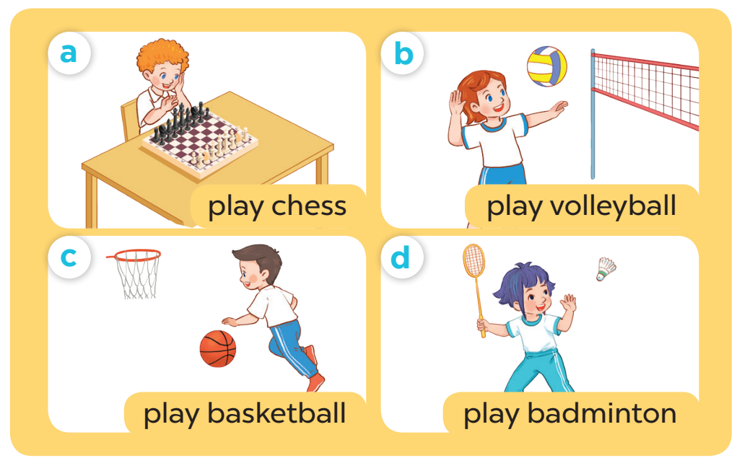
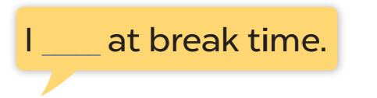
2. POINT AND SAY

Slide 22
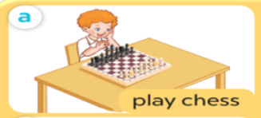
I_________________ at break time.
play chess
Notes:
MADE BY FACEBOOK :TRAN THI THANH TAM

Slide 23
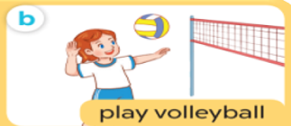
I_________________ at break time.
play volleyball
Notes:
MADE BY FACEBOOK :TRAN THI THANH TAM

Slide 24
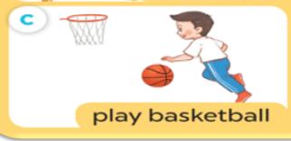
I_________________ at break time.
play basketball
Notes:
MADE BY FACEBOOK :TRAN THI THANH TAM

Slide 25
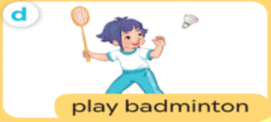
I_________________ at break time.
play badminton
Notes:
MADE BY FACEBOOK :TRAN THI THANH TAM

Slide 26
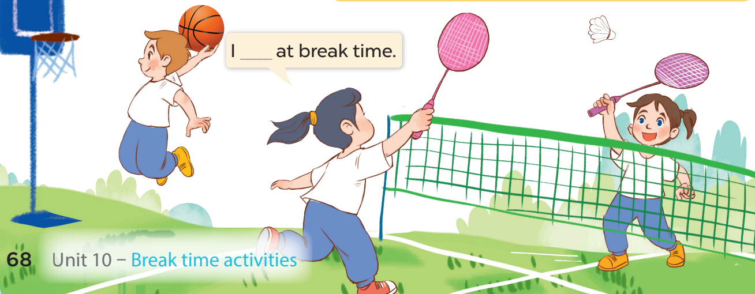
3. LET’S TALK

Slide 27


Let's play

Slide 28












SNOW WHITE

Slide 29








I play badminton at break time.
YES

Slide 30
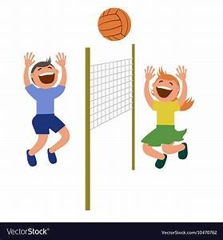
I play volleyball at break time.
YES

Slide 31
I play chess at break time.
YES

Slide 32
at break time.
YES

Slide 33
at break time.
YES

Slide 34

SUMMARY
Notes:
MADE BY FACEBOOK :TRAN THI THANH TAM

Slide 35
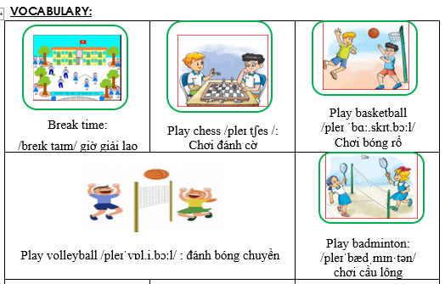
Notes:
Made by Facebook: TRAN THI THANH TAM

Slide 36
SENTENCE PATTERN
Notes:
MADE BY FACEBOOK :TRAN THI THANH TAM

Slide 37
Nói về hoạt động vào thời gian giải lao
I play chess at break time.
(Tôi chơi đánh cờ vào giờ giải lao.)

Slide 38

Homework:
- Learn vocabulary and sentence pattern by heart
- Prepare Unit 10- lesson 1 ( 4, 5, 6)
Notes:
MADE BY FACEBOOK :TRAN THI THANH TAM

Slide 39

Notes:
MADE BY FACEBOOK :TRAN THI THANH TAM

