Slide 3
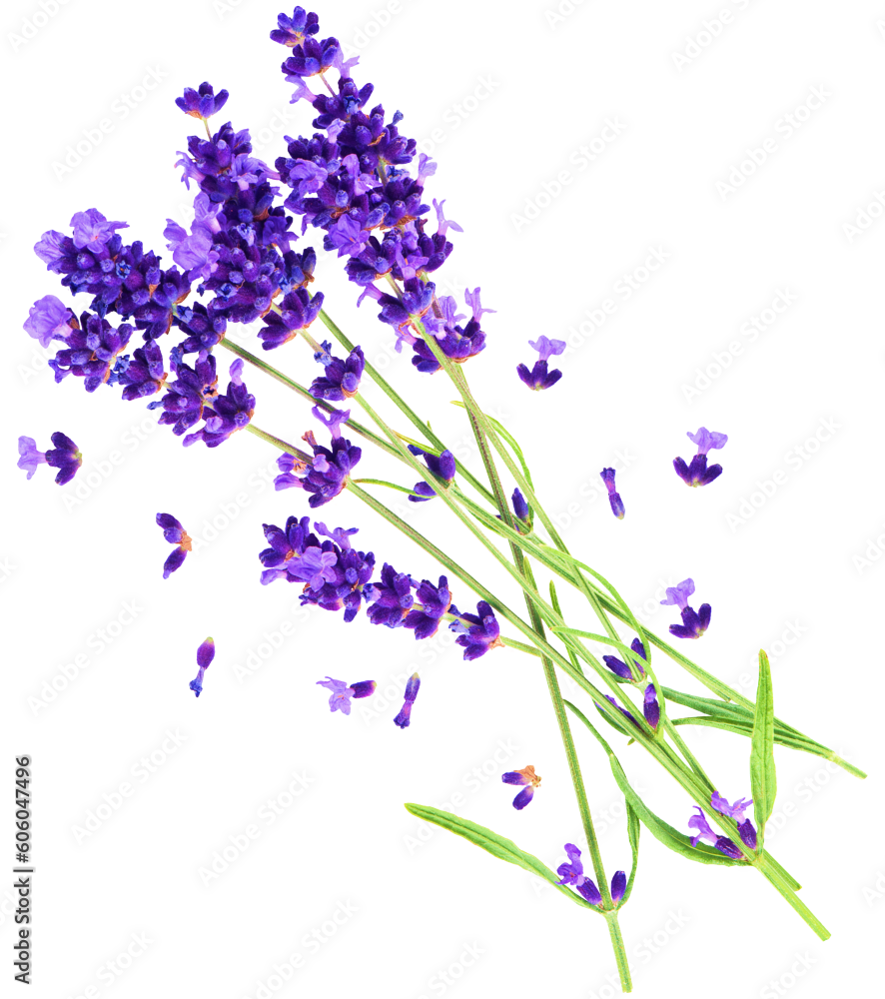
Warm-up and review
1
1
Chant + Game
3
3

Slide 6
Tuesday, December 19th, 2023
UNIT 9. OUR SPORTS DAY
Lesson 3. part 4,5,6

Slide 7
Task 4: Read and tick True or False.

Slide 8
4.Read and tick True or False
Our sports day is in November. It is in the school playground. There are many pupils and teachers. We play different sports and games. The boys play badminton. The girls play football. The teachers play basketball. It is a lot of fun!
 | True | False
0.The teachers play volleyball.
1.The sports day is in November. 2. The sports day is in the school gym.
3.The boys play badminton.
4.The girls play basketball.

Slide 9
4.Read and tick True or False
Our sports day is in November. It is in the school playground. There are many pupils and teachers. We play different sports and games. The boys play badminton. The girls play football. The teachers play basketball. It is a lot of fun!
 | True | False
0.The teachers play volleyball.
1.The sports day is in November. 2. The sports day is in the school gym.
3.The boys play badminton.
4.The girls play basketball.

Slide 10
4.Read and tick True or False
Our sports day is in November. It is in the school playground. There are many pupils and teachers. We play different sports and games. The boys play badminton. The girls play football. The teachers play basketball. It is a lot of fun!
 | True | False
0.The teachers play volleyball. |  | ˅
1.The sports day is in November. 2. The sports day is in the school gym.
3.The boys play badminton.
4.The girls play basketball.

Slide 11
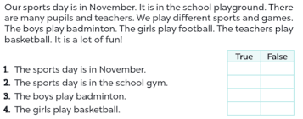
1.
2.
3.
4.
Task 4

Slide 12
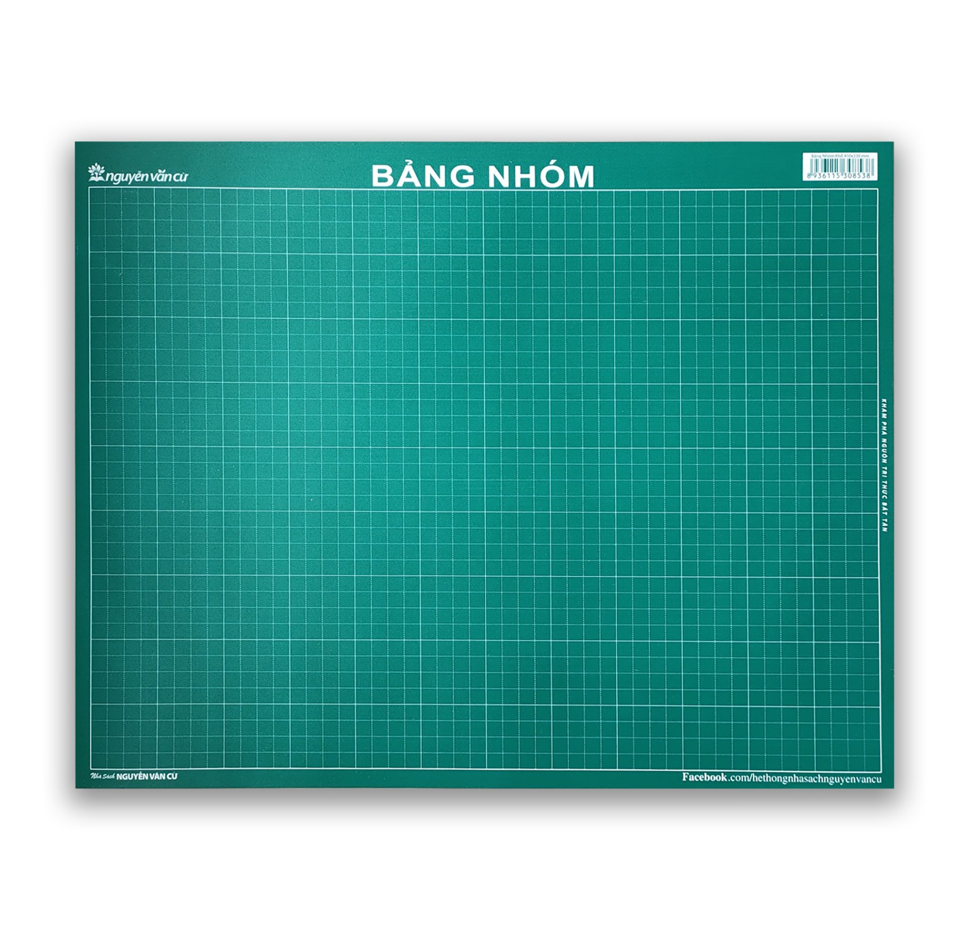
The correction of Task 4

Slide 13
4.Read and tick True or False
Our sports day is in November. It is in the school playground. There are many pupils and teachers. We play different sports and games. The boys play badminton. The girls play football. The teachers. It is a lot of fun! play basketball
 | True | False
1.The sports day is in November.

Slide 14
4.Read and tick True or False
Our sports day is in November. It is in the school playground. There are many pupils and teachers. We play different sports and games. The boys play badminton. The girls play football. The teachers. It is a lot of fun! play basketball
 | True | False
1.The sports day is in November. | V

Slide 15
4.Read and tick True or False
Our sports day is in November. It is in the school playground. There are many pupils and teachers. We play different sports and games. The boys play badminton. The girls play football. The teachers play basketball. It is a lot of fun!
 | True | False
2. The sports day is in the school gym.

Slide 16
4.Read and tick True or False
Our sports day is in November. It is in the school playground. There are many pupils and teachers. We play different sports and games. The boys play badminton. The girls play football. The teachers play basketball. It is a lot of fun!
 | True | False
2. The sports day is in the school gym. |  | V

Slide 17
4.Read and tick True or False
Our sports day is in November. It is in the school playground. There are many pupils and teachers. We play different sports and games. The boys play badminton. The girls play football. The teachers play basketball. It is a lot of fun!
 | True | False
3. The boys play badminton.

Slide 18
4.Read and tick True or False
Our sports day is in November. It is in the school playground. There are many pupils and teachers. We play different sports and games. The boys play badminton. The girls play football. The teachers play basketball. It is a lot of fun!
 | True | False
3. The boys play badminton. | V

Slide 19
4.Read and tick True or False
Our sports day is in November. It is in the school playground. There are many pupils and teachers. We play different sports and games. The boys play badminton. The girls play football. The teachers play basketball. It is a lot of fun!
 | True | False
4. The girls play basketball.

Slide 20
4.Read and tick True or False
Our sports day is in November. It is in the school playground. There are many pupils and teachers. We play different sports and games. The boys play badminton. The girls play football. The teachers play basketball. It is a lot of fun!
 | True | False
4. The girls play basketball. |  | V

Slide 21
4.Read and tick True or False
Our sports day is in November. It is in the school playground. There are many pupils and teachers. We play different sports and games. The boys play badminton. The girls play football. The teachers play basketball. It is a lot of fun!
 | True | False
0.The teachers play volleyball. |  | V
1.The sports day is in November. 2. The sports day is in the school gym. | V | V
3.The boys play badminton. | V
4.The girls play basketball. |  | V

Slide 22
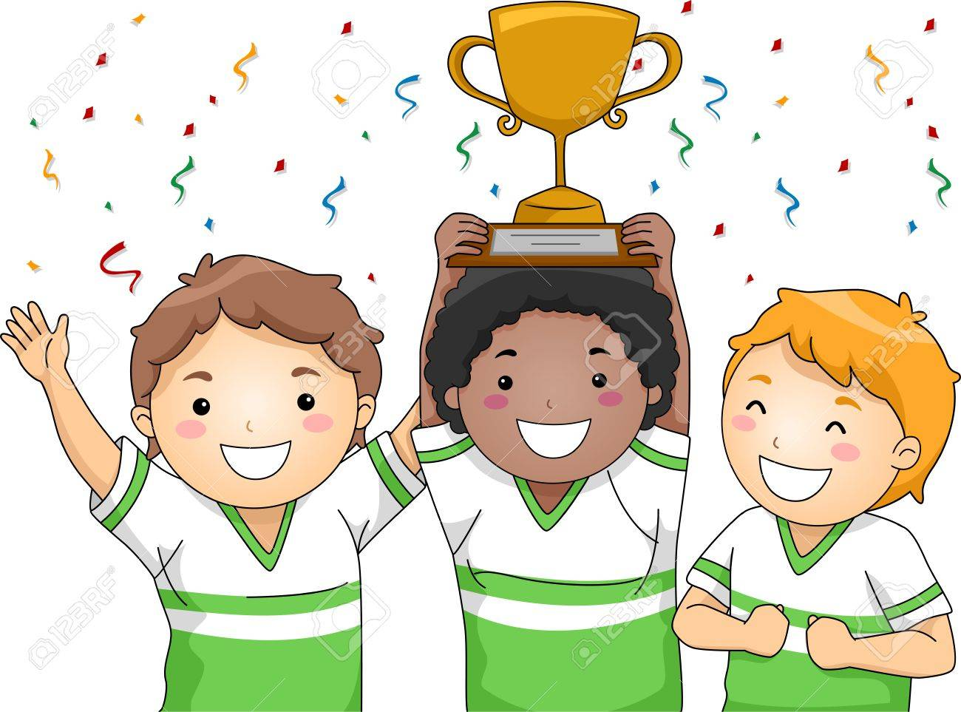

Slide 24
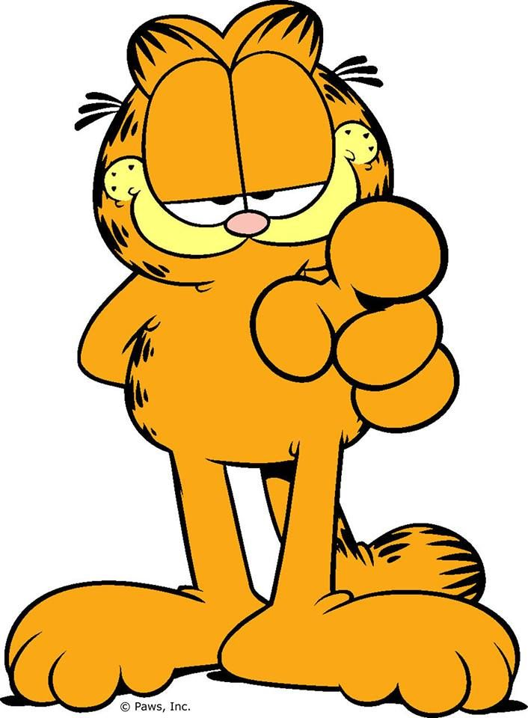
What
You?
about

Slide 25
Task 5: Let’s write.
3
3

Slide 26
5.Let’s write
Our school sports day is in ___________. We play sports and games in the school playground. The girls _________________. The boys ______________.The teachers_______________________. We all love our sports day.

Slide 27
The correction of Task 5
3

Slide 28
Task 6: Project
4
4

Slide 29
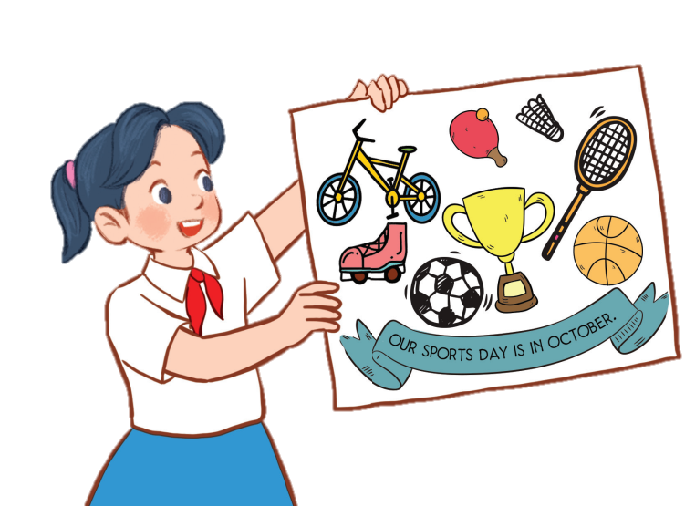
6
Project
Our sports day poster
Our sports day is in October. _______.

Slide 30
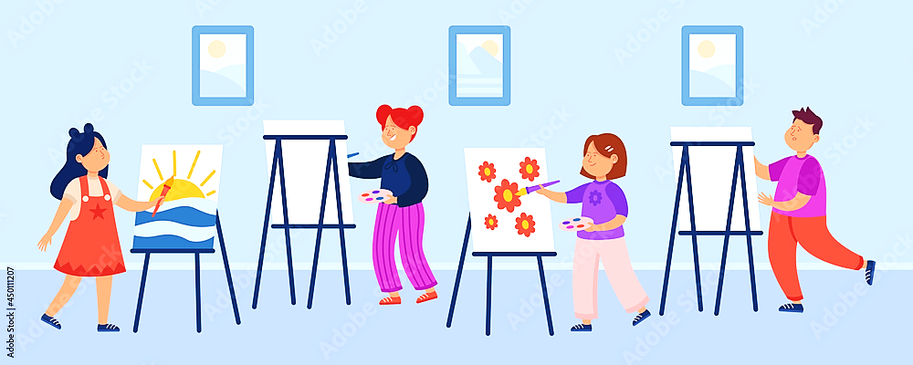
Gallery

Slide 31
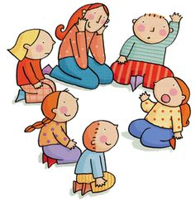
5
5

Slide 32
The importance of sports and games.

Slide 33
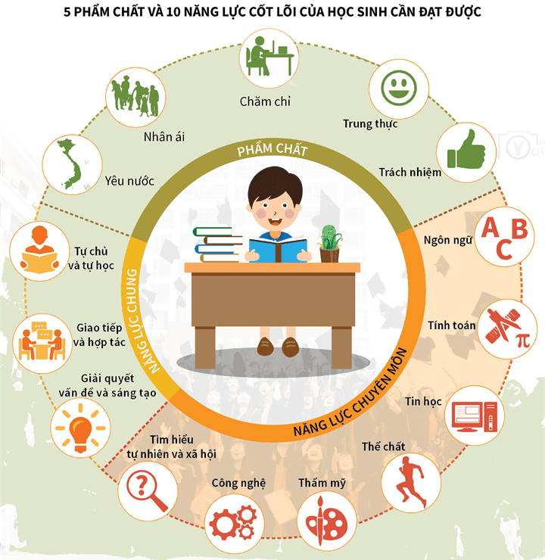
5 PHẨM CHẤT VÀ 10 NĂNG LỰC CỐT LÕI CỦA HỌC SINH CẦN ĐẠT ĐƯỢC
- Ps are hard-working and try to do tasks.
- Task 6: Cheer for the presenters.
- Ps help each other.
- Ps check their friends’ answers.
- Task 4: Ps do the task individually first.
- Task 4: Ps do the task individually first.
- Task 4: P lead the correction of the task.
- Task 5: Ps read their completed texts in front of the class.
- Task 6: Ps present.
- Task 4: Ps discuss in groups
- Task 6: Ps model the presentation.
- Let’s chant + do actions.
- Ps present the answers on the sub-board.
- T educates Ps to join sports and games to develop their health. Besides, T helps Ps identify the importance of sports and games in improving relationships with friends and teachers.

