Slide 1
Unit 13
WHAT DO YOU DO
IN YOUR FREE TIME?
Lesson 3

Slide 2
Objectives
By the end of this lesson, students will be able to…
- Use the words & phrases related to the topics Free time activities.
- Say questions and answers with the correct intornation.
Developping: Listening – Speaking skills
Vocabulary : go camping, go shopping...
Structure: What does your ... do in his/her free time? He/She ... Phonetic:
What do you do in your free time?
– I surf the internet.
What do they do in their free time?
– They go camping.

Slide 3
Warm-up

Slide 4
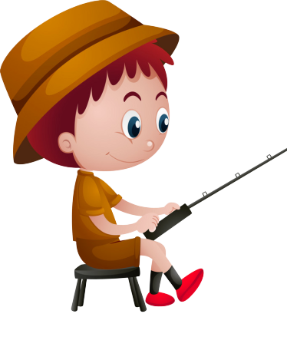
GO FISHING
Game
PLAY
EXIT

Slide 5
0
Score:
13
12
EXIT
11
14
7
8
15
1
6
9
2
5
3
10
4

Slide 6
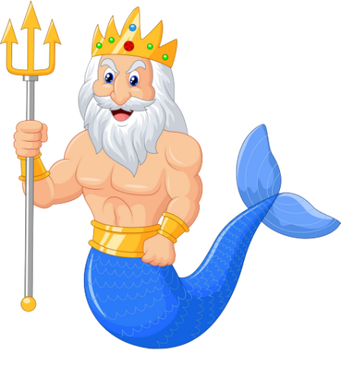
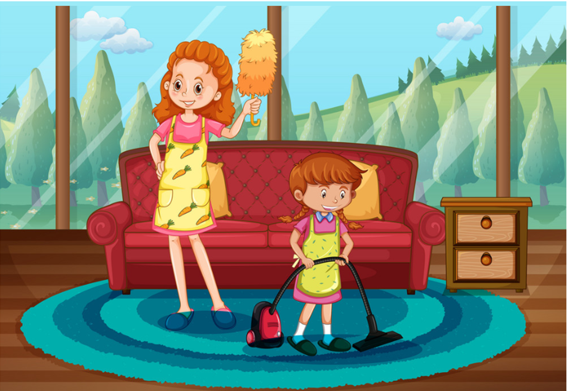
A
I cleans my house.
What do you do in your free time?
B
I cleanes my house.
C
I clean my house.
D
You clean my house.

Slide 7
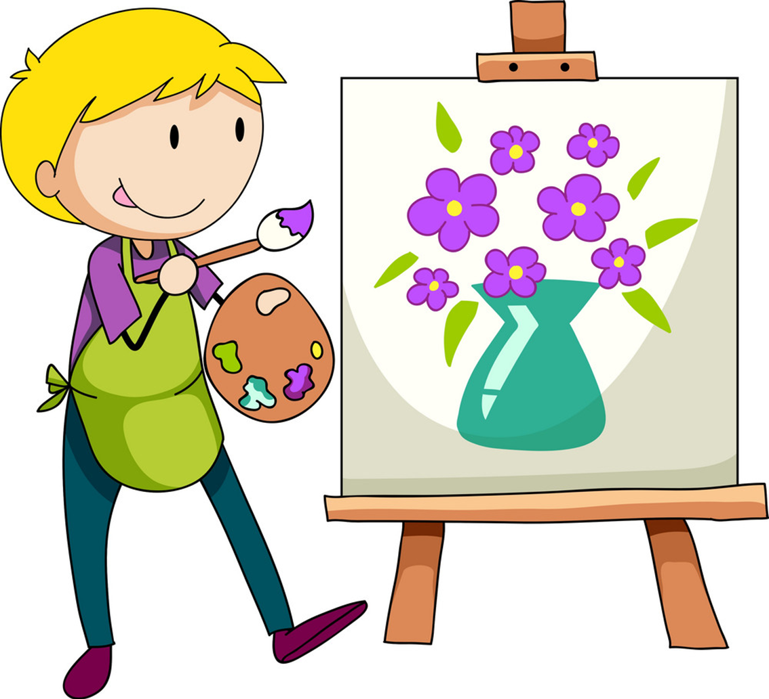
A
What do he do
_____________ in his free time?
He draws pictures.
B
What does he do
C
What do she do
D
What does she do

Slide 8
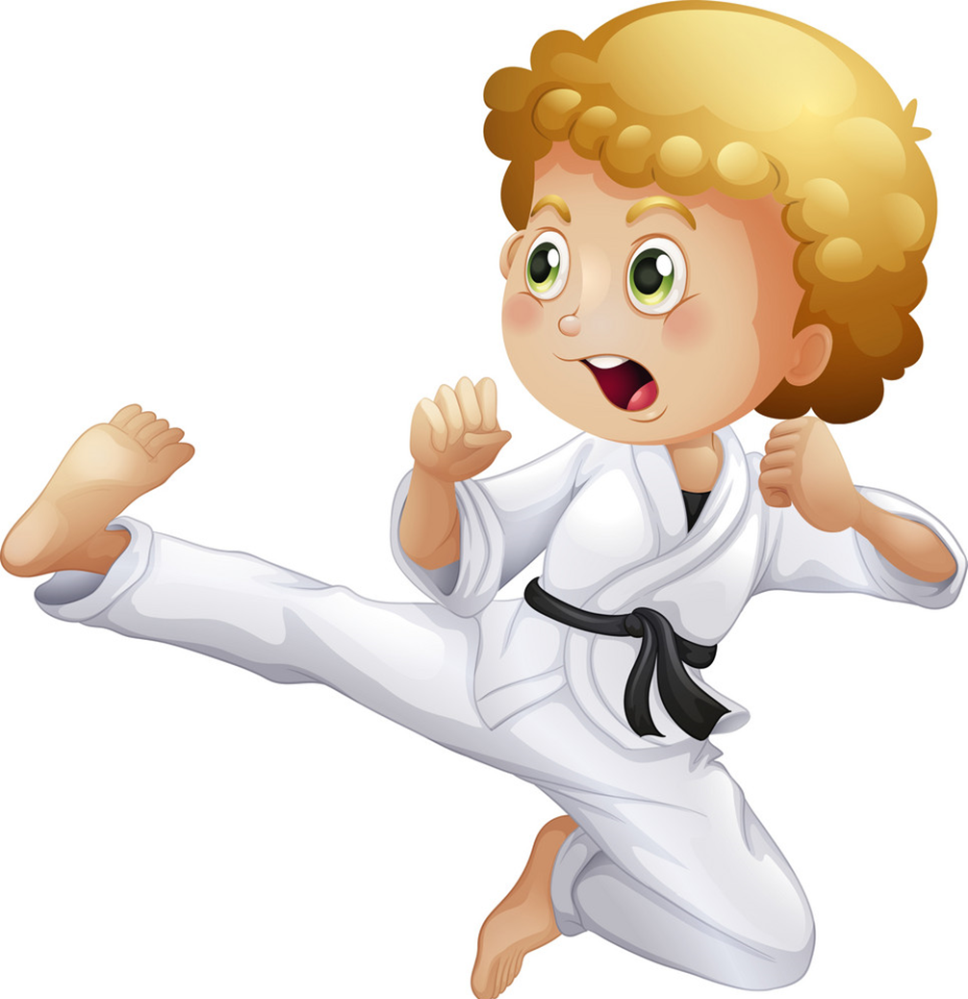
A
does karate
What do you do in your free time?
I _____________.
B
do karate
C
dos karate
D
deos karate

Slide 9
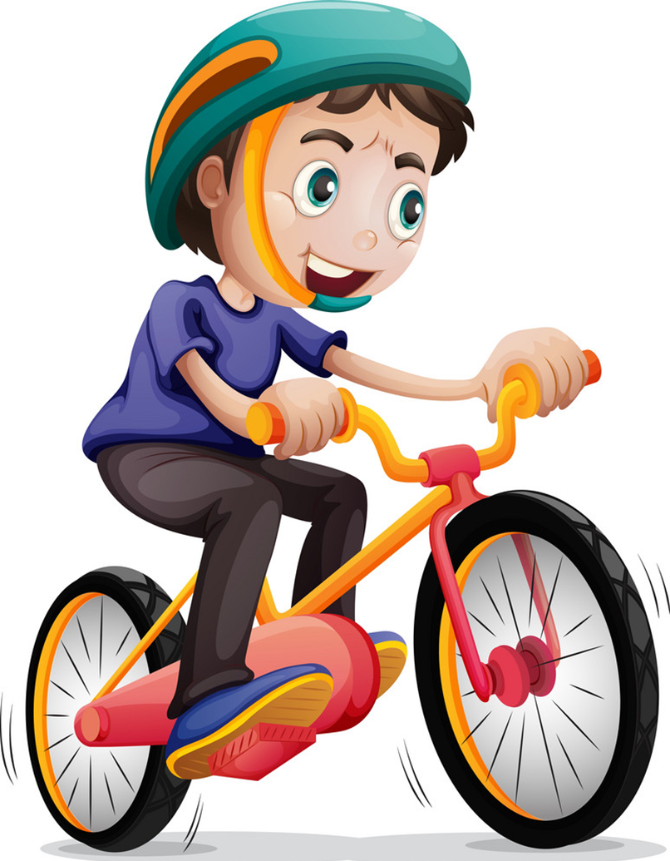
A
What do you do
in your
______________ free time?
He rides his bike.
B
What do you do
in his
C
What do he do
in his
D
What does he do
in his

Slide 10
A
surf the Internet
What does you brother do
in his free time?
- He_______________.
B
surfes the Internet
C
surf the Internets
D
surfs the Internet

Slide 11
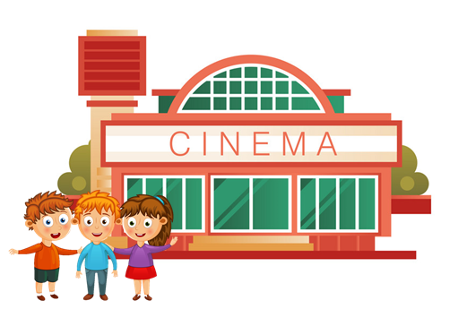
What does your friend do
in her free time?
- She goes to the cinema.
A
True
B
False
C
By
D
Next to

Slide 12
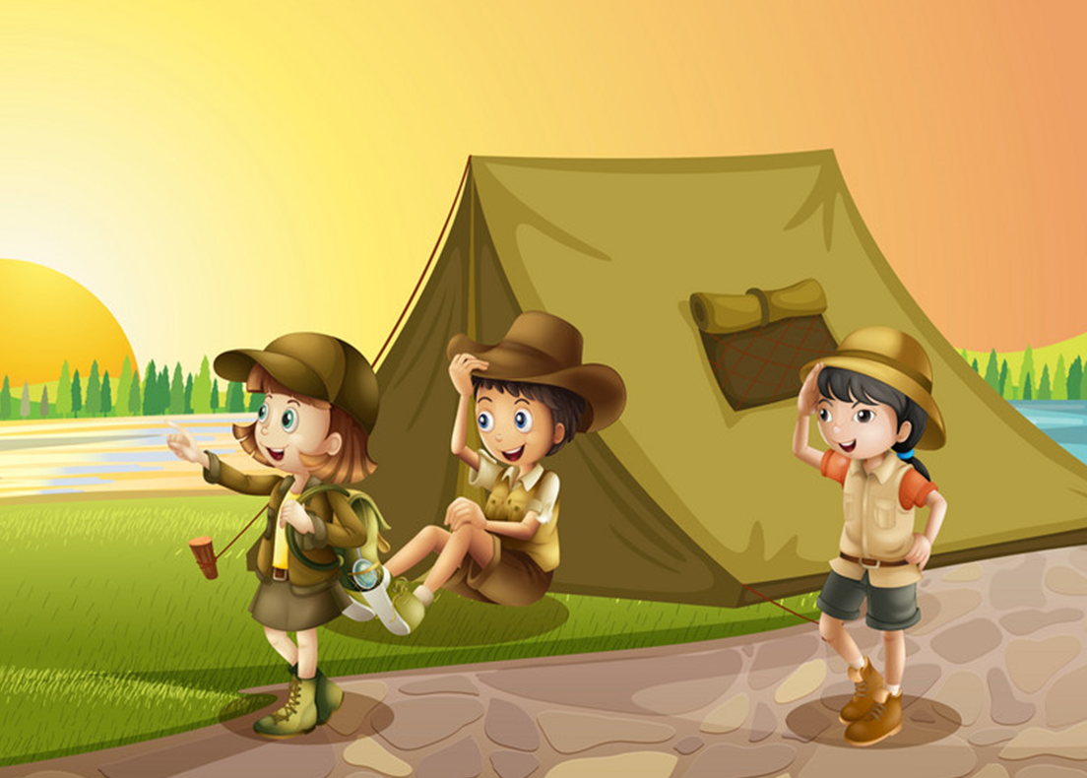
What do you do in your
free time?
- I go camping.
A
True
B
False
C
Should
D
May

Slide 13
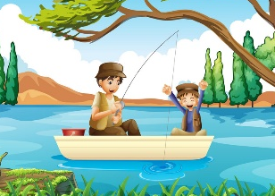
What do your father do
in his free time?
- He goes fishing.
A
True
B
False
C
Play
D
Watch

Slide 14
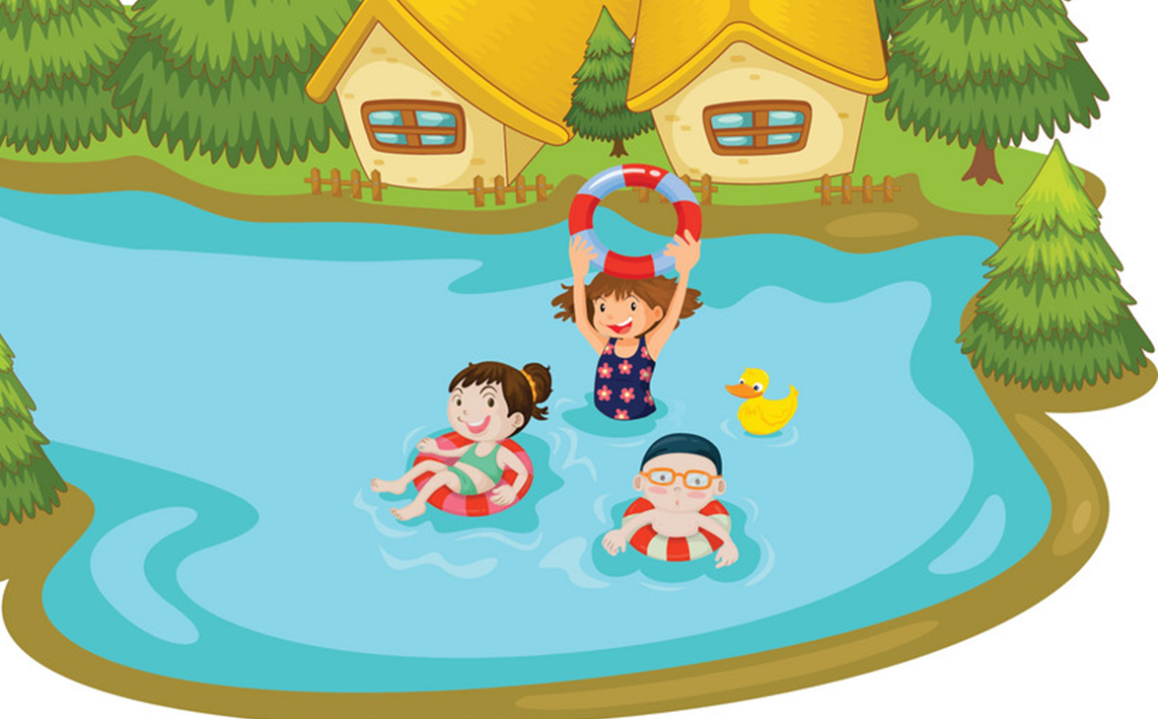
What does your sister do
in her free time?
- She go swimming.
A
True
B
False
C
Play
D
Watch

Slide 15
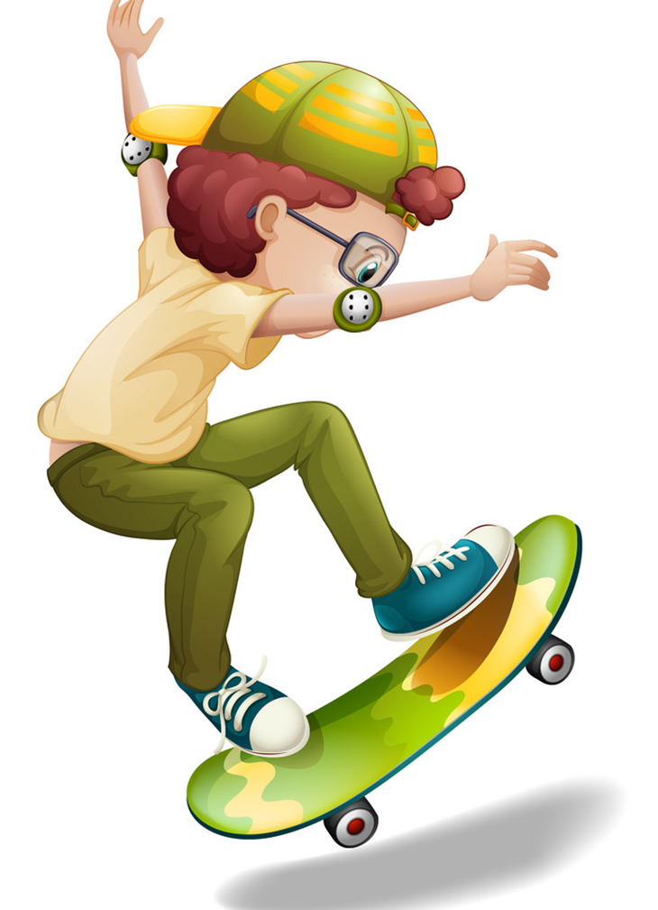
_____ two black cats.
What does you brother do
in his free time?
- He goes skating.
A
True
A
There is
B
False
B
There are
C
Should
C
Play
D
May
D
Watch

Slide 16
Pronounciation

Slide 17
1. Listen and repeat
1. | What do you do in your free time? ↷ I surf the Internet. ↷
2. | What does he do in his free time? ↷ He listens to music. ↷
3. | What does she do in her free time? ↷ She goes shopping. ↷
4. | What do they do in their free time? ↷ They go camping. ↷

Slide 18
2. Listen and circle a or b. Then say the sentences aloud.
1. What do you do in your free time? I ________.
a. clean the house b. watch cartoons
2. What does she do in her free time? She ______.
a. goes skating b. goes fishing
3. What does he do in his free time? He ________.
a. does karate b. goes to the cinema
4. What do they do in their free time? They ________.
a. work in the garden b. go shopping

Slide 19
REVIEW

Slide 20
Model sentence
What do you do in your free time?
I ______________________.
ride my bike
surf the Internet
do karate
draw pictures
clean the house
go to the cinema

Slide 21
Model sentence
What does your ________ do in ____ free time?
She/he ______________________.
surfs the Internet
go fishing
go swimming
clean the house
go to the cinema
go camping
do karate
go skating

Slide 22
3. Let’s chant

Slide 23
THANK YOU!

