Slide 2
Welcome to Group 2
Nguyễn Nhật Anh
Đặng Thanh Hằng
Nguyễn Thị Mỹ Linh
Nguyễn Thị Kim Long
Trương Thị Thảo Nguyên

Slide 3
Things we can do
5
LESSON 1 PERIOD 1

Slide 4
Table of contents
Warm-up Say a chant.
04
01
02
03
Activity 2 Listen, point and say.
New words
05
Activity 3 Let’s talk.
Activity 1 Look, listen and repeat.
06
Games

Slide 5
01
Warm-up

Slide 8
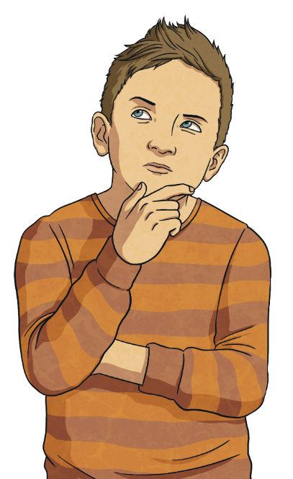
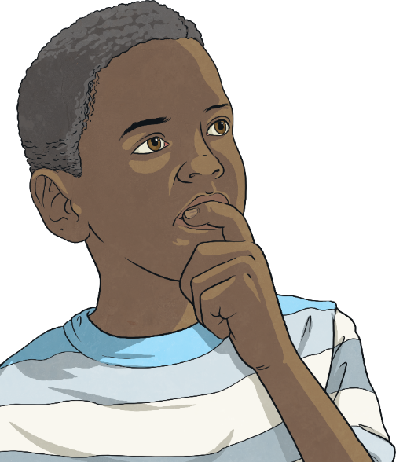
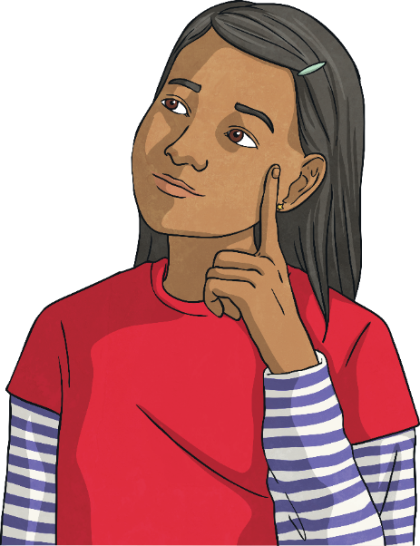
How to Play
Click on the boxes to reveal the picture underneath.
Can you work out what is it?
Click on ‘answer’ to reveal the answer.

Slide 9
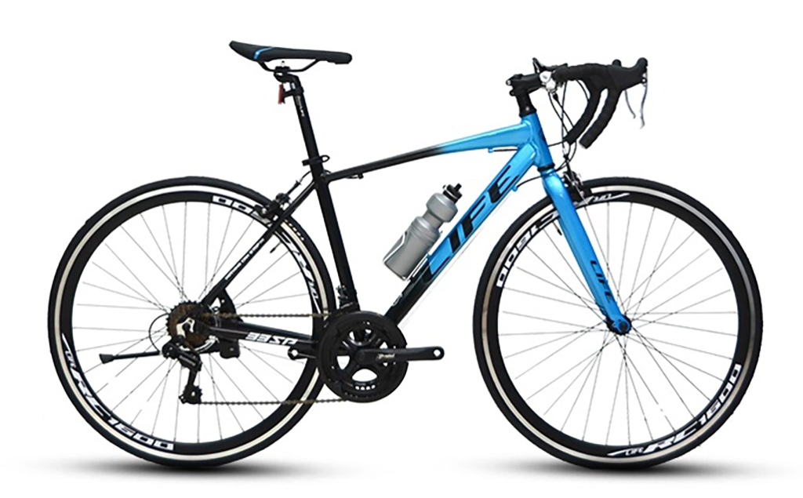
Bike
Answer

Slide 10
Bike

Slide 11
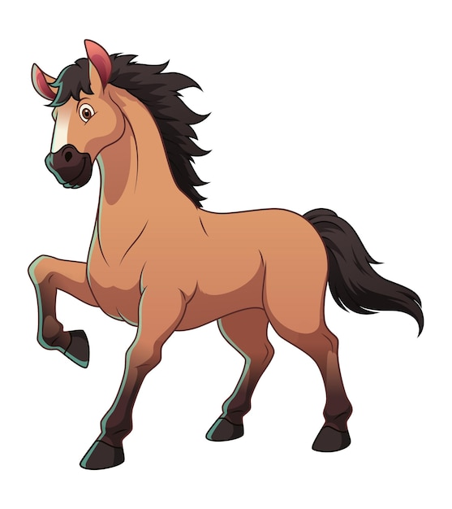
Horse
Answer

Slide 12
Horse

Slide 13
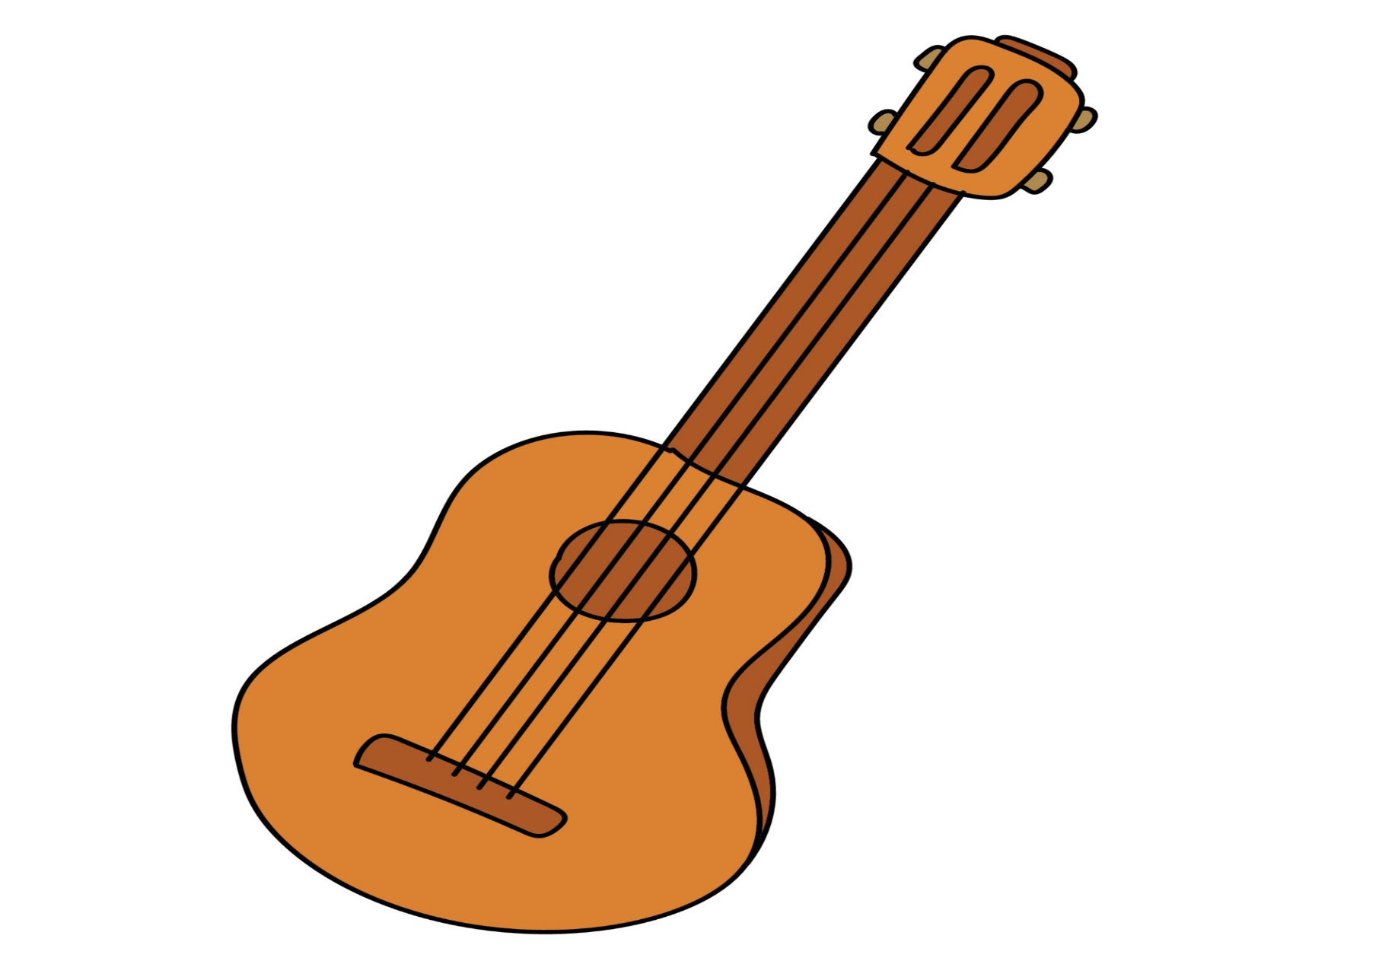
Guitar
Answer

Slide 14
Guitar

Slide 15
Piano
Answer

Slide 16
Piano

Slide 18
New words

Slide 19
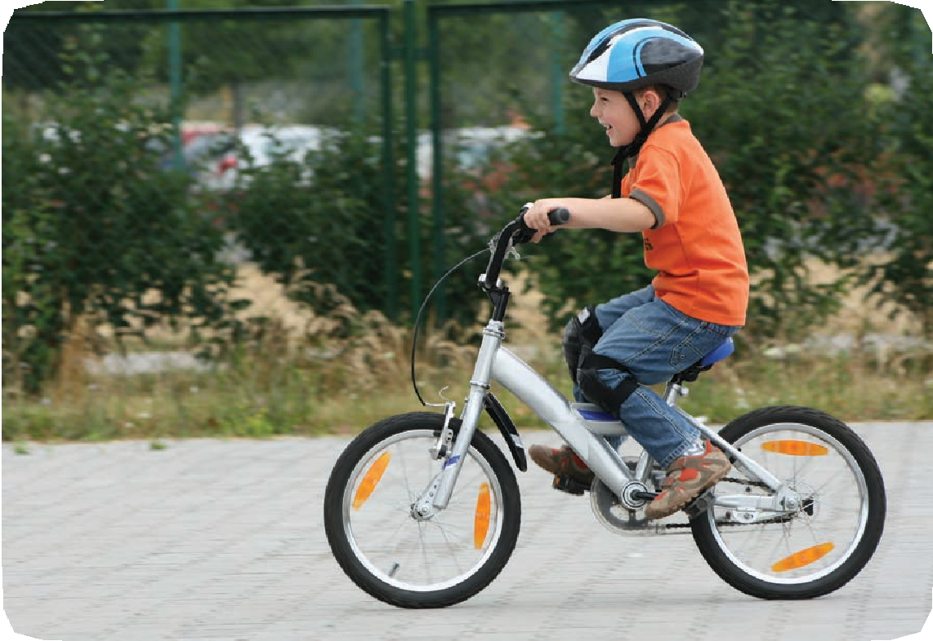
ride a bike

Slide 20
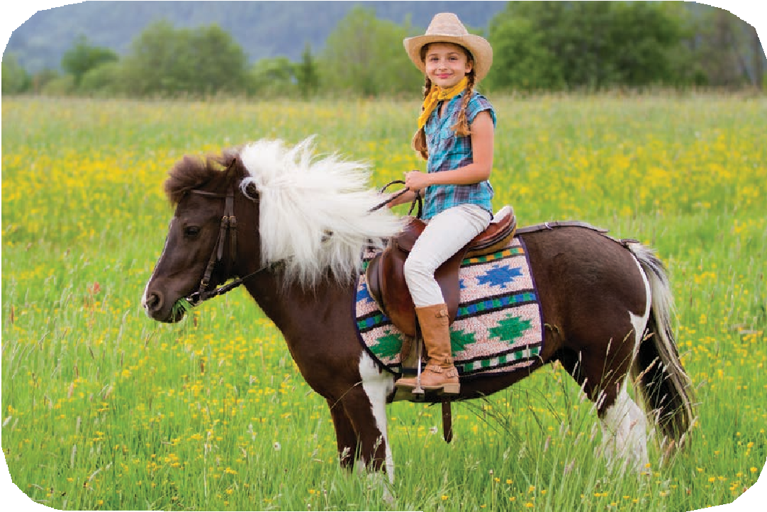
ride a horse

Slide 21
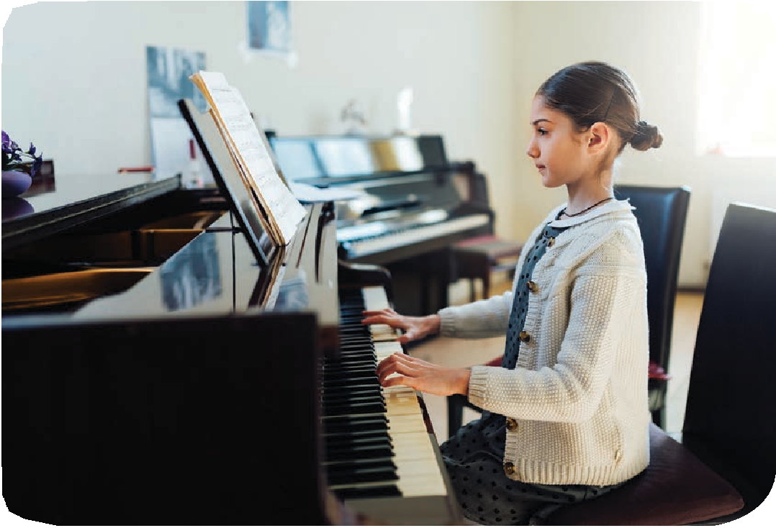
play the piano

Slide 22
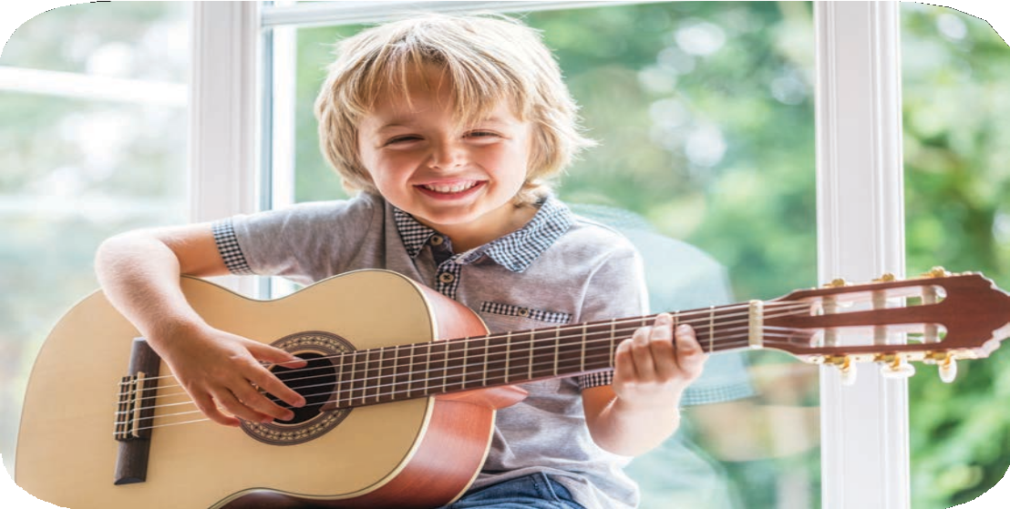
play the guitar

Slide 23
03
Activity 1 Look, listen and repeat.

Slide 24
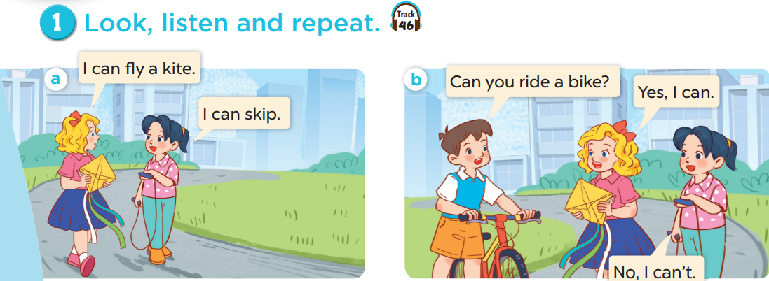
What does Mary have?
What does Mai have?
What does Minh have?
Who are they?

Slide 25
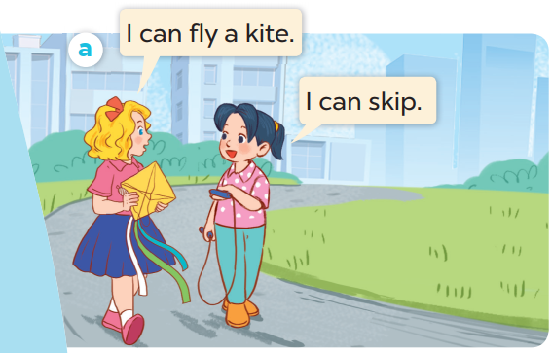

Slide 26
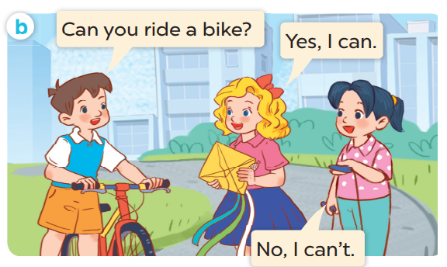

Slide 27
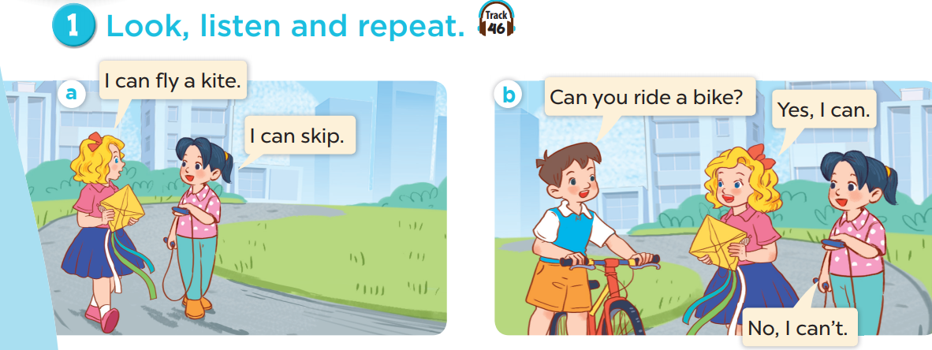
Work in pairs. Practise.
Listen and repeat.

Slide 28
04
Activity 2 Listen, point and say.

Slide 29
Can you + (name of activity)?
Yes, I can.
No, I can’t.

Slide 30
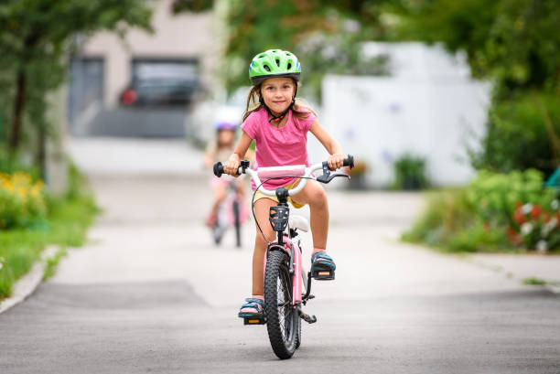
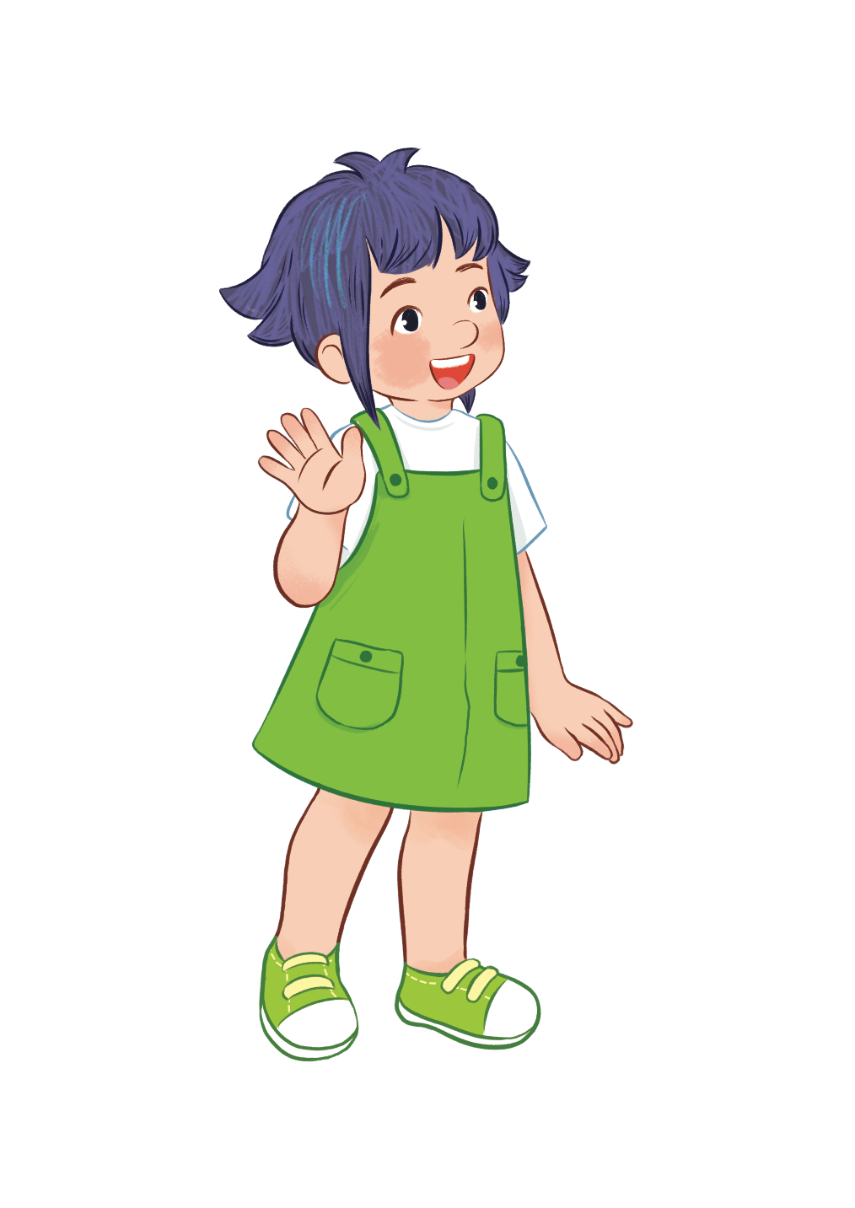
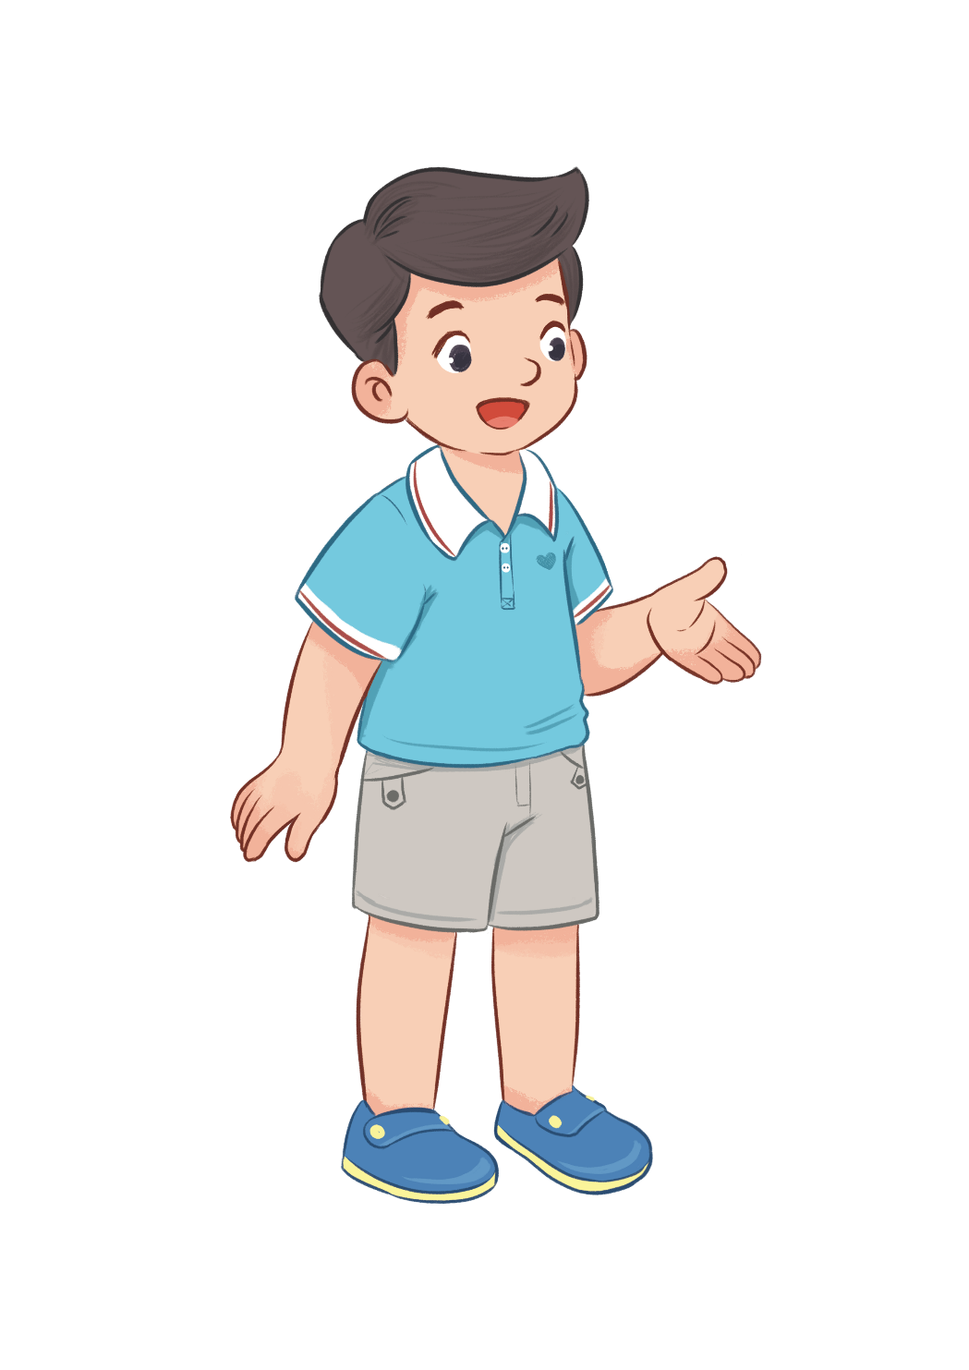
Can you ride a bike?
Yes, I can.

Slide 31
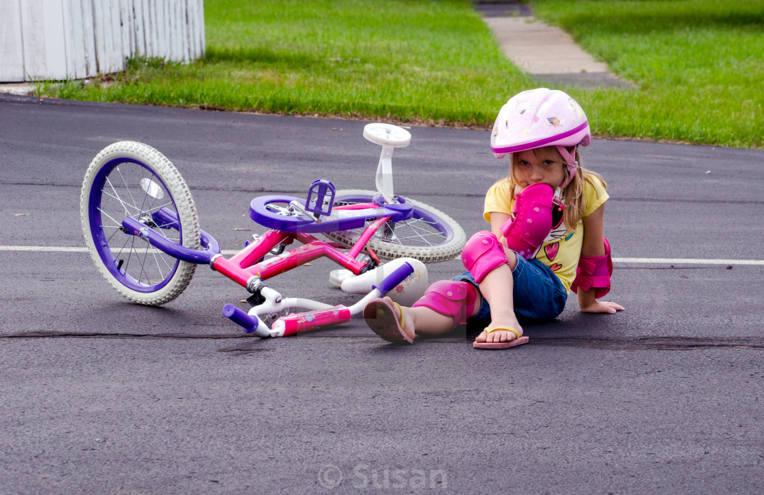
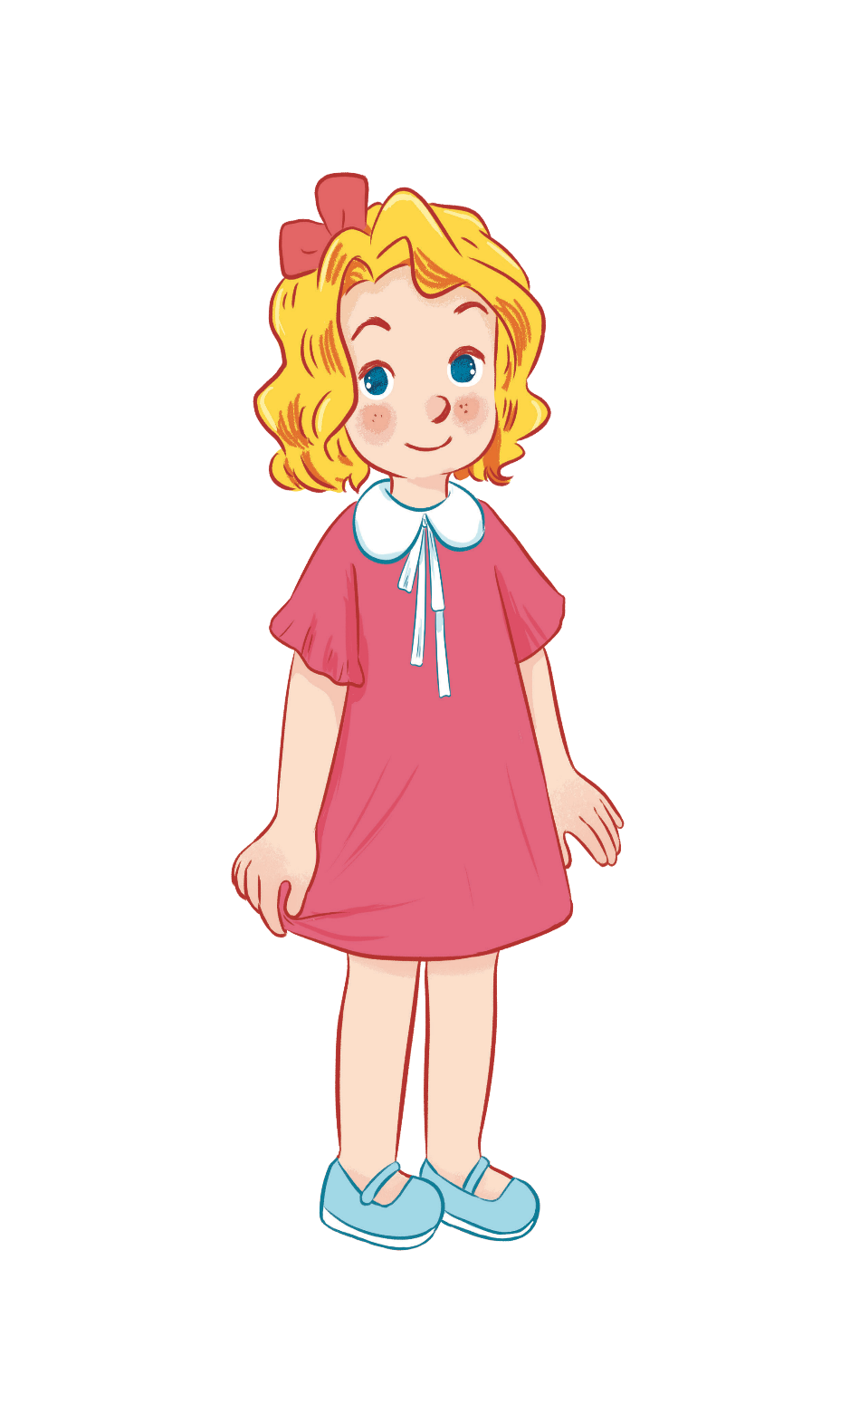
Can you ride a bike?
No, I can’t.

Slide 32
Can you play the guitar?
Yes, I can.

Slide 33
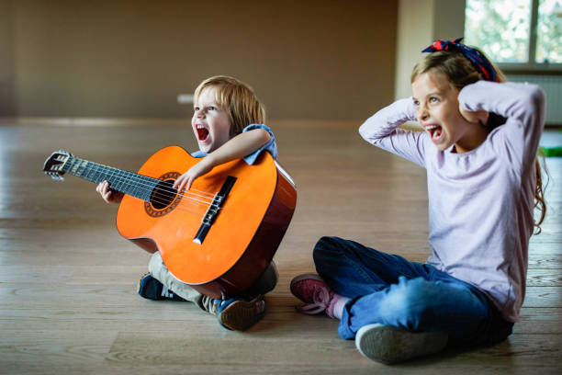
Can you play the guitar?
No, I can’t.

Slide 34
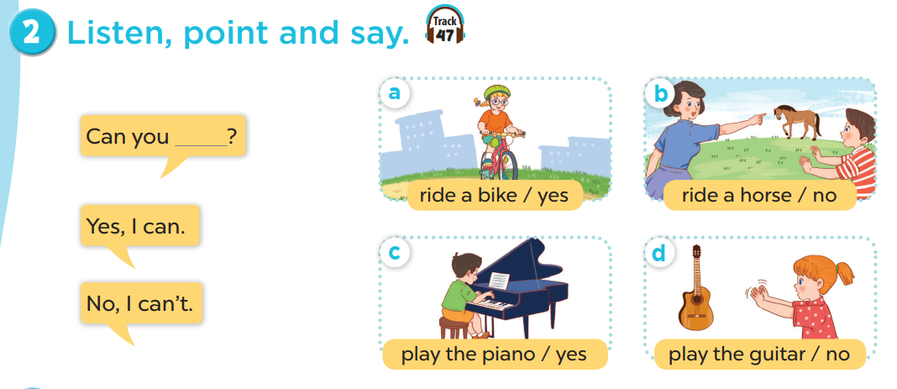
Work in pairs. Practise.
Listen, point and say.

Slide 35
05
Activity 3 Let’s talk.

Slide 36
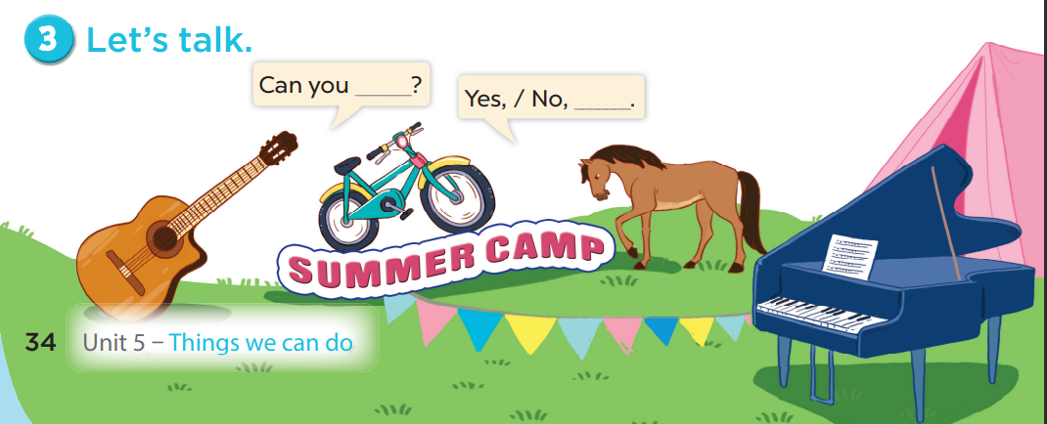

Slide 37
06
Games

Slide 38
LUCKY WHEEL
10 ms
15
1
2
3
5 ms
20
2
3
0
0
4
5
4
5
6
6
50
40
STOP
PLAY

Slide 39
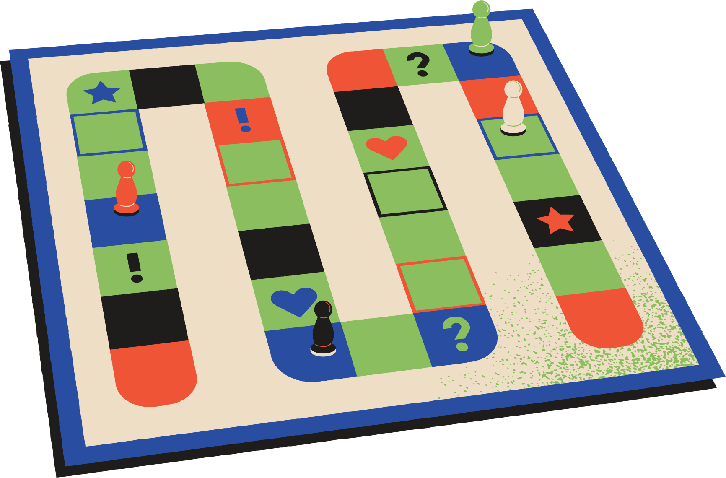
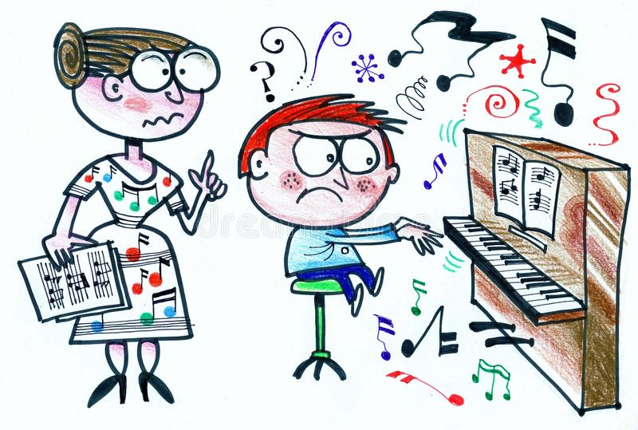

Slide 40
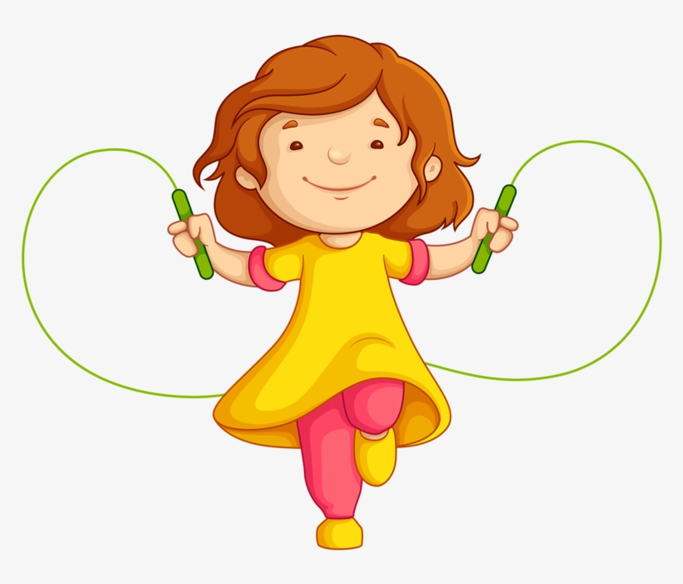

Slide 41
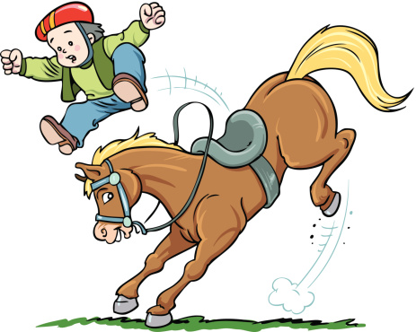

Slide 44
You are lucky

Slide 46
You are lucky

