Slide 1
Welcome to our class 3C
Teacher: Nguyen Thi Thuy Vinh

Slide 3
My pets lesson 2 period 4
16

Slide 4
01
Warm up
Sing a song

Slide 5
Notes:
https://www.youtube.com/watch?v=pWepfJ-8XU0

Slide 6
02
Activity 4
Listen and number

Slide 7
4
1
2
3

Slide 8
03
Activity 5
Look, complete and read

Slide 9
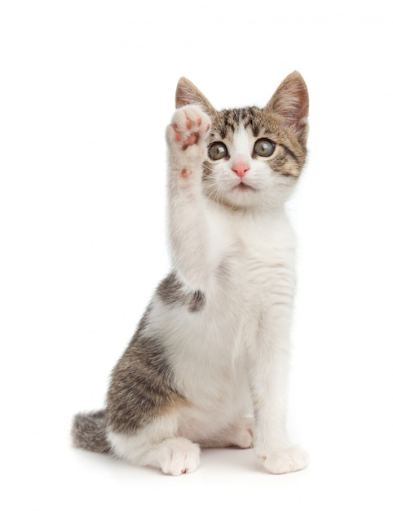
How many ………..do you have?
cat
a cat
cats
Notes:
https://www.freepik.com/premium-photo/puppy-cat_4193304.htm#query=cats&position=7&from_view=search

Slide 10
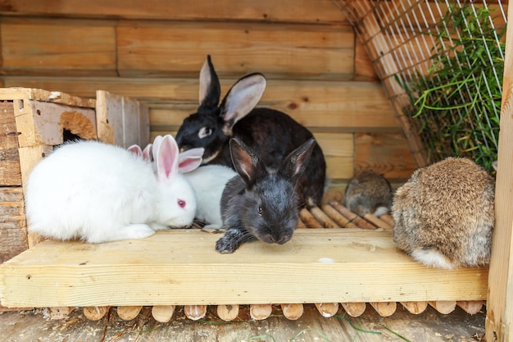
……………… many rabbits do you have?
How
What
Who
Notes:
https://www.freepik.com/premium-photo/many-different-small-feeding-rabbits-animal-farm-rabbit-hutch_10916142.htm#query=many%20rabbits%20pets&position=17&from_view=search

Slide 11
How many cats do you have?
I have one cat.
I have some cats.
I have many cats.
Notes:
https://www.freepik.com/premium-photo/puppy-cat_4193304.htm#query=cats&position=7&from_view=search

Slide 12
How many parrots do you have?
I have one parrot.
I have some parrots.
I have many parrots.
Notes:
https://www.freepik.com/premium-photo/common-pet-parakeet-african-grey-parrot-lovebirds-zebra-finch-cockatielisolated-white_13748224.htm#query=parrots&position=13&from_view=search

Slide 13
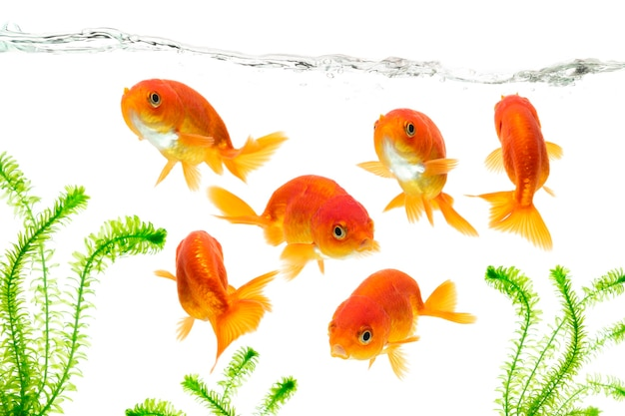
How many fish do you have?
I have one fish.
I have some fish.
I have many fish.
Notes:
https://www.freepik.com/premium-photo/goldfish-swimming-isolated-white-background_19668306.htm#query=goldfish&position=6&from_view=search

Slide 14
Open your book!

Slide 15
one rabbit.
two dogs.
some parrots.
many goldfish.

Slide 16
04
Activity 6
Let’s play

Slide 18
05
Fun time
Look, complete and read

Slide 19
5
10
1
7
8
SPIN
-5
3
9
-3
4
6
2
tekhnologic
Notes:
Gv cho hs quay vòng quay để nhận điểm
Gọi 2 hs từ mỗi đội lên hỏi và trả lời theo mẫu trong bài

Slide 20
06
Extra stuffs

Slide 21
Homework
Review the words and structure
Do exercise in the Workbook, page 62
Prepare the new lesson

