Slide 1
WELCOME TO CLASS 5C!
Unit one : All about me
Lesson two ( Part 1,2,3)
Teacher :Trần Thị Thu Trâm

Slide 3
Unit 1. All about me!
Lesson 2 (part 1,2,3)

Slide 4
Warm-up and review

Slide 5
Game
MATCHING

Slide 6
https://wordwall.net/resource/26966514/matching#

Slide 7
MATCHING
WIN

Slide 8
1
Look, listen and repeat.

Slide 9
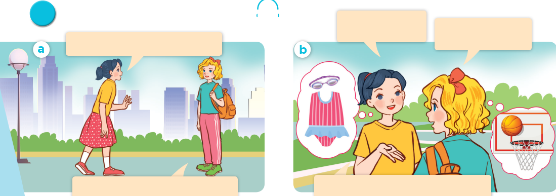
Look, listen and repeat.

Slide 10
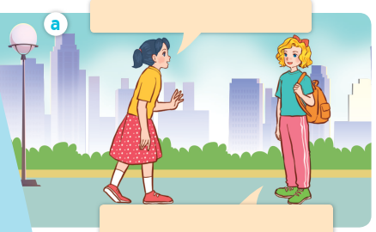
Look, listen and repeat.
Look, listen and repeat.
Where are you going, Mary?
I’m going to the sports centre.
Notes:
Nháy vào hội thoại để nghe lại âm thanh từng câu.

Slide 11
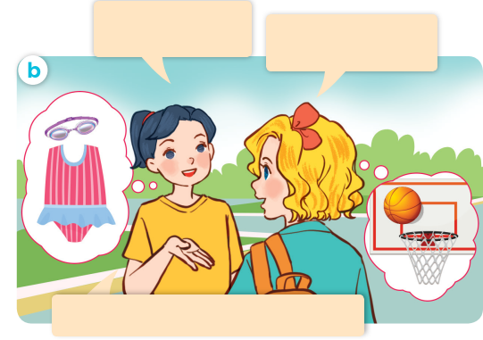
I’m going to the sports centre.
I’m going to the sports centre.
Look, listen and repeat.
Look, listen and repeat.
What’s your favourite sport?
It’s basketball. What about you?
My favourite sport is swimming.
Notes:
Nháy vào hội thoại để nghe lại âm thanh từng câu.

Slide 12
Look, listen and repeat.
Look, listen and repeat.
What’s your favourite sport?
It’s basketball. What about you?
Where are you going, Mary?
I’m going to the sports centre.
My favourite sport is swimming.

Slide 13
What’s your favourite sport?
It’s basketball.

Slide 14
2
Listen, point and say.

Slide 15
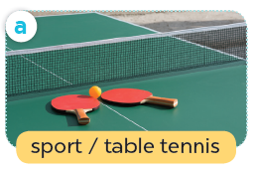
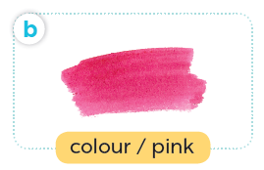
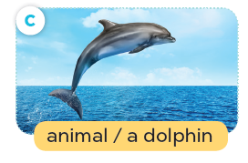
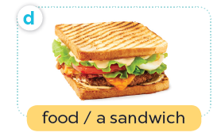
Listen, point and say.

Slide 16
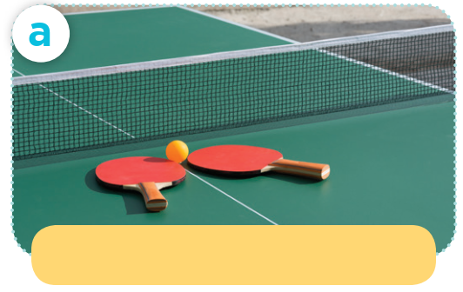
Listen, point and say.
sport / table tennis

Slide 17
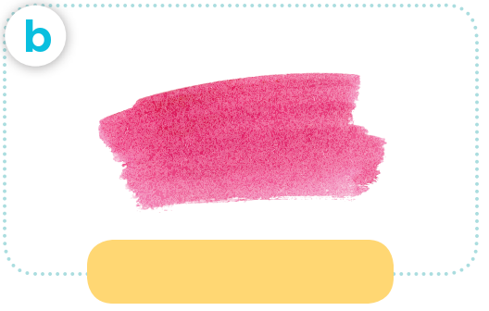
Listen, point and say.
colour / pink

Slide 18
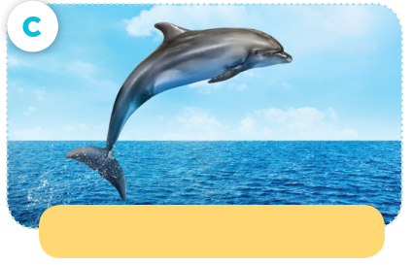
Listen, point and say.
animal / a dolphin

Slide 19
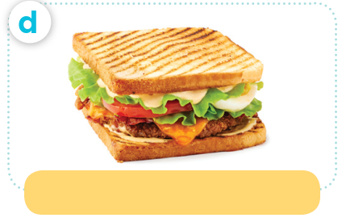
Listen, point and say.
food / a sandwich

Slide 20
What’s your favourite ____?
It’s _____

Slide 21
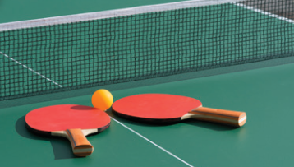
Listen, point and say.
What’s your favourite sport?
It’s table tennis.

Slide 22
Listen, point and say.
What’s your favourite colour?
It’s pink.

Slide 23
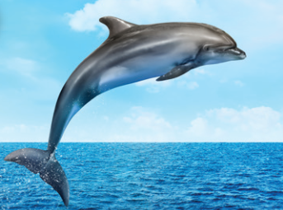
Listen, point and say.
What’s your favourite animal?
It’s a dolphin.

Slide 24
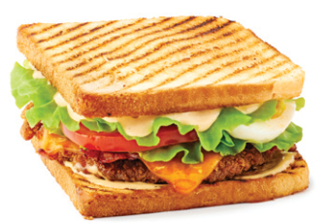
Listen, point and say.
What’s your favourite food?
It’s a sandwich.

Slide 25
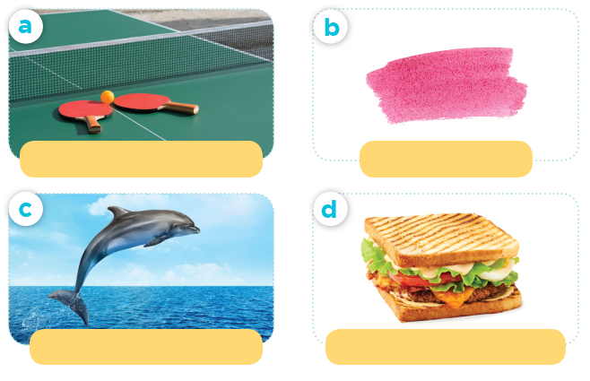
Work in pairs.
What’s your favourite ____?
sport / table tennis
colour / pink
It’s ____.
animal / a dolphin
food / a sandwich

Slide 26
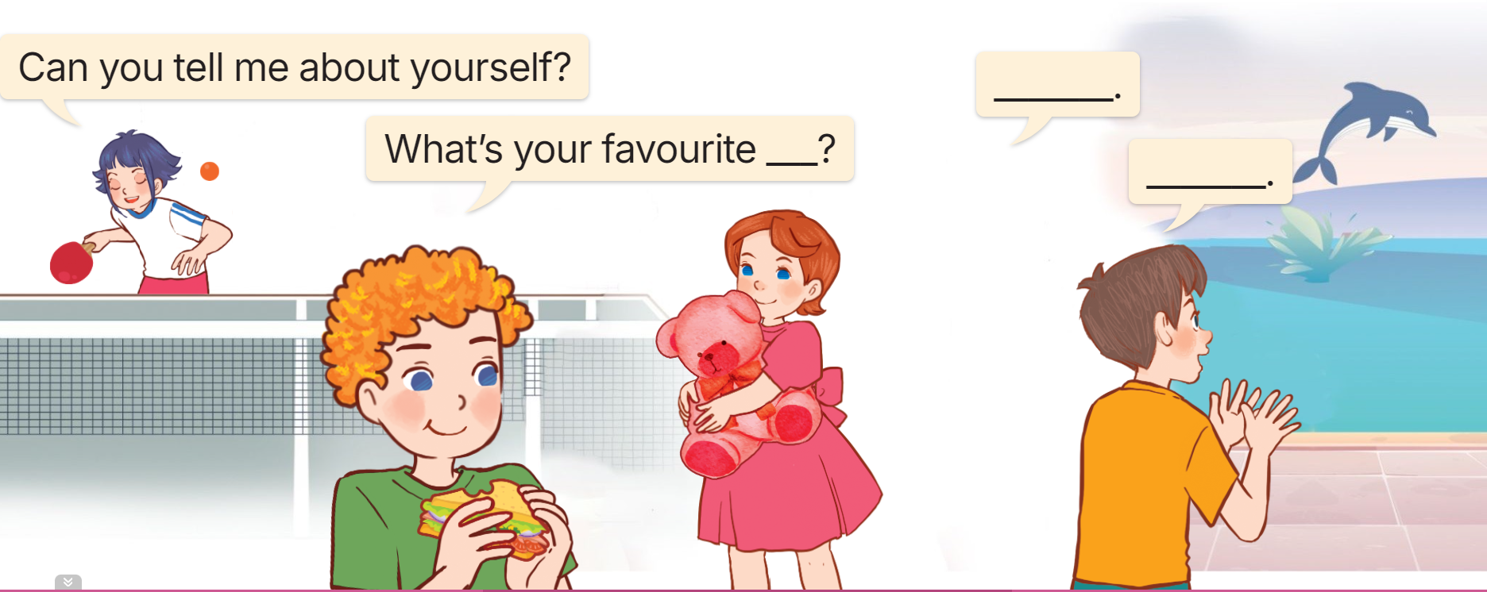
3. Let’s talk
I’m in class…..I live……
It’s …

Slide 27
Fun corner and wrap-up

Slide 28
Monday September 16th ,2024
Unit one: All about me.
Lesson one : Part 1,2,3
New words
-favourite : yêu thích nhất
-favourite sport: môn thể thao yêu thích nhất
-animal : động vật
-a dolphin: 1 con cá heo
-a sandwich :1 bánh mì kẹp thịt
Structure
What’s your favourite sport?
It’s table tennis.
Homework
-Learn by heart the new words and structure
-Practice the structure

