Slide 1
Sở Giáo Dục và Đào Tạo Bình Định
Trường THPT Xuân Diệu
Giáo viên: Nguyễn Thị Xuân Mỹ
Lớp: 12A2
Môn: Tiếng Anh

Slide 2
Unit 3: WORLD OF WORK
Lesson 1.1: Vocab & Reading
Pages: 26 & 27

Slide 3

WARM-UP

Slide 4
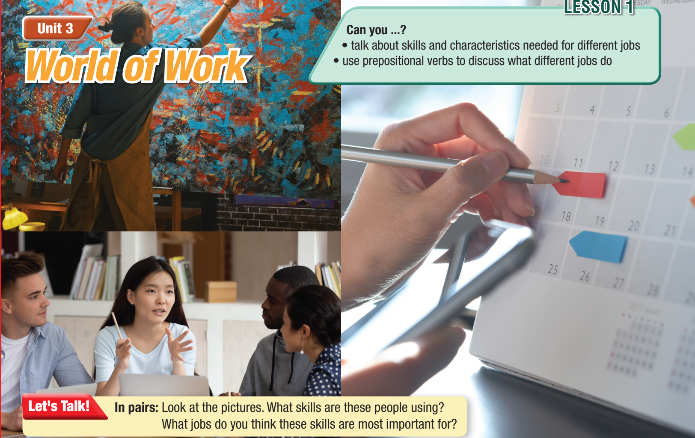

Slide 5

Suggested answers
First picture: creativity, painting. They're important for designers, artists.
Second picture: speaking, listening, communication. They're important for teachers, sales assistants.
Third picture: planning, organization. They're important for assistants, teachers, managers.

Slide 6



Slide 7


Listen and repeat. Click on each word to hear it.
﻿accountant (n) /əˈkaʊntənt/ kế toán viên
﻿receptionist (n) /rɪˈsepʃənɪst/ tiếp tân
﻿architect (n) / ˈɑːrkətekt / kiến trúc sư
﻿organized (adj) /ˈɔːrɡənaɪzd/ có tính tổ chức
﻿adaptable (adj) /əˈdæptəbəl/ có khả năng hoà nhập
﻿patient (adj) /ˈpeɪʃən/ kiên nhẫn
﻿confident (adj) /ˈkɒnfɪdənt/ tự tin
Notes:
GV click vào từng cụm nghe âm thanh

Slide 8
Work in pairs. Look, say and write the English words.
accountant
/əˈkaʊntənt/ ______________________
receptionist
﻿/rɪˈsepʃənɪst/ ______________________
architect
﻿/ ˈɑːrkətekt / ______________________
organized
﻿/ˈɔːrɡənaɪzd/ ______________________
adaptable
﻿/əˈdæptəbəl/ ______________________
patient
﻿/ˈpeɪʃən/ ______________________
confident
﻿/ˈkɒnfɪdənt/ ______________________
Notes:
Bấm vào từng từ để nghe; SPACEBAR để hiện đáp án

Slide 9


a. Read the words and definitions, then fill in the blanks. Listen and repeat.
accountant: a person whose job is to check and record information about the money of a person or business
receptionist: a person whose job is to welcome or help people and answer the phone
architect: a person whose job is to design buildings and places
Notes:
organized:
adaptable:
patient:
confident:

Slide 10
a. Read the words and definitions, then fill in the blanks. Listen and repeat.
organized: able to plan your life and work well and efficiently
adaptable: able to change your behavior to be more successful in new situations
patient: able to wait for a long time or accept annoying behavior without getting angry
confident: feeling sure about your own ability to do things well and be successful

Slide 11
﻿a. Read the words and definitions, then fill in the blanks. Listen and repeat.
﻿1. I felt __________ that I could win the cycling competition, but I wasn't fast enough.
2. I called the hotel, and the __________ booked me a really nice room with a great view.
3. François Lagisquet is one of the __________ s who designed the Hanoi Opera House.
4. If you have a difficult job, learning to be __________ can help you when there are new problems
confident
receptionist
architect
adaptable

Slide 12
﻿a. Read the words and definitions, then fill in the blanks. Listen and repeat.
﻿5. "You need to be ___________ and wait for me to finish what I'm doing. I won't be much longer.”
6. Tom spoke to his ___________, and she said that he couldn't afford to buy a new car this year.
7. I try to be really ____________ and plan everything carefully. Otherwise, I might forget to do something.
patient
accountant
organized

Slide 13


Slide 14
Read the article and write the correct heading for each section. Choose the correct answer.
Pre-reading

Slide 15
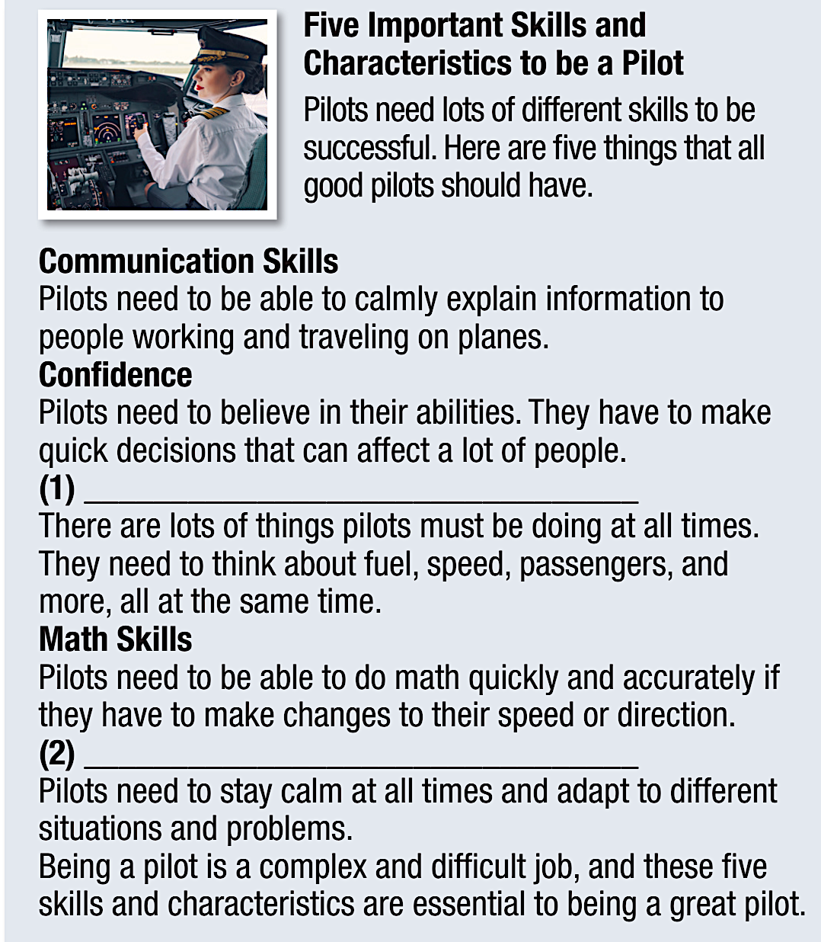
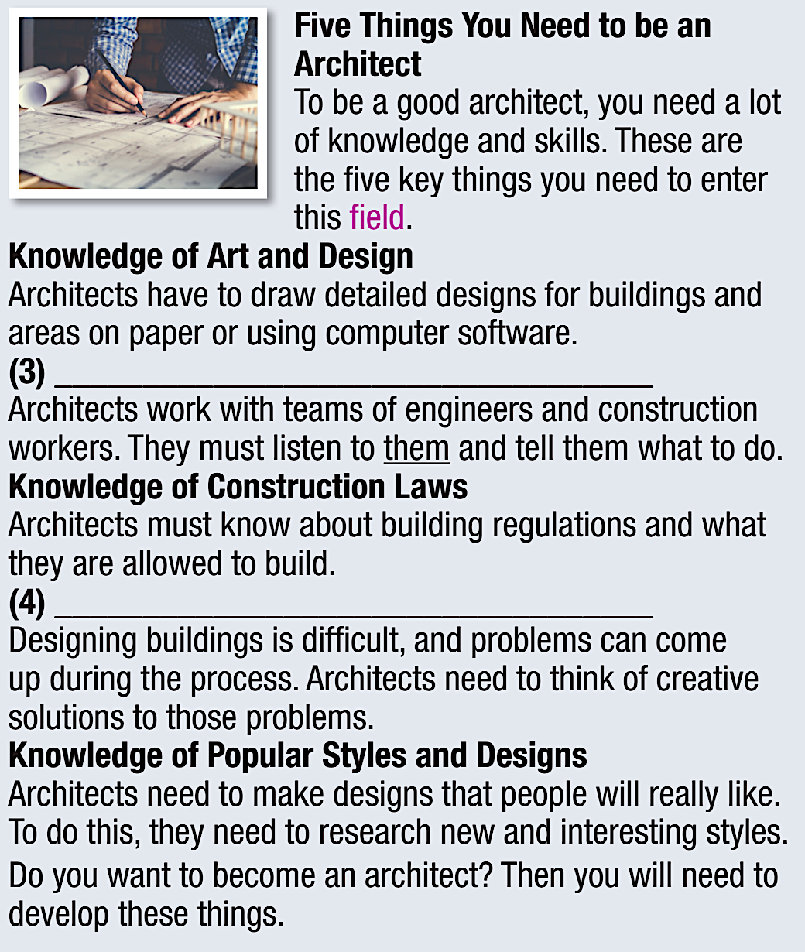
Leadership and Teamwork Skills
Multitasking
Problem-solving Skills
Stress management
Notes:
Press SPACE for answers.

Slide 16
Pre-reading
Now, read and answer the questions.
﻿1. What skill is NOT mentioned in the article about being a pilot?
﻿A. stress management | ﻿B. math skills |  | ﻿C. problem-solving skills
﻿2. According to the article about pilots, what two things must they be able to do fast? _______________________________________________________
3. ﻿ The word them in the article about being an architect refers to ____.
﻿A. architects | ﻿B. pilots | ﻿C. engineers and workers | ﻿C. engineers and workers

Slide 17
Pre-reading
Now, read and answer the questions.
﻿4. Why do architects need to know about building laws? _______________________________________________________.
5. Which of the following can be inferred about architects from the article?
A. ﻿They mostly work alone. | ﻿B. They do some of their work on computers. | ﻿C. Being an architect is easier than being a pilot.

Slide 18
Pre-reading
Now, read and answer the questions.
﻿1. What skill is NOT mentioned in the article about being a pilot?
﻿A. stress management | ﻿B. math skills | ﻿C. problem-solving skills

Slide 19
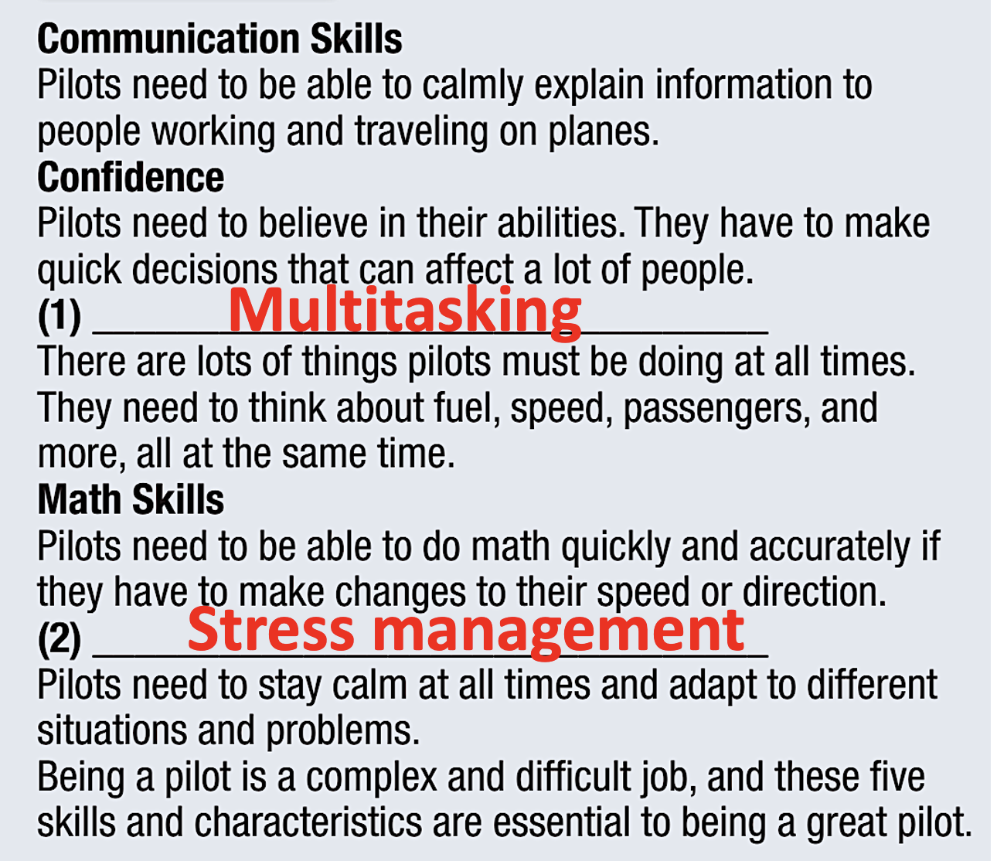
Explanation

Slide 20
While-reading
Now, read and answer the questions.
﻿2. According to the article about pilots, what two things must they be able to do fast? ___________________________________________________
making decisions and doing math

Slide 21
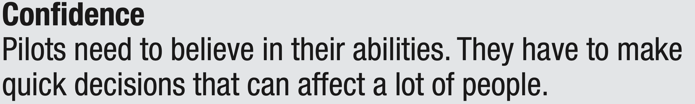
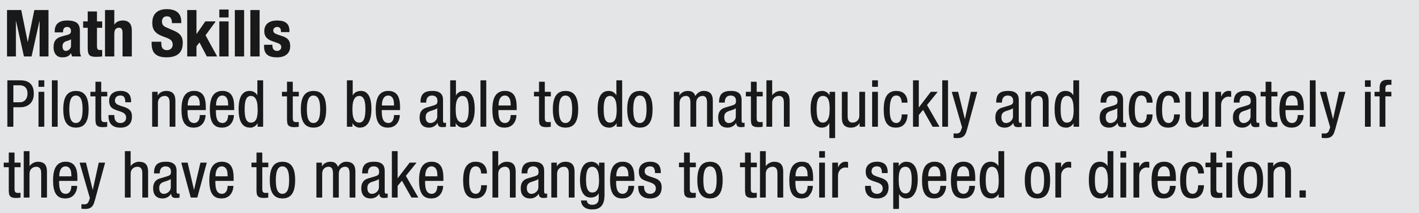
Explanation

Slide 22
While-reading
Now, read and answer the questions.
3. ﻿ The word them in the article about being an architect refers to ____________ .
﻿A. architects | ﻿B. pilots | ﻿C. engineers and workers

Slide 23
Explanation

Slide 24
While-reading
Now, read and answer the questions.
﻿4. Why do architects need to know about building laws? _____________________________________________________ .
Because they must know about building regulations and
what they are allowed to build.

Slide 25
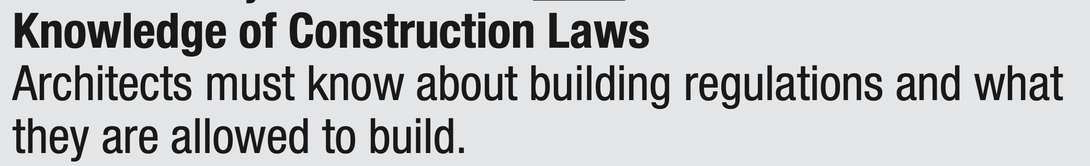
Explanation

Slide 26
While-reading
Now, read and answer the questions.
5. Which of the following can be inferred about architects from the article?
A. ﻿They mostly work alone. | ﻿B. They do some of their work on computers. | ﻿C. Being an architect is easier than being a pilot.

Slide 27
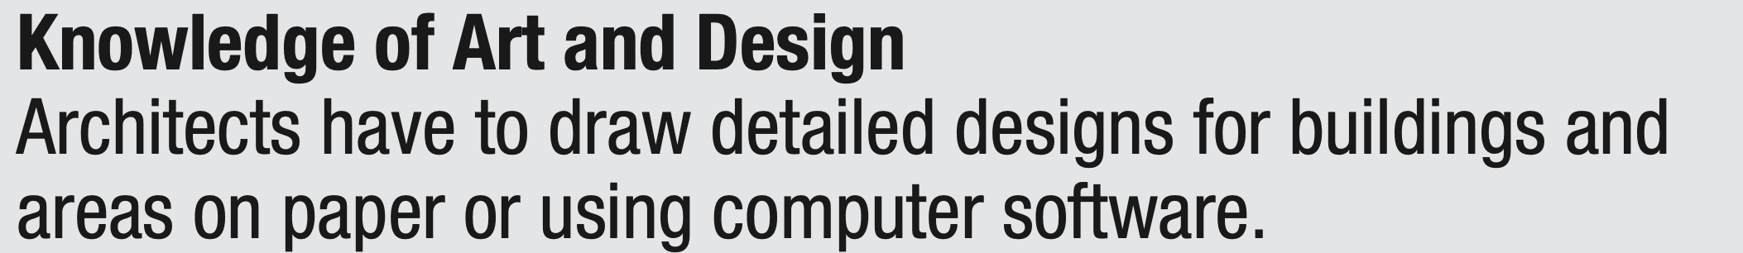
Explanation

Slide 28
While-reading
Listen and read.
Five Important Skills and
Characteristics to be a Pilot
Pilots need lots of different skills to be
successful. Here are five things that all
good pilots should have.
Confidence
Pilots need to believe in their abilities. They have to make
quick decisions that can affect a lot of people.
Communication Skills
Pilots need to be able to calmly explain information to people working and traveling on planes.

Slide 29
While-reading
Listen and read.
Multitasking
(1) ________________________________
There are lots of things pilots must be doing at all times.
They need to think about fuel, speed, passengers, and
more, all at the same time.
Math Skills
Pilots need to be able to do math quickly and accurately if
they have to make changes to their speed or direction.

Slide 30
While-reading
Listen and read.
Stress management
(2) ________________________________
Pilots need to stay calm at all times and adapt to different
situations and problems.
Being a pilot is a complex and difficult job, and these five
skills and characteristics are essential to being a great pilot.

Slide 31
While-reading
Listen and read.
Five Things You Need to be an Architect
To be a good architect, you need a lot of knowledge and skills. These are the five key things you need to enter this field.
Knowledge of Art and Design
Architects have to draw detailed designs for buildings and
areas on paper or using computer software.

Slide 32
While-reading
Listen and read.
Leadership and Teamwork Skills
(3) __________________________________
Architects work with teams of engineers and construction
workers. They must listen to them and tell them what to do.
Knowledge of Construction Laws
Architects must know about building regulations and what
they are allowed to build.

Slide 33
While-reading
Listen and read.
Problem-solving Skills
(4) __________________________________
Designing buildings is difficult, and problems can come
up during the process. Architects need to think of creative
solutions to those problems.
Knowledge of Popular Styles and Designs
Architects need to make designs that people will really like.
To do this, they need to research new and interesting styles.
Do you want to become an architect? Then you will need to
develop these things.

Slide 34
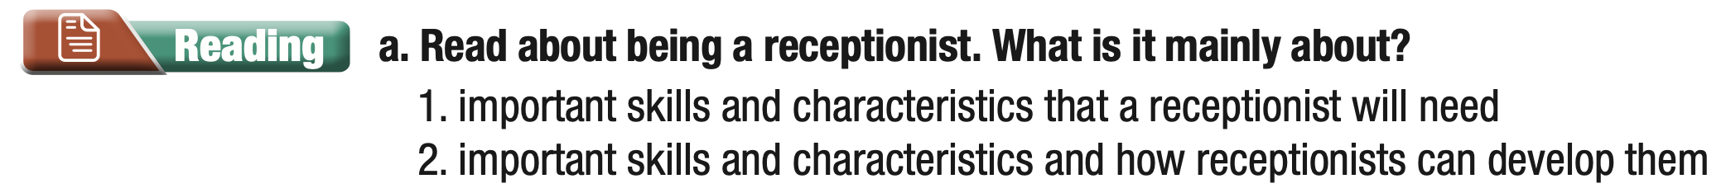

Extra practice
(WB, page 14)
Are you thinking of becoming a receptionist? Many people might tell you it’s an easy job. However, a receptionist has many responsibilities. So, what makes a good receptionist?
First of all, receptionists have to be friendly and welcoming. They’re often the first people who see and speak to visitors at a company or organization, so they need to create a good image for the visitors. Good communication skills are really important, and they need to be patient and professional in all situations.

Slide 35
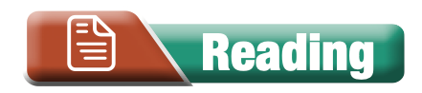
Extra practice
(WB, page 14)
Second, good receptionists should be organized. They will have to multitask because they often need to cope with many requests at the same time. They will receive information from people and they’ll need to take action. They should also have a good memory so that they remember important details about customers or visitors.

Slide 36
Extra practice
(WB, page 14)
Next, they need to know a lot about the company they work for and the services or products it offers. They need to be confident that they know the facts and that the information they tell the customers is correct. This will help them answer customers’ questions or find help from the right person.

Slide 37
Extra practice
(WB, page 14)
Next, they need to know a lot about the company they work for and the services or products it offers. They need to be confident that they know the facts and that the information they tell the customers is correct. This will help them answer customers’ questions or find help from the right person.

Slide 38
Extra practice
(WB, page 14)
Finally, receptionists need to have good technology skills. There’s lots of equipment receptionists need to use in order to do their jobs effectively. Sometimes, they’ll need to help their co-workers who aren’t so good with technology. Also, technology is always changing, so receptionists will need to adapt to and learn how to use new tools.

Slide 39
Extra practice
(WB, page 14)
Do you think you have these skills and characteristics? Do you enjoy working with different types of people in different situations? Do you like the idea of working in a job with lots of responsibilities? If the answer to these questions is “yes”, then being a receptionist might be the right job for you.

Slide 40
Extra practice
(WB, page 14)
Answer key:
1. important skills and characteristics that a receptionist
will need

Slide 41
Extra practice
(WB, page 14)
b. Now, read and answer the questions.
1. What characteristics of a receptionist will help their company have a positive image?
________________________________________________
They are friendly and welcoming.
2. Why do receptionists need to be organized?
_________________________________________________
They often need to manage many requests at the same time.
Notes:
Press SPACE for answer keys.

Slide 42
Extra practice
(WB, page 14)
3. What things do receptionists need to know well about their company?
_______________________________________________
They need to know its services and products.
4. What might receptionists need to help their co-workers with?
________________________________________________
They might need to show them how to use equipment.
5. What do receptionists need to adapt to?
________________________________________________
They need to adapt to changes in technology.

Slide 43
In pairs: Which job sounds more interesting to you? Why?
Post-reading
Suggested answers
Which job sounds more interesting to you? Why?
For me, being an architect sounds more interesting because the ideas of designing and planning the construction of buildings and structures really fascinate me.
Notes:
Press SPACE for suggested answers

Slide 44
Homework
- Make sentences using the vocabulary;
- Do the vocabulary tasks a & b on pages 14 & 15, WB;
- Prepare the next lesson: Grammar (pages 27 & 28, SB);
- Play the consolidation games on www.eduhome.com.vn .

Slide 45

Lesson 3
Stay positive and have a nice day!

