Slide 1
WELCOME TO OUR CLASS
Teacher: Vo My Thu
Class: 11A3

Slide 2
- List any keywords
- What is the video about ?

Slide 4
WHAT IS THE VIDEO ABOUT ?
A
Solutions for global warming
Definition of global warming
B
Causes and Effects of global warming
C

Slide 5
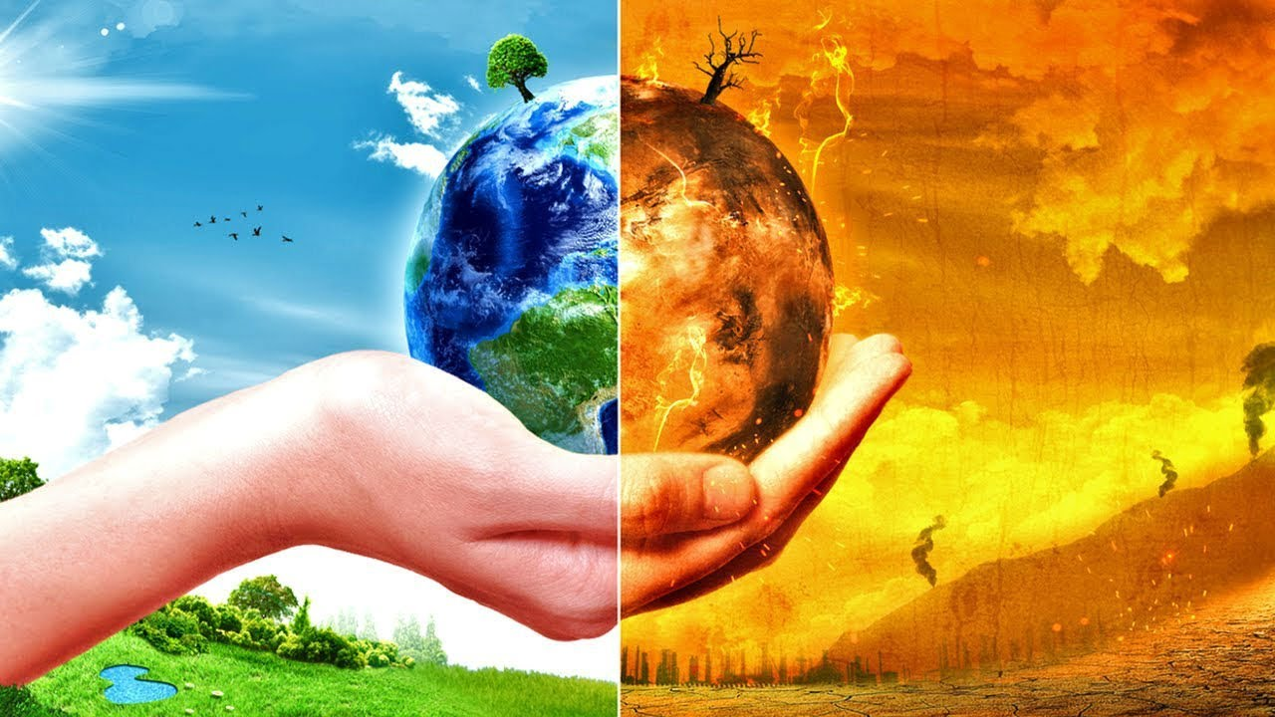
UNIT 4: GLOBAL WARMING
Lesson 2.3. Pronunciation & Speaking

Slide 6
UNIT 4: GLOBAL WARMING
Lesson 2.3. Pronunciation & Speaking
Warm-up
Pronunciation
Speaking
Consolidation
Wrap-up

Slide 7
Post-speaking
PRONUNCIATION

Slide 8
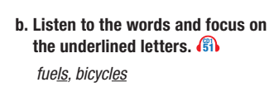

Slide 10
READING TIME

Slide 11
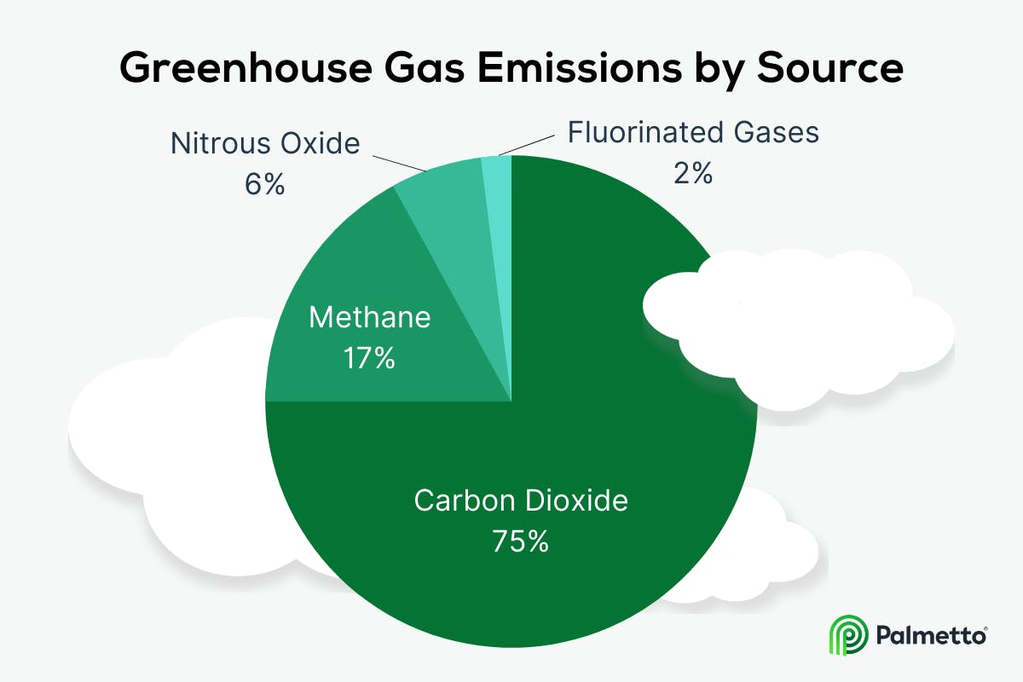
EMISSION
Which gas
is not a greenhouse gas?
CO₂
O₂
CH₄
N₂0

Slide 12
SPEAKING

Slide 13
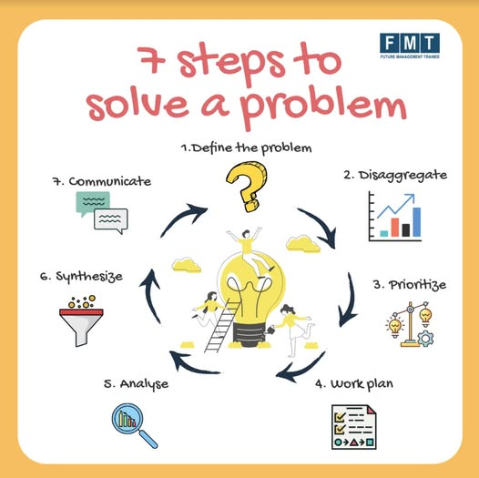
PRE-SPEAKING: MATCHING
A.
ways/ plans to solve
1.solve
disadvantage
B.
2. solution
C.
producing a successful
result
3.advantage
D.
4. effective

Slide 14
PRE-SPEAKING:
VOCABULARY
Solve /sɒlv/ (v)
giải quyết
Solution /səˈluːʃn/ (n)
giải pháp
Advantage ≠ Disadvantage (n)
thuận lợi ≠ bất lợi
/ədˈvæntɪdʒ/ /ˌdɪsədˈvæntɪdʒ/
Effective /ɪˈfektɪv/ (adj)
hiệu quả

Slide 15
USEFUL EXPRESSIONS: CONVERSATION
Tom: What’s the best way to stop global warming? Liz: Hmm. I’m not sure. Is_______a good idea? Tom: I think it would be___________. Liz: Ok. Would_________be a better solution? Tom: I think so./ I don’t think so. It will/ won’t________ Liz: Maybe you’re right. I think_________might be a good solution. Tom: I’m not so sure Liz: ..............

Slide 16
Question - What’s the best way to stop global warming? - Is_______a good idea? - Would_________be a better solution?
AGREE | DISAGREE
I think so Maybe you’re right. I see your point. I couldn’t agree more. I guess so. | - I’m not so sure I don’t think so. I don’t think that’s right. That doesn’t sound right to me.

Slide 17
WHILE-SPEAKING:

Slide 19
WHILE-SPEAKING:

Slide 20
WHILE-SPEAKING:
Prohibiting deforestation will reduce greenhouse gases. What do you think?
I think it will be difficult to stop farmers from cutting trees.

Slide 21
Protect the natural habitat of plants and animals
Use a lot of space
Reduce air pollution
make life less efficient
Use less energy -> lower greenhouse gas

Slide 22
b. Join another pair and compare your choices. Did you choose the same solutions? Why (not)?
EFFECTIVE SOLUTIONS
PROHIBITTING DEFORESTATION
USING WIND/SOLAR POWER
- Less CO2 emissions, more O2
- Limit natural disaster
- smoke-free
- renewable
-
-
-

Slide 23
Post-speaking
In groups:Imagine that you are a member at GREEN CLUB. Give a talk about ways to limit global warming.

Slide 24
Post-speaking
PRESENTATION
WELCOMING AND INTRODUCTION:
- Hello everyone./ Good morning/afternoon.
- I’m here today to talk to you about.../Today, Id like to share with you..
BODY
- The first solution is to..
- Secondly, it’s important to....
- Another solution is...
CONCLUSION AND THANKING
- That’s the end of our presentation today.
- Thank you for listening/ your attention.

Slide 25
WRAP-UP
Pronunciation:
The pronunciation of the /lz/ sound.
Speaking:
- Talking about what we can do to stop global warming.

Slide 26
HOMEWORK
Practice the pronunciation of the /lz/ sound.
Prepare the next lesson 3.1. Reading & Listening (page 44 SB)
Play the consolidation games on www.eduhome.com.vn

