Slide 1
Sở Giáo Dục và Đào Tạo Bình Định Trường THPT Xuân Diệu Giáo viên: Chế Việt Hà Lớp: 11A9 Môn: Tiếng Anh

Slide 2
OBSTACLE RACE
0
7
L
E
T
T
E
R
S

Slide 3
PUZZLE
H
E
A
L
T
H
C
A
R
E
1
1
M
A
S
K
S
2
2
L
O
C
K
D
O
W
N
3
3
I
S
O
L
A
T
I
O
N
4
4

Slide 4
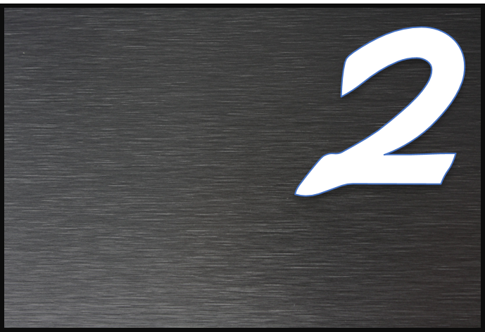
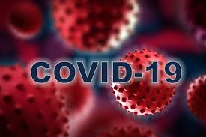
LETTER

Slide 5
the service that look after people’s health
H_ _ L _ _ C _ _ _
15
14
13
12
11
10
09
08
07
06
05
04
03
02
01
HẾT GIỜ

Slide 6
a covering for your face or for part of your face
M _ _ K S
15
14
13
12
11
10
09
08
07
06
05
04
03
02
01
HẾT GIỜ

Slide 7
L _ C _ D _ W _
15
14
13
12
11
10
09
08
07
06
05
04
03
02
01
HẾT GIỜ

Slide 8
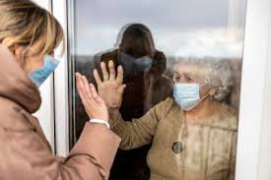
I S _ L_ T _ _ N
15
14
13
12
11
10
09
08
07
06
05
04
03
02
01
HẾT GIỜ

Slide 9
Unit 3: SOCIAL ISSUES
Lesson 3.1 Listening and Reading
Page: 32

Slide 10
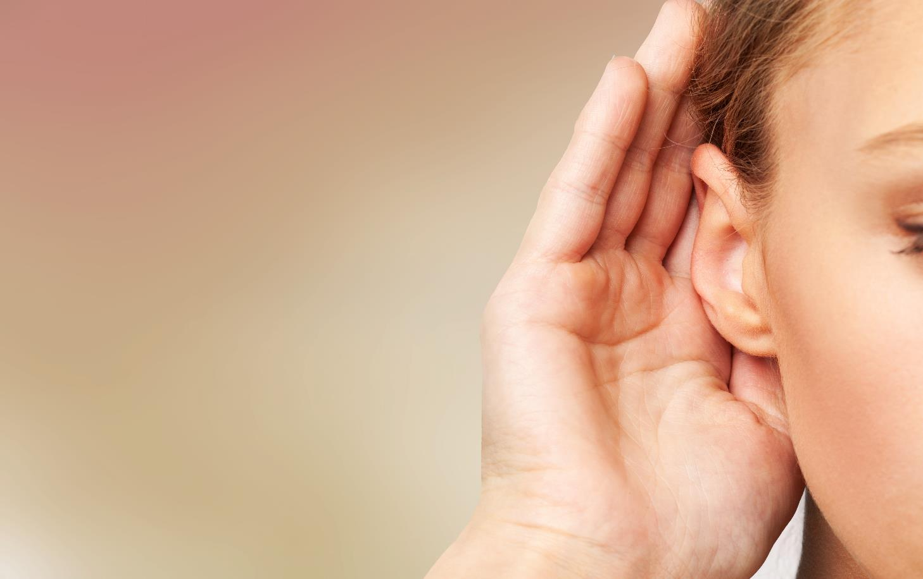

Slide 11
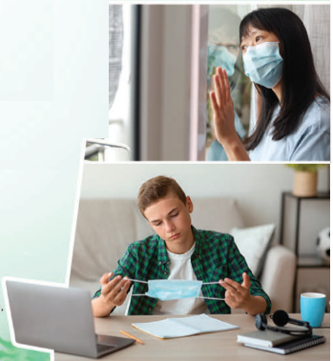
How are the girl and the boy feeling?

Slide 12
a. Listen to a podcast about the COVID-19 pandemic .
What kind of experiences did Donald and Dorothy have?
1. positive 2. negative 3. positive and negative
Donald: In the beginning …….
After a few weeks ……..
Dorothy: I was ………, and soon I ……..

Slide 13
b. Listen and circle the correct answers.
1. During the pandemic, Donald …
a) joined a new school. b) moved house. c) studied online.
2. Donald had problems with …
a) focusing on lessons. b) his laptop speaker. c) his teacher.
3. During the pandemic, Dorothy spoke to her friends …
a) face-to-face. b) at the bus stop. c) on social media.
4. In the future, Dorothy wants to …
a) become a teacher. b) help teenagers. c) quit her part-time job

Slide 14
What would you do if you were in the same situation as
Donald and Dorothy?

Slide 15
Reading

Slide 16
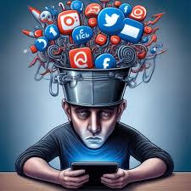
What’s the matter with him?

Slide 17
VOCABULARY
addiction /əˈdɪkʃn/ (n)
cause /kɔːz/ (n)
effect /ɪˈfekt/ (n)
self-esteem /self ɪˈstiːm/ (n)
distract /dɪˈstrækt/ (v)
Example: If the TV is distracting you from your homework, turn it off.

Slide 18
VOCABULARY
addiction /əˈdɪkʃn/ (n) sự nghiện
cause /kɔːz/ (n) nguyên nhân
effect /ɪˈfekt/ (n) kết quả
self-esteem /self ɪˈstiːm/ (n) lòng tự trọng
distract /dɪˈstrækt/ (v) làm sao lãng

Slide 19
c _ _ s _
a _ _ i c t _ _ n
_ i _t _ a _ t
4. s_l_-e_ _ _ _ _
5. _ f_ _ _ t
a u e
d d i o
d s r c
e f s t e e m
e f e c

Slide 20
a. Read John's essay about social media addiction and choose the best introduction sentence. 1. One problem affecting teenagers in the USA is social media addiction.
2. Today, more teens use social media than ever before.

Slide 21
One problem affecting teenagers in the USA is social media addiction. This essay will look at the causes and effects of this problem.
The first cause of social media addiction is the social media apps. The apps are designed to make people keep using them by knowing exactly what they like to read, watch, and look at and showing you it when you turn on the app. This means you will always see new interesting content. The second cause of social media addiction is the need to create an attractive "online life." For some teens, it is more important to be cool and popular online than offline. They spend hours every day trying to create the perfect "online life."

Slide 22
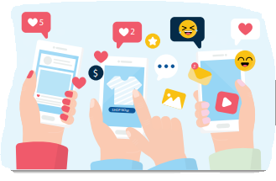
The first effect of social media addiction is it causes low self-esteem. This means you do not feel confident in yourself. Seeing photos of others having fun makes you feel sad because you do not have the same experiences. The second effect of social media addiction is it
damages your "offline life." Relationships with friends and family get damaged because teens are distracted by social media.
In conclusion, social media addiction is a problem for teens in the USA. It is caused by apps and the importance of a cool "online life,“ and results in low self-esteem and problems in your "offline life."

Slide 23
Social media addiction
Causes
Social media app
Need to create “online life”
Effects
Low self-esteem
Damage people’s “offline life”

Slide 24
Cause 1: social media (1)___________
Designed to be addictive, know what you like, always have new content
Cause 2: need to create "online life"
Being (2) ______ and popular online is more important than offline
Effect 1: low self-esteem = not feeling (3) _________
Sadness when seeing other people having fun
Too distracted → problems with (4) __________ and family
Effect 2: damages "offline life"
apps
cool
confident
friends

Slide 25
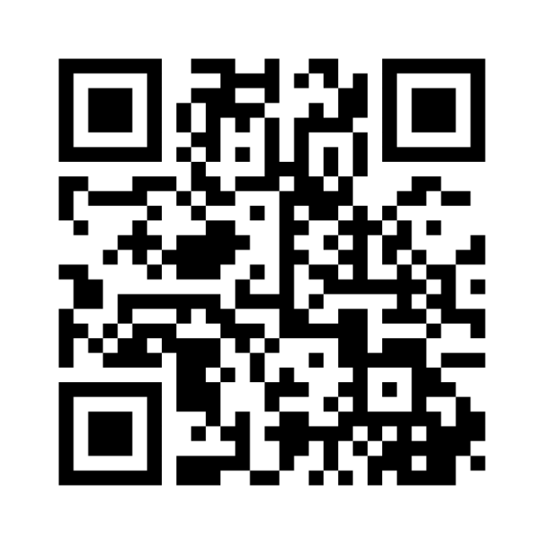
How many times a day do you check your social media? What kind of information do you look for?
https://www.menti.com/alk2qthoahfv

Slide 26
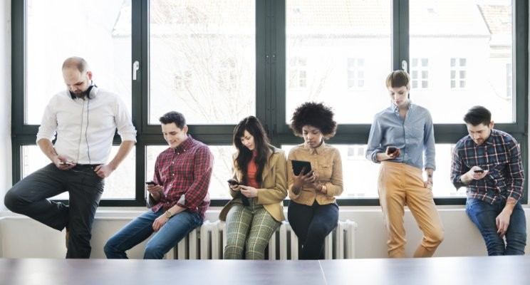

Slide 28
Do the tasks again.
Prepare the next lesson - Speaking & Writing on page 33 in SB.
Play the consolidation games in Tiếng Anh 11 i-Learn Smart World DHA App on www.eduhome.com.vn

Slide 29
THANK YOU!

