Slide 1
Sở Giáo Dục và Đào Tạo Bình Định Trường THPT Xuân Diệu Giáo viên: Trần Thị Thái Châu Lớp: 11A8 Môn: Tiếng Anh

Slide 2
Unit 5: Vietnam & ASEAN
Lesson 1.3: Pronun. & Speaking
Pages: 48 & 49

Slide 3
Lesson Outline
Warm-up
Pronunciation
Speaking
Consolidation
Wrap-up

Slide 4
By the end of this lesson, students will be able to…
practice intonation for WH- questions.
ask and answer questions about ASEAN.
Notes:
To practice and learn vocab. related to a country and its relationship
To practice listening for specific information
To practice functional English (Holding your turn)

Slide 5
WARM UP

Slide 6
Work in pairs.
Reorder the words to make meaningful questions:
1. did /you/ to school /How/ go/this morning?
→ How did you go to school this morning?
2. you/were/Why/absent/yesterday?
→ Why were you absent yesterday?

Slide 7
Presentation

Slide 8
INTONATION
1. When was ASEAN established?
2. When was ASEAN established?
→ Intonation falls at the end of WH-QUESTIONS

Slide 9
PRONUNCIATION
Intonation falls at the end of WH-QUESTIONS
1. When was ASEAN established?
2. When was Le Luong Minh secretary Greneral?

Slide 10
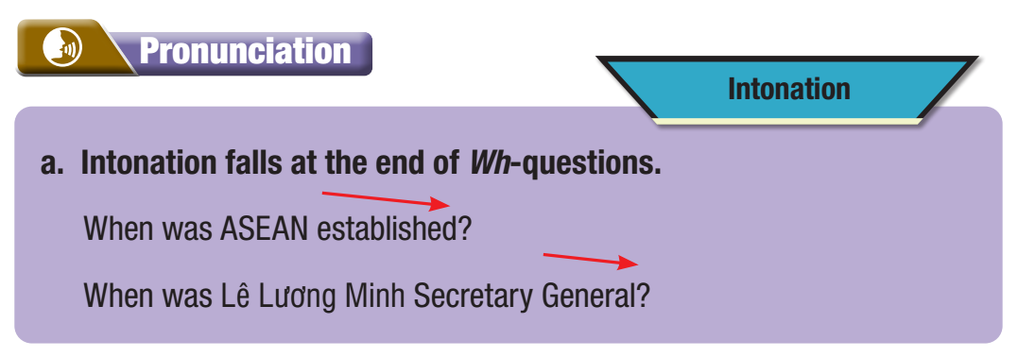
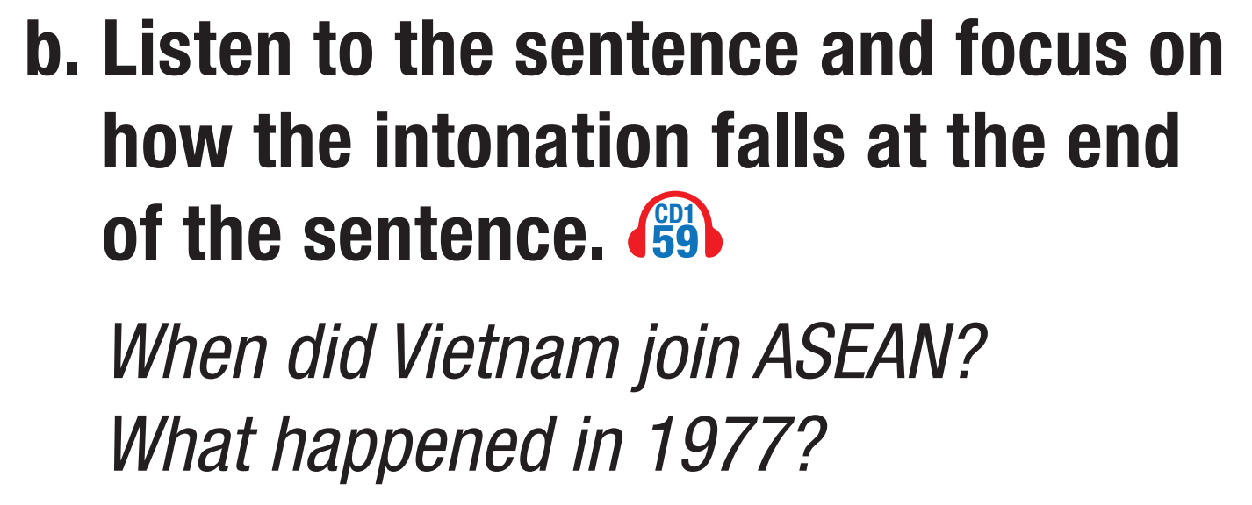

Slide 12
Practice

Slide 13
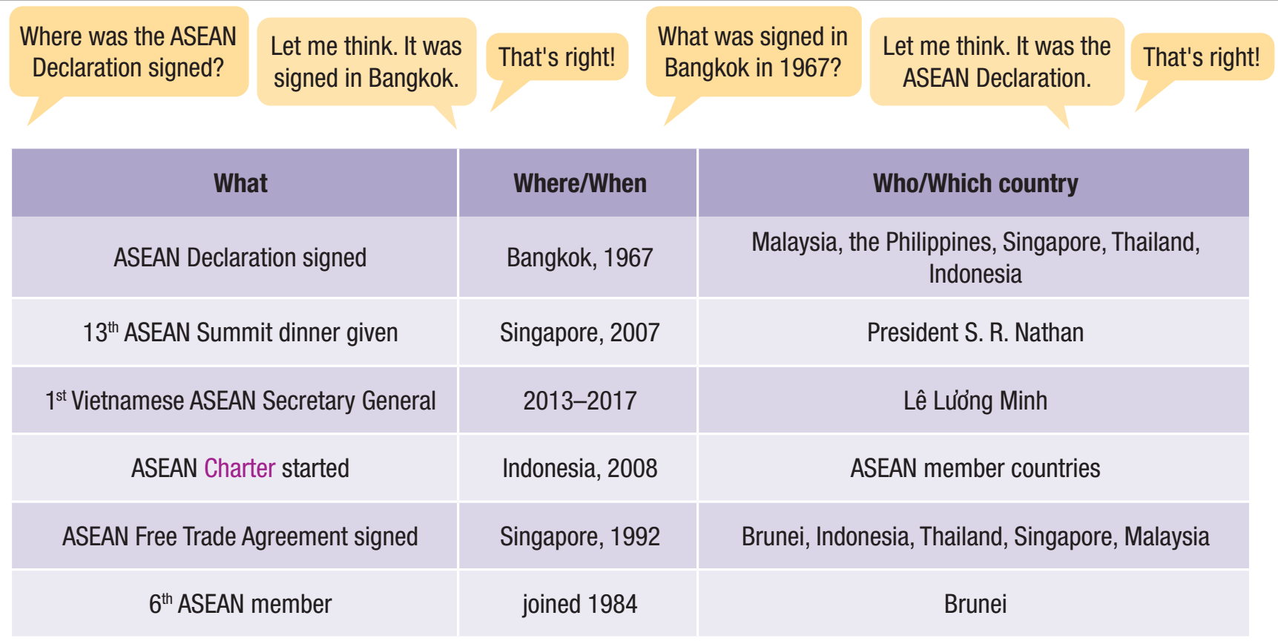
Practice asking and answering questions using the information in the table. Hold your turn if you need time to think.

Slide 14
Which phrases can be used to hold a turn?
B
A
B
A
B
A
Let me think.
Let me see.
Let’s see.
Interesting questions.

Slide 15
Practice asking and answering questions using the information in the table. Hold your turn if you need time to think.

Slide 16
Production

Slide 17
Task a. You're reviewing for an ASEAN Quiz.
In pairs: Use ideas from the lesson or your own knowledge to write five questions about Vietnam and ASEAN.
Then, join another pair. Close your books and take turns asking the questions you wrote.

Slide 18
Task b. In pairs: What's one thing you learned about ASEAN that surprises you?
Tell me one thing about ASEAN that surprises you
Let me see/Let me think/Let’s see/Interesting questions. ……………………………………….

Slide 19
Task b. In pairs: What's one thing you learned about ASEAN that surprises you?
Suggested answers:
ASEAN stands for the Association of Southeast Asian Nations.
Vietnam became a member of ASEAN on July 28, 1995.
Malaysia, the Philippines, Thailand, Indonesia, and Singapore were the first members of ASEAN.
ASEAN has had a Vietnamese Secretary General, Lê Lương Minh.
The ASEAN university network was started in 1995.

Slide 20
CONSOLIDATION

Slide 21
GAME: LUCKY NUMBER
1
Which country joined ASEAN in 1984?
Brunei.
2
President S.R. Nathan
Who gave the 13th ASEAN summit dinner?
In Indonesia.
3
Where was ASEAN Charter started?
4
When did Vietnam become the member of ASEAN?
In 1995
5
LUCKY NUMBER

Slide 22
WRAP-UP

Slide 23
Today’s lesson
Pronunciation
Speaking
Let me see
Let me think
Let’s see
Interesting question

Slide 25
Homework
Do the writing exercise on page 27 WB.
Prepare the next lesson (Vocabulary & Reading pages 50 & 51 SB).
Play the consolidation games on www.eduhome.com.vn.

Slide 26
Lesson 3
Stay positive and have a nice day!

