Slide 1
Sở Giáo Dục và Đào Tạo Bình Định Trường THPT Xuân Diệu
Giáo viên:Le Ha Bich Thuy
Lớp: 10A3
Môn: Tiếng Anh

Slide 2
UNIT 3: SHOPPING
Lesson 2.2 – Grammar
Page 23

Slide 5
It overheats when I do my homework.
Notes:
Please, click on each phrase to hear the sound

Slide 6
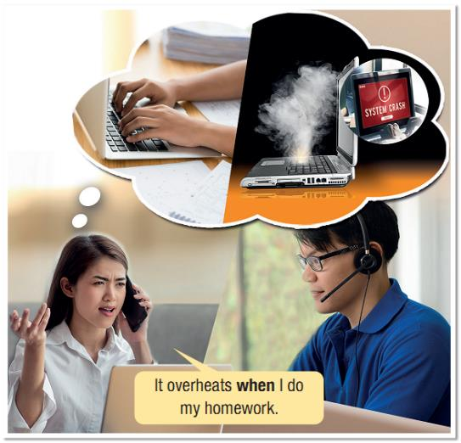
Unit 3 Lesson 2.2
1. What is the when- clause?
→ when I do my homework
2. How is the when- clause used?
→ to connect 2 clauses
Notes:
Please, click on each phrase to hear the sound

Slide 7
Unit 3 Lesson 2.2
Notes:
Please, click on each phrase to hear the sound

Slide 8
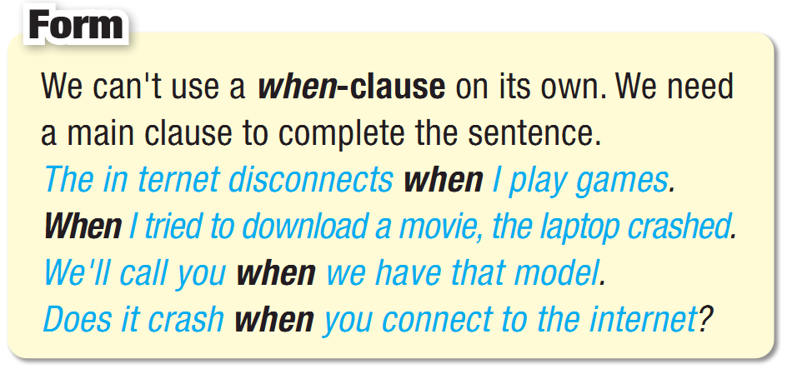
Unit 3 Lesson 2.2
When-clause
Notes:
Please, click on each phrase to hear the sound

Slide 9
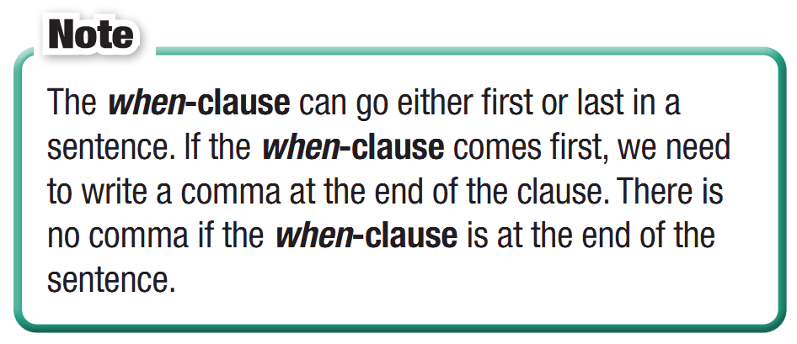
Unit 3 Lesson 2.2
When-clause
Notes:
Please, click on each phrase to hear the sound

Slide 10
Practice

Slide 11
Unit 3 Lesson 2.2
b. Unscramble the sentences.
1. photos,/overheats./it/When/I/edit _________________________________________________
2. when/crashes/games./I/play/It ________________________________________________
3. the/disconnects/when/internet./I/use/It _________________________________________________
4. you/We/when/let/it's/will/fixed./know _________________________________________________
5. ready./call/I’ll/it’s/you/when
_________________________________________________
When I edit photos, it overheats.
It crashes when I play games.
It disconnects when I use the internet.
We will let you know when it's fixed.
I'll call you when it's ready.
Notes:
Please, click on each phrase to hear the sound

Slide 12
Unit 3 Lesson 2.2
c. Join the sentences using when
to make two new sentences.
1. The computer didn't restart. I pressed the restart button.
when-clause first: _______________________________________________________________
when-clause last: _______________________________________________________________ 2. We have the battery for the camera. We'll call you.
when-clause first: _______________________________________________________________ when-clause last: _______________________________________________________________
When I pressed the restart button, the computer didn't restart.
The computer didn't restart when I pressed the restart button.
When we have the battery for the camera, we'll call you.
We'll call you when we have the battery for the camera.
Notes:
Please, click on each phrase to hear the sound

Slide 13
Unit 3 Lesson 2.2
c. Join the sentences using when
to make two new sentences.
3. The camera disconnected. I tried to copy photos to my laptop.
when-clause first: _______________________________________________________________
when-clause last: _______________________________________________________________ 4. My laptop crashed. I played games.
when-clause first: _______________________________________________________________ when-clause last: _______________________________________________________________
When I tried to copy photos to my laptop, the camera disconnected.
The camera disconnected when I tried to copy photos to my laptop.
When I played games, my laptop crashed.
My laptop crashed when I played games.
Notes:
Please, click on each phrase to hear the sound

Slide 14
Unit 3 Lesson 2.2
Extra Practice
WB, page 17
b. Combine the two sentences using when.
1. I charged my phone. It crashed.
_________________________________________________
2. I disconnect the screen. It restarts.
_________________________________________________
3. I took my phone to the store. They asked for my receipt.
_________________________________________________
4. My phone crashed. I tried to play a new game.
_________________________________________________
5. Remember your receipt. Take your laptop to the store.
_________________________________________________
When I charged my phone, it crashed.
When I disconnect the screen, it restarts.
When I took my phone to the store, they asked for my receipt.
My phone crashed when I tried to play a new game.
Remember your receipt when you take your laptop to the store
Notes:
Taken from TA 10 i-Learn Smart World WB, page 2

Slide 15
Unit 3 Lesson 2.2
d. In pairs: Talk about your devices
using when-clauses.
When I do my homework, my laptop disconnects.
Notes:
Please, click on each phrase to hear the sound

Slide 16
Consolidation

Slide 17
WRAP-UP

Slide 18
Unit 3 Lesson 2.2
Today’s lesson
Wrap-up
Grammar: When-clauses
Speaking: Talking about your devices

Slide 20
Unit 3 Lesson 2.2
Make 10 sentences, using when-clause.
Do the exercises in WB on page 17.
Prepare the next lesson – Pronunciation on page 25 .

